Slide 1
Screening for the Use of Alcohol and Other Drugs
Nursing & Midwifery – COP Presentation, April 2021
Prepared by Tonina Harvey AM

Slide 2
This presentation was prepared by Tonina Harvey as part of the Nursing and Midwifery Community of Practice, it supports the implementation of the NSW Health Policy Directive Nursing and Midwifery Management of Drug and Alcohol Use in the Delivery of Health Care PD2020_032.

Slide 3
What we will cover
Specific Screening Questions Quantifying & Documenting Substance Use
Treatment of an in-patient on an Opioid Treatment Program
Where to get Assistance
Brief Intervention and Referral for a Comprehensive Assessment
HELP
SCREENING & REFERRAL

Slide 4
We all use substances
It’s not what you use but:
How much
How often
The impact it has on your life and
Your response to that impact

Slide 5
Everyone who uses substances does not become dependent
The World Health Organisation (WHO) lexicon of alcohol and drug terms identifies dependence syndrome as ‘a cluster of behavioural, cognitive, and physiological phenomena that may develop after repeated substance use’.1 These phenomena include:
a strong desire to take the drug
impaired control over its use
persistent use despite harmful consequences
a higher priority given to drug use than to other activities and obligations
increased tolerance
experience of physical withdrawal reaction when drug use is discontinued.

Slide 6
What the Policy says
On admission to a health service all patients will undergo an initial screening to identify alcohol and/or drug use and risks as part of all nursing and midwifery care
The nurse or midwife is to screen for the presence of any substance use that may impact clinical care.
Identify and document details about the patient’s past or current alcohol and other drug use including tobacco use, prescribed medications, non-prescribed pharmaceuticals, and legal and illicit substances.
Patients with identified AOD related risks must be referred for a comprehensive assessment of their alcohol and/or drug use, as required
Notes:
Screening and, where indicated, comprehensive assessment, enables a greater
Understanding of the patient’s history of AOD use, and helps to identify any immediate or ongoing health risks

Slide 7
Why Screen
Understand the patient’s individual circumstances and concerns
Understand risks in the provision of care
Plan clinical care
Facilitate access to drug and alcohol withdrawal services and rehabilitation services, as appropriate
Facilitate access to specialist drug and alcohol services

Slide 8
Initial Screening includes
Past medical history
Psychosocial issues
Indicators of risk
Physical signs and symptoms
Current mental health status
Pathology results.
It is important to note that no single sign, symptom or pathology test is conclusive
evidence of an alcohol or drug-related issue
As part of the initial screening, all patients are also to undergo preliminary screening for
suicide risk, as outlined in the NSW Health Policy Clinical Care of People Who May Be
Suicidal (PD2016_007).

Slide 9
Barriers to getting and asking information
Previous negative experiences
Anxiety
Shame
Fear of:
being vulnerable
being judged
ongoing stigma and discrimination
Withdrawal
Not getting adequate pain relief
May be compounded if person is Aboriginal or from CALD background

Slide 10
How this translates for patients
Due to fear of stigma & discrimination:
People are more likely to have a lack of willingness to access medical assistance for future or ongoing treatment of health conditions
They have decreased motivation to disclose their status of alcohol and/or drug use, a history of injecting, or associated medical conditions
Stigma & Discrimination
Limits the ability to receive quality therapeutic care and treatment from a broad range of health practitioners

Slide 11
SCREENING Integrated into nursing assessment, conducted on engagement and reviewed regularly for patients with multiple admissions
Type of substance ( illicit, licit)
Route of administration
Frequency of use
Dose – amount used
Duration of use
(including history & current use)
Time and amount of the last dose, e.g. grams of alcohol, millilitres and milligrams of methadone, grams of cannabis, etc.

Slide 12
Initial Screening Questions
This includes asking the patient the following questions:
In the last month have you:
Smoked tobacco or vaped?
Consumed alcohol on 4 days or more in a week or had 6 or more standard drinks on one occasion?
Used any recreational drugs?
Taken medication for pain, anxiety/stress or sleeping problems?
Used any other substances?

Slide 13
If YES - ASK
How frequently have you used the substances you have identified?
When did you last use this drug, smoke tobacco/vape or drink alcohol?
How do you take the drug or alcohol? (e.g. drink, inject, snort, smoke, vape)
Have you ever overdosed or experienced withdrawal symptoms?
Have you ever attended a drug or alcohol service for treatment for your alcohol or drug use?
Screening is in the process of being built into EMR

Slide 14
Screening Tools – Refer to local Protocols
Alcohol Use Disorders Identification Test (AUDIT) (AUDIT-C)
DASS 21 (Depression, Anxiety, Stress Scales)
Kessler 10 (K-10)
Severity of Dependence Scale
Indigenous Risk Impact Screen (IRIS)
Substance and Choices Scale (for ages 13-18)
Mental State Examination
Fagerstrom Nicotine Tolerance Questionnaire
Edinburgh Depression Scale
Alcohol, Smoking and Substance Involvement Screening Test (ASSIST) (Short
and long version)
The CAGE-AID is a four-item questionnaire which assesses alcohol and other
drug use. It is easy to administer with good sensitivity and specificity.
Some commonly used tools

Slide 15
What Not to Ask
Don’t make assumptions - clarify what you don’t understand
Do not ask in a way that makes drinking or substance use sound abnormal or judgemental
Do not use terms such as “social drinker”, as this gives no understanding of amounts used and can vary from one person to another.
Don’t ask in minimal amounts of use – often it is easier for a person to disclose if you are overestimating

Slide 16
What if a patient refuses Assessment, Treatment or Referral
Patients are unlikely to object to a drug and alcohol use assessment if the questions are asked in an empathetic manner as part of routine history collection.
It may be difficult for some patients to answer questions due to their anxiety, capacity to recall information or fear of retribution if they disclose what they perceive to be personal information.
In circumstances where a clear history cannot be elicited due to capacity it is often wise to ask family or friends if they have any knowledge of substance use which may be impacting their clinical presentation.
In all circumstances nurses and midwives are obliged to ask about substance use and document the response. All patients have a right to refuse to give information, decline treatment or interventions.
All patients have a right to refuse to give information, decline treatment or interventions.

Slide 17
What if a patient is on Opioid Treatment ?
If the patient is on Methadone, Naltrexone or Buprenorphine it is critical that their treatment is maintained if there are no medical contraindications.
On admission it is important to:
Verify the patient’s identity
Contact the authorised prescriber and opioid treatment dosing point
Confirm type of treatment, date and time of last dose, including any takeaway doses given

Slide 18
Harm Reduction, Brief Intervention & Comprehensive Assessment

Slide 19
Harm Reduction
Harm reduction is an approach which is based on the reduction of harm associated with substance use rather than on the prevention of substance use itself.
This approach does not accept or encourage unsafe substance use or in any way abandon the goal or importance of abstinence from drugs and alcohol. It simply means that abstinence is one of a range of strategies and not the only goal.

Slide 20
Common Harm Reduction Strategies
Health promotion campaigns – aimed at preventing young people from taking up smoking, risks of drink-spiking, promotion of light beer or specific Campaigns such as “Dry July”
Providing pharmacotherapy treatment – e.g. methadone/buprenorphine for opioid dependence
Providing access sterile injecting equipment – disposal units, needles, syringes and swabs
Assessing drug and alcohol use at the various points of contact across the health system – emergency departments, pre-admission clinics, midwifery services and mental health services.

Slide 21
Brief Intervention
ASK
ADVISE
REFER
A brief intervention is the process of providing relevant, easy-to-understand information, such as self-help materials or handouts, which may lead a patient to seek further help

Slide 22
Role of Nurses and Midwives
When delivering care, nurses and midwives are to provide information and non-judgmental advice to reduce the risk of harm associated with alcohol and other drug use.
Brief interventions can be done at any time during contact with the patient who is being assessed including, for nurses and midwives, during holistic health assessments and other care processes
Referral information and relevant contact details for AOD services are also to be provided when appropriate, particularly for treatment-seeking individuals with substance-related problems

Slide 23
Comprehensive Assessment
Comprehensive assessment builds on initial assessment to further understand the impact of the patient’s alcohol and other drug use
Comprehensive assessments are to be performed by an alcohol and other drug (AOD) specialist. If there are no AOD specialist services available in your district, consult with: Drug and Alcohol Specialist Advice Service (DASAS) – available 24/7
It is essential that the outcomes of assessment, including risk monitoring, are integrated into the treatment and care plan

Slide 24
Pregnant Women
Supporting and engaging pregnant women who use substances is a key to providing opportunities to access treatment services and other supports
If the patient is pregnant and, as a result of the screening, has been identified as using alcohol or drugs to any extent, they must also be referred for a comprehensive assessment to a Substance Use in Pregnancy and Parenting Service (SUPPS) or Specialist Alcohol and Other Drug Service

Slide 25
Referral and Where to get assistance

Slide 26
Referral
Following the screening process, any patient identified as using at harmful levels is to be referred for a comprehensive assessment
Make yourself aware of the referral pathways in your LHD and ensure that all staff have access to this information
Understand your local procedures for referral and where to access assistance
Notes:
Clinical Specialist consultation services are also available for medical and nursing professionals for:
Clinical advice on AOD patient management of withdrawal syndromes and intoxication
Management of medical, pain and psychiatric complications associated with AOD use
Drug interaction information relating to substances of abuse
Phone Sydney Metropolitan (02) 9361 8006
Operates 24/7 for health professionals
Regional and Rural NSW
1800 023 687 - Free call numbers are not free from mobile phones, except Telstra mobiles
24 hour phone service for health professionals

Slide 27
Other Referral Considerations
Aboriginal Health Worker and/or Aboriginal Liaison Officer
Health Language Services or Translation Services for Culturally and Linguistically Diverse patients
Social worker, mental health or other allied health as appropriate
Family Referral Service as per local protocols

Slide 28
Where to get Assistance
First Point of Contact should be your local Drug & Alcohol Specialist Service
If no service available contact the Drug and Alcohol Specialist Advisory Service
Check local policies and protocols and referral pathways
NSW Health Website for Policy & Clinical Guidelines
If unclear what is available contact the Alcohol and Drug Information Service
Poisons Information Service

Slide 29
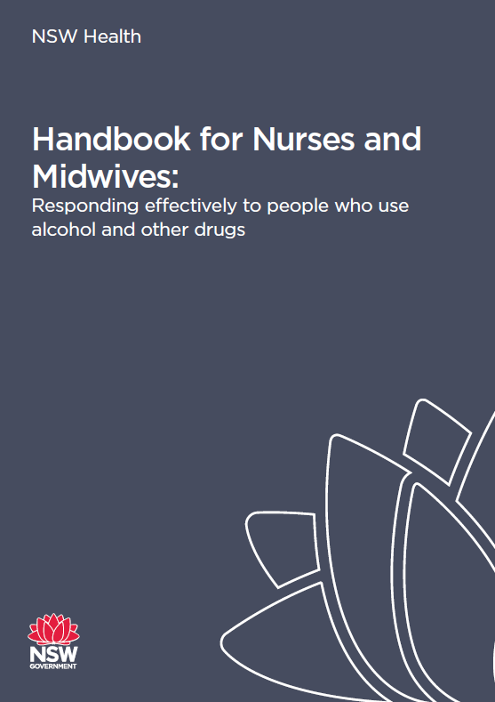
Clinical Resources
NSW Clinical Guidelines: Treatment of Opioid Dependence (GL2018_018)
Opioid Dependent Persons Admitted to Hospitals in NSW – Management(PD2006_049) – recently reviewed
Guidelines for the Management of Substance Use during Pregnancy, Birth and the Postnatal Period (GL2014_022) – under review
Withdrawal Guidelines
FASD Guidelines

Slide 30
Reflection Questions
How can you reduce barriers to care for people experiencing harm from AOD use?
What are the important questions to ask when screening for substance use?
What do you do if you recognize a patient is using substances at harmful levels ?
Where will you find your local protocols and information for working with people experiencing harm from AOD use?

Slide 31
References
World Health Organization, Management of substance abuse, Lexicon of alcohol and drug terms, retrieved 25th July 2020, https://www.who.int/substance_abuse/terminology
Australian Government, National Framework for Alcohol, Tobacco and Other Drug Treatment 2019–29, Department of Health, retrieved 30 July 2020, https://www.health.gov.au/resources/publications
NSW Health, Clinical Care Standards for Alcohol and Other Drug Treatment 2020, Centre for Alcohol and Other Drugs, retrieved 24th July 2020 https://www.health.nsw.gov.au
K Lancaster, K Seear, A Ritter, Drug Policy Modelling Program Monograph 26, Reducing Stigma And Discrimination For People Experiencing Problematic Alcohol And Other Drug Use, retrieved July 25th 2020
Commonwealth of Australia as represented by the Department of Health 2017: National Drug Strategy 2017-2026: Publications Number: 11814
IMAGES
www.Gettyimages.com.au
www.Pixabay.com
www.shutterstock.com

