Slide 1
Health Analytics
in practice
Federico Girosi

Slide 2
Data Sources
Stakeholders
Health
Analytics
collaboration
model
personalized
info app
CRC
PHI
patients
Uni

Slide 3
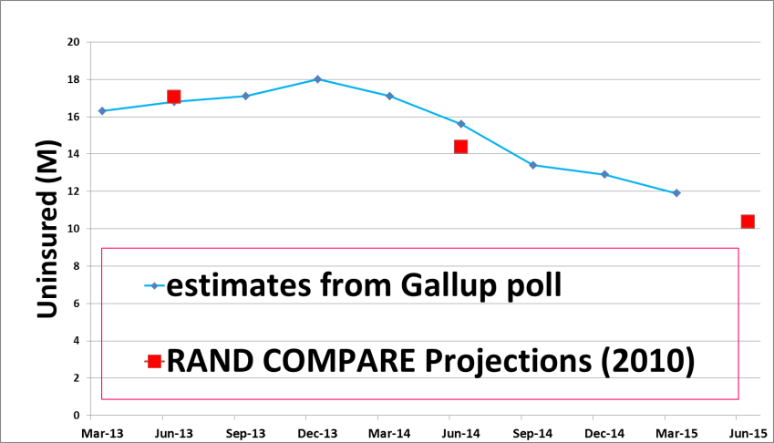
the RAND model:
Comprehensive Assessment of Reform Efforts
(COMPARE)
COMPARE was very successful in guiding
the implementation of health care reform
RAND Corporation
Infrastructure
COMPARE
Board
CRC
alignment
of objectives
Uni
Research
industry
partners
funders/
stakeholders

