Slide 1
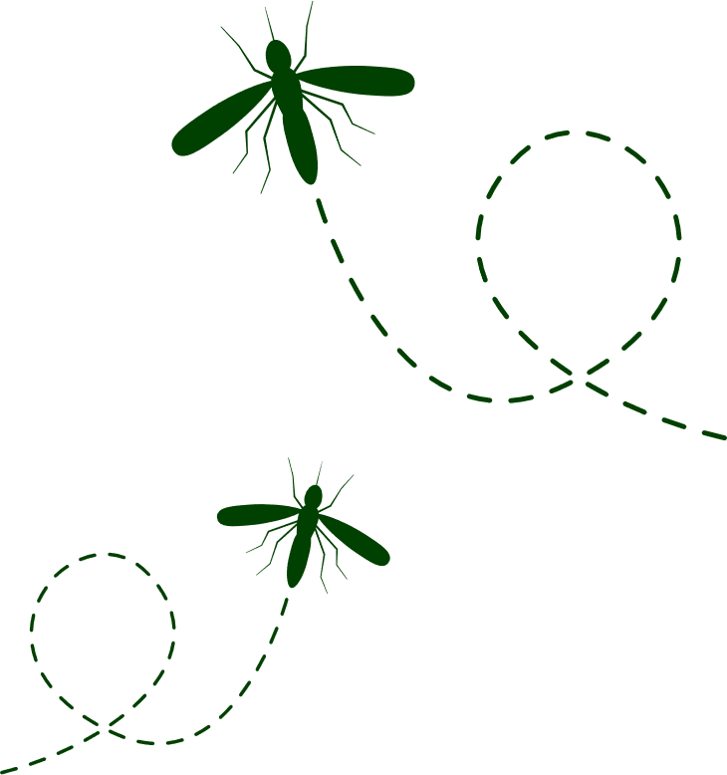
Japanese encephalitis virus
Protect yourself in time for summer by getting vaccinated today!
Free vaccination clinic
[insert address here]
[insert time here]
No booking required. Please bring identification and your Medicare card (if you have one)
Visit health.nsw.gov.au/jevaccine for more information.
© NSW Ministry of Health 2022

Slide 2
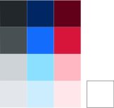
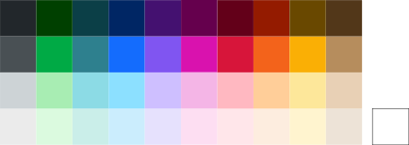
^{Colours & Font}
1. Corporate
Ministry and whole of branch communications.
2. Non-Corporate
Programs | Events | Campaigns | Initiatives
A greater emphasis on illustration and photography will ensure individuality.
Note: use Eyedropper on the coloured boxes for change of colour. First two rolls of colour can have white texts.
Font used: Public sans
Download url: digitalnsw.github.io/public-sans/download/
For more information please go to NSW Government brand guidelines: www.nsw.gov.au/sites/default/files/2022-01/Quick_Reference_Guide_Masterbrand.pdf

