Slide 1
Mosquito bite prevention this summer
NSW Health and NSW Department of Customer Service
Communication toolkit
November 2022

Slide 2
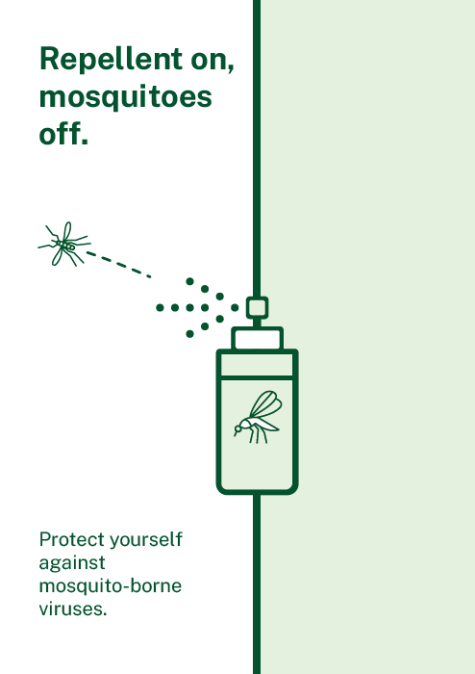
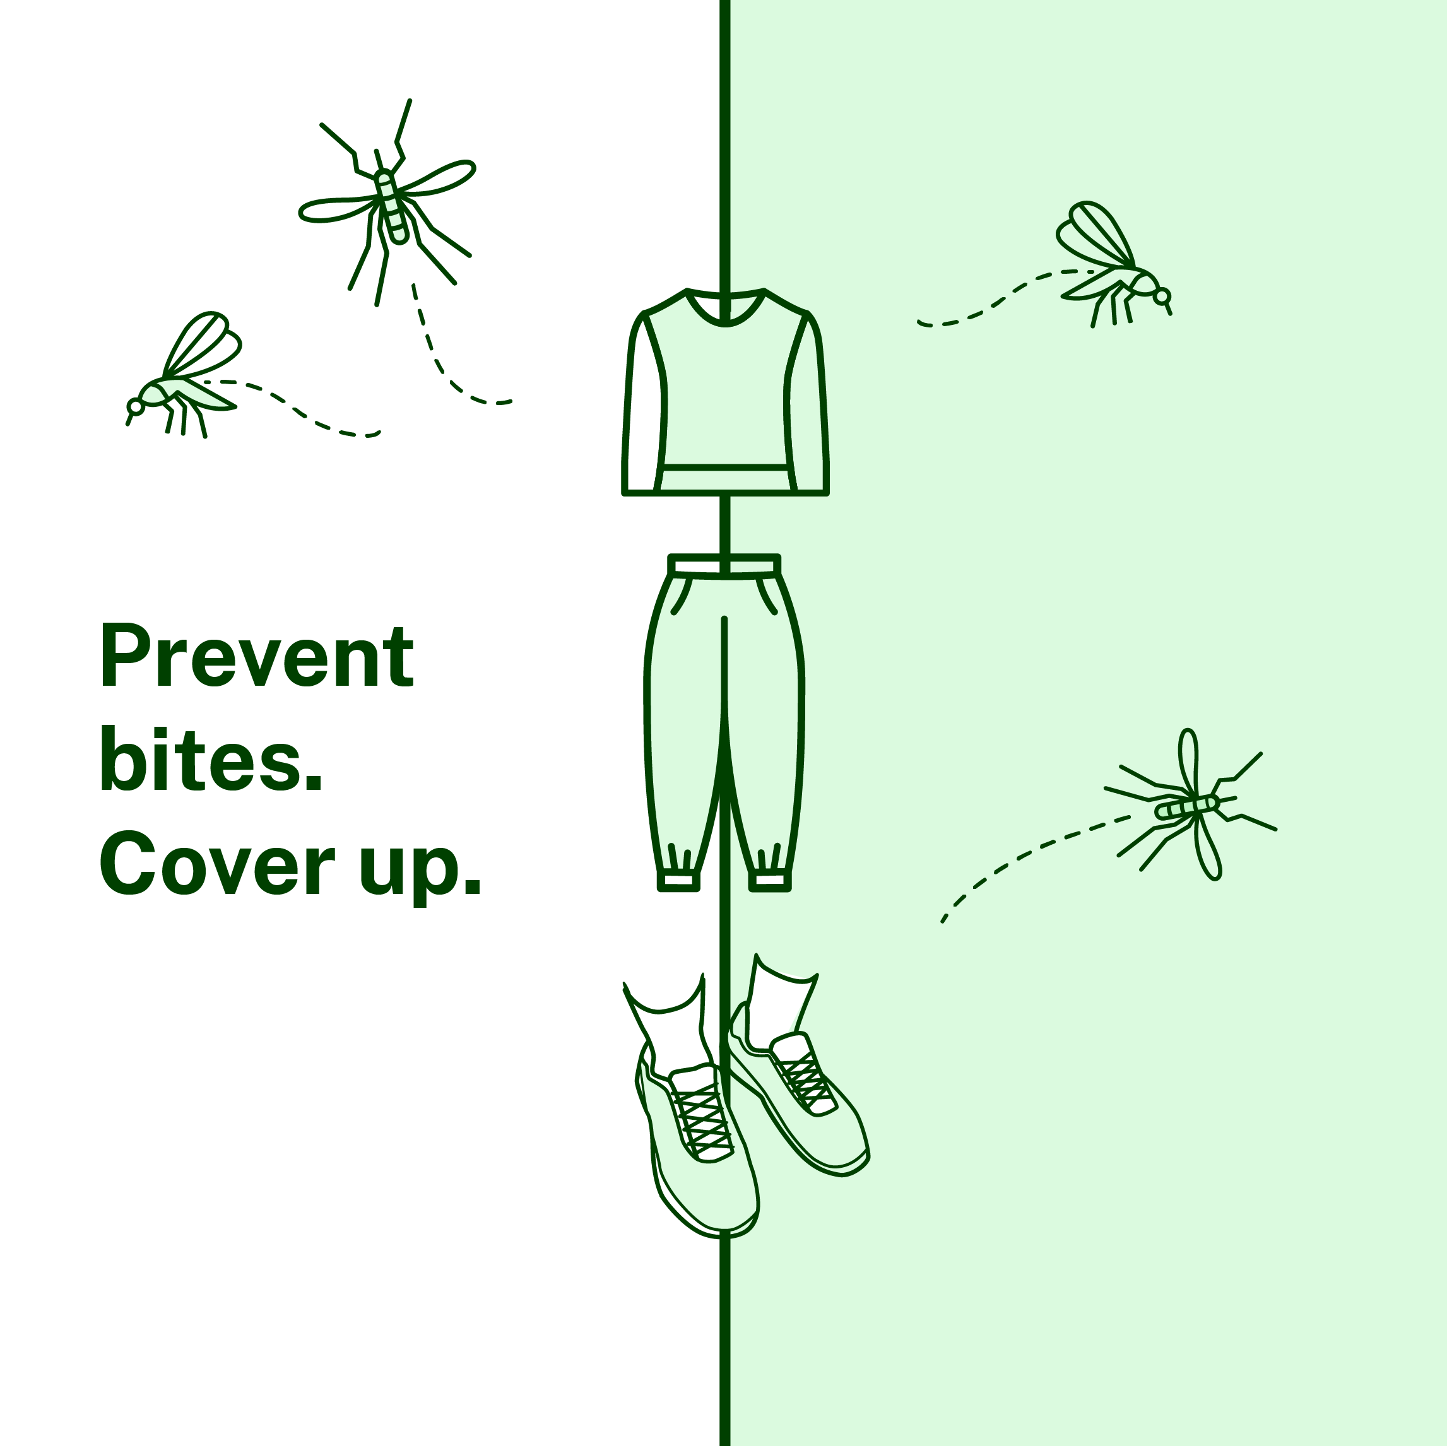
Purpose of this toolkit
With a warm, wet summer forecast, the number of mosquitoes is expected to increase. Mosquitoes can carry and spread viruses like Japanese encephalitis (JEV), which can lead to serious illness. It’s important that we all take simple steps to prevent mosquito bites and reduce the number of mosquitoes around our homes and community. Start preparing now to protect yourself and your community against mosquito-borne diseases this summer.
This toolkit has been developed to help councils and organisations communicate with their local community.
It contains important information and reminders that include:
simple and easy steps to prevent mosquito bites, such as:
wearing and regularly reapplying insect repellent
covering up when outdoors.
keeping mosquitoes out of your home and community, including:
closing doors and windows or using insect screens
removing stagnant water.
This toolkit contains two asset options to help support JEV communications: with NSW branding and an option for unbranded. The assets can be downloaded via the links supplied and your logos added using your existing editing software. The latest information can be found at www.health.nsw.gov.au/mosquitoes. Thank you for your ongoing support to help protect the NSW community.
Your logo
Your logo

Slide 3
Mosquito bite prevention: Newsletter/email copy
Get ready for mosquito season
Warmer weather and this year’s higher-than-average rain make the perfect conditions for a big mosquito season. While mosquitoes are well known for their annoying buzz and itchy bites, many people don’t know that in NSW they can also spread viruses such as Japanese encephalitis virus, Murray Valley encephalitis and Ross River virus to humans. While serious illness and hospitalisation from these viruses is rare, the more mosquitoes, the greater the risk. With summer on our doorstep, it’s a good time to take the steps to prevent bites.
Here are five simple ways to prevent mosquito bites:
Cover up while outside. Wear light, loose-fitting long-sleeved shirts, long pants and covered footwear with socks.
Wear and reapply repellent. Repellent containing DEET, picaridin or oil of lemon eucalyptus should be used on any areas of exposed skin and reapplied regularly. Apply sunscreen first, followed by repellent, so you can stay safe from the sun and mosquito bites.
Keep mosquitoes out. Close doors and windows when indoors or install fly screens where possible to keep mosquitoes out.
Stop mosquitoes breeding. Mosquitoes breed in stagnant water. Remove items around your home that might collect water such as old tyres, children's toys and empty pots to lower the chance of mosquitoes breeding. Think about improving drainage around your home to ensure water doesn’t become stagnant.
Ask your GP about the Japanese encephalitis virus vaccination. Japanese encephalitis virus (JEV) was detected for the first time in NSW earlier this year. In some cases, JEV can cause a rare but serious illness called Japanese encephalitis. If you live in some areas of NSW, you’re eligible for a free JEV vaccine - talk to your GP.
Following these simple steps will help to protect you and the community from mosquito bites and illnesses, so you can relax and enjoy the warmer weather ahead.
The latest information on mosquitoes and bite prevention can be found at health.nsw.gov.au/mosquitoes

Slide 4
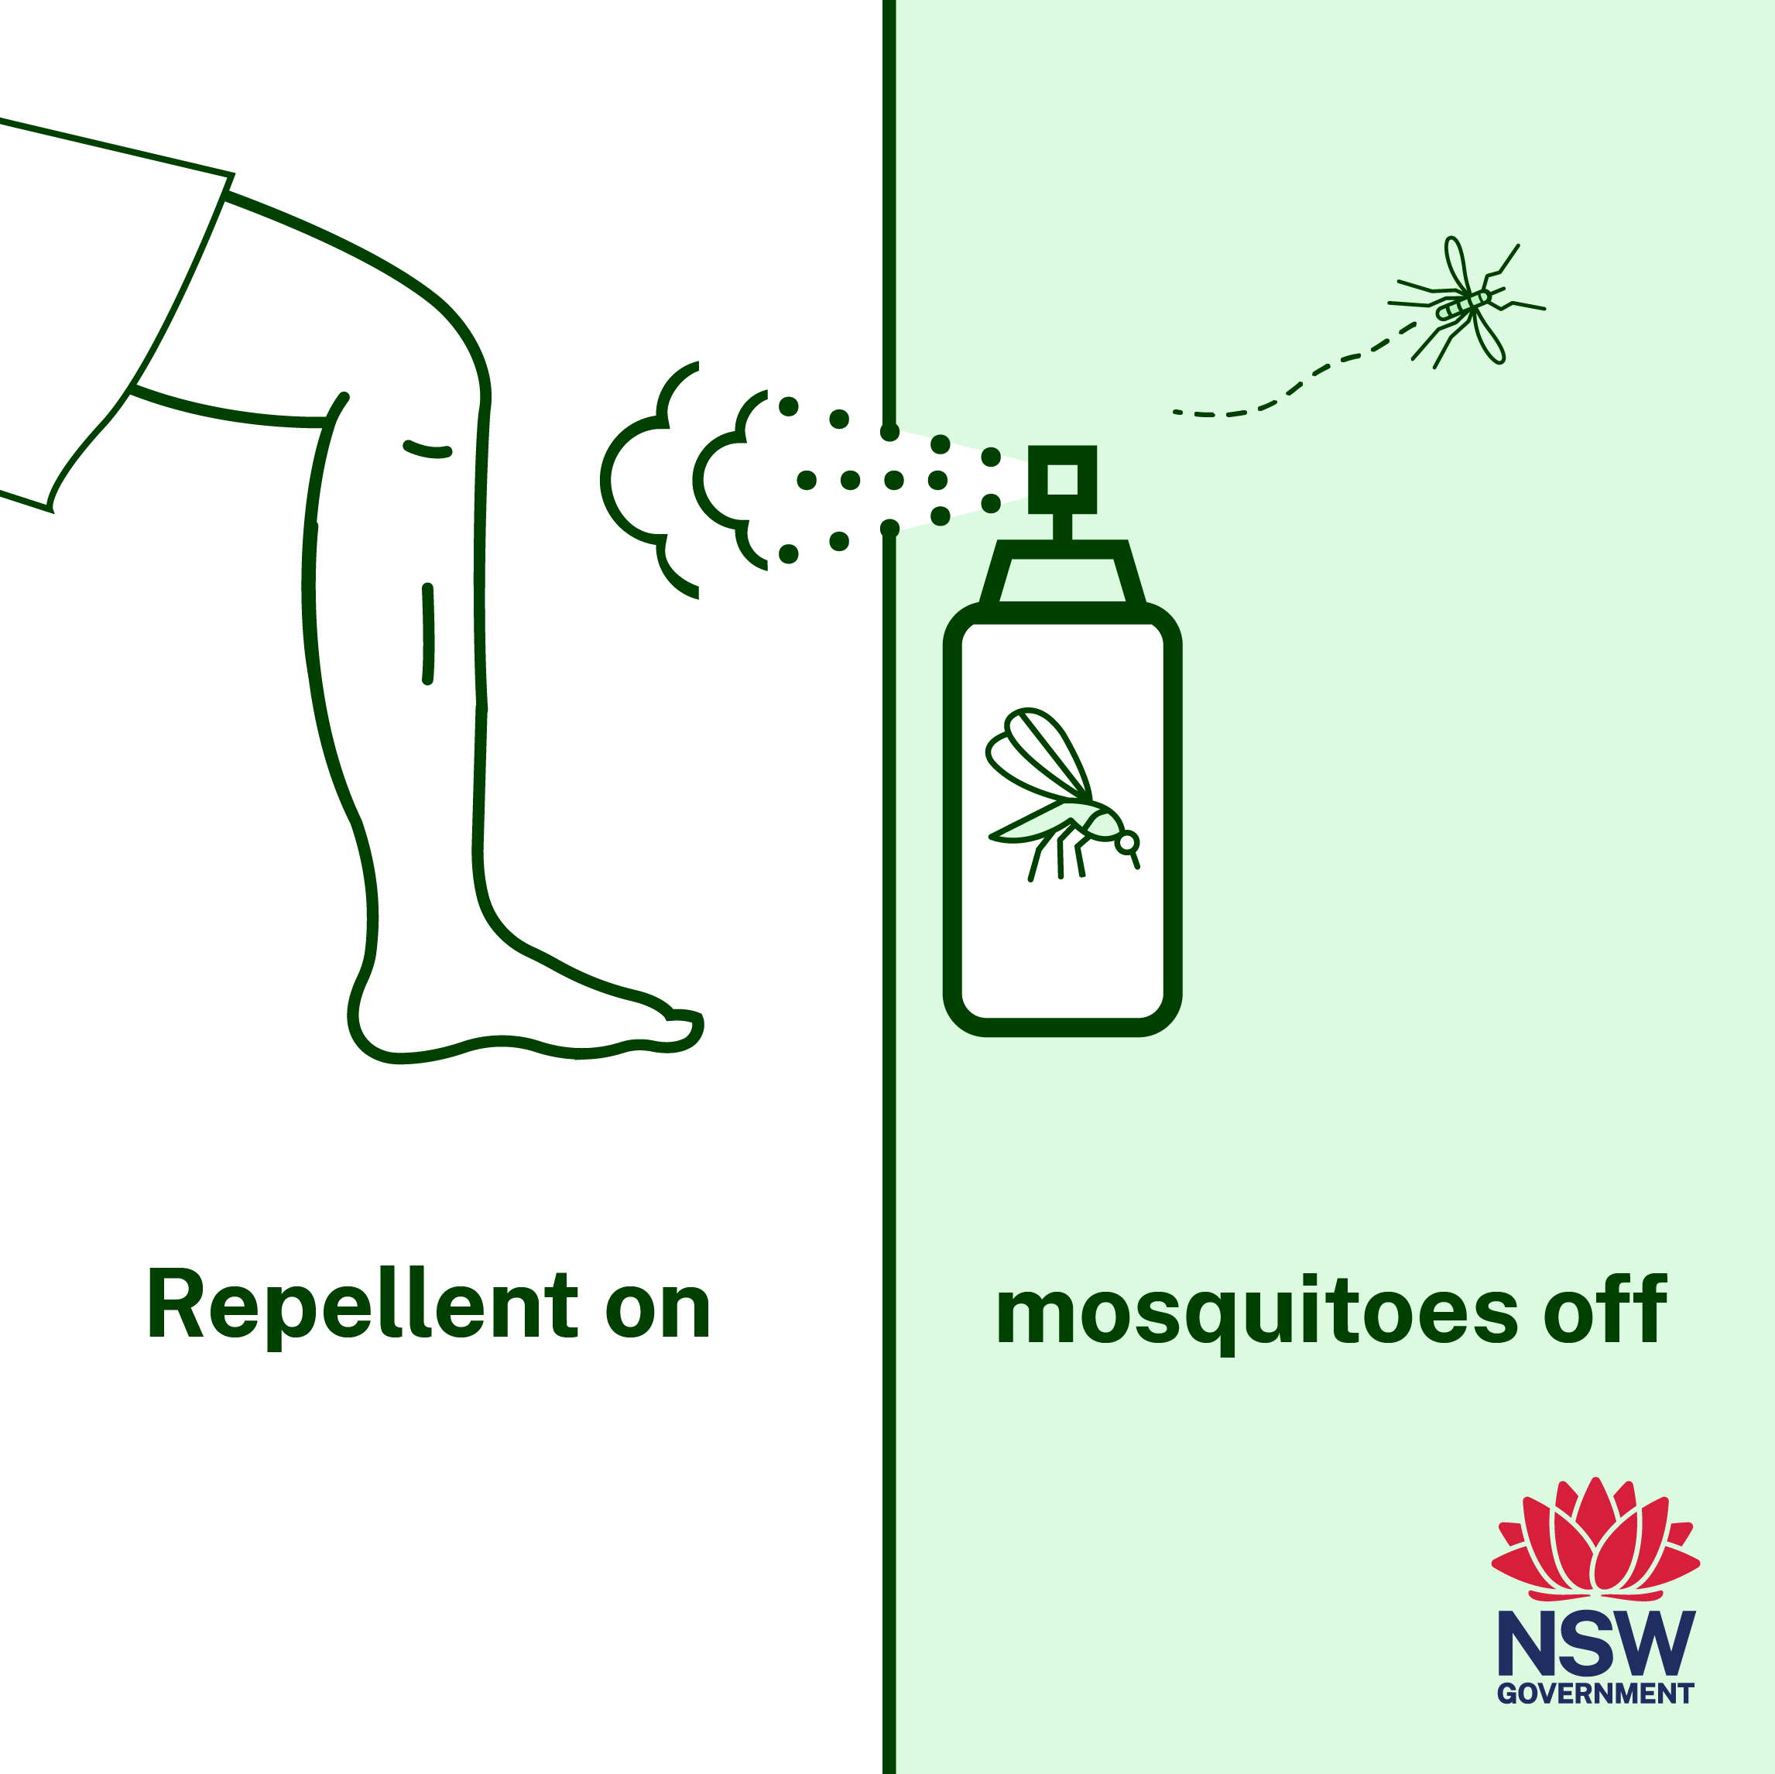
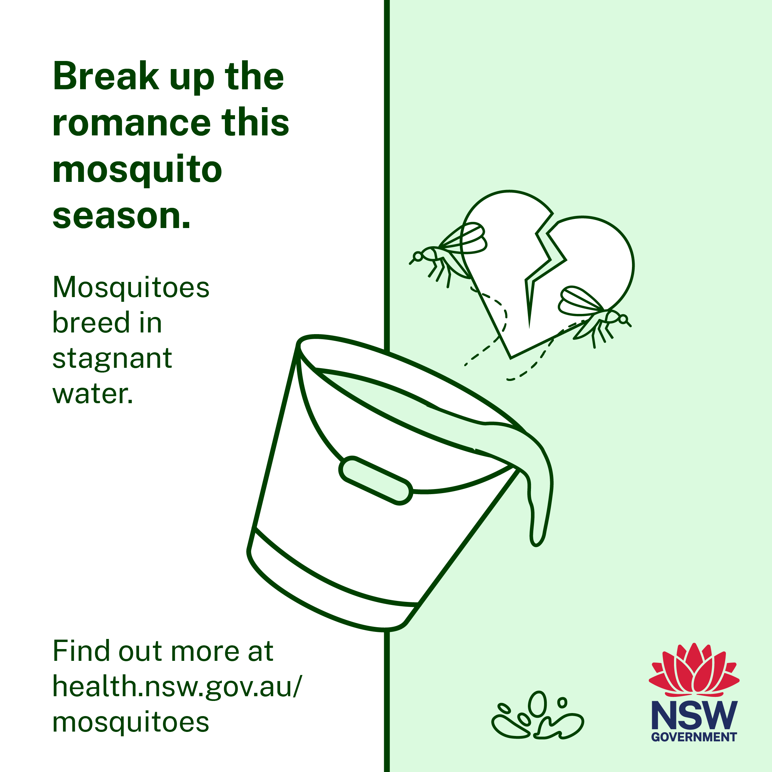
Mosquito bite prevention: social content
Click here to download social tiles
Click here to download social tiles
Post: Mosquitoes love warm, wet weather so their numbers are expected to increase this summer, along with the risk of mosquito-borne diseases like Japanese encephalitis. It’s important to prevent mosquito bites by wearing insect repellent and covering up when outdoors. Find out more at health.nsw.gov.au/mosquitoes
Post: Did you know mosquitoes breed in stagnant water? Remove items around your home that collect water such as old tyres and empty pots to lower the chance of mosquitoes breeding. Find out more at health.nsw.gov.au/mosquitoes

Slide 5
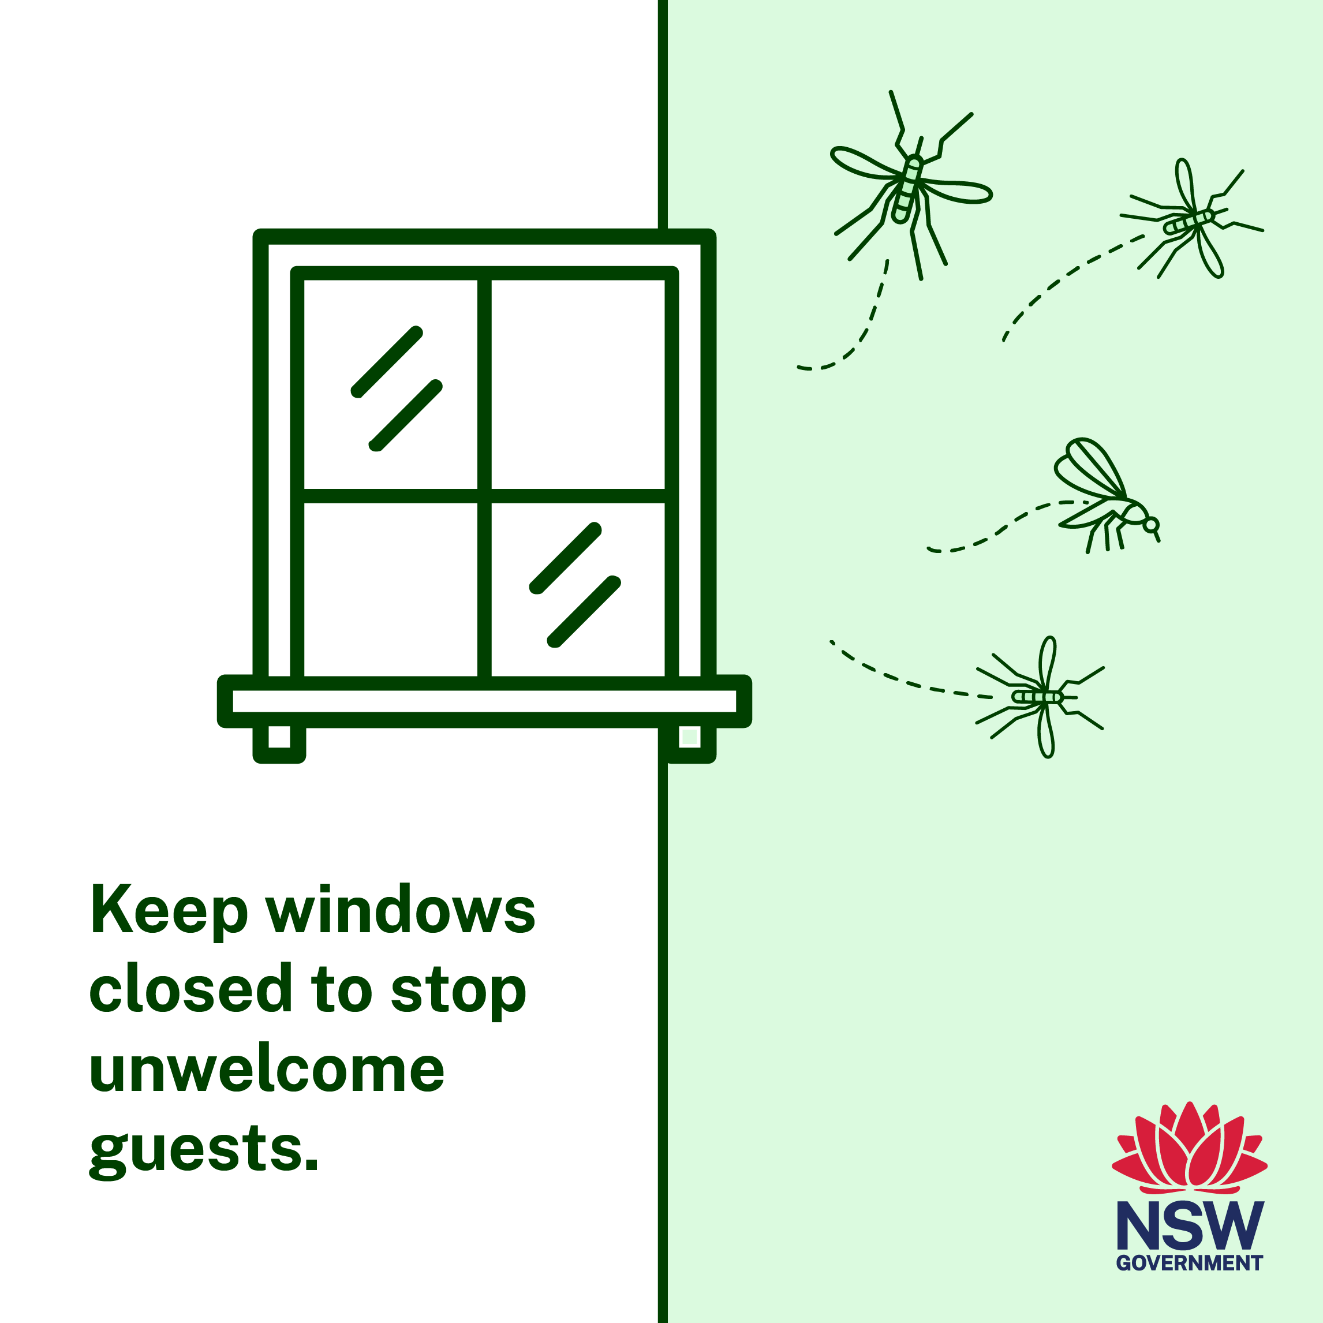
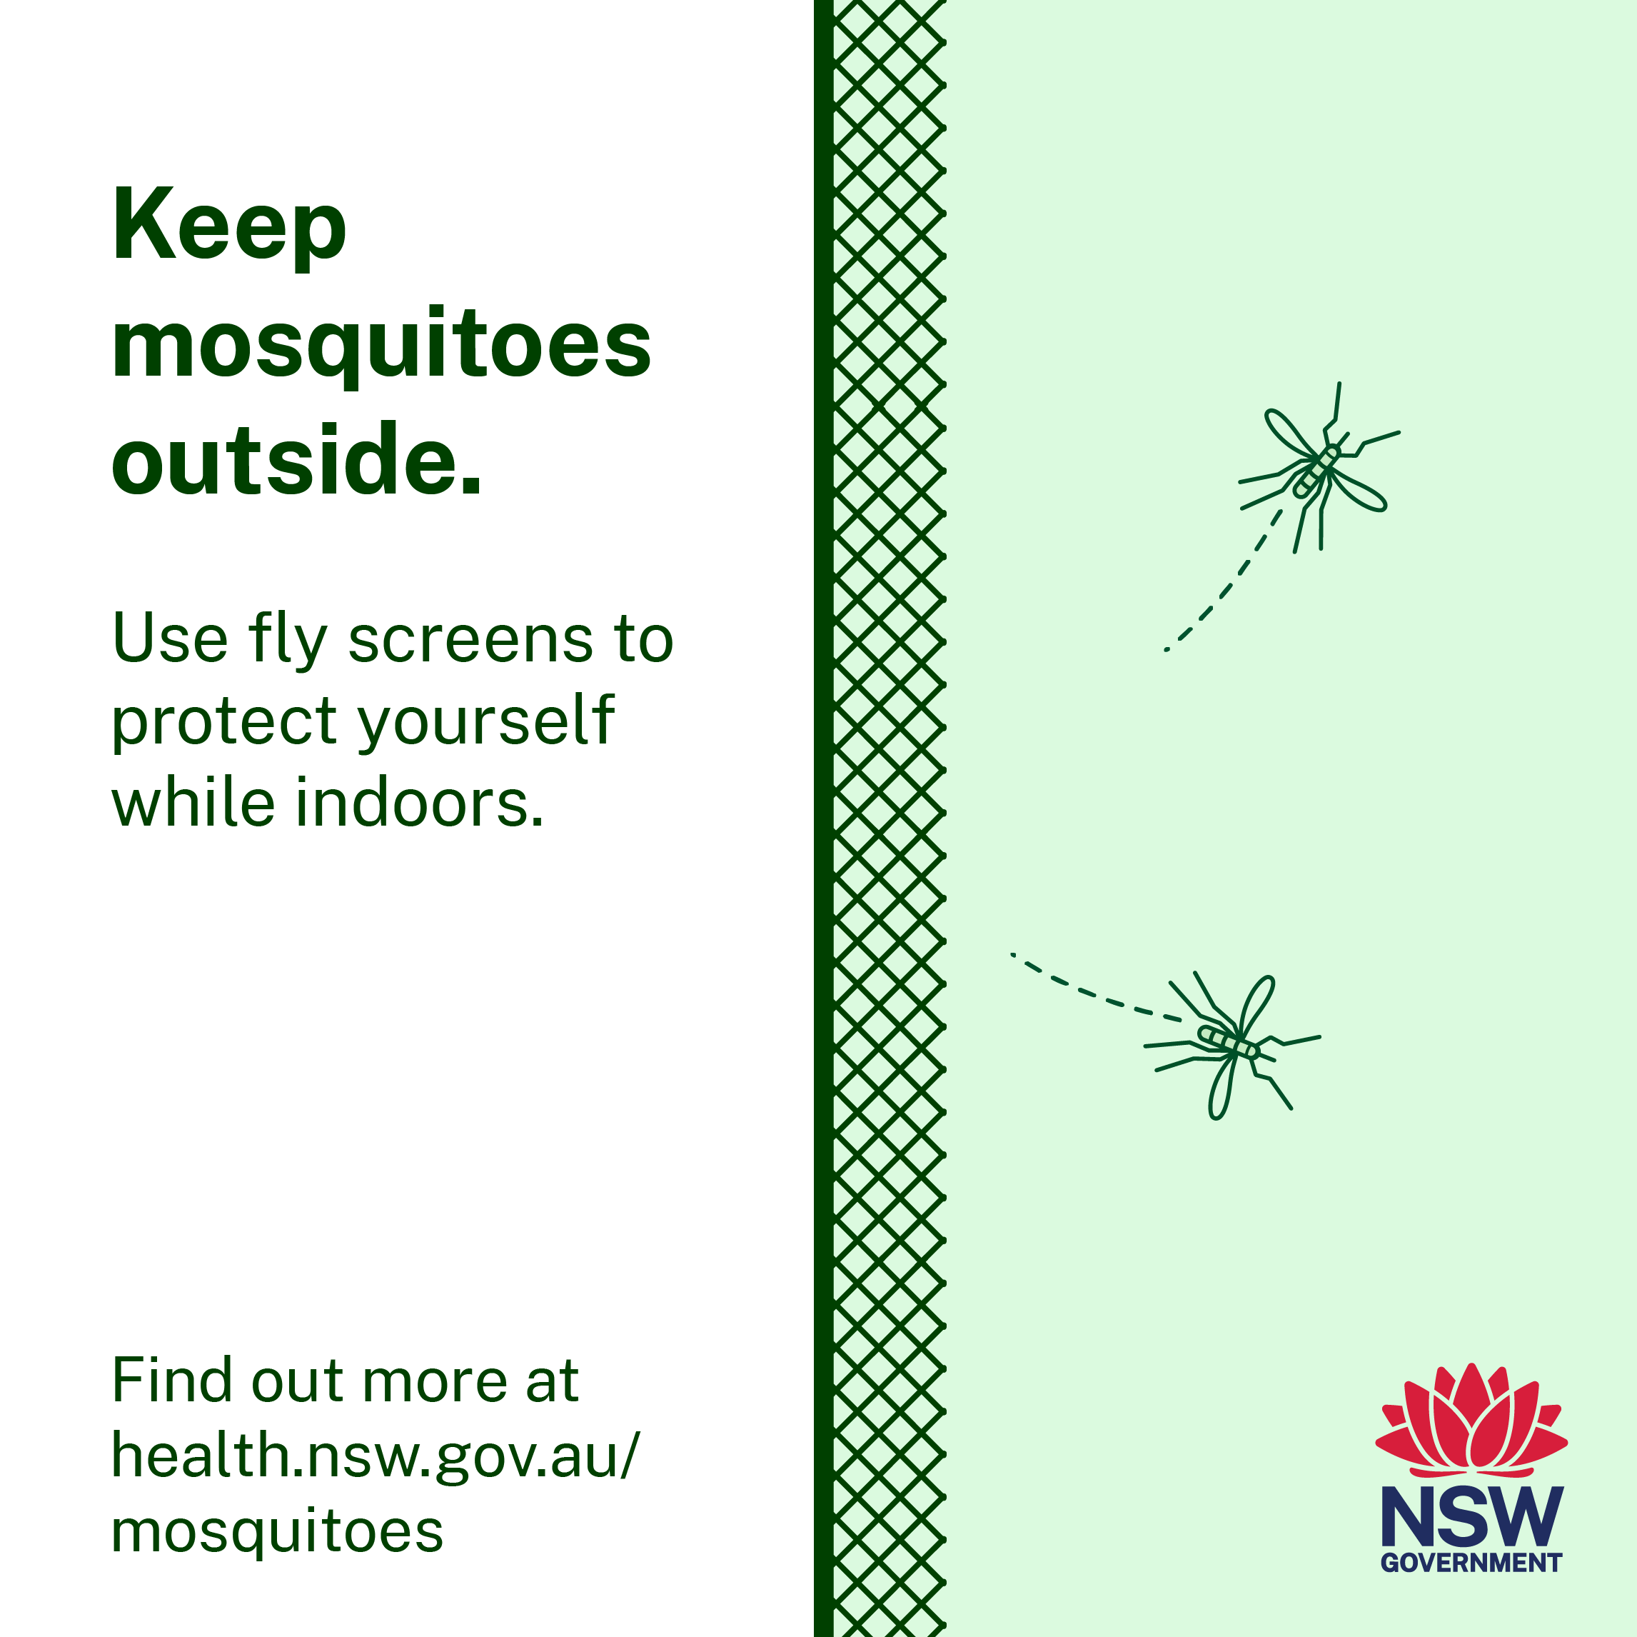
Mosquito bite prevention: social content
Click here to download social tiles
Click here to download social tiles
Post: Don’t let mosquitoes ruin your party or your summer. Some mosquitoes carry viruses like Japanese encephalitis that can make you sick. Keep mosquitoes out by closing windows and doors, or using insect screens. Find out more at health.nsw.gov.au/mosquitoes
Post: Some mosquitoes carry viruses like Japanese encephalitis that can make you sick. Install fly screens where possible to keep mosquitoes out. Find out more at health.nsw.gov.au/mosquitoes

Slide 6
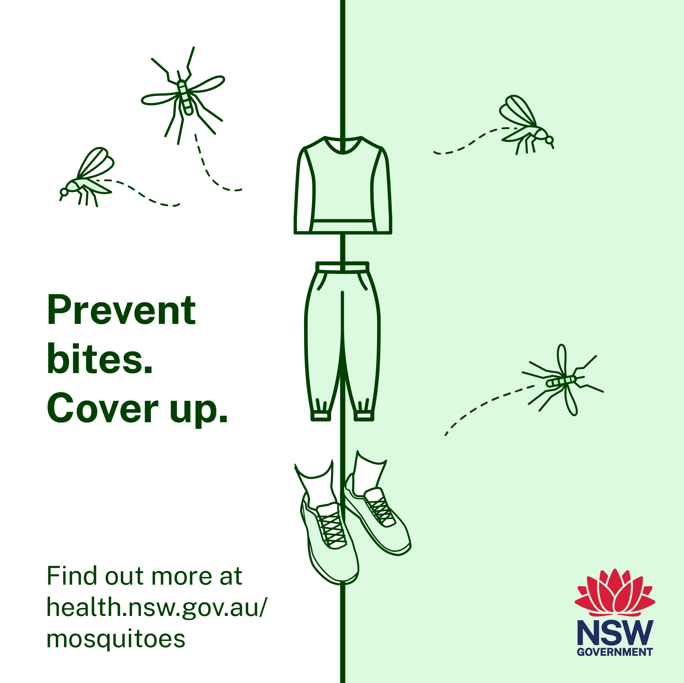
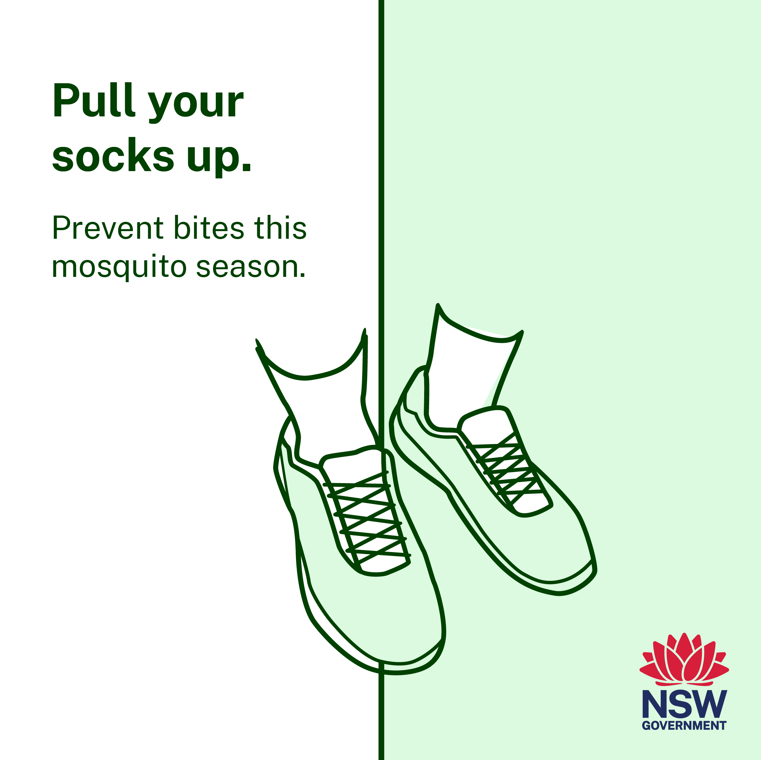
Mosquito bite prevention: social content
Click here to download social tiles
Click here to download social tiles
Post: This summer will see increased mosquito numbers. Mosquitoes in NSW can carry viruses like Japanese encephalitis virus, so it’s important to protect yourself against bites. Wear long pants, long sleeves, shoes and socks when outdoors and apply repellent to any areas of exposed skin. Find out more at health.nsw.gov.au/mosquitoes
Post: While covering up arms and legs is easy to remember, our ankles can be an easy one to forget, and a great place for mosquitoes to bite. Some mosquitoes in NSW carry viruses like Japanese encephalitis. So don’t forget to pull your socks up this summer. Find out more at health.nsw.gov.au/mosquitoes

Slide 7
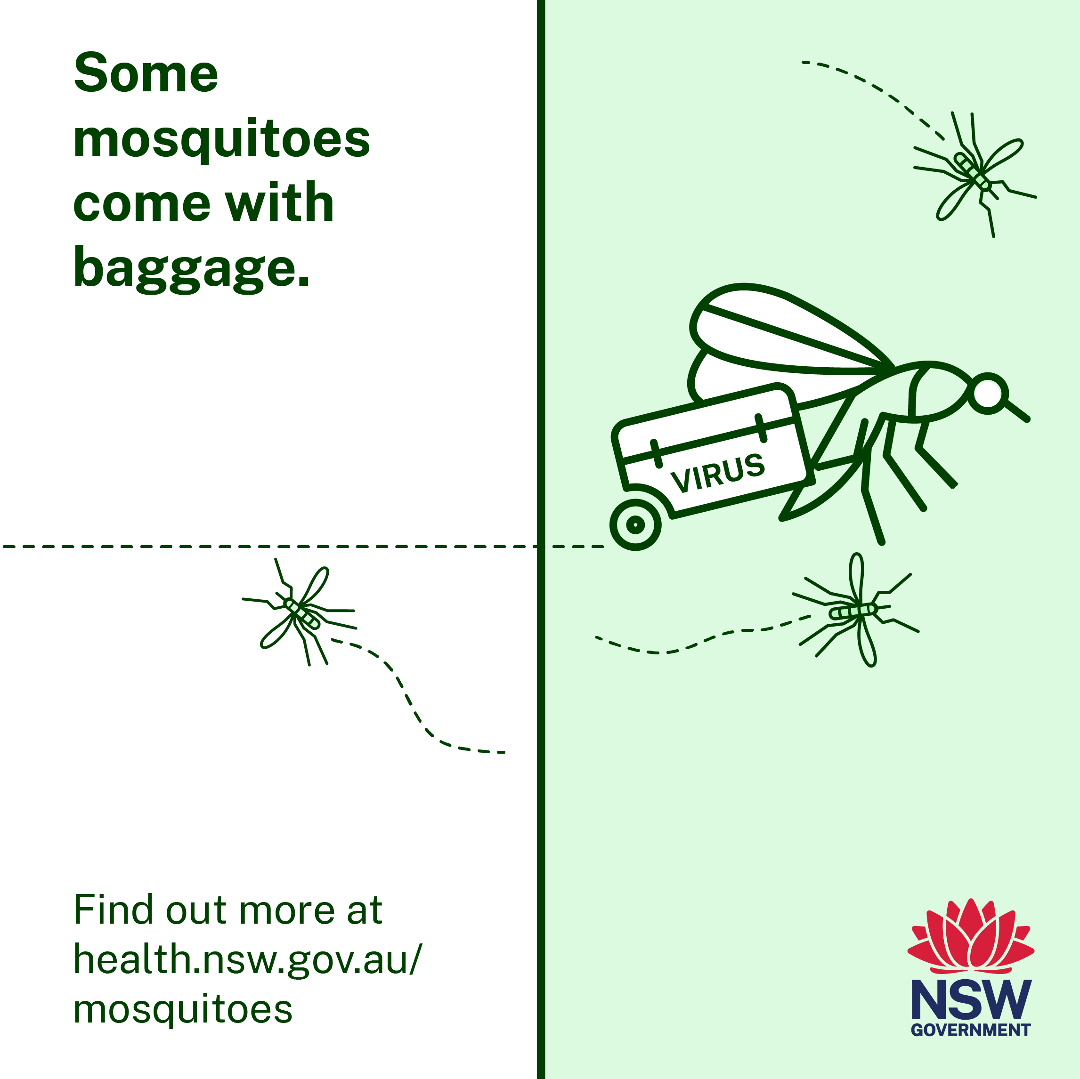
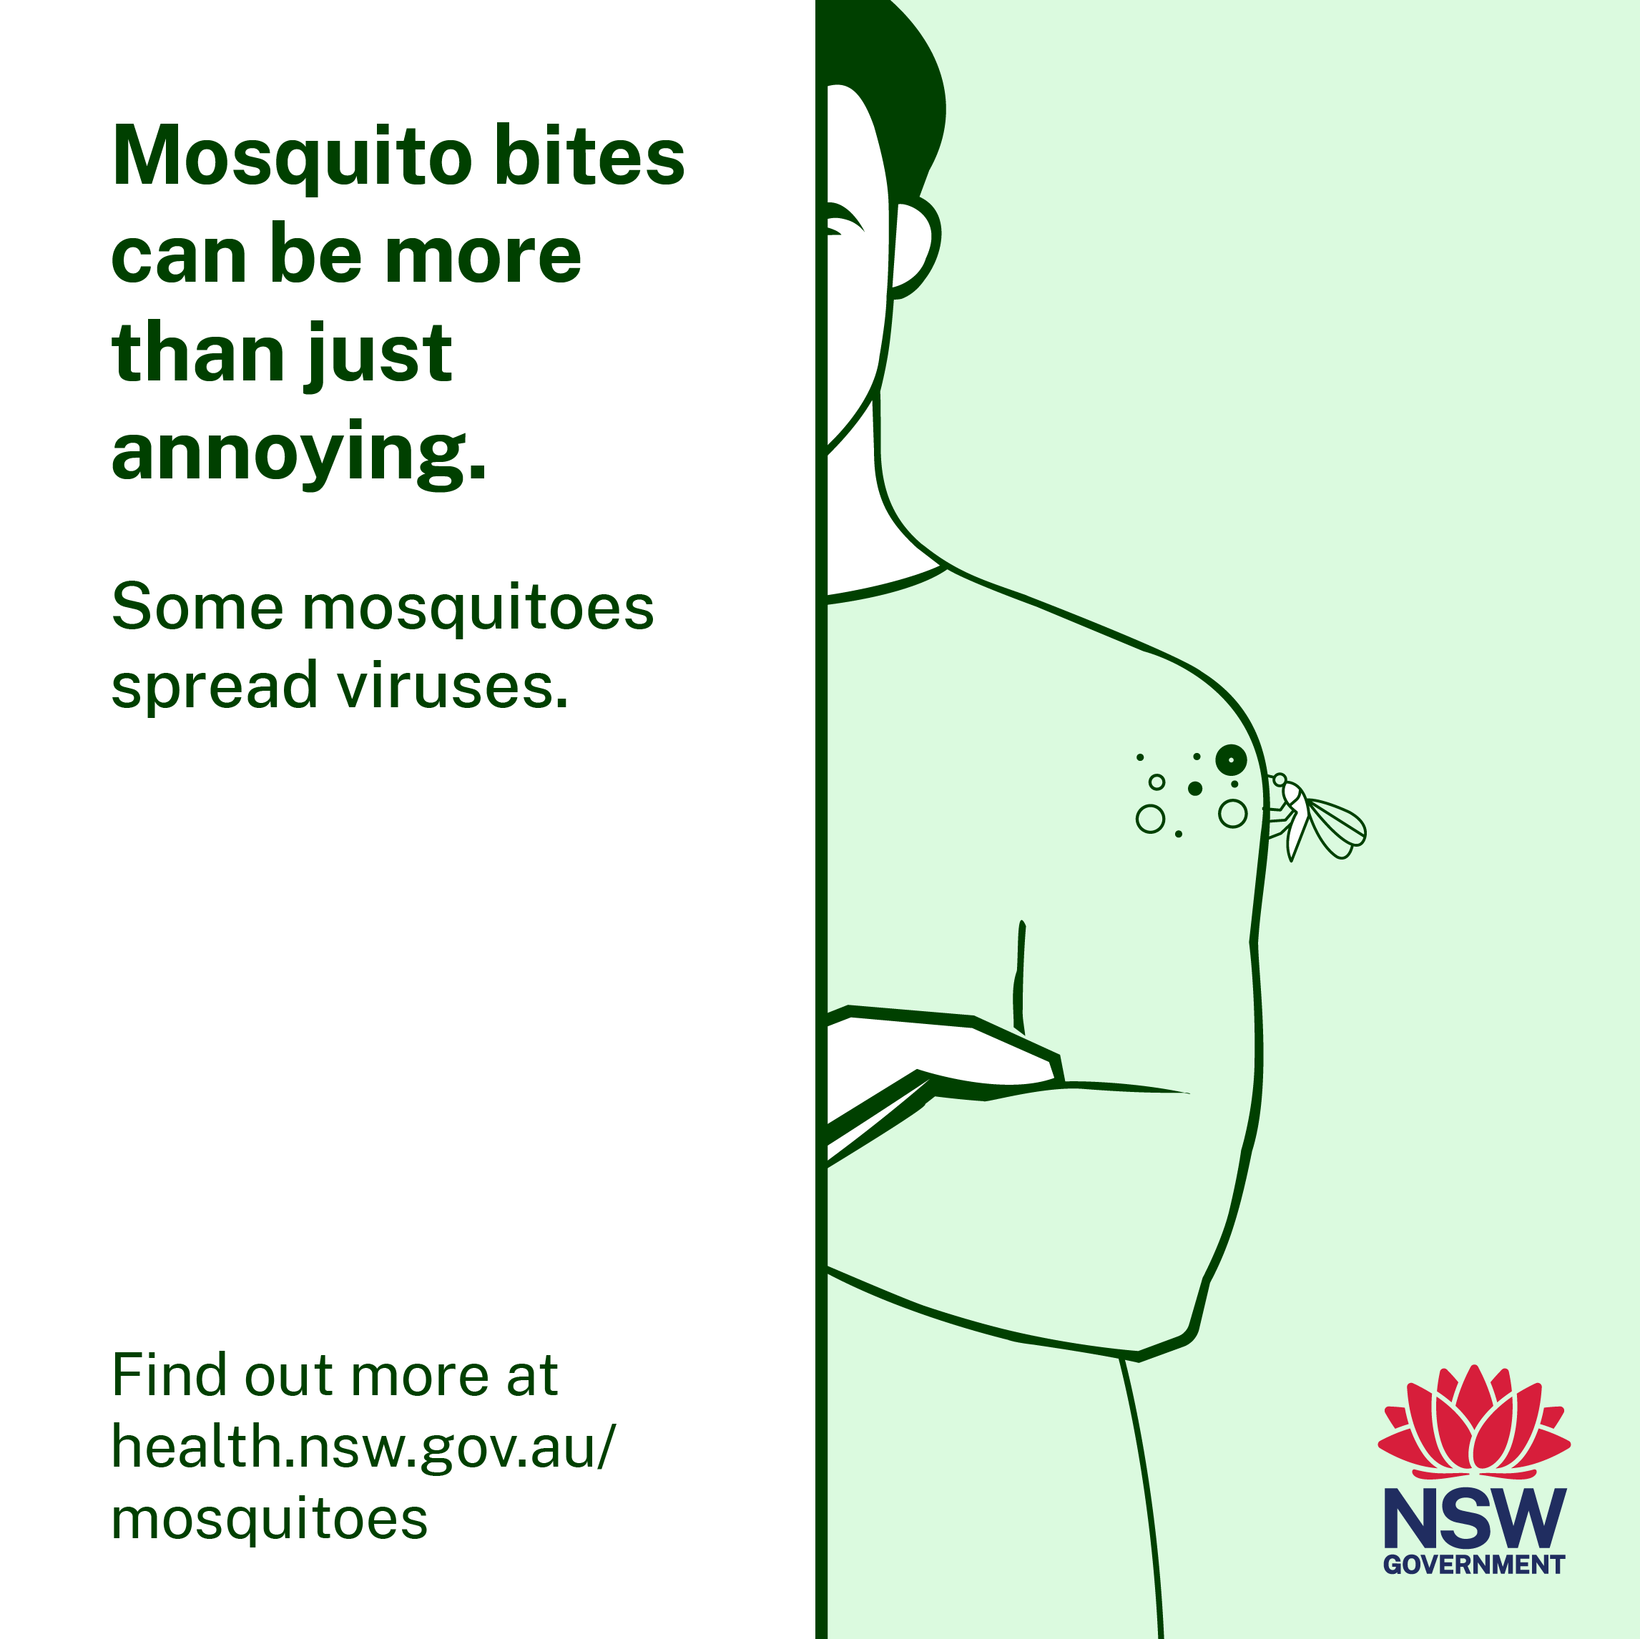
Mosquito bite prevention: social content
Click here to download social tiles
Click here to download social tiles
Post: Did you know that mosquitoes can give you more than just itchy bites? Some mosquitoes in NSW carry viruses like Japanese encephalitis virus. An extra reason to protect yourself from mosquito bites by covering up when outdoors and wearing mosquito repellent. Find out more at health.nsw.gov.au/mosquitoes
Post: In NSW, mosquitoes can carry viruses, like the Japanese encephalitis virus. It’s important to protect yourself by preventing mosquito bites. Cover up when you’re outside, wear effective mosquito repellent that contains picaridin, DEET or oil of lemon eucalyptus. Find out more at health.nsw.gov.au/mosquitoes

Slide 8
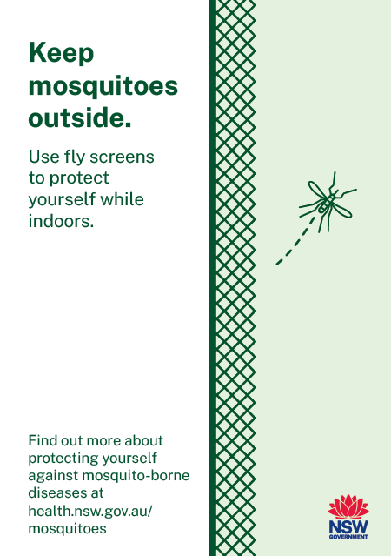
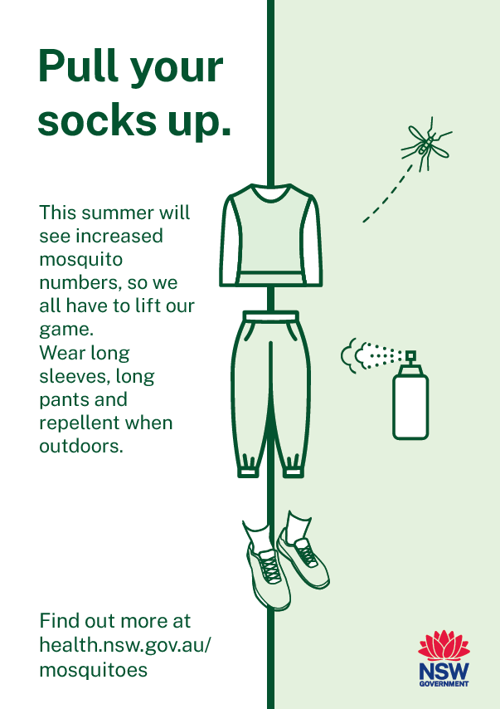
Mosquito bite prevention: posters
Click here to download poster
Click here to download poster

Slide 9
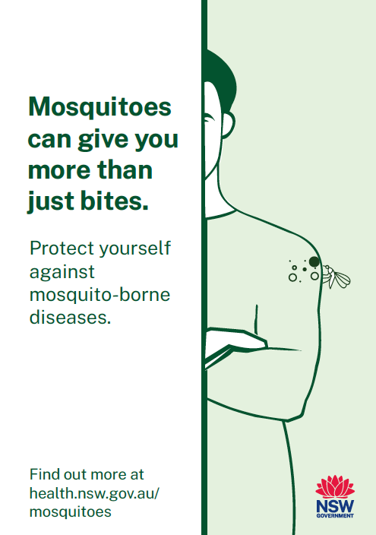
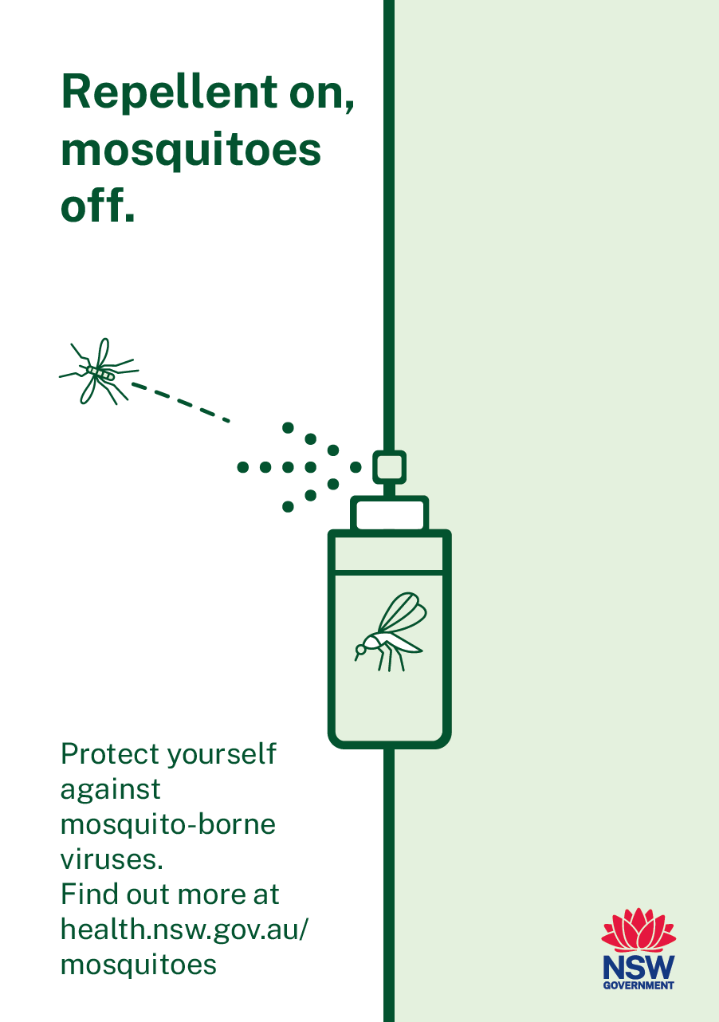
Mosquito bite prevention: posters
Click here to download poster
Click here to download poster

Slide 10
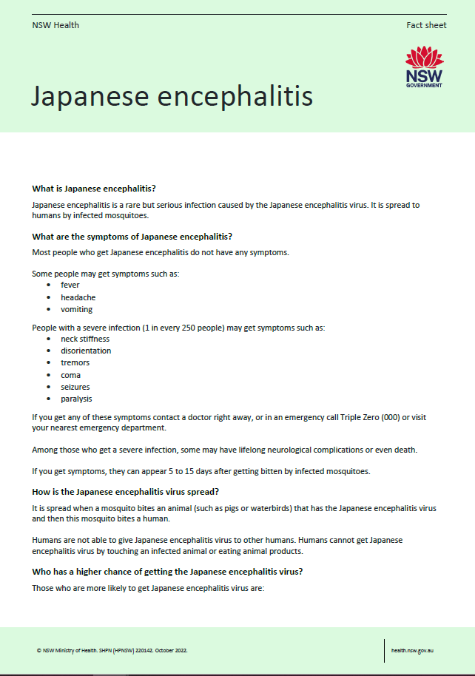
Japanese encephalitis virus: translated fact sheet
Languages available: Arabic, Chinese – Simplified, English, Filipino, Hindi, Italian, Kurdish – Kurmanji, Malayalam, Nepali, Punjabi, Vietnamese

Slide 11
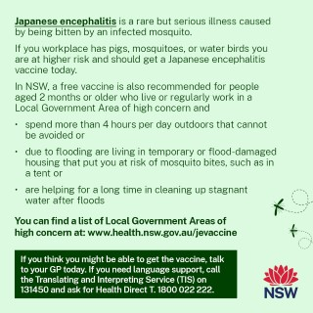
Japanese encephalitis virus: translated social tile
Languages available: Arabic, Chinese – Simplified, English, Filipino, Hindi, Italian, Kurdish – Kurmanji, Malayalam, Nepali, Punjabi, Vietnamese

Slide 12
Vaccination alert for identified local government areas
The local government areas below have been identified as areas of high-concern for Japanese encephalitis virus. The following assets have been created to increase awareness of vaccine eligibility in these communities.
Albury
Balranald
Berrigan
Bland
Bogan
Bourke
Brewarrina
Broken Hill
Carrathool
Central Darling
Cobar
Coolamon
Coonamble
Dubbo Regional
Edward River
Federation
Forbes
Gilgandra
Goulburn Mulwaree
Greater Hume
Griffith
Hay
Junee
Lachlan
Leeton
Lockhart
Moree Plains
Murray River
Murrumbidgee
Narrabri
Narrandera
Narromine
Parkes
Temora
Unincorporated Far West Area
Wagga Wagga
Walgett
Warren
Warrumbungle
Weddin
Wentworth

Slide 13
Japanese encephalitis alert: Newsletter/email copy to community
Japanese encephalitis alert for [add identified Local Government Area (LGA) name here]
NSW Health has advised our community to take steps to protect ourselves and each other from Japanese encephalitis virus (JEV) and other mosquito-borne diseases. JEV spreads to people from infected mosquitoes. In rare cases, it can cause severe illness and long-term health problems. [LGA name] has been identified as an area of higher risk for JEV.
The wet weather, together with warmer temperatures, means the risk of mosquito-borne diseases is expected to increase in the weeks and months ahead. It is important to act now to protect ourselves and reduce the risk of mosquitoes and JEV in our community by:
Getting vaccinated now. [LGA name] residents are eligible for a free JEV vaccine if they are aged 2 months and older AND:
spend significant time outdoors (four hours per day), for unavoidable work, recreation, education, or other essential activities, OR
are living in temporary or flood damaged accommodation (e.g. camps, tents, dwellings exposed to the external environment) that place them at increased risk of exposure to mosquitoes, OR
are engaged in prolonged outdoor recovery efforts (clean up) of stagnant waters following floods.
The vaccine is proven safe and effective for anyone over the age of 2 months old. Your GP can provide further information and advice to those who may not be eligible for the free vaccine but still wish to be vaccinated.
Prevent mosquito bites. Wear light, loose-fitting long-sleeved shirts, long pants and covered footwear with socks. Apply insect repellent regularly to any areas of exposed skin. Even if you’re vaccinated against JEV, it’s important to protect yourself from other mosquito-borne diseases.
Keep your property safe from mosquitoes. Keep doors and windows closed where possible and use insect screens when open. Make sure to clean up any items that might collect water, such as old tyres and empty pots, where mosquitoes can breed.
It’s also important for people to remember that humans cannot get infected with JEV by touching an infected animal or by eating animal products.
If we all take these small steps, we can help make sure that all of us and our community stay safe. The latest information can be found at www.health.nsw.gov/mosquitoes.

Slide 14
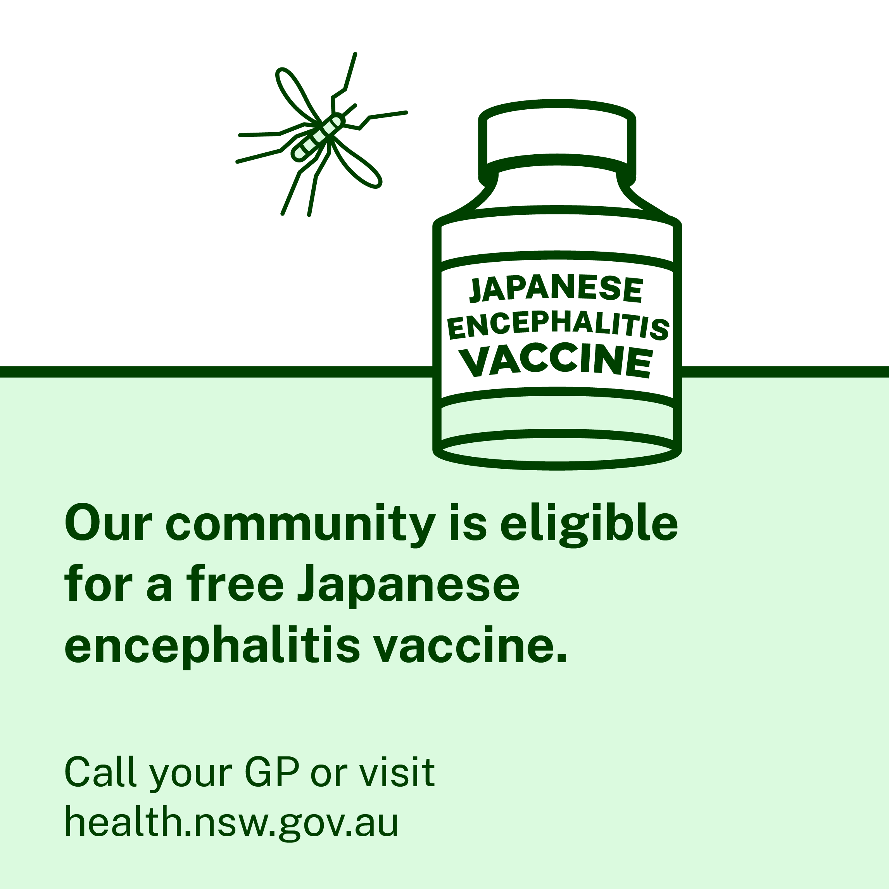
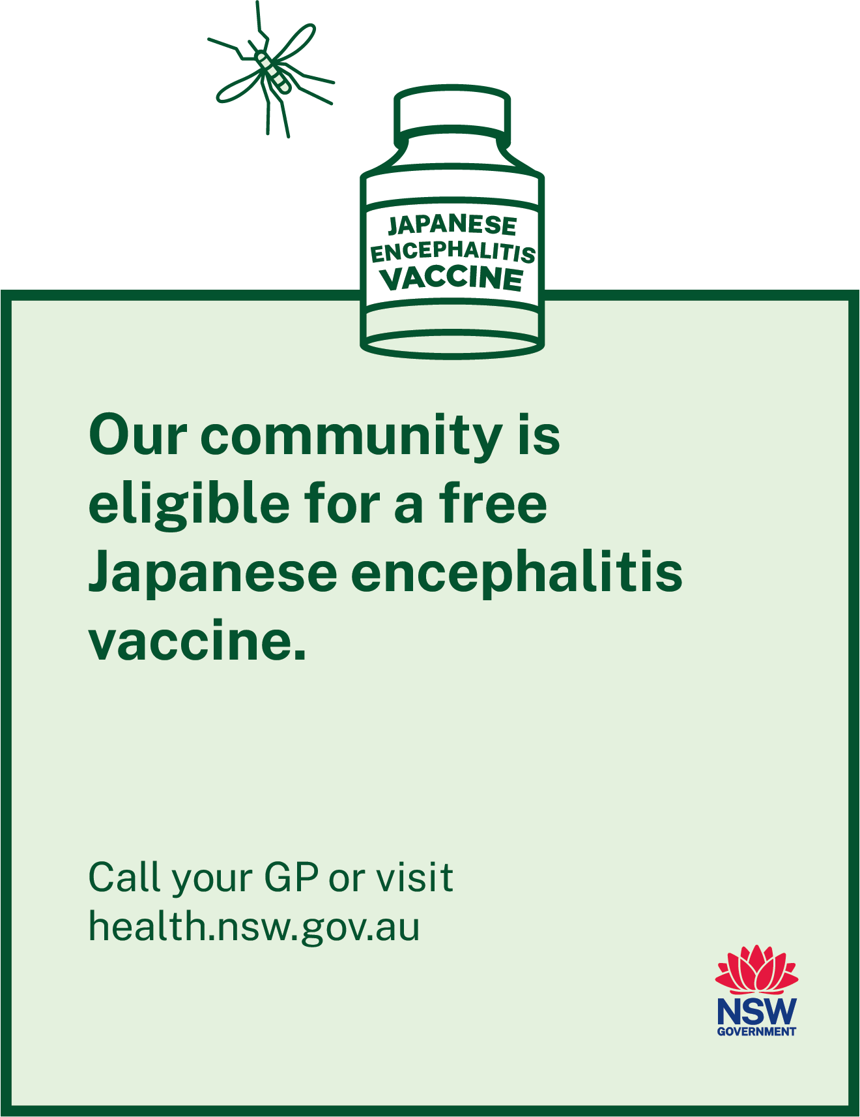
Japanese encephalitis vaccination alert: social tile and poster
Click here to download social tile
Click here to download poster
Post: Our community [LGA] has been identified as high-risk for Japanese encephalitis virus. Call your GP or visit health.nsw.gov.au to find out more about a free vaccine.

