Slide 1
Acknowledgement Of The Land
I would like to acknowledge the traditional owners of the land, the Wiradjuri and Dharawal people and pay my respects to Elders past, present and emerging leaders and Aboriginal people here today.

Slide 2
This presentation was prepared by Martina Greenaway MLHD Area D&A CNC, Rose Teale District Nurse Manager Workforce & Innovation ISLHD and Amee Hunt D&A CNC ISLHD as part of the Nursing and Midwifery Community of Practice, it supports the implementation of the NSW Health Policy Directive Nursing and Midwifery Management of Drug and Alcohol Use in the Delivery of Health Care PD2020_032.

Slide 4
NSW Health – Policy Directive Nursing & Midwifery Management of AOD use in the Delivery of Health Care (2021) Chapter 6 Care Planning

Slide 6
MLHD Comprehensive Care Planning District Guideline: NSQHSv2: 2, 5, 6, 8 February 2021 Primary Healthcare Performance Initative https://improvingphc.org/comprehensiveness

Slide 7
Screening, Assessment & Intervention - Admission - Transfer of Care - Discharge Planning:
1
Patient (carer) presents to the hospital
Screening, assessment and interventions (include carer),
2
3
Internal escalation (NUM/ Medical, Line Managers, CL Teams) or external (DASAS)
Multi-disciplinary team intervention (medication administration) and planning,
Identifying presenting problem and other critical care risks (delirium, psychosis, seizures)
Identifying other risks (self harm, suicidal, pregnancy, child and family, domestic violence, sexual health – BBV, Hep B&C & HIV)
Referrals (consumer consent) Planning Transfer of care and discharge
Orientation to the hospital environment (Aboriginal Health Liaison Officers)
Admission or discharge
If person says something you don understand ‘Ask’

Slide 8
Care Planning
Introducing self and explaining to the consumer what you will be doing (screening / assessment) building rapport reducing judgement, stigma and discrimination whilst providing orientation to hospital
The consumer is the expert in their own care – include them
Consumer consenting include carer / family in care planning discussions,
Provide the consumer / carer with a printed copy of the care plan
Informing the consumer the Multi - disciplinary team (MDT) will provide integrated care coordination whilst they are an inpatient

Slide 9
Transfer of Care - Referral & Liaison
Important part of care planning is the coordination of key specialties and services to be engaged in the patients care and discharge planning
Ensuring early referral to services during an admission once screened and prior to discharge can improve patient outcomes both during the admission and on discharge
Some of the services or disciplines that nurses and midwives may engage and refer to may include:
AOD Consultation and Liaison team within your facility, if one is available
AOD Clinical Nurse Consultant or Nurse Practitioner
Social work teams
Substance Use in Pregnancy and Parenting Services (SUPPS)
Mental Health services
Aboriginal Health teams, if the patient identifies as an Indigenous person
Interpreter services, if the patient or family or carer’s first language is not English
Domestic and family violence services.
Throughout the process of care, it is important to:
discuss transfer of care goals with the patient
communicate with the patient and all team members on the plan for treatment and transfer of care
manage the patient’s transfer of care plan
communicate progress with the patient and/or their family or carer
coordinate referrals and the transfer of the patient to alternative treatment programs and back to the community

Slide 10
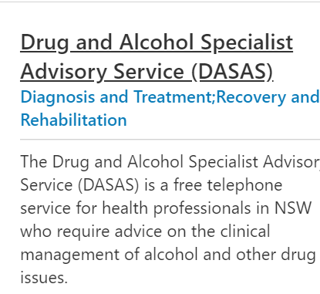
The Drug and Alcohol Specialist Advisory Service (DASAS):
I
S
B
A
R

Slide 11
Transfer of Care / Discharge
Discharge planning occurs on admission with consumer and carer,
Best practice send GP, referring agency discharge letter
Referral to community Drug and Alcohol, Mental Health services, or other services, if possible wait until the consumer has been accepted before formally discharging.
Provide AOD factsheets and local service information for referral back to service (Alcohol Drug Information Service ADIS Accessline)
When unplanned discharge occurs (AOD withdrawal, intoxication, medication sedation) provide brief health promotion interventions ensuring consumer safety, (including BBV, Hep B & C, needle syringe locations and overdose prevention including THN)
Safety – Consumers can be detained under “Duty of Care or Scheduled Mentally Disordered ” if deemed unsafe to leave (AOD related delirium, seizures, drug induced psychosis and sedation)
Transferring professional responsibility and accountability for the care of a patient to another professional, or a combination of professionals.
The process of transferring care within, or between services is a vulnerable and high-risk time for patients experiencing harm from AOD use.

