Slide 1
Acknowledgement Of The Land
I would like to acknowledge the traditional owners of the land, the Wiradjuri people and pay my respects to Elders past, present and emerging leaders and Aboriginal people here today.

Slide 2
This presentation was prepared by Martina Greenaway as part of the Nursing and Midwifery Community of Practice, it supports the implementation of the NSW Health Policy Directive Nursing and Midwifery Management of Drug and Alcohol Use in the Delivery of Health Care PD2020_032.

Slide 4
NSW Health – Policy Directive Nursing & Midwifery Management of AOD use in the Delivery of Health Care (2021) - Chapter 4 Identifying and Managing Other Risks
Prepared by: Martina Greenaway MLHD Registered Mental Health Nurse (RMHN), MLHD District Drug & Alcohol, Clinical Nurse Consultant.

Slide 6
Recent discharge (Rehab, Prison, Hospital) Increases risk of overdose
Risk factors for sexually transmitted infections and blood-borne viruses
Risk of harm to self or others (MH, domestic violence aggression or violent behaviour)
Risk of harm to children - Substance Use in Pregnancy (MRG)
Priority populations Aboriginal Torres Strait Islanders, CALD, LGBTQI Young & Older people, Pregnancy (children under 5yrs)
Special attention to consumers who are homeless

Slide 7
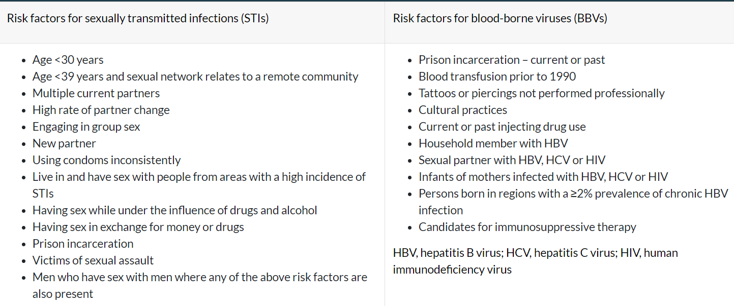
Sexual Health Screening and Assessment:

Slide 8
Know, Prevent, Test, Treat, Eliminate Hepatitis (WHO)
Hepatitis B / HBV: direct blood contact, unprotected sex. Vaccination is the best prevention.
Hepatitis C: Blood to blood contact with someone who has the virus, sharing of drug injecting equipment, tattooing and skin piercing or medical needle stick injuries. Hep C is relatively easy to treat.

Slide 9
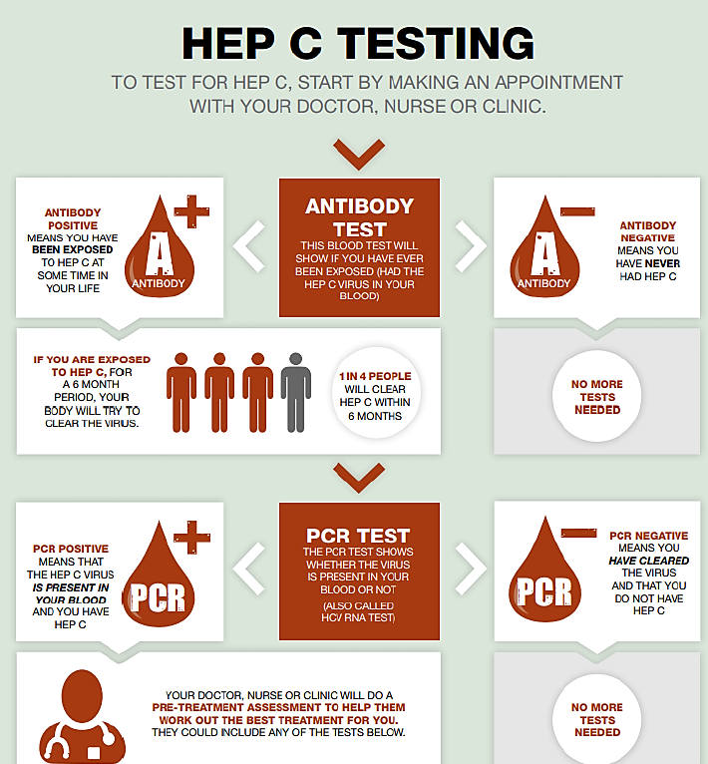
PCR: Polymerase Chain Reaction (takes 1 – 2 weeks to get the result)
Viral Detection, Load and Genotype (Hep C strain 1- 6)
Viral Load – Tells you how many weeks of treatment you will require
Treatment – oral medication: First line
Epclusa (all genotypes and for 12 weeks)
Maviret (all genotypes and for 8 weeks)

Slide 10
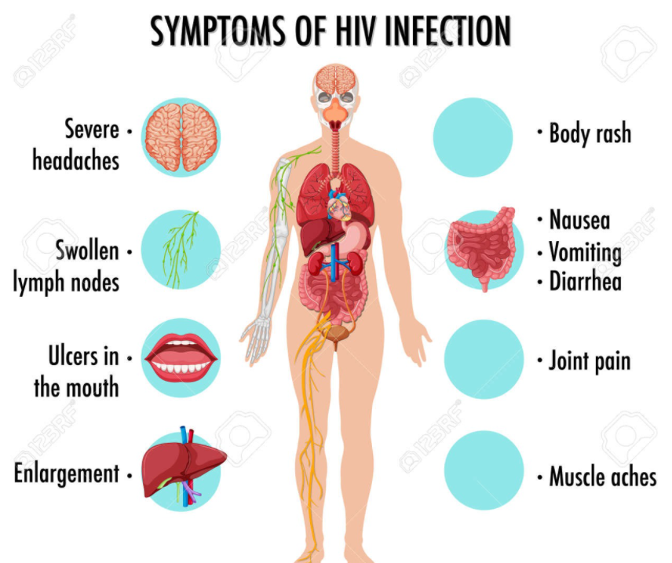
Human Immunodeficiency Virus (HIV)
A virus that damages the immune system.
It is transmitted through body fluids.
Treatment as Prevention (TasP) are available keeping the person well,
Pre-exposure prophylaxis (PrEP) On demand or event driven 2 tablets before sex, followed by 1 pill 24 hrs later and a second dose 24 hrs after that
There is no vaccine or cure. AIDS is a late stage of HIV infection.
The HIV Support Program (HSP) supports people who are HIV positive.
HIV & Related Program Unit (HARP) NSP, Sexual health and health promotion programs https://www.health.nsw.gov.au/Infectious/factsheets/Pages/HIV-infection.aspx

Slide 11
HSP & HARP programs support the person:
Management including treatment
Psychosocial support
Prevention of infection to others
Partner Notification
Specialist & Community Services
LHDs - Sexual Health / HIV or Health Promotion Manager
ACON NSW provide outreach services https://www.acon.org.au/
NSW Sexual Health Infolink (SHIL) provide HIV & STI information service for health professionals (testing, treatment guidelines, support with contact tracing and resources) https://www.health.nsw.gov.au/sexualhealth/Pages/default.aspx
NSW STI Programs Unit (STIPU)
Stigma STI / HIV Testing Tool – A step by step guide to testing

Slide 12
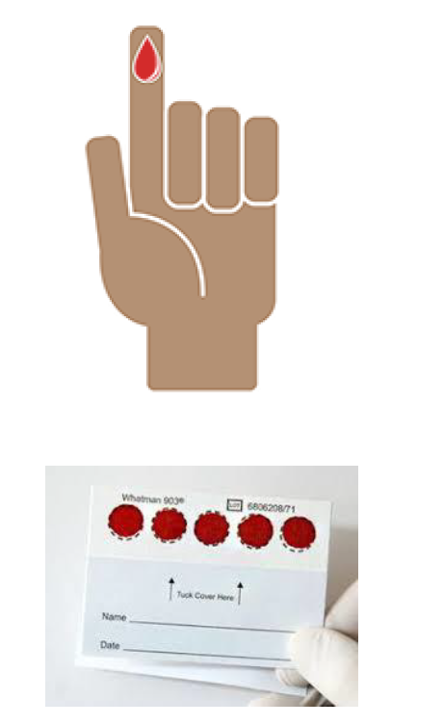
Health Promotion and Harm Minimisation:
Building rapport is key before asking sensitive questions, no matter how difficult asking the question is for the clinician it must not be ‘omitted’. The clinician is providing an opportunity for the consumer to think and identify any potential ‘exposure risks’ in the previous weeks ‘Treat More & Test Early = Better Health Outcomes’.
Needle & Syringe Program (NSP) Access to swabs, sterile water injection sites, sterile water, spoons in which to mix the solution, and filters to remove particles from the drugs. (Fitpacks)
Easy access (drop in appointments) reducing the barriers for testing and treatment. Dry Blood Spot (DBS) is a valuable tool. Its anonymous, non-invasive, and results indicate current infection.
Hep Cured communication campaign targeting People Who Inject Drugs (PWID) at settings relevant to them

Slide 14
References:
At The Sharp End- A snapshot of 21st century injecting Drug use (Turning point Victoria)
Taking a sexual history adapted from the NSW STI Programs Unit’s STI/HIV Testing Tool
Hepatitis Australia – A guide to Hep C https://www.hepatitisaustralia.com/hep-c-guides
National guide to a preventative health assessment for Aboriginal and Torres Strait Islander people
Burnett Institute. Partner notification of sexually transmitted infections in New South Wales: An informed literature review. Melbourne: Burnet Institute, 2010. [Accessed 14 April 2017].
MLHD HIV & Related Program Unit (HARP) https://www.mlhd.health.nsw.gov.au/our-services/sexual-health-service/the-hiv-related-program-unit-(harp)
Sexual Health Info Link https://www.shil.nsw.gov.au/
Needle and Syringe Program (NSP) Services https://www.mlhd.health.nsw.gov.au/our-services/needle-and-syringe-program-(nsp)-services
NSW Users and AIDS Association (NUAA) is the peak drug user organisation in NSW. NUAA provides education, practical support, information and advocacy to users of illicit drugs, their friends, and allies.
Australian Injecting & Illicit Drug Users League (AIVL) is the national organisation representing people who use/have used illicit drugs and is the peak body for the state and territory peer-based drug user organisations.
Hepatitis NSW provides information, support, referral and advocacy for people affected by viral hepatitis in NSW. https://www.hep.org.au/hep-c/hep-c-testing/pcr-tests/?sfw=pass1634013207

Slide 15
