Slide 1
Managing Intoxication and Overdose
Nursing and Midwifery CoP Presentation June 2021
Prepared by Tonina Harvey

Slide 2
This presentation was prepared by Tonina Harvey as part of the Nursing and Midwifery Community of Practice, it supports the implementation of the NSW Health Policy Directive Nursing and Midwifery Management of Drug and Alcohol Use in the Delivery of Health Care PD2020_032.

Slide 3
What we will cover
Intoxication
Identifying
Deterioration
Overdose
Can be progressive over time – dependent on substances used

Slide 4
Intoxication
Can mimic or mask serious illness and injury
Can be life threatening and cause altered physical or mental functions
Can affect mood, cognition, behaviour and physiological functioning
Can result in aggressive or disruptive behaviour which can pose a risk to both the person’s safety and that of other visitors, staff and patients.

Slide 5
Other conditions can mimic intoxication
Infection
Respiratory disease, hypoxia
Head injury (e.g. subdural haematoma)
Acute psychosis
Cerebrovascular accident (CVA or stroke) or transient ischaemic attack (TIA)
Diabetes, hypo or hyper glycaemia
Epilepsy, postictal confusion
Drug toxicity (e.g. phenytoin, digoxin)
Meningitis
Alcohol and/or benzodiazepine withdrawal
Wernicke’s encephalopathy

Slide 6
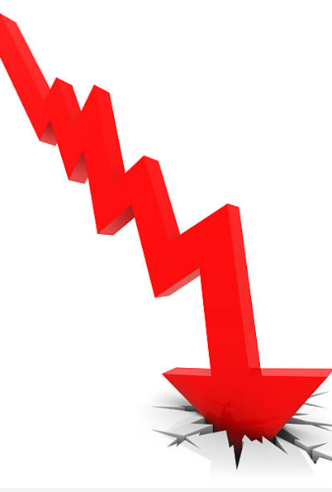
Managing a Deteriorating Patient
Attain accurate history, if possible
Monitor Vital Signs:
Temp
Pulse
BP
Respiratory rate
Oxygen saturation regularly as outlined by local policy
Unconscious patients – ensure basic life support and that resuscitation equipment is readily available
Escalate to Medical Officer if patient deteriorates or you have concerns

Slide 7
A person who has had a potentially lethal overdose must be assessed immediately.

Slide 8
General Principles for Management of Intoxication
Treat any patient presenting as incoherent, disoriented or drowsy as having a head injury until proven otherwise
Risk factors for accidental overdose include:
history of overdose
frequent use and higher levels of dependence
use following period of abstinence (due to a reduced level of tolerance)
mixing drugs / alcohol and regular poly substance use

Slide 9
Physical Care
Take
Take baseline observations: blood pressure, respiratory rate, temperature and pulse
Maintain
Maintain observations half hourly in the acute phase and then 2nd hourly until stable
Measure
Measure fluid intake and maintain hydration
Ensure
Ensure thorough physical and mental status examination
Identify and observe
Identify and observe for the effects of more than one substance in every intoxicated person

Slide 10
Physical Care
Any patient presenting with seizures should be assessed for alcohol withdrawal, benzodiazepine withdrawal or stimulant intoxication as well as other possible causes.
Seizures must be treated according to policy and the patient observed for at least 4 hours post-seizure using the Glasgow Coma Scale (GCS). Some areas use the Alert, Verbal, Pain, Unconscious (AVPU) scale.
Maintain medication regimen as ordered by a Medical Officer
Ensure pathology tests are followed up to gauge level of use and susceptibility to withdrawal

Slide 11
Behavioural Management
GUIDELINES FOR MANAGEMENT OF SPECIFIC BEHAVIOURS OF AN INTOXICATED PATIENT
Anxiety, agitation, panic | Approach in a calm and confident manner Explain interventions Move and speak in an unhurried way Minimise the number of staff attending to the patient Provide a quiet environment to reduce stimulation Reassure the patient frequently Protect the patient from accidental harm
Confusion, disorientation | Use clear and simple communication Provide frequent reality orientation Display some object familiar to the patient, eg own dressing gown or slippers Ensure frequent supervision Accompany the patient to and from places (e.g. bathroom, TV lounge)

Slide 12
GUIDELINES FOR MANAGEMENT OF SPECIFIC BEHAVIOURS OF AN INTOXICATED PATIENT
Altered perception, hallucinations | Explain perceptual errors and re-orientate Create a simple, uncluttered environment Nurse in well-lit surroundings to avoid perceptual confusion Protect the patient from harm
Anger, aggression | Use space for self-protection (e.g. don’t crowd the patient, keep furniture between yourself and the patient if feeling unsafe) Speak in a calm, reassuring way Use the patient’s name when speaking to them Do not challenge or threaten the patient by tone of voice, eyes or body language Let the patient air their feelings, and acknowledge them Determine the source of the patient’s anger and if possible, remove it Be flexible within reason Be aware of workplace policies on managing aggression

Slide 13
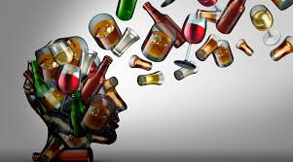
Signs & Symptoms of Intoxication and Overdose

Slide 14
Alcohol
INTOXICATION
OVERDOSE
Passing out or blackouts; stupor or coma; cold and clammy skin; lowered body temperature; lowered blood pressure;
Slow and noisy respiration; accelerated heart rate or bradycardia; strong smell of alcohol; positive breath alcohol reading.
Alcohol intoxication is a potentially lethal condition. The majority of overdoses are due to polydrug toxicity involving the concomitant consumption of other CNS depressants
Death is usually due to respiratory depression or inhalation of vomitus.
Each person has a different tolerance to alcohol – on average, the lethal blood alcohol concentration is 0.45-0.5%.

Slide 15
Alcohol - Management
Recognition and exclusion of other potential causes of changes in mental status:
head trauma,
hypoglycaemia,
Hypoxia
poisoning with other agents.
Treatment:
Supportive care
identification and correction of hypovolaemia and hypoglycaemia
close monitoring of respiratory status
intravenous thiamine in patients at risk of WE
Notes:
Management of acute intoxication requires recognition and exclusion of other potential causes of changes in mental status, such as head trauma, hypoglycaemia, hypoxia, and poisoning with other agents.
Treatment is largely supportive and consists of identification and correction of hypovolaemia and hypoglycaemia, close monitoring of respiratory status, and intravenous thiamine in patients at risk of WE

Slide 16
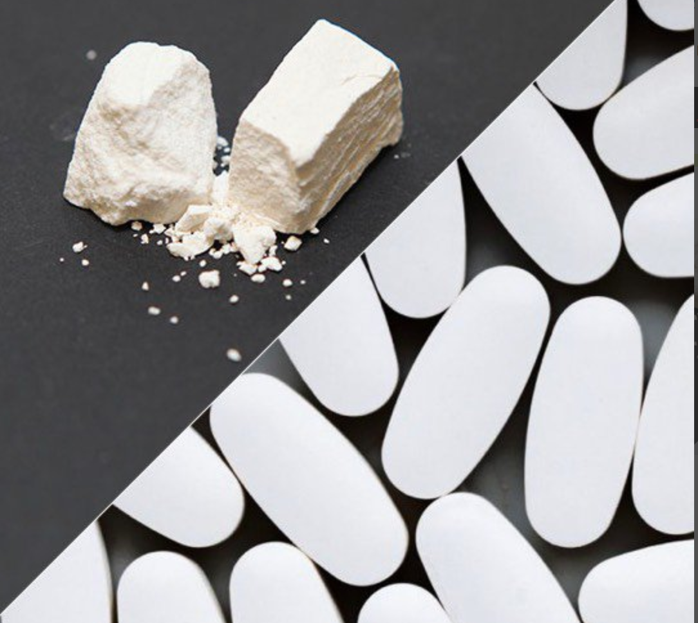
Opioids Heroin / Morphine / Codeine / Oxycodone / Hydrocodone/ Fentanyl / Tramadol / Methadone
INTOXICATION
OVERDOSE
Reduced sensitivity to pain, euphoria or negative mood, dizziness or faintness.
Decreased level of consciousness (from drowsiness to coma)
slow respiration,
bradycardia
pinpoint' pupils
muscle twitching
cyanosis
hypotension
pulmonary oedema and
hypothermia may also be present.
Aspiration pneumonia is the most serious condition frequently seen in heroin overdose.
Opioids have emetic and cough suppressant properties, which, combined with a decreased level of consciousness can increase the likelihood of aspiration.
Death is usually due to respiratory failure, although cardiac arrest may occur secondary to myocardial oxygen deprivation

Slide 17
Opioids - Management
Monitoring vital signs
Maintenance of airway and breathing
Follow cardiopulmonary resuscitation (CPR) protocol.
Administration of naloxone, a short-acting opioid antagonist will reverse the effect of opioid overdose.
Patients who were previously sedated may become agitated, aggressive and difficult to manage due to sudden precipitated withdrawal syndrome
Methadone and long-acting prescribed opioids – have a longer half-life
Naloxone may wear off and the person can become sedated again
may seem to recover initially but can relapse into respiratory depression and coma if not adequately monitored and treated.
On discharge offer patient Take Home Naloxone
Notes:
Maintenance of airway and breathing are most important in overdose management. Follow cardiopulmonary resuscitation (CPR) protocol.
Administration of naloxone, a short-acting opioid antagonist will reverse the effect of opioid overdose. Naloxone may be administered by intravenous, intramuscular or subcutaneous injection, or by nasal spray. Patients who were previously sedated may become agitated, aggressive and difficult to manage due to sudden precipitated withdrawal syndrome
In the case of overdoses involving methadone and long-acting prescribed opioids, naloxone may wear off and the person can become sedated again. Because of the longer half-life of methadone compared with heroin or morphine (methadone = 24–48 hours), people who overdose from methadone and who are subsequently treated with naloxone may seem to recover initially but can relapse into respiratory depression and coma if not adequately monitored and treated.
On discharge offer patient Take Home Naloxone – National Strategy to reduce Overdose deaths from Opiates

Slide 18
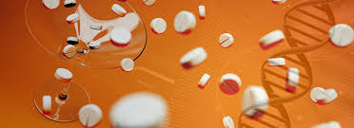
Benzodiazepines Diazepam/ Alprazolam / Lorazepam/ Clonazepam/ Flunitrazepam/Clobazam/ Nitrazepam / Temazepam Zolpidem / Zopiclone - known as Z Drugs
INTOXICATION
OVERDOSE
Benzodiazepines have anxiolytic, sedative, hypnotic, muscle relaxant and anti-epileptic effects.
Unwanted effects include:
depression
confusion
feelings of isolation or euphoria
impaired thinking and memory loss headache, drowsiness, sleepiness and fatigue,
dry mouth, slurred speech or stuttering
double or blurred vision
impaired coordination
dizziness and tremors
nausea and loss of appetite
diarrhoea or constipation
CNS depression (over-sedation or sleep) is the most common finding after overdose.
Respiratory depression may also occur, but is more common with concurrent use with alcohol, opioids
In high doses, patients may manifest coma, respiratory depression, hypotension, bradycardia, hypothermia, and rhabdomyolysis.

Slide 19
Benzodiazepines - Management
The cornerstone of treatment in benzodiazepine overdoses is good supportive care and monitoring.
Monitoring vital signs
Maintenance of airway and breathing
Follow cardiopulmonary resuscitation (CPR) protocol.
Altered mental status, a blood glucose level should be obtained immediately.
If complicated by respiratory depression or failure, a concomitant opioid overdose may be present and it is reasonable to administer appropriate doses of parenteral naloxone.
Note: Gastrointestinal decontamination with activated charcoal is usually of NO benefit and increases the risk of aspiration.
Notes:
As with any overdose, assess the patient's airway, breathing, and circulation, and address rapidly as needed. In any patient with an altered mental status, a blood glucose level should be obtained immediately. The cornerstone of treatment in benzodiazepine overdoses is good supportive care and monitoring.
In patients with benzodiazepine overdose complicated by respiratory depression or failure, a concomitant opioid overdose may be present and it is reasonable to administer appropriate doses of parenteral naloxone.
Note:
Gastrointestinal decontamination with activated charcoal is usually of NO benefit and increases the risk of aspiration

Slide 20
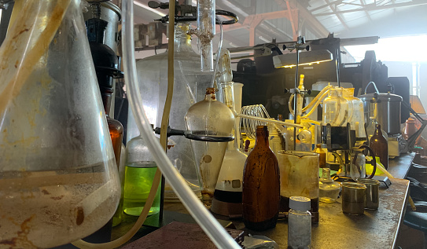
Psychostimulants “Ritalin” / “Concerta” / Dexamphetamine/ Lis dexamphetamine / Cocaine / Amphetamine/ Methamphetamine and MDMA “Ecstasy”
INTOXICATION
OVERDOSE
Euphoria, increased sense of wellbeing, increased energy, more confidence or over-confidence, improved cognitive and psychomotor performance, suppression of appetite and reduced sleep.
Increased heart rate and respiration, nausea and vomiting, dilated pupils, hot and cold flushes, sweating, headaches, pallor, jaw clenching, paranoia, anxiousness, panic attacks, difficulty sleeping, moodiness, irritability and agitation.
Secondary complications can involve the kidneys, skeletal muscles and gastrointestinal system.
The most common causes of death related to amphetamine toxicity are arrhythmia, hyperthermia and intracerebral haemorrhage.

Slide 21
Psychostimulants -Management
Uncomplicated intoxication may only require observation and monitoring in a quiet environment until symptoms subside.
Supportive care, with an emphasis on sedation and reduction of body temperature.
Some patients also require pharmacologic therapy for control of hypertension.
Use of amphetamines may cause thirst. Large consumption of water may lower the blood concentration of electrolytes.
Patients who complain of chest/muscle pain should have bloods, chest X-ray investigations and an ECG, as relevant

Slide 22
Hallucinogens Lysergic acid diethylamide (LSD) / phencyclidine (PCP, Angel dust)/ psilocybin (magic mushrooms) and dimethyl tryptamine (DMT).
INTOXICATION
OVERDOSE
Euphoria and wellbeing, dilation of pupils, seeing and hearing things that aren’t there (hallucinations), confusion and trouble concentrating, depersonalisation, derealisation, headaches, nausea, fast or irregular heartbeat, increased body temperature, breathing quickly, vomiting, facial flushes, sweating and chills.
Psychiatric disturbances such as prolonged psychosis, depression, personality disruption and post-hallucinogen perceptual disorder have been attributed to prolonged use.
Many patients intoxicated with hallucinogens are awake, aware that their symptoms are drug-induced, and able to provide a history of recreational hallucinogen use.
Seizure and rhabdomyolysis have been reported in extreme cases.
Severe injury or death (e.g. from drowning) more commonly occur as a result of impaired judgment and warped sense of distance, time and reality while intoxicated.

Slide 23
Hallucinogens -Management
Uncomplicated intoxication may only require observation and supportive care
Monitoring in a quiet environment until symptoms subside.
Symptoms of intoxications are self-limited and not usually severe a conservative approach is preferred unless there is evidence of severe toxicity (e.g. hyperthermia and severe agitation).
Benzodiazepines are first-line therapy for acute agitation and dysphoria. If psychotic symptoms persist (e.g. after agitation subsides), neuroleptics such as haloperidol may be titrated with careful monitoring.

Slide 24
Cannabis Herbal Cannabis ( Marijuana) / Cannabis resin( Hashish) / Cannabis oil (Hashish oil) / Cannabis products - Nabiximols
OVERDOSE
INTOXICATION
Complications associated with inhalation of cannabis include acute exacerbations and poor symptom control in patients with:
asthma;
chest pain,
subcutaneous emphysemas caused by deep inhalation with breath holding and
rarely, angina and myocardial infarction.
Signs of cannabis intoxication in adolescents and adults may include:
tachycardia;
increased blood pressure or orthostatic hypotension
increased respiratory rate
conjunctival injection (red eye)
dry mouth
increased appetite
Nystagmus
ataxia and
slurred speech.

Slide 25
Cannabis -Management
Recreational cannabis intake to achieve psychoactive effects can often result in adverse effects because there is no clear indication of doses that achieve symptoms desired by the user and noxious effects.
Monitoring vital signs
Asymptomatic treatment as effects of cannabis also vary between people and may even be different for the same person at different times.

Slide 26
Reflection Questions
What are the illnesses or injuries that can mimic intoxication?
What is the key principle for managing anyone who is disorientated, drowsy or confused?
How would you recognize if a patient was progressing from intoxication to overdose?
What are the core elements of care when providing support to an intoxicated person?
What are your local protocols for management of intoxication & overdose? Where might you locate these?

