Slide 1
Orientation to Nursing and Midwifery Management of Drug and Alcohol use in the Delivery
of Health Care
Policy & Procedures
PD2020_032

Slide 2
What we will cover in this presentation
Where to get more Information and support
What is different to previous policies?
Overview of
Policy & Procedures
Core Processes of Care
What this means for Nursing & Midwifery Practice

Slide 3
1992 - 2006
FOCUS ON:
Assessment
Opportunistic Intervention
Management of Intoxication
Management Withdrawal
Education and Training
Notes:
Treatment

Slide 4
Success to date
Little integration of the impact of AOD use in mainstream training – often deemed to be a “mental health” problem
Limited integration of policy and procedures into everyday practice
People experiencing harm from AOD use seen as troublesome
Complexity of presentations often makes getting a history difficult and questions regarding AOD are sometimes seen as invasive
Some staff seeing that addressing AOD use is the role of “specialist” services

Slide 5
Initial
Screening
Comprehensive
Assessment
Risk Identification and Response Monitoring
Care Planning
Transfer of Care
2020
Focus is on
Core Processes of Care
To guide risk identification, clinical management and integration of care
Notes:
Pathways of Care

Slide 7
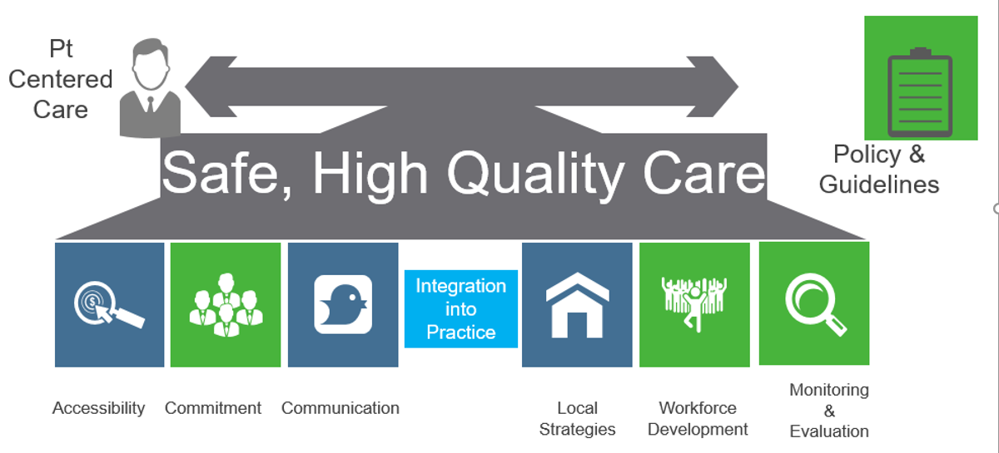

Slide 8
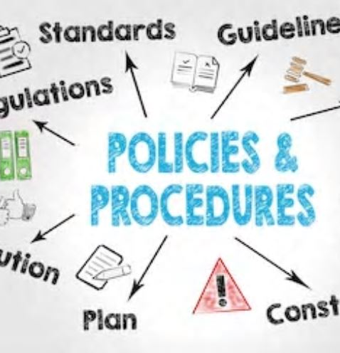
Overview of the Policy and Procedures Nursing and Midwifery Management of Drug and Alcohol use in the Delivery of Health Care

Slide 9
2020 The Policy
All care and treatment delivered to people who are experiencing harm from alcohol and other drug use is to be person centered and non-discriminatory
On admission to a health service all patients will undergo an initial screening to identify alcohol and/or drug use and risks as part of all nursing and midwifery care
The use of drugs and alcohol is to be recorded for all patients so that there is a consistent approach to provision of care and referral of patients to specialist services.

Slide 10
2020 The Policy
As part of responding to alcohol and/or drug use risks, nurses and midwives are to deliver brief interventions in line with their scope of practice, consult and refer to a specialist treatment provider for comprehensive assessment, as appropriate
Nurses and midwives need to maintain awareness that patients presenting with risk factors, associated with alcohol and other drug use, also may predispose any child to increased risks to their wellbeing. Where this is identified, appropriate and sensitive questioning must be undertaken in line with NSW Health Policy

Slide 11
2020 The Policy
The drug and alcohol goals, and treatment plan must be considered and integrated into the overall holistic health care plan, in collaboration with the patient
Nurses and Midwives must ensure a patient’s drug and alcohol health care needs are integrated into their transfer of care planning process
At each transition of care, clinical handover must occur to ensure patient safety

Slide 12
Procedures – CONTENTS

Slide 13
Procedures – CONTENTS

Slide 14
Procedures – CONTENTS

Slide 15
Procedures – CONTENTS

Slide 16
Procedures – CONTENTS

Slide 17
What this means for Nursing and Midwifery Practice

Slide 18
Key to Implementation
Be aware of the impact you and colleagues have on people who use alcohol and other drugs (AOD) – ensure your approach is not stigmatizing or discriminatory
Build your knowledge of policy and procedures and clinical impact of AOD use
Integrate Policy and Procedures into everyday practice
Ensure Accurate Documentation:
Assessment
Referral
Ongoing Risk Monitoring
Care Planning
Transfer of Care

Slide 19
WHAT THIS MEANS IN PRACTICE
SETTING
ED/ Maternity / Outpatient Clinic / Ward / MH / Community
Integrated into practice by Nurses and Midwives
POLICY & PROCEDURES
Core Processes of Care
Screening & Assessment
Identifying and Monitoring Risk
Care Planning
Transfer of Care
SUPPORTED BY EVIDENCE BASED CLINICAL GUIDELINES
Substance Use in Pregnancy / Withdrawal Management / Opioid Treatment / Naloxone/ Child Protection

Slide 20
Links to other Programs of work in NSW Health
Substance Use in Pregnancy & FASD Guidelines
Clinical Outcomes & Quality Improvement
- Clinical Standards for AoD Treatment
Stigma & Discrimination Project
Comorbidity
Get Healthy in Pregnancy Initiatives
First 2000 Days

Slide 21
Information and Support

Slide 22
Policy & Procedures PD2020_032 are online Handbook for Nurses and Midwives Responding effectively to people who use alcohol and other drugs To be launched early 2021 and will be available on MOH website

Slide 23
Other Clinical Guidelines, Info & Policy
Drug & Alcohol Withdrawal Clinical Practice Guidelines
Substance Use in Pregnancy Guidelines
Opioid Treatment Guidelines
Fetal alcohol spectrum disorder: A national diagnostic tool and a guide to its use
Opioid Dependent Persons Admitted to Hospitals in NSW - Management
Dosing Facilities in Public Hospitals for Patients on Opioid Treatments
Take Home Naloxone supply by hospital units
Notes:
Nursing and Midwifery Management of Drug and Alcohol use in the Delivery
of Health Care
Summary
This Information Bulletin provides guidance for pharmacy departments, emergency departments, pain clinics and other hospital units wishing to supply PBS-subsidised naloxone to patients on discharge

Slide 24
Clinical Support
Drug and Alcohol Services in your district should always be your first call
Drug & Alcohol Specialist Advisory Service (DASAS)
Phone Sydney Metropolitan (02) 9361 8006
Operates 24/7 for health professionals
Regional and rural NSW 1800 023 687*
* Free call numbers are not free from mobile phones, except Telstra mobiles
24 hour phone service for all health professionals

Slide 25
Reflective Questions
What do you need to know to improve your capacity to work with people experiencing harm from AOD use?
How will you integrate the policy into your practice on a daily basis?
Where can you get support?

Slide 26
How can YOU make a difference??

