Slide 1
Tobacco, EXercise and dieT MEssages
Westmead Hospital
TEXT ME
A/Prof. Clara Chow
Program Director, Community-based Cardiac Services, Westmead Hospital
Acting Director CV Division, The George Institute
NHMRC/ NHF Career Development Fellow
TEXT ME was funded by:
a National Heart Foundation Grant in Aid &
A BUPA Foundation Award

Slide 2
The context
Heart disease accounts for greater morbidity and mortality in Australia than any other disease state
1/3rd of 55,000 patients presenting with a heart attack are presenting for the 2nd time - & cost Australia $8.4 billion annually
Reducing repeat events is possible with current treatments, but is not being done
Can M-health strategies address the gap?
Notes:
Heart disease remains the leading cause of death and morbidly in Australia.
About 1/3rd of the 55000 patients presenting each year with a heart attack are presenting for the 2nd time
Reducing repeat events is possible with evidence-based treatments but is not done
Our focus has been examining whether E- and M-health strategies address the gap.

Slide 3
TEXT ME - Tobacco, EXercise and dieT MEssages
Randomised clinical trial of 710 patients presenting to hospital with CHD
352 received TEXT ME,
358 received usual care
~100 messages over 6 mths
Provided education, motivation, support
Customised to patient characteristics
Decreased cholesterol, BP, BMI &
Increased Physical activity + smoking cessation
Chow CK, et al. JAMA. 2015;314(12):1255-1263
Notes:
TEXT ME – stands for Tobacco Exercise and dieT MEssages.
We conducted a randomised clinical trial of 710 patients with coronary heart disease.
We compared clinical measures in 352 patients that received TEXT ME to 358 who received usual care.
TEXTME is a customised program of education, motivation and support delivered in bite-size text message chunks over 6 months.
We found those receiving the program had decreased cholesterol, BP, BMI and increased physical activity and smoking cessation

Slide 4
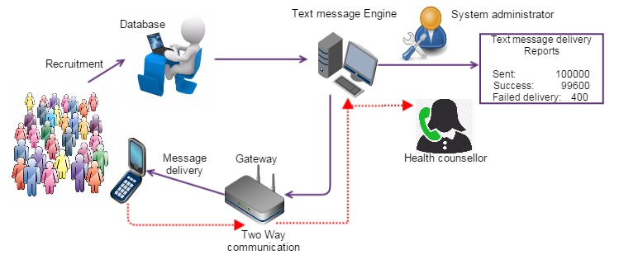
Interaction with the existing health care team
Text message support program – ‘the back room’
Westmead hospital
Automation –
Directly talk to E-Health Records?
Flexibility for
Content updates
Other programs
Who customises and prescribes the program?
Hospital medical team
Will ‘hospitalised” patients – be outside the hospital of the future?
Thakkar J, Chow CK et al Designing a computerised text message delivery system Unpublished 2015
Notes:
Key to our next step is addressing how the TEXTME program seamlessly interacts with the existing health care team.
The health care models need to change.
This figure by my PhD student Dr Thakkar, shows the staff that are involved to support our current text message support program.
Database managers, system administrators, health counsellor, health providers and health care teams.
To achieve widespread translation – we need to evolve the roles of existing health care team members.
The question for us in Health is – “Will hospitals of the future need to provide care to patients inside and outside of the hospital?”

