Slide 1
NSW CHILD AND FAMILY HEALTH
CDC PRESENTATION
Parent-Engaged Developmental Monitoring Using CDC’s Developmental Milestone Checklists

Slide 3
Parent-Engaged Developmental Monitoring Using
CDC’s Developmental Milestone Checklists
An
An Overview of Revisions and Updates
The findings and conclusions in this presentation are those of the authors and do not necessarily reflect the views of the CDC.
Notes:
Original content in the PowerPoint has been developed by the US Centres for Disease Control and Prevention, with minor modifications made by NSW Ministry of Health (i.e., NSW parent resources and website links)
Reference: Developmental milestone content and artwork provided by the U.S. Centers for Disease Control and Prevention, “Learn the Signs. Act Early.” program (www.cdc.gov/ActEarly; accessed [date]).

Slide 4
Presentation Objectives
Recognise many children with developmental delays and disabilities are not identified early
Understand CDC’s Learn the Signs. Act Early. program’s revisions to free communication resources for families to monitor and discuss their child’s development
Promote parent-engaged developmental monitoring
Support developmental surveillance at well-child visits with healthcare providers
Improve awareness of systems for early identification of developmental delays and disabilities
Notes:
The objectives of this presentation is to provide an overview on the:
evidence informed review process on the LTSAE milestone checklists,
the practice changes for health staff on the revised checklists and what this means for implementation
positive outcomes for increasing parent engagement in monitoring their child’s development
strengths of the revised LTSAE checklists for earlier detection and referrals to specialists,
resources for health staff to promote child development; and
resources developed in the Communications Package by NSW Ministry of Health to support local implementation.

Slide 5
Why Monitor Development?
Developmental disabilities are common and often not identified before school age
Up to 1 in 4 (< 5 yrs. of age) are at moderate to high risk for developmental, behavioral, or social-emotional delays¹
1 in 6 (3–17 yrs. of age) has a developmental disability²
1 in 44 (8 yr. olds) are estimated to have autism spectrum disorder³
1. National Survey of Children’s Health, 2011-12
2. Zablotsky, B, et al, Pediatrics 2019
3. CDC, MMWR Surveillance Summary 12/2021
Notes:
This slide provides opportunity to discuss key information about the importance of monitoring development and the prevalence of developmental concerns being undetected for children before a child starts school. Please note that the data presented is from the United States.

Slide 6
Earlier Intervention is Better
Evidence shows that starting supports as early as possible is best
The earlier a child is identified, the sooner targeted intervention and family supports can start
It is never “too late” to start services and supports
Intervention can improve skills, abilities, future school performance, long-term self-care skills, and quality of life
Other benefits of early identification & intervention
Families understand their child’s strengths, and areas they may need support
Family wellness
Notes:
Use this slide to reinforce the importance of earlier detection, followed by referral to targeted supports and interventions, leading to improvements on a child’s developmental outcomes and readiness for school.

Slide 7
Developmental Surveillance vs Screening
Surveillance
Screening
Monitoring is one part of developmental surveillance
Occurs at each well child visit
Uses developmental milestones and much more
Families and early childhood professionals also monitor development (team approach)
Ongoing
No scores, no risk categorisation
Can support the need for any additional developmental screening
Administered by early childhood professionals
Recommended at specific ages
Also recommended if there are concerns at other times
Uses validated developmental screening tools with milestones
Provides risk categorisation/scores
Not diagnostic
Helps determine if diagnostic evaluations are needed
May be used to qualify for state early intervention programs
Notes:
This slide provides a summary of the differences between developmental surveillance and developmental screening.
When presenting, be careful to explain that the LTSAE milestone checklists are developmental surveillance tools not screening.
The differentiation between ‘surveillance’ and ‘screening’ is outlined on the slide showing the different functions between the tools.

Slide 8
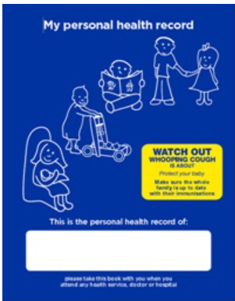
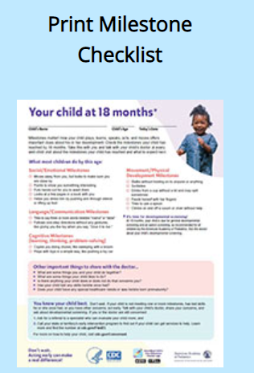
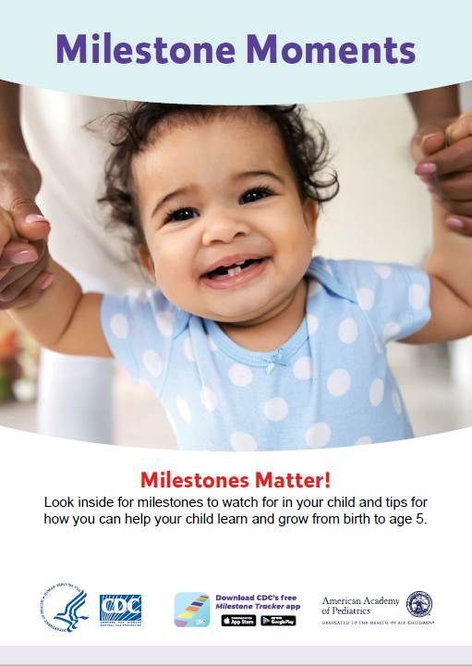
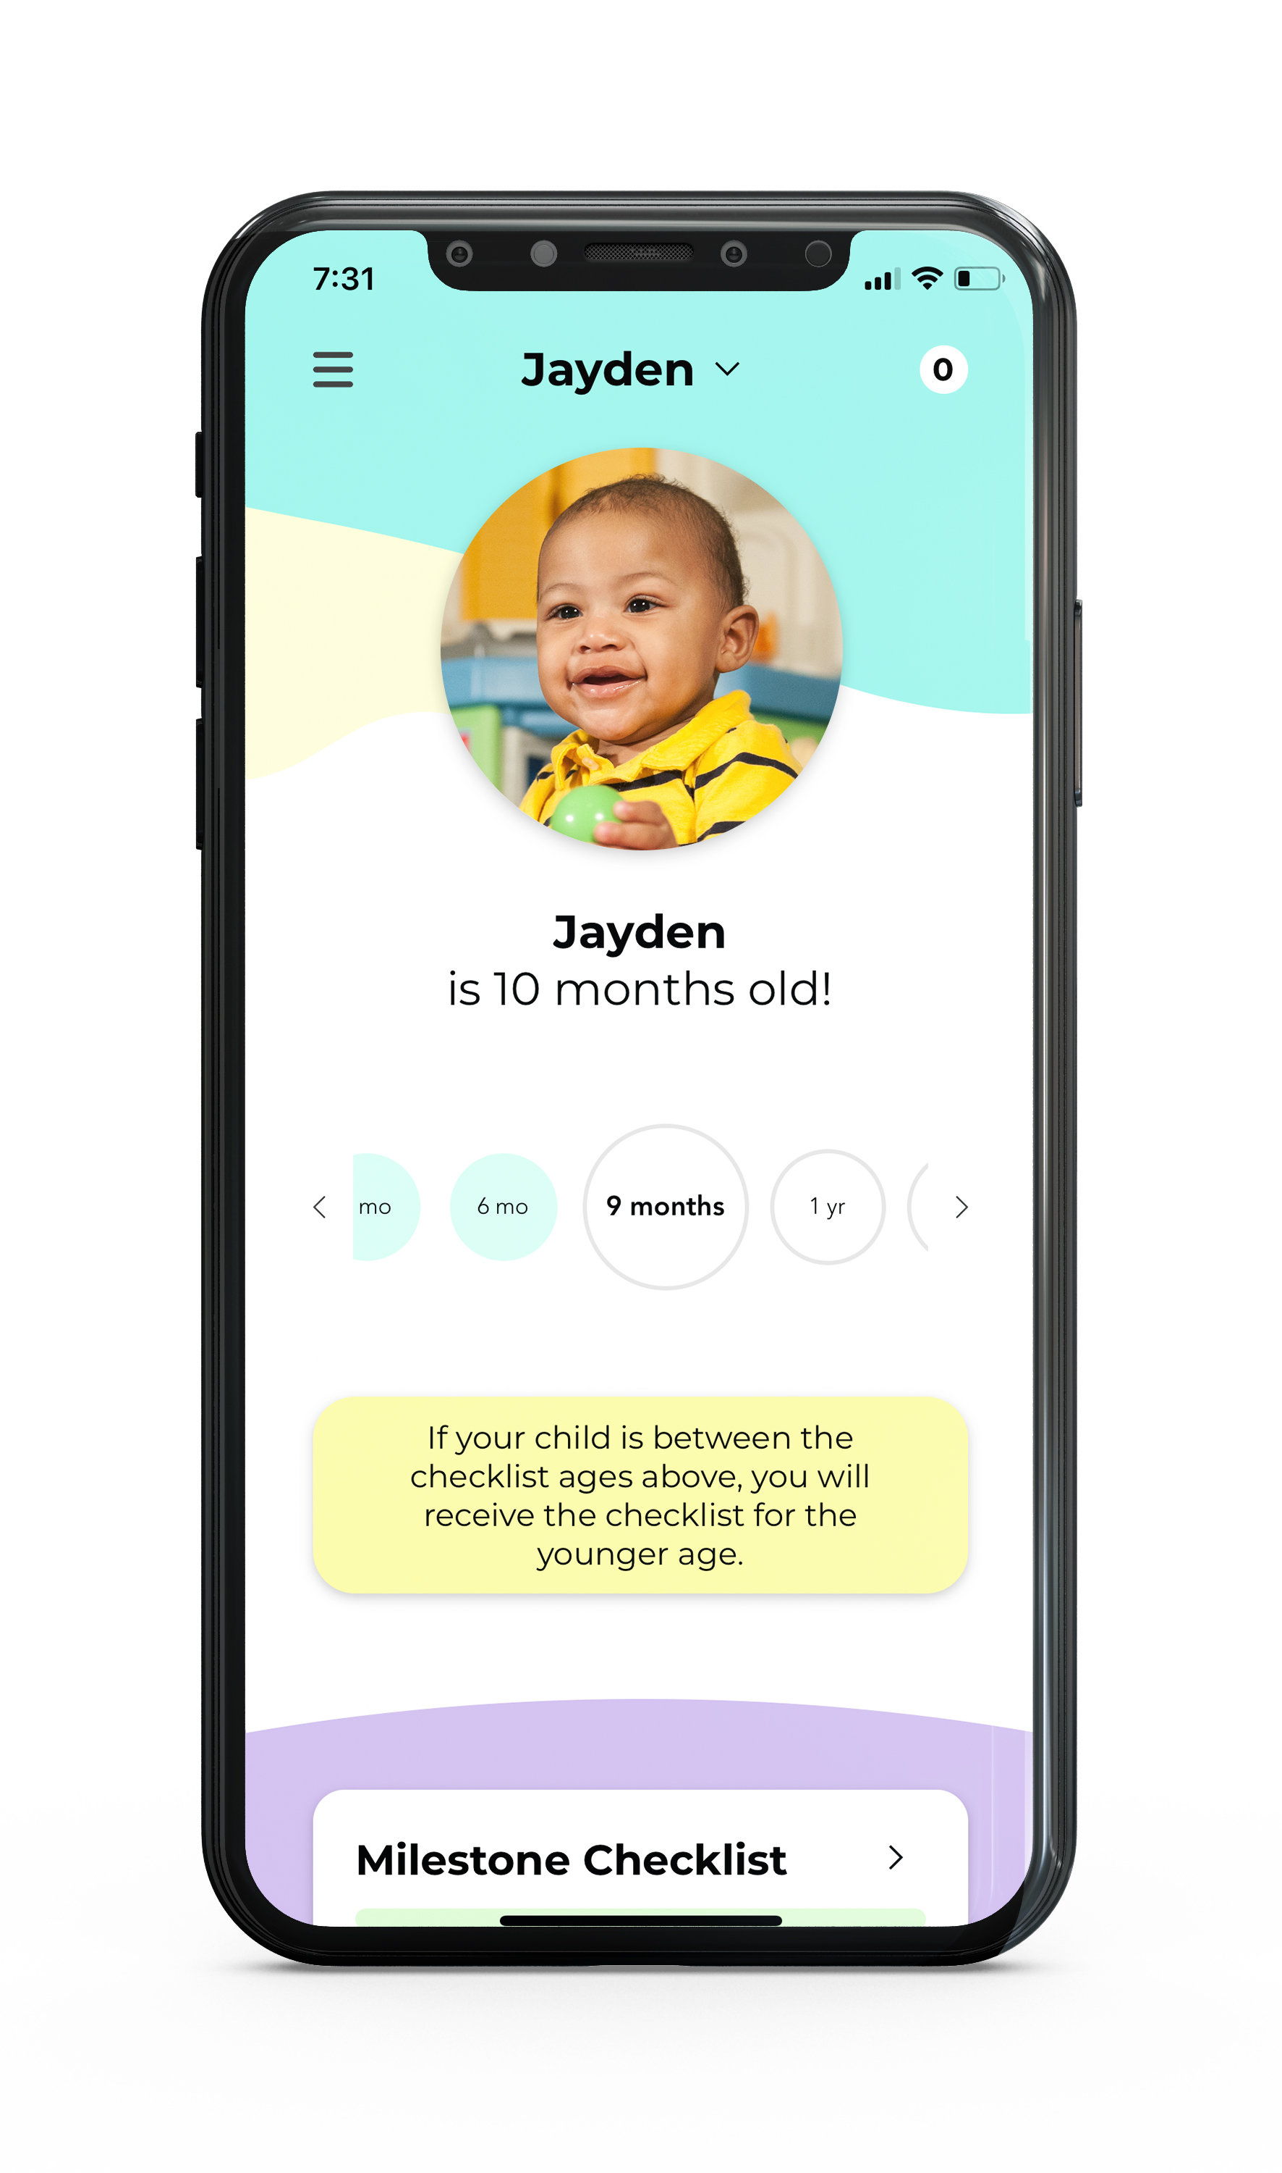
CDC’s Milestone Checklists
www.cdc.gov/ActEarly/Materials
Notes:
There are many ways parent/carers and health staff can access the revised LTSAE milestone checklists (some examples included in this slide).
For local examples, the child Personal Health Record (the Blue Book) has all the updated LTSAE milestone checklists. For families using previous editions of the Blue Book, parents or health professionals can print the updated LTSAE milestone checklists from the NSW Health website to use. There is a pocket for additional information to be stored at the back of the Blue Book.

Slide 9
Developmental Monitoring
Helps with early identification
Adds different information than screening alone
Longitudinal
More than milestones
Education/protective
i.e., Strengthening Families
Developmental promotion
Family engagement- trusting relationships
Notes:
This slide shows the important role developmental surveillance has in the earlier identification of child developmental concerns, as well as the vital role it plays fostering engagement and relationship building between parents/carers and health staff, and its role in increasing education and understanding of child development

Slide 10
You May Have Heard…
CDC milestone checklists:
Are communication tools for developmental monitoring
Not screening tools
Do not replace screening
Not standards or CDC guidance
Revisions were completed in 2019
publication of the process and results in Feb. 2022
Notes:
This slide is included to really emphasise the message that LTSAE milestone checklist are for developmental surveillance not screening.
There are a range of questions participants may ask. To access further information explaining the differences between surveillance and screening, visit the CDC website below.
Link: https://downloads.aap.org/AAP/PDF/Developmental_Surveillance_Spark_Training_Presentation_FINAL_10.2020.pdf

Slide 11
Why Revise?
Incorporate feedback from over 15 years of use
Where are 15- and 30-month checklists?
Vague (“may”, “begins”)
“How many milestones can be missing without being concerned?”
Are only the “warning signs” important?
Are these milestones MOST children do by this age?
Notes:
This slide explains some of the drivers for the CDC’ decision to revise the checklists, and refers to the feedback received over a 15-year period form the LTSAE milestone checklists. Improvements to the revised LTSAE milestone checklists were made for earlier detection and intervention strategies by removing terms that were unclear such as ‘may’ and ‘begins’.

Slide 12
Unnecessary Worry?
Notes:
As mentioned in the previous slide (10) a child with developmental concerns can be detected earlier and receive earlier interventions than previously (moving from 50% to 75% of what most children are expected to achieve at a certain age range) which is hoped to alleviate the amount of unnecessary stress and pressure experienced by parents/carers in the developmental surveillance process.

Slide 13
Developmental Expertise
Developmental-behavioral pediatricians
Neurodevelopmental pediatrician
General pediatrician
Speech language pathologist
Child and developmental psychologists
Professor of special education and early intervention
Developer of developmental screening tools
Editor of Bright Futures: Guidelines for Health Supervision of Infants, Children, and Adolescents 4th Edition
Authors of AAP’s 2020 clinical report Promoting Optimal Development: Identifying Infants and Young Children with Developmental Disorders Through Developmental Surveillance and Screening
Parent representative/disability navigator
CDC Learn the Signs. Act Early. Ambassador
Notes:
This slides shows the range of experts and professionals that contributed to the review of the LTSAE milestone checklists.

Slide 14
Developed 11 Criteria
Age most (≥75%) children would be expected to demonstrate the milestone
Eliminate “warning signs”
Easy for families of different social, cultural, and linguistic backgrounds to observe
Able to be answered with yes/not yet/not sure
Use plain language; avoiding vague terms like may, can, and begins
Organise in developmental domains
Show progression of skills with age, when possible
No repetition across checklists
Include open-ended questions
Include information for developmental promotion
Include information on how to act early if there are concerns
Notes:
This slide illustrates the criteria used for the review process on the LTSAE milestone checklists, As presented in the slide, there was a focus to improve parent/carer understanding of checklists and child development and what that looks like and means, with additions made to include open-ended questions prompting conversations between parents and health staff on a child development.

Slide 15
Why “Most” (≥ 75%)?
Traditionally, milestone lists use 50th percentile or average age milestones
Half of children not expected to exhibit the milestone yet
What if a child is missing 50th percentile milestones?
May cause unnecessary parental concern
May result in “wait and see” approach by professionals
≥ 75th percentile milestones may better support validated screening as next step for children missing milestones
Notes:
The slide presents the rationale around improving the LTSAE milestone checklists to reach 75% of what most children can be expected to achieve by a certain age group.

Slide 16
Evaluating “Most”
Literature search to find individual milestones with normative data
34 articles found
24 had normative data
10 published clinical opinion
First reviewed existing milestones for evidence-base and age placement using:
Literature review data
Common screening and evaluation tools
Common published clinical opinion
Original milestones without an evidence-base and expert agreement were eliminated
New milestones with evidence and expert agreement were added
Notes:
This slides shows the process for review of the LTSAE milestone checklists which involved undertaking a literature review data, common screening and evaluation tools and published clinical opinions (or peer reviews). Overall, 34 articles were found from the Literature review process. Milestones without evidence-base and age placement were eliminated as part of the review process.

Slide 17
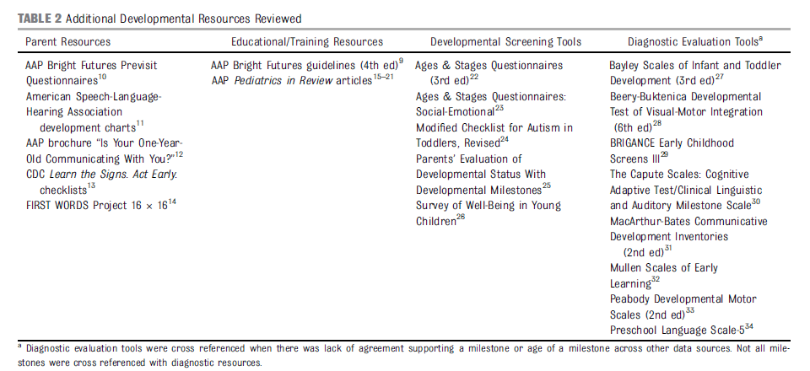
Additional Sources
Notes:
Slide 15 continued - the table shown in this slide illustrates the additional developmental sources reviewed. Diagnostic evaluation tools were cross referenced when there was a lack of agreement supporting a milestone or age of a milestone across other data sources noting that not all milestone were cross referenced with diagnostic resources.

Slide 18
Biggest Challenges
Normative data difficult to find
Typical developmental milestone tables
Resources used for such tables are not usually cited
Cite each other
Screeners/psychometric tests - based on unpublished normative data
Even when normative data exists milestones don’t “fit” nicely into health supervision visit ages
Notes:
As presented in this slide, some of the challenges experienced in the review process included being able to find well referenced published normative data, and in some instances, when normative data was available not all milestones correlated with existing routine child health checks.

Slide 19
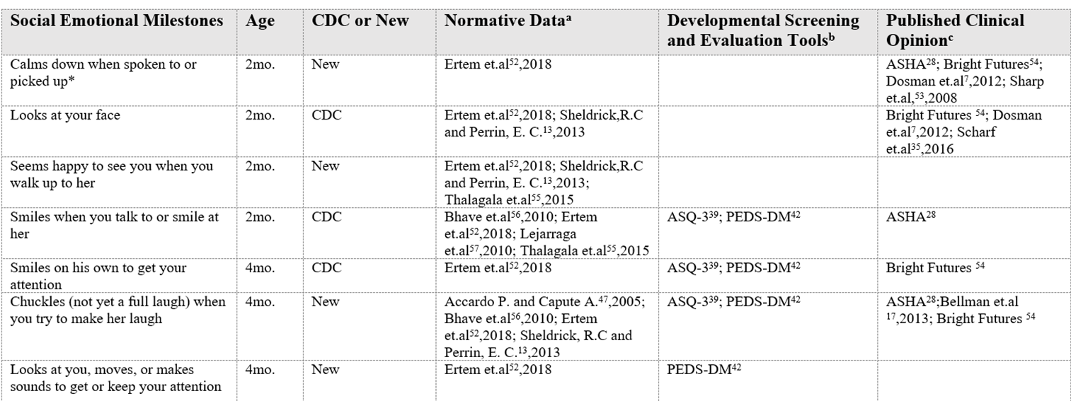
“Evidence-Informed”
Notes:
Linking back to slide 15 and 16 regarding the evaluation and review process of the LTSAE milestone chekists, this table shows an example of the selection criteria used to inform the revised LTSAE milestone checklists. As an example, the ‘new’ checklists within specific ages, 2 months and 4 months have been informed by a range of published data and evidence which is an increase on normative data in previous checklists.

Slide 20
Remaining Criteria
Reviewed using remaining criteria
LTSAE team also reviewed for:
Family friendly
5-7th grade reading level
Cognitive testing with English and Spanish-speaking parents, mothers and fathers from different
Racial groups
Educational levels
Income levels
Notes:
This slide describes the other parts of the selection criteria used to informed the revised LTSAE milestone checklists, for example ensuring the checklists were targeted at a 5-7th school grade reading level. Also, consultations with parents/carers from diverse backgrounds were undertaken to reduce any barriers around parent/carer engagement and understanding of the checklists.

Slide 21
Results of the Process
26% reduction in total milestones
216 to 159 milestones
25 duplicates removed
Average number of milestones/checklist was reduced from 23 to 13
40% milestone replacement
94 retained and 65 new
1/3 of retained milestones were moved to a different age
2/3 moved to older age
80% of the final milestones had normative data from ≥ 1 source
Social-emotional and cognitive milestones were the most difficult to find
Notes:
This slide illustrates the outcomes of the review process, to summarise the key highlights for noting are that:
40% of milestones were replaced, 94 milestones were retained, and 65 milestones are new
1/3 of the retained milestones were moved to different ages to reduce reliance on the ‘wait and see approach’ in previous milestones
The evidence base has increased - now 80% of milestones have normative data from one or more sources

Slide 22
What about crawling and talking?
CDC’s milestone checklists:
are not developmental guidelines or standards, nor screening or diagnostic tools
do not include all possible milestones children might exhibit
milestone inclusion or exclusion
based on limited available published evidence
is not a reflection of the significance of the milestone in a child’s development.
do not change screening or diagnostic evaluation tools used by therapists/specialists or the development of treatment plans
should not be used to establish medical necessity for initiation or continuation of services
are more than just the milestones (open-ended questions, how to connect with early intervention, parent tips)
Notes:
It is important to note that the CDC milestone checklists are not developmental guidelines, nor are they a screening tool and/or diagnostic tool. They are to be used in practice as a surveillance tool for child development.

Slide 23
Milestones Used Differently
Monitoring or Surveillance
Screening
Standardized against evaluation tools
Administered and scored by early childhood professionals
Diagnostic
Standardized
Scored as groups of milestones, scoring ranges
Provide risk categorization for developmental delay or disability
Help determine if further evaluation is warranted
“Normal” screening results but concerns= still recommended to evaluate further
Scored as groups of milestones, scoring ranges
Can provide a diagnosis
Intellectual disability, mixed expressive-receptive language disorder, autism, and more
Determine if qualify for services
Some early intervention programs use to qualify a child for services
Early child educators
Healthcare providers
Home visitors
Administered by developmental specialists at the end of the early identification process
Developmental and Behavioral Pediatricians
Child Psychologists
Speech, Occupational, Physical Therapists, and others
Engage families
Presented as individual milestones
Spark discussions which can identify concerns and indicate need for screening (outside of universal screening ages)
No score, no risk categorization
Not standardized
Do not provide any risk assessment
Not used to qualify for services
Used in the beginning of early identification (parents, early childhood educators, doctors)
Notes:
This slide reiterates the important differentiation between monitoring and surveillance, screening and diagnostics tools. The LTSAE milestone checklist fall within the surveillance category as outlined on the slide, also for noting an explanation around ‘screening’ and ‘diagnostics’ tools.

Slide 24
Pediatrics
More information about the revision process can be found in the article
“Evidence-Informed Milestones for Developmental Surveillance Tools”
https://doi.org/10.1542/peds.2021-052138
Notes:
Following the review process, the CDC published a journal article titled ‘Evidence-Informed Milestones for Developmental Surveillance Tools’ and can be easily accessed via the weblink provided on this slide.

Slide 25
Additional Checklist Features
Open-ended questions (new)
Act early messaging
Early intervention information
Tips and activities for developmental promotion and early relational health (revised/expanded)
Reminders about developmental screening
Notes:
This slide provides an overview of additional changes made in the update of the LTSAE Developmental Surveillance & Monitoring Checklists.
For example the checklists are open-ended questions with more detail provided on slide 26.
There are other features to note as well such as tips and activities for developmental promotion which is free to access on the CDC website as well as other environmental based activities promoted by NSW Health and more information on these resources are on slide 30 of this presentation.

Slide 26
Implications on practice
Practice Change required from a ‘watch and wait’ approach at the time of the developmental check (if the child is not meeting developmental milestones) to earlier referral to the next stage of an ASQ/ASQ-SE screen.
This Practice Change could lead to earlier referral for specialist and early intervention services.
Parents should be supported during this time with developmentally enriching resources.
Notes:
As key health professionals (child and family health nurses and/or doctors), it is important to note the implications to practice regarding the revised LTSAE milestone checklists and also what the changes mean for parents/carers.
In particular, where a “watch and wait” recommendation may have been appropriate for children not meeting all milestones on the previous version of the checklists, more caution should be used in recommending a “watch and wait” approach with the new checklists. Practitioners should consider recommending a developmental screening tool be used where parents or clinicians are concerned about a child’s progress.

Slide 27
Open-Ended Questions
Other important things to share with the doctor…
What are some things you and your child do together?
What are some things your child likes to do?
Is there anything your child does or does not do that concerns you?
Has your child lost any skills he/she once had?
Does your child have any special healthcare needs or was he/she born prematurely?
Notes:
As discussed, as developmental surveillance tools an important function of the LTSAE checklists is to provide opportunities for health professionals to explore parent’s experience of their child’s development and any concerns they may have.
The tools need to be used in the context of other information, much of which a parent can provide in the course of a conversation that explores their child’s health history. The examples shown on this slide are the types of open-ended questions within the LTSAE milestone checklists which prompt parent and health professionals to explore and discuss in more detail a child’s development. The new additions to the LTSAE milestone checklists generate greater discussions between parents and health professionals especially if there are parent concerns about a child’s development.

Slide 28
Where are the “Red Flags”?
“When to act early” milestones served as “red flags”
77% of these milestones are still represented in the revised checklists
Missing any milestone that 75% or more of children are expected to exhibit could warrant screening
What about the ones that were deleted?
Physical exam findings / subjective
Open ended questions: “Is there anything your child is doing or is not doing that concerns you?”, “Has your child lost any skills he/she once had?”
Notes:
As presented within the slide, health professionals are required to ‘act early’ rather than a ‘wait and see approach’ where there are any missing milestones that 75% or children are expected to exhibit. It is important to note that 77% of these milestones are still represented in the revised checklists and as covered in slide 20 of this presentation 1/3 of the retained milestones were moved to different ages to improve the ‘wait and see approach’.

Slide 29
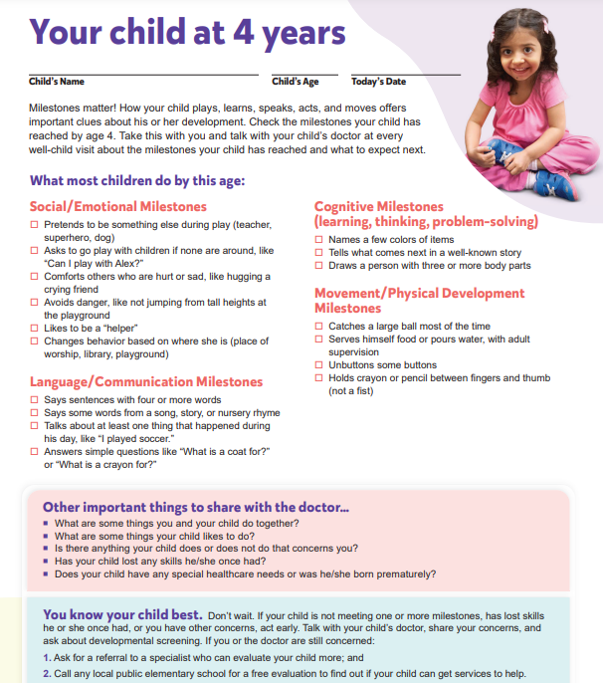
Developmental Screening Reminders
Notes:
This slide shows an example of a LTSAE milestone checklist. It is important to note that the checklist age groups have not changed i.e. 6-8 week, 6 months, 12 months, 18 months, 2-year, 3 year and 4 year.

Slide 30
Parent Tips and Activities
Used CDC’s positive parenting tips as foundation
www.cdc.gov/ncbddd/childdevelopment/positiveparenting/
Reviewed parenting tips from trusted organizations
CDC communication expert, early childhood educator, pediatrician, speech language pathologist
CDC nutrition, injury prevention, LTSAE and other CDC groups reviewed and made recommendations
Looked for areas for improvement/expansion
Reworded for clarity and added more examples
Included social emotional, relational health, responsive parenting & feeding, self-care, screen time
Notes:
A range of parent tips and promotional activities developed by CDC are also free to download and access.

Slide 31
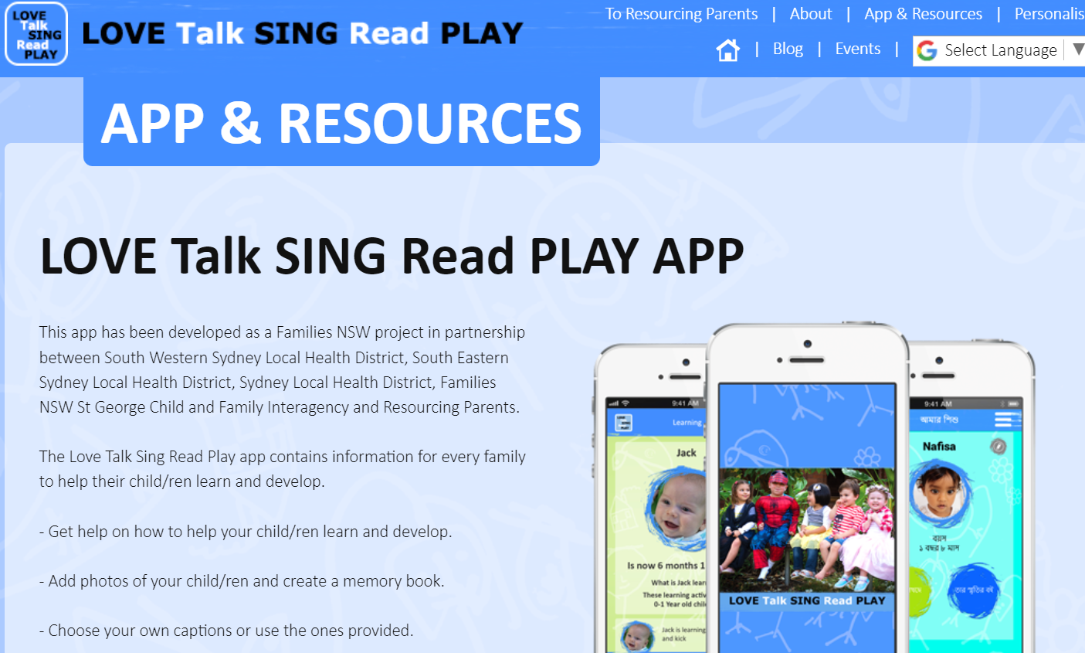
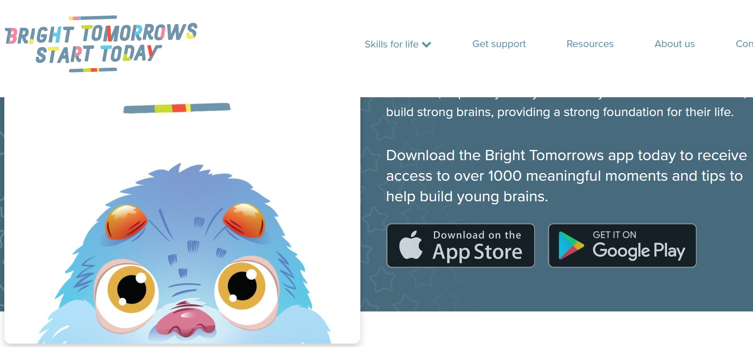
Enrichment Activities
Love Talk Sing Read Play
Bright Tomorrows
Brighter Beginnings (https://www.nsw.gov.au/initiative/brighter-beginnings)
Notes:
There are also a range of Australian and NSW based resources and ideas that parents can access to promote child development such as Love Talk Sing Read Play flipchart and app, the Bright Tomorrows app, and resources available through the Raising Children Network and Brighter Beginnings initiative. There might be local opportunities to attend community events/groups to promote these resources to families also.

Slide 32
Strengths
Tools to support conversations that may:
Improve clarity
Improve sharing concerns
Improve sharing concerns when there is no corresponding milestone
Decrease “wait and see”/ support trusting relationships
Support screening as a next step
Additional tips/activities for developmental promotion
Notes:
This slide lists the strengths relating to the revised LTSAE milestone checklists such as improving dialogue between parent/carers and health professionals such as including open-ended questions and clarity to content and language for parents/carers to increase their understanding of child development.

Slide 33
Relatable
International normative data used to determine milestones
Reviewed by 2 native Spanish speaking pediatricians
Milestones are those that can be observed in natural settings
Written at 5th-7th grade reading level, using family-friendly language
Cognitively tested milestone descriptions with a diverse group of parents
“Says about 50 words.” Parents described the milestone as asking whether a child has “a few words” or “a lot of words.”
Notes:
The CDC consulted with parent/carers from diverse backgrounds on the revised LTSAE milestone checklists prior to finalising to ensure that the checklists included family-centred language and is relatable i.e ‘natural settings’.

Slide 34
Checklist Limitations
CDC surveillance tools are not developmental screeners or “pre-screeners”
Not validated (screening tools are validated; surveillance tools are not)
Not inclusive of all potential milestones
Surveillance is more than milestones/checklists
Have not been tested to see if they:
-Improve conversations
-Support developmental surveillance
-Support developmental screening as next step
Notes:
As per slide, the CDC acknowledges that there are some limitations to the LTSAE checklists (although minimal in the context of surveillance screening) such as the checklists are not inclusive of all potential milestones which could have been used, is not a validated screening tool but rather a surveillance tool, however with the improvements made to the checklists an earlier referral to the next stage of an ASQ/ASQ-SE screen can be made.

Slide 35
The Larger Landscape
Social emotional development
Infant and early childhood mental health
Safe stable nurturing relationships
Resiliency/Adverse Childhood Experiences (ACEs)
Developmental promotion
Social determinants (drivers) of health and health equity
Family-centered care
Notes:
This slide provides opportunity to discuss the overarching context, and the ways in which the revised LTSAE milestone checklists links with strengths based practices, and in with principles of family partnership model as well as in the child and family health and provision of family-centred patient care.

Slide 36
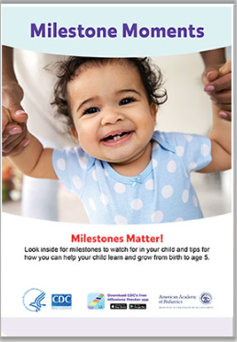
LTSAE: More Than Materials
Mission: To improve early identification of developmental delays and disabilities by promoting developmental monitoring and screening so children and their families can get the services and support they need.
Notes:
This slide presents examples on the various CDC promotional tools and access points for parents/carers. For ideas locally, refer back to slide 30. Also covered is the LTSAE mission statements and strategy.

Slide 37
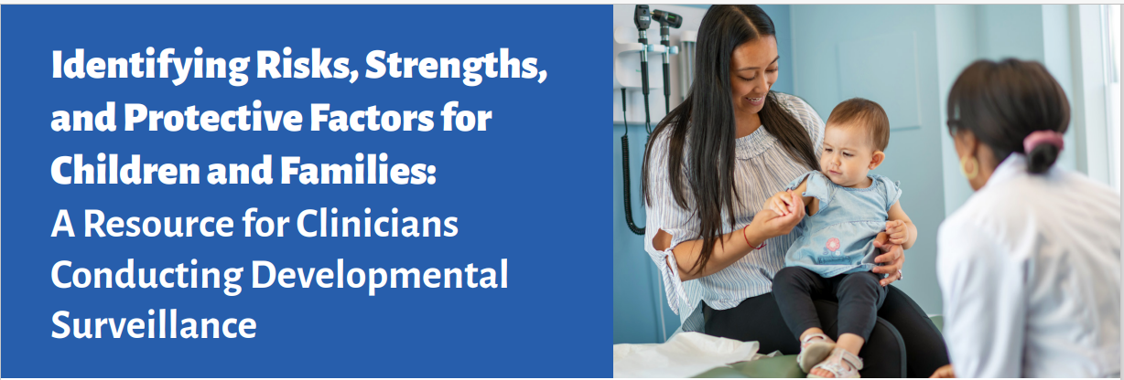
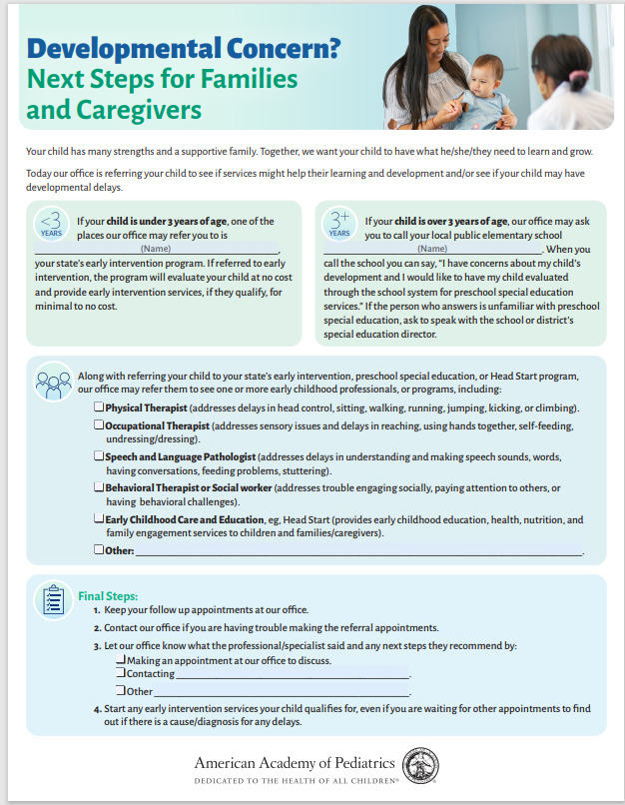
AAP Partnership
Clinician Tip Sheet
Family-friendly Guide to Next Steps
Free Online Courses
www.aap.org
Notes:
An example of just ONE of the partnerships CDC’s LTSAE program has to support early identification of children with developmental delays and disabilities and linkage to services is a partnership with the American Academy of Pediatrics.
CDC and the LTSAE program have partnered through a co-operative agreement to develop additional resources for healthcare providers and the families they provide care for.
Does this inspire you to think of local partnerships you could promote to support children’s development?
Here are just a few examples of FREE resources for healthcare providers in addition to the milestone checklists to support developmental surveillance, screening, and referral. Pediatricians identified a need for more information on how to assess strengths, risks, and protective factors during developmental surveillance. So, short resource guide was developed. LTSAE_PediatriciansResourceGuide.pdf (aap.org)

Slide 38
Post-Release Recap
People are talking about child development more than ever!
Higher engagement with resources than ever!
2.7M LTSAE webpage visits in Feb 2022 compared to average of 1.3M/monthly
59K app downloads in Feb 2022 compared to average of 25K/monthly
Altmetrics score: 1006 (top 5% of all research articles; 66 news stories, etc.)
Opportunity to engage with new partners: SLPs, PTs, OTs
Chance to clarify purpose, elucidate research gaps, explain context and challenges of early identification
“Screen your young child early and often for developmental delays.”
“…allows pediatricians to more quickly and effectively identify delays so they can help families…“
“Thanks to these changes, worried parents everywhere can let out huge sighs of relief and feel confident in taking whatever next step they think is appropriate for their child(ren).”
Notes:
There have been many positive developments since the release of the article and updated resources….

Slide 39
Support from Leaders in the Field
Dr. Paul Dworkin, Help Me Grow National Center Strengthening Developmental Surveillance to Enhance Developmental Promotion and Early Detection | Help Me Grow National Center
“… simply a reflection of the intent to more clearly identify children who are lagging behind the majority of their peers and to encourage a closer look at children, through such methods as screening, when they are not meeting age expectations.”
“For those who understand the intent and purposes of this revision, the new CDC developmental checklists should be a welcome addition to our developmental monitoring and early detection strategies.”
Dr. Barbara Howard, Johns Hopkins University, creator of CHADIS What Can Be New About Developmental Milestones? (medscape.com)
“As primary care providers, we not only need to detect children at risk for developmental problems but also promote and celebrate developmental progress. I hope that changing the threshold for concern to 75% will allow for a more positive review with the family...”
“The recommended "use of validated screening tools" when the new milestones are not met give us an objective tool to share with parents, more confidence in when referral is warranted…and baseline documentation from which we can "track" referrals, progress, and, hopefully, better outcomes.”
Zero to Three Leading Early Childhood Development Nonprofit Applauds New Pediatric Milestones • ZERO TO THREE
“By moving… specific milestones from 50 percent to 75 percent, we will be able to move away from ‘wait and see’ to a more direct and targeted approach. When we know what our children are facing, we can move toward earlier intervention and, ultimately, better outcomes.”
Notes:
This slide lists the high level support received from ‘leaders’ in the field on the revised LTSAE milestone checklists as well as links to their published articles. The published article are free to access if interested to read more about this topic.

Slide 40
Take Aways (LTSAE Milestones)
Learn the Signs. Act Early. program and CDC’s Milestone Checklists:
CDC’s health communication tools are not screening tools, and should not replace developmental screening
Designed to support conversations without creating unnecessary worry from 50th percentile milestones
The LTSAE program supports early identification through partnerships, ACT Early networks, and Ambassador program
Developmental monitoring, surveillance, and screening are complementary but different
can support parent-engaged developmental monitoring in early childhood systems
can support parent-engaged developmental surveillance at well-child visits
Notes:
In summary of this presentation, some key ‘takeaways’ or ‘key things to note’ on the revised LTSAE milestone checklists include (read points 1-5).

Slide 41
Take Aways (Early Identification)
Developmental delays and disabilities are common
Earlier is better for identification of developmental delays and disabilities
Universal developmental screening at recommended ages AND when ever there are concerns
Monitoring, surveillance, and screening are part of a layered and continuous approach to early identification across systems
Common goal: children/families to be identified early
Know the strengths and limitations of monitoring, surveillance and screening tools you use when considering next steps
For example, screening tools have variable positive predictive values
Parental concerns should be addressed regardless of monitoring, surveillance, and screening results
Notes:
To summarise key ‘takeaways’ regarding early identification includes, but not limited to the following:
developmental delays and disabilities are common as shown on slide 3 of this presentation
earlier identification of developmental delays and disabilities is better outcomes for a child and their readiness for school
monitoring, surveillance, and screening are part of a layered and continuous approach to early identification across system
Parental concerns should be addressed regardless of monitoring, surveillance, and screening results

Slide 42
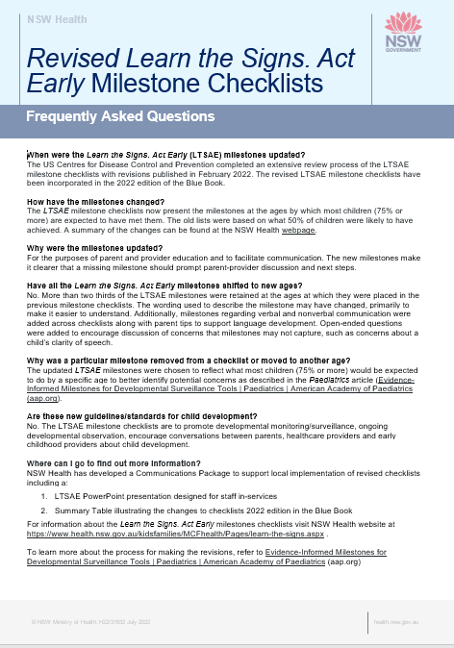
FAQs
Notes:
In conclusion, NSW Ministry has developed a communications package to support local practice changes for implementation of the LTSAE milestone checklists such as a
- Frequently Asked Fact Sheet,
- this PowerPoint presentation and
- a summary table which illustrated the previous LTSAE milestone checklists wit the updated revised checklists (slide 42).

Slide 43
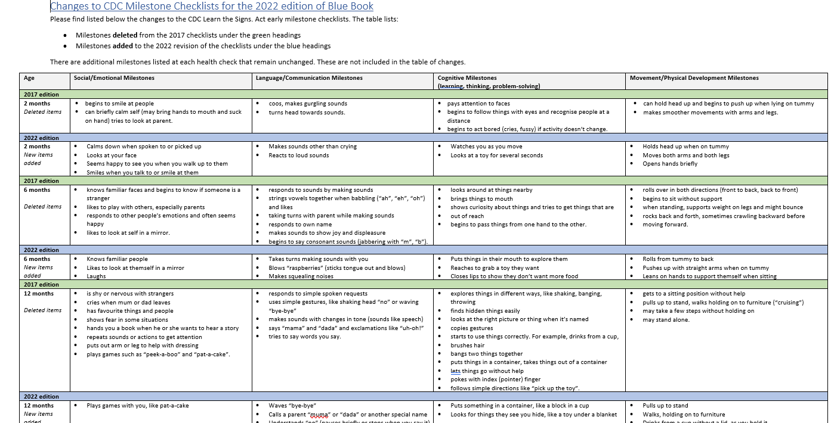
Summary Table - Changes to the Milestone Checklists
Notes:
As mentioned, a summary table has been developed to illustrate the change of the LTSAE milestone checklists from 2017 to 2022.

Slide 44
Questions?
ActEarly@cdc.gov
Presenter contact information
Notes:
Thank you for you for listening and participating in this presentation. Are there any questions?

