Slide 1
NSW Health
PD2019_035 Management of Sudden Unexpected Death in Infancy (SUDI)

Slide 2
Outline
Introduction and aim
Definitions
When to use this policy
Changes from the previous policy
The NSW Government response
NSW Health’s role
Forensic Medicine (NSW Health Pathology)
Further support, advice and referrals
Summary

Slide 3
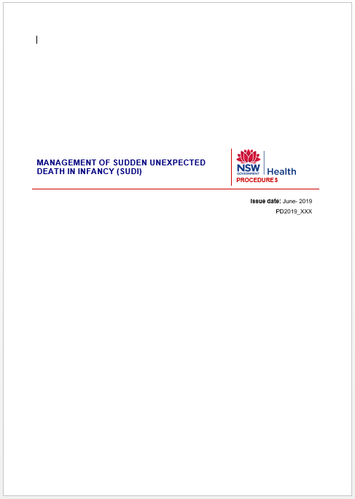
Introduction
New Ministry of Health policy directive:
PD2019_035 Management of Sudden Unexpected
Death in Infancy (SUDI)
Notes:
Discuss the layout of the procedure document, it includes:
A procedure that supports the journey of the infant and the parents/carers through the NSW Health system and other relevant NSW Government agencies.
Two attachments that will be discussed:
Attachment 6.1 Response to Sudden Unexpected Death in Infancy (SUDI) - Roles and Responsibilities. This document outlines the roles of the various professionals involved in the NSW Government response to SUDI.
Attachment 6.2 Medical History Guide - Sudden Unexpected Death in Infancy (SUDI) supports completion of the infant’s medical history. The medical history is to be completed by the AMO or paediatrician in the infant’s health care record.

Slide 4
Aims
To care for the infant and parents/carers
To establish the cause of death and assist parents/carers in understanding how and why the death occurred
To provide parents/carers with information about any health risks for surviving family members
To ensure that statutory obligations are met
Notes:
Bullet 4: This includes assisting the NSW Coroner and Police in their role of investigating the infant’s death. Discuss the role and expectations of Police in your facility, in their role of representing the Coroner. Note you may want to discuss Section 4.3.1 Police of the procedure document, which outlines the process where there is uncertainty about the roles and expectations of Police in a NSW Health facility.

Slide 5
Definitions
Sudden Unexpected Death in Infancy (SUDI):
The sudden, unexpected death of an infant:
Less than 12 months of age
And where the cause was not immediately apparent at the time of death
Notes:
This definition excludes infants who die unexpectedly in misadventures due to external injury (such as transport incidents) and accidental drowning.

Slide 6
Definitions
Sudden Infant Death Syndrome (SIDS)
The sudden, unexpected death of an infant:
Less than 12 months of age
With onset of the fatal episode apparently occurring during sleep, which remains unexplained after a thorough investigation, including performance of a post mortem and review of the circumstances of the death and the clinical history
Notes:
Discuss the difference between SUDI and SIDS.
SUDI is where the cause was not immediately apparent at the time of death
SIDS is where the cause of death remains unexplained and appears to have happened during sleep.

Slide 7
When to use this policy
When an infant is brought to a NSW Health facility, following a sudden, unexpected death
When an infant is brought to a NSW Health facility after a ‘near SUDI’ and dies in the facility
When there is a sudden, unexpected infant death during a hospital admission

Slide 8
Changes from the previous policy
It has been emphasised that the parents/carers are to receive any support or referral they may need
SUDI deaths are to be managed in hospital, regardless of where the death occurred
Local Health Districts/Specialty Health Networks (LHDs/SHNs) are not required to have facilities designated that respond to SUDI
The SUDI Medical History Protocol has been revised
Notes:
Bullet 1: Discuss the health professionals involved and space available for responding to SUDI in your facility.
Bullet 2: Discuss that where there is an infant death in the community, the infant will be brought to hospital so that the infant’s medical history can be completed and the parents/carers receive support and referral. Bullet 3: Discuss how SUDI is managed in your local health district or specialty health network, when you might need to access locally networked paediatric services and how to do that in your facility.

Slide 9
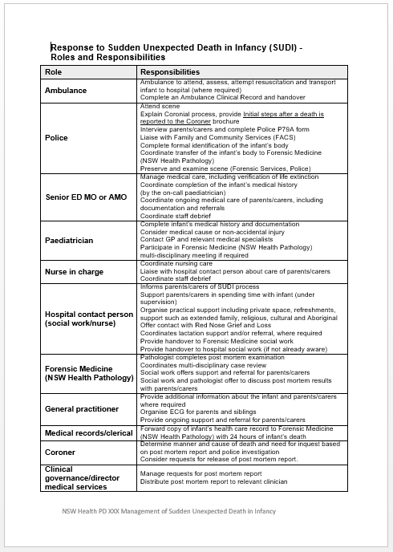
The NSW Government response
SUDI requires a coordinated response from:
Police
NSW Health:
Ambulance
Hospital care
Forensic Medicine (NSW Health Pathology)
NSW Coroner
General Practice
Notes:
Show a copy of Attachment 6.1 Response to Sudden Unexpected Death Infancy (SUDI) – Roles and Responsibilities and discuss how the response to SUDI is coordinated in your department.

Slide 10
NSW Health’s role
Care of the infant and the parents/carers
Completion of the infant’s medical history
Completion of the post mortem examination
Participation in the NSW Government response to SUDI
Notes:
Bullet 2: A copy of the infant’s health care record is to be forwarded to Forensic Medicine (NSW Health Pathology) within 24 hours of the infant’s death.
Bullet 3: Clarify that Forensic Medicine is part of NSW Health Pathology. Forensic Medicine provides social work support for parents/carers once the infant’s body has been transferred from hospital care to Forensic Medicine. This support is available until completion of the final post mortem examination report.
It may take months for the final post mortem examination to be completed.

Slide 11
Initial care of the parents/carers
Contact with the infant’s body must be supervised by a health professional or Police
Police will provide the parents/carers with a copy of the Initial steps after a death is reported to the Coroner brochure
If the parents/carers object to a post mortem, they will be contacted by a representative from the Coronial Information and Support Program
Notes:
Refer to the procedure document Section 4.5 Initial Care of the Parents/Carers for a step by step guide to care of the parents/carers, an overview of the Coronial process and the Police in their role representing the Coroner.

Slide 12
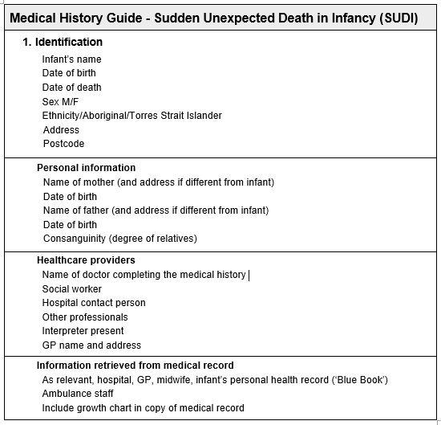
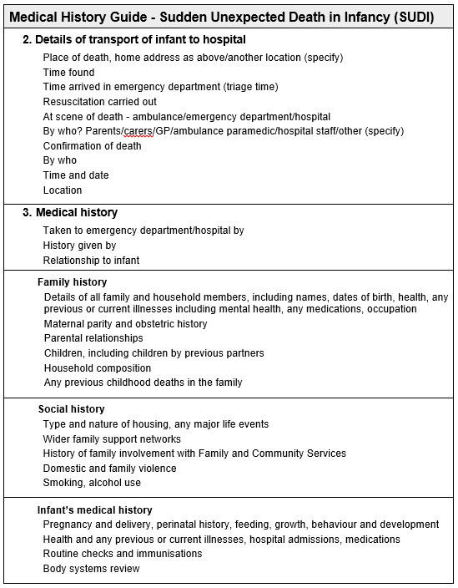
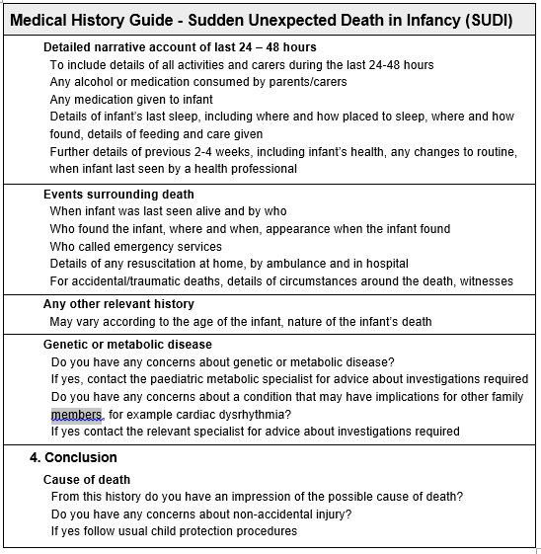
The infant’s medical history
Attachment 6.1 Medical History Guide - Sudden Unexpected Death in Infancy (SUDI) is designed to support completion of the medical history
The infant’s health care record is to be transferred to Forensic Medicine (NSW Health Pathology) within 24 hours
Notes:
Bullet 1: The infant’s medical history is to be completed by the AMO or paediatrician and documented in the infant’s health care record.
Discuss the process for management of child protection concerns or genetic or metabolic disease.
Bullet 2: The infant’s health care record assists the forensic pathologist in completion of the post mortem examination. It is important that the forensic pathologist has a copy of the infant’s medical history within 24 hours of the infant’s death. If this can be facilitated by medical or nursing staff then this should occur.
The forensic pathologist (NSW Health Pathology) will contact the hospital if a copy of the infant’s healthcare record is not received within 24 hours of the infant’s death.

Slide 13
Departure from hospital care
Information should be provided to parents/carers about how to access support and advice including:
Child and Family Health Services
Their GP
A medical specialist
Mental Health Services
Other health services such as the Aboriginal Maternal and Infant Health Service or NSW Refugee Health Service
Red Nose Grief and Loss
Notes:
Discuss services provided by Red Nose Grief and Loss such as a 24 hour bereavement support line, access to professional counselling, support groups for parents/carers and other family members and a library.

Slide 14
Forensic Medicine (NSW Health Pathology)
The pathologist completes the post mortem examination
Social work offers parents/carers support, advice and referral
Social work and the pathologist offer to discuss post mortem results with parents/carers
Coordinates a multi-disciplinary case review
Notes:
Forensic Medicine (NSW Health Pathology) social work is available to provide support and referral for parents/carers once the infant’s body is transferred from hospital to Forensic Medicine and up until the final post mortem report is completed
Forensic Medicine social work (NSW Health Pathology) can assist parents/carers in communicating with the Coroner.
Forensic Medicine (NSW Health Pathology)LHD/SHN may convene a multi-disciplinary case review. LHD/SHN staff may be invited to participate.

Slide 15
Further support, advice and referrals
The Coroner will contact the parents/carers when the final post mortem results are available
Forensic Medicine (NSW Health Pathology) social work will offer to discuss the final post mortem results with the parents/carers
During these discussions any ongoing support or referrals should be provided
Notes:
The parents/carers may want to discuss the post mortem results with health professionals from their hospital admission. This may include the hospital social worker or contact person, the senior medical officer, paediatrician or general practitioner.
Forensic Medicine (NSW Health Pathology) social work and/or the forensic pathologist can be contacted to discuss any questions about the post mortem.
NSW Health staff who would like a copy of the infant’s final post mortem report should contact their Director of Clinical Governance or Director of Medical Services.

Slide 16
Summary
Sudden Unexpected Death in Infancy (SUDI) is a tragic event and likely to create an intense response in parents/carers as well as health professionals
NSW Health’s role in response to SUDI includes:
Providing initial care to the infant and the parents/carers
Completion of the infant’s medical history
Completion of the post mortem examination
Working with other agencies involved in the response to SUDI
Providing parents/carers with support, advice and referral

