Slide 1
Youth Health and Wellbeing Assessment Guideline
GL2018_003
Prepared by Youth Health and Wellbeing Maternity, Child, Youth and Paediatrics Health and Social Policy Branch NSW Ministry of Health
February 2018

Slide 2
Purpose
Many of the major threats to youth health and wellbeing are psychosocial. Youth health and wellbeing (YHW) assessment provides opportunity to identify and provide early intervention for health issues.
The guideline (GL2018_003) supports a consistent approach to psychosocial YHW assessments of young people (aged 12-24) across health settings in NSW.
The guideline aligns with the commitment to provide evidence-based and responsive care to young people set out in the NSW Youth Health Framework 2017-2024 (PD2017_019).

Slide 3
Implementation
The audience is all clinicians caring for young people (12-24 years old) in a paediatric, adolescent or adult healthcare setting in hospitals or the community.
In general, a YHW assessment (12-24 years old) should be conducted with every young person who attends a health service or hospital.
Where appropriate young people admitted to an adult or paediatric service should have a YHW assessment completed in conjunction with other screening assessment/admission processes.

Slide 4
What is the YHW assessment tool?
The guideline focuses on the HEEADSSS assessment as a means of conducting a YHW assessment.
The HEEADSSS assessment tool is used widely in Australia and internationally.
The YHW assessment is not a diagnostic tool. It is a holistic, flexible approach designed to build rapport and engage with a young person in a clinical setting.
Information gathered can be used to directly address any concerns and/or refer a young person for a specialist response.

Slide 5
The HEEADSSS Domains
HEEADSS covers the domains of -
H – home
E – education and employment
E – eating and exercise
A – activities, hobbies and peer relationships
D – drug use, cigarettes and alcohol
S – sexual activity and sexuality
S – suicide, depression, self harm
S – safety

Slide 6
Clinical judgement
Clinical judgement should be used to determine the appropriateness of the assessment for 12-24 year olds.
This includes considering the young person’s
health condition
maturity
the environment and
health service context (for example, sufficient time or privacy may not be available in an Emergency Department context).

Slide 7
Culture and Language
Culture and language must always be considered.
It is important however that the clinician does not make assumptions about behaviours based on a young person’s cultural or religious background.
Respecting the difference – be aware of the cultural differences of Aboriginal people. Refer to your local Aboriginal liaison officer or for further information see NSW Health Communicating positively – A guide to appropriate Aboriginal terminology.

Slide 8
YHW assessment options
The preferred options for clinicians when conducting a YHW assessment in NSW Health are:
Face-to-face interview with a focus on some or all of the HEEADSSS domains as needed
AND/OR
2. Young person completes the NSW Health approved Statewide Health Form YHW Assessment Chart This should then be reviewed by a clinician and have appropriate follow-up discussion and action.

Slide 9
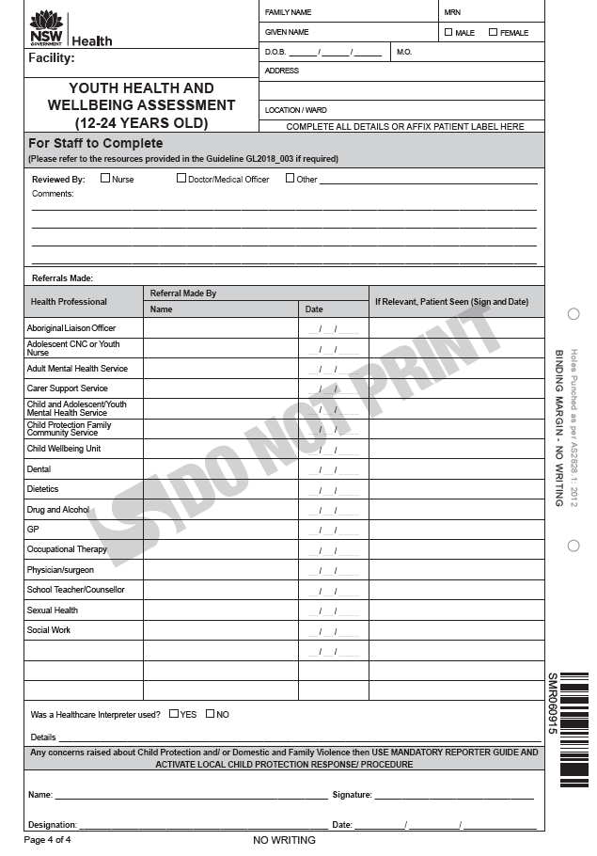
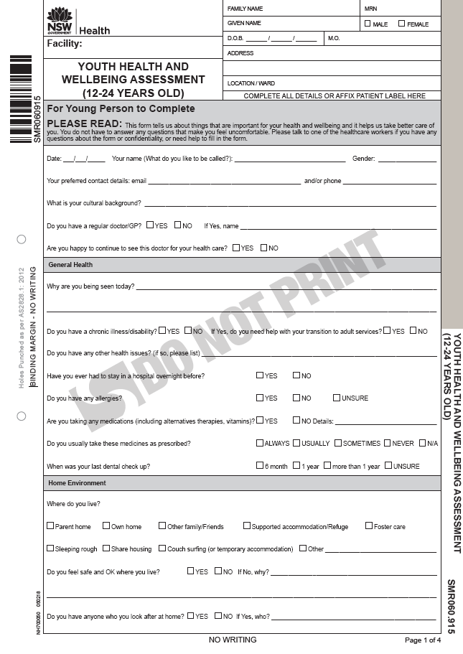
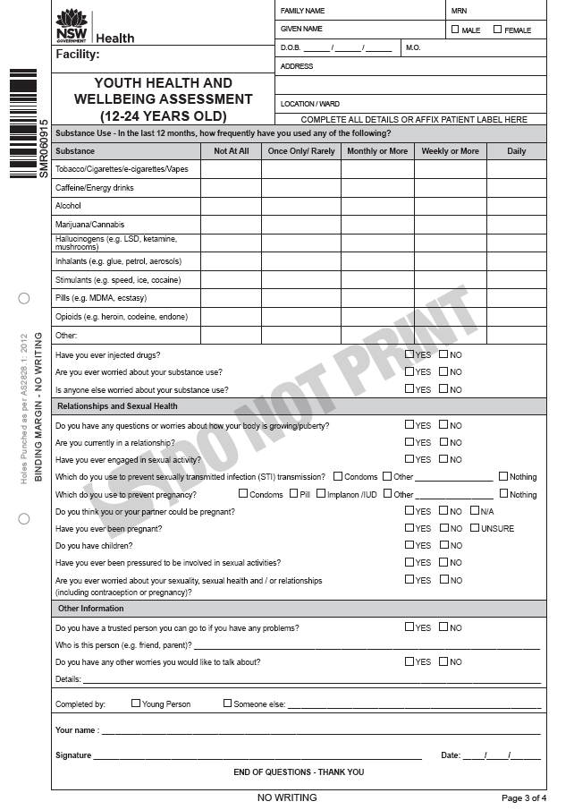
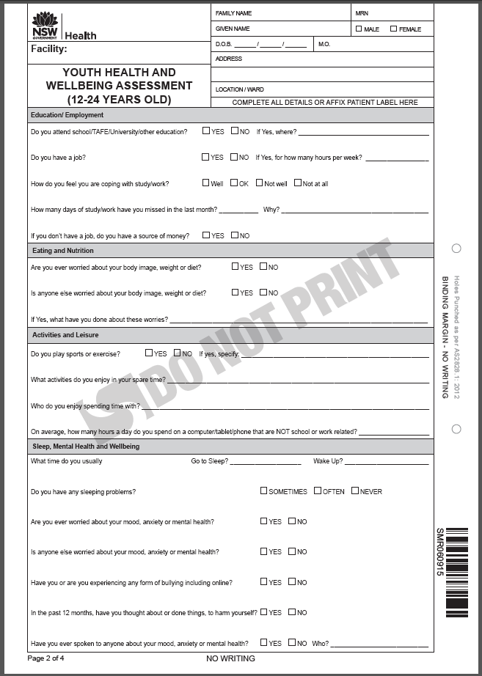
YHW Assessment Chart (Appendix 1)
Copies of this NSW Health Chart can be ordered through the Local Health District/Specialty Health Network Print Manager.
Pages 1-3 are for young Page 4 is for staff to complete people to complete

Slide 10
When handing out the Chart
Use clinical judgement to assess appropriateness for those under 14 years old and young people with a disability as they may require support to complete the Chart
Explain confidentiality to young people or/and provide the We keep it zipped wallet-sized card* to young people if needed
Let young people know that they may ask for support/help to complete the Chart if required
*The We keep it zipped wallet-sized card is a youth friendly confidentiality resource for young people listed on the resources for workers and young people (Appendix 3 and 4)

Slide 11
Upon completion of YHW Assessment
Review the assessment and/or self-completed Chart
Follow up with young people if any concerns about their health and wellbeing have been identified
Provide young people’s resources and contact handout if required
Refer young people to the appropriate service if required
Document any action taken and file the completed signed Chart (if applicable) according to your local records system

Slide 12
Use of the Guideline - summary
This guideline should be followed when providing a service to young people (12 - 24 years old) who attend a health service or hospital.
This guideline outlines the -
approach that should be taken by NSW Health staff when conducting a YHW assessment (Sections 7 - 10)
issues to consider when implementing the YHW assessment within different health settings and with different age groups (Sections 11 - 12)
A range of resources for workers are available to support YHW assessment when needed (Appendices 1 - 4).

Slide 13
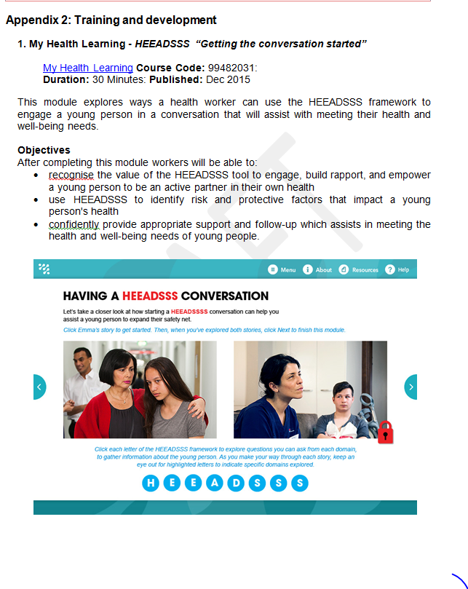
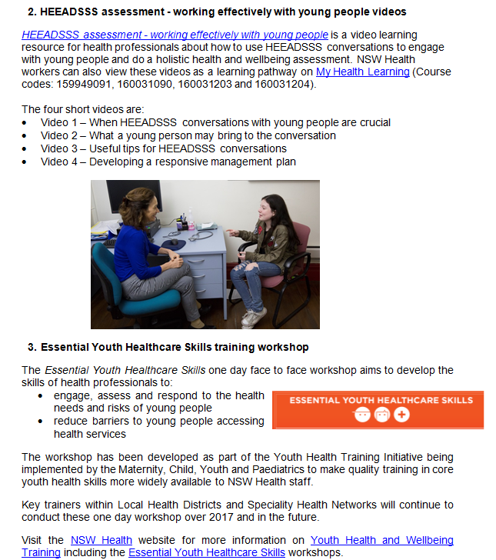
Resources to support YHW assessments
Training and development for workers (Appendix 2)

Slide 14
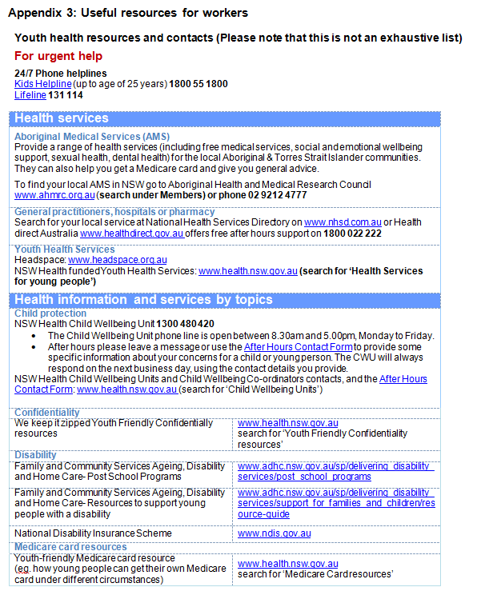
Resources to support YHW assessments
Resource for workers (Appendix 3)
This can be printed to keep in the clinic/service for staff members’ reference when required
Questions:
Do we have a list of local
services?
If so, where can we find it?
If not, do we need to compile one?

Slide 15
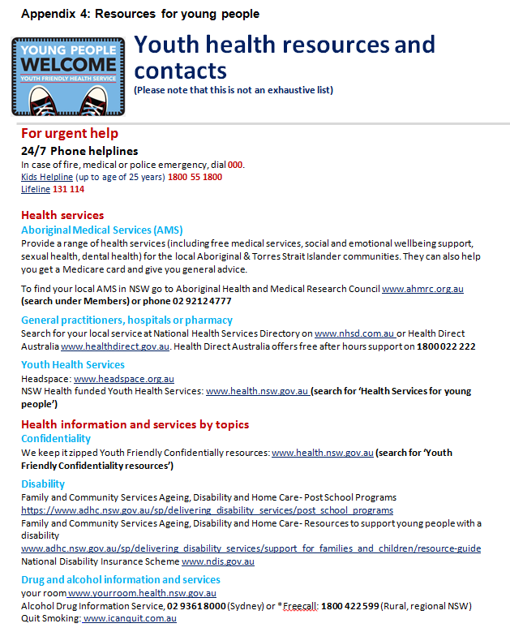
Resources to support YHW assessments
Youth health resources and contacts for young people (Appendix 4)
This can be printed to provide to young people if required
Questions:
Do we have a list of local
services?
If so, where can we find it?
If not, do we need to compile one?

Slide 16
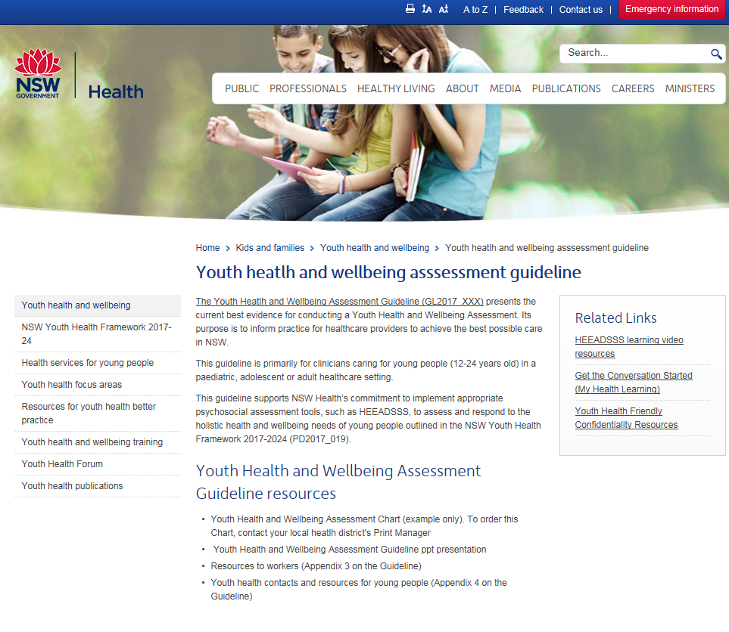
Access resources in the Guideline
Visit the NSW Health website: www.health.nsw.gov.au and search for ‘Youth Health and Wellbeing Assessment’

