Slide 1
Bachelor Health Science – Mental Health
Steph Perrot
Faye Mc Millan

Slide 2
We would like to acknowledge the Gumbaynggirr people of Australia, who are the traditional owners and custodians of the lands on which this venue is located, and pay respect to their Elders both past and present.

Slide 3
Bachelor Health Science (Mental Health)
The Program (History)
Began in 1993 as a pilot project
Included 5 trainees from NSW
On completion, trainees were awarded a Certificate of Completion
Notes:
A pilot Aboriginal Mental Health Education Program was developed and operated between 1993 and 1995.
Five Aboriginal people were employed as mental health workers in mainstream mental health services in Queanbeyan NSW at their three health districts.
The students were to receive a ‘Certificate of Completion’ at the end of the program, students and committee members expressed the need to have the program recognised as a suitable tertiary level qualification.
The Academic Senate at Charles Sturt University accredited the course as a Diploma of Health Science (Mental Health)

Slide 4
Bachelor Health Science (Mental Health)
The Program (Today)
We currently have approximately 65 students across all 3 years from all states except Tasmania and South Australia.
We employ 4 staff within the program and utilise another 4 dedicated and committed staff from within the SNMIH
- Students graduate with fellow students from the SNMIH with a Bachelor Degree

Slide 5
Bachelor Health Science (Mental Health)
So...
In 21years the program has evolved to the program it is today, which reflects the quality required to meet workforce expectations.
Supported over 100 students to graduate with a Bachelor of health Science (Mental Health) degree.

Slide 6
Curriculum

Slide 7
Why the Curriculum changed
Importantly to meet the identified needs of Industry
And for ease of evolvement as the need for change occurs over time

Slide 8
The New Curriculum

Slide 9
First Year
Session 1 MHP105 Primary Health Care: Mental Health MHP109 The Body, Illness and Health MHP111 Clinical 1 (commencing) MHP112 History, Social and Emotional Wellbeing
Session 2 MHP111 Clinical 1 (completing) MHP113 Introduction to Pharmacology in Mental Health MHP114 Human Development Across the Lifespan MHP115 Introduction to Substance Use: Alcohol and Other Drugs

Slide 10
Second Year
Session 1 MHP211 Clinical 2 (commencing) MHP212 Healing Our Spirit: Grief, Loss and Yarning MHP213 Crisis and Assessment Management (commencing) MHP214 Primary Health Care: Community Development
Session 2 MHP209 Mental Health, Law and Ethics MHP211 Clinical 2 (completing) MHP213 Crisis and Assessment Management (completing) MHP216 Suicide Prevention

Slide 11
Third Year
Session 1 MHP301 Research in Mental Health (commencing) MHP302 Professional Issues in Aboriginal and Torres Strait Islander Mental Health (commencing) MHP311 Clinical 3 (commencing) MHP312 Sexual Assault, Family Violence and Associated Trauma
Session 2 MHP301 Research in Mental Health (completing) MHP302 Professional Issues for Aboriginal and Torres Strait Islander Mental Health (completing) MHP311 Clinical 3 (completing) MHP313 Working with Families and Diverse Communities

Slide 12
1st Year
MHP105 – Primary Health Care (PHC)
Assessment 1 used for MHP214
2nd Year
MHP214 – Community Development (PHC)
Assessment item from 1st year is revisited and built upon using the increased skills and knowledge acquired to inform the 2nd year assessment
3rd Year
MHP301 – Research in Mental Health
Assessment item from 2nd year is revisited and built upon using the increased skills and knowledge acquired to inform the 3rd year assessment around ethical engagement.
Notes:
Scaffolding

Slide 13
Clinical Subjects
MHP111 Clinical 1
MHP211 Clinical 2
MHP311 Clinical 3

Slide 14
MHP111 Clinical 1
This placement is a 3 week observational placement which aims to enhance student’s awareness of the mental health environment and mental health issues for Aboriginal and Torres Strait Islander people and communities.

Slide 15
MHP211 Clinical 2
This placement is a 6 week placement in which
students are expected to demonstrate their
understating of the mental health environment
and mental health issues for Aboriginal and
Torres Strait Islander people and communities

Slide 16
MHP311 Clinical 3
This placement is a 8 week placement in which
students are expected to demonstrate their
knowledge and skills by analysing and
assessing the mental health environment and
mental health issues for Aboriginal and Torres
Strait Islander people and communities.

Slide 17
Clinical
To look at how clinical is scaffolded over the 3 years,
Clinical 1 = Observation
Clinical 2 = Demonstration of Understanding
Clinical 3 = Demonstration of Knowledge and Skills

Slide 18
National Practice Standards
https://www.health.gov.au/internet/main/publishing.nsf/Content/5D7909E82304E6D2CA257C430004E877/$File/wkstd13.pdf

Slide 19
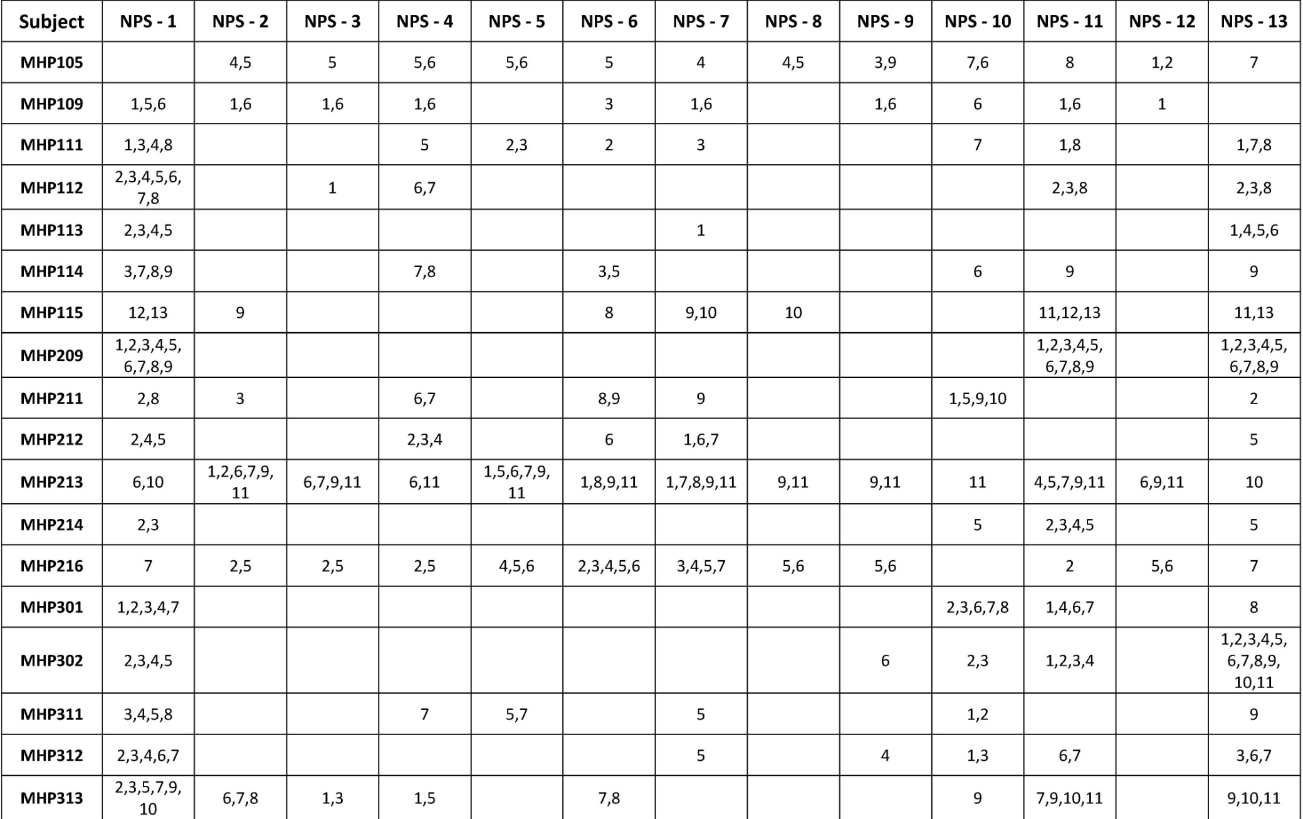

Slide 20
The End

