Slide 1
AH&MRC SEWB WSU
The fall and rise of clinical supervision
Gina O’Neill Ann Baker

Slide 2

Who are we?
LUCY ABBOTT
MANAGER
ANN BAKER
STATE MENTAL HEALTH COORDINATOR
GINA O’NEILL
CLINICAL SPECIALIST
Lucy
Sofia
Alana
Rodney
Clinical Specialist
Also in the team:
State Mental Health Coordinator
ADAN Senior Project Officer - Kristie
KRISTIE HARRISON
ADAN SENIOR PROJECT OFFICER
ALANA ROSSMANN ACTING SENIOR PROJECT OFFICER
RODNEY TURNER
PROJECT OFFICER (ADAN)
JASMINE DAY
SEWB CADET

Slide 3
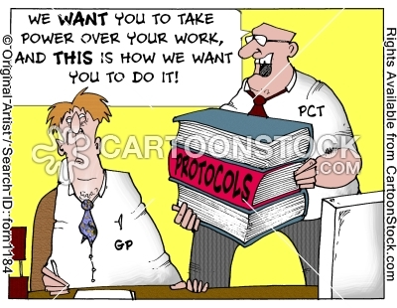
Clinical supervision - then

Slide 4
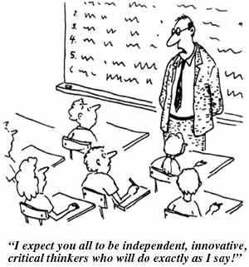
Top – down approaches

Slide 5
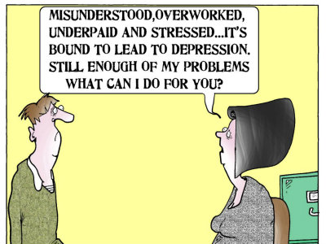
High burnout rates

Slide 6
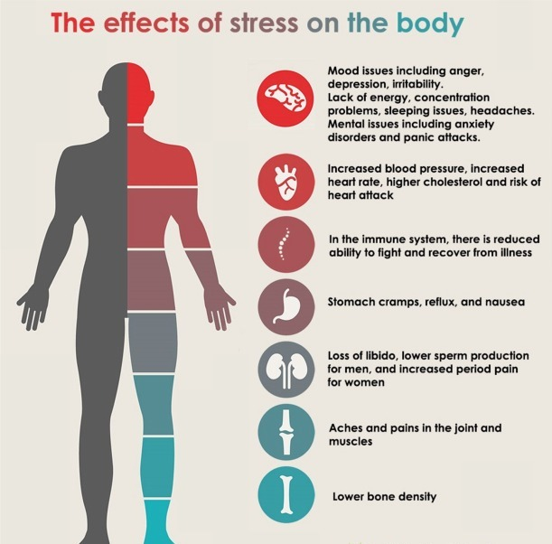
Clinical supervision & neuroscience

Slide 7
Mental health worker stress facts
SEWB/Mental health workers witness trauma: suicide, violence, verbal abuse, the system and learned helplessness, consistent crisis/emergency situations
SEWB/Mental health workers experience 3 x the rate of aggression from patients
Aboriginal workers have additional stressors of working within their own communities

Slide 8
Conditions for successful clinical supervision
Confidentiality
Professional supervisor (not manager)
Safety and trust
For Aboriginal workforce cultural safety is important
Contract/agreement
A set of guidelines/principles
A shared purpose & understanding

Slide 9
A new model
Our Healing Ways: A culturally appropriate supervision model for Aboriginal workers
(Victorian Dual Diagnosis Initiative)
Adopted by the AH&MRC Clinical Governance Advisory Committee
Training being undertaken throughout 2014
Wide application

Slide 10
Our Healing Ways
The purpose: to provide the best possible service to clients and community by building worker’s knowledge, skills, insight and wisdom in how to support and care for clients and themselves, in the cultural context of working with community

Slide 11
The process: reflective, holistic, open, validating, non-judgemental, two way learning
The relationship: is with a skilled and experienced person who is respectful, trustworthy, caring, honest and knowledgeable about the subject matter and the local Aboriginal community
The Context: regular, by agreement and supported by the worker’s organisation

Slide 12
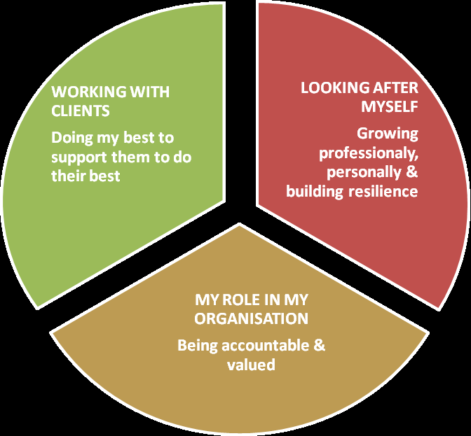
Working within community
Enjoying the advantages & managing the challenges

Slide 13
Supervision is self reflection
“Reflection is the process that turns information and knowledge into wisdom”
M. Carroll 2010

Slide 14

A reflective experience for you
Where am I now?

Slide 15

What’s emerging in my life?

Slide 16

What’s holding me back?

Slide 17
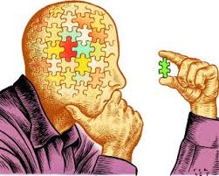
What do I need to develop in order to co-operate with what’s emerging?

Slide 18

Supervision is the process of being with a skilled experienced and wise person who respectfully, caringly and honestly supports a worker to reflect on their work in a meaningful way, to learn and grow as an Aboriginal worker in the context of working with community.”
VDDI:education & training unit: 2012

Slide 19

THANK YOU

