Slide 1
South Coast Workforce Support Unit
Greater Southern NSW & ACT Region

Slide 2
Workforce Support Unit Staff
Nathan Deaves
Program Coordinator
Wade Longbottom
Project Officer

Slide 3
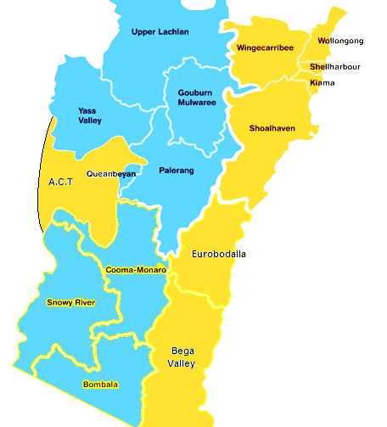
Geographical Borders
Illawarra
Shoalhaven
Eurobodalla
Bega Valley
ACT

Slide 4
Registered Training Organisation
Aboriginal Health College of the AH&MRC
Yurauna Centre of Canberra Institute of Technology- AMHFA only

Slide 5
Workforce
29 SEWB Workforce staff
28 Currently Filled
7 different organisations
Illawarra AMS
South Coast AMS
Katungul ACCH&MS
Waminda Women’s Health & Welfare Aboriginal Corporation
Oolong Aboriginal Corporation (Resi-Rehab)
Wandarma Aboriginal Drug & Alcohol Service
Aboriginal Justice Centre - ACT

Slide 6
SEWB Workforce Funded Positions

Slide 7
SEWB Workforce, Indigenous Staff

Slide 8
How Does The WSU Support The Workforce?
Coordinate regional networking through forums and conferences
Professional development workshops
Develop “Best Practice” resources
Coordinate the delivery of nationally recognised training to the workforce through the RTO
Promote and encourage access to professional supervision
Conduct workforce service visits
Provide bi-monthly SEWB Workforce
E-Newsletter via Mail Chimp

Slide 9
Statistical Achievements
(85%) of workforce staff have attained minimum mandatory qualifications
96% of positions accessed at least 1 hour per month of either internal or external supervision in the last 6 months.
82% workforce staff retention rates in 2013, compared to 68% in the year 2012.
100% of workforce staff have had training and development needs individually assessed and Training and Development Plans are currently being developed

Slide 10
Future Plans – 6 months
Better Practice DVD Launch
Develop formal partnerships between Gorman House (Detox Unit), Oolong House (Resi Rehab)& Workforce employer Organisations
Implement Workforce Training & Development Agreements
2 x Regional Forums
Professional Development Workshops - Case Note & Report Writing, Presentation / facilitation skills, Grief & Loss
Workforce Service Visits
Develop culturally appropriate SEWB screening tool

Slide 11
