Slide 1
HEALING PROGRAM
Healthy Eating Activities and Lifestyles for Indigenous Groups
Jessica Morris
Aboriginal Health Promotion Officer
MNC LHD
Marilyn Dean
Aboriginal Health Education Officer
MNC LHD
Notes:
Good afternoon my name is Marilyn Dean and I am the Aboriginal Health Education officer based a Kempsey and this is my colleague Jessica Morris , Aboriginal Health promotion officer based in PMQ.
Before we begin I would like to pay my respects to the local people of the land we are meeting on and elders past and present along with other guest from visiting nations.
Today we are presenting the healing program, a localised program that was run in Kempsey last year.
The Healthy Eating Activities (and) Lifestyles (for) Indigenous Groups (HEALInG) program is an Indigenous-specific program designed to provide support and information for participants in making positive lifestyle changes and taking control of their lives.

Slide 2
Background of the program
A program developed by the Health Promotion Unit, Population Health, Planning and Performance, Laurel Rogers- Aboriginal Health Promotion officer, Northern Rivers Area Health Service.
Adapted from the QLD Healthy Weight Program
Notes:
It is a requirement of our operation plan to provide at least 2 healing programs per year. This program is adaptable for different ages, genders and communities.

Slide 3
The Project Aims
Improve the self-esteem and confidence
Increase physical activity to recommended daily levels
Expand participants knowledge
To close the gap on Aboriginal life expectancy by reducing obesity and chronic disease risk factors.
Notes:
Encouraging Participants to look after themselves through eating healthy
Adhering to the 30 minutes of recommended PA guidelines for adults
Providing education sessions on different health related topics through guest speakers
By improving diet and increasing exercise levels this reduces risk of associated diseases being;
Obesity
Cardiovascular
Diabetes
Cancer

Slide 4
Program Outline
An 8-12 week Program that has 3 components:
1 hour Physical Activity session
1 hour session on healthy lifestyles
Healthy Eating, preparing & sharing lunch
Notes:
The program also covers NSW Health priorities of healthy weight, tobacco cessation and injury prevention
1. The physical activities includes a variety of activities
Walking
Circuit exercises
Zumba/dance
Gyms
& utilising Fitness instructors
2. Healthy lifestyle sessions provide information on associated risk behaviours and strategies to reduce risks relating to poor diet and physical inactivity.
For the session themes often health professionals as guest speakers discuss a topic related to the target group. Eg A women’s health nurse- discussing women's health & mental health professional discussing self-esteem and anxiety with the group.
3. The Healthy Eating session targets healthy eating principles such as:
Dietary guidelines
Food groups
Serving sizes
Fats in food
Reducing amounts of sugar and salt in meals
Budgeting
Understanding food labels.
The program is flexible to the needs of the participants and includes:
Childcare for preschool children
Transport provided
As part of the program it is essential for participants to have a pre-program medical check up with a GP prior to commencement of the program
A pre program medical check-up is a clearance that allows the individual to participant in low-moderate intensity exercise, which adheres to insurance guidelines. This also engages the participant with a GP, as not all participants are actively engaged in medical check-ups. This process also encourages participant to follow through with having a full health assessment.
Participants plan and set goals for themselves throughout the program. Friendships are established during the program with future group fitness sessions and walking groups encouraged.
This promotes sustainability of utilising what the participants have learnt during the program

Slide 5
Notes:
The program ran for 8 week, every Thursday. It is best to consult with the community in choosing the right day of the week.
This was a partnership between MNC LHD and Department of Education, Schools as Communities Centres with Karen Hall (Coordinator). The program was delivered at Kempsey south public school.
Participants were women aged 20 years and older who reside in the Kempsey area, some of the participants also had children and grandchildren who attend the public school. By having the program at the school enhanced the community participation with the school. This partnership provided this venue free of charge and access to the schools hall, Aboriginal resource room, community garden, utilising the produce.
Participants weight and measurements were recorded at the start and completion of the program which provided data for evaluation purposes

Slide 6
Notes:
We provided the participants with a range of different activities, this included ball games such as captain ball, tunnel ball ect, different circuits consisting of squats, skipping, up/down stairs, star jumps, suiting a range of fitness levels. We also did a walking beep test, and participants aimed to beat their level set in the previous week. Pedometers were also provided to motivate participants to aim for the recommended 10,000 steps per day.
The different fitness activities were provided with the option of an easier or more difficult alternative for each exercise. Eg having squats, with or without a chair.

Slide 7
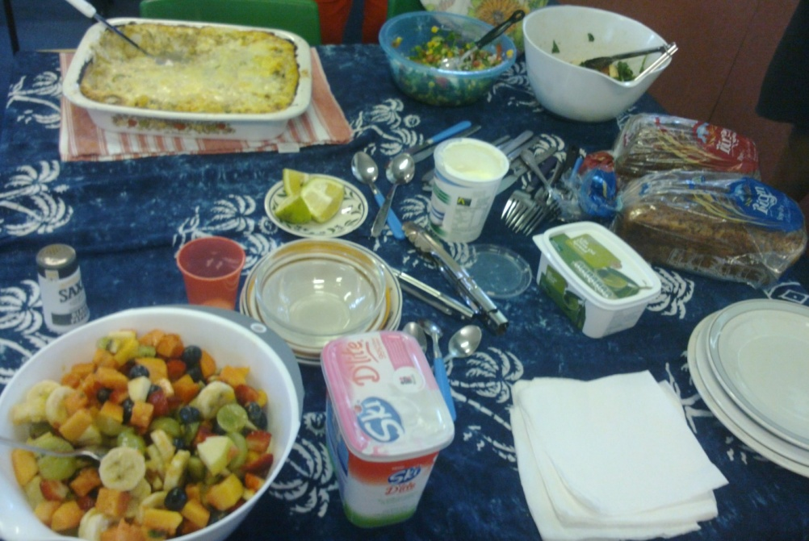
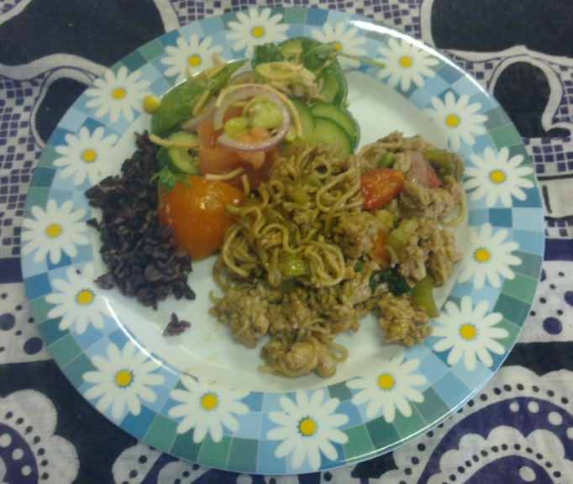
Notes:
After the exercise session, Karen Hall, Schools as Communities assisted the participants with the cooking by preparing a healthy lunch and dessert. New foods were introduced each week, incorporating meals on a budget, suitable for families with children. This also encouraged whole foods and the recommended portion size for each food group.
Participants were encourage to help with the meal preparation and clean up, providing practical experience
This session encouraged a relaxed environment to socialise and reflect.

Slide 8
Notes:
One of the stand out sessions: self-esteem & anxiety
2 mental health professionals, both being female, one from Durri AMS (Leanne Scholes-Asper) and the other from Community Mental Health (Julie Sutton), to provide an education session on self-esteem & anxiety. From all the education sessions provided, this session received the most positive feedback. The guest speakers guided participants to talk about self-esteem and what does that mean to them, it also encouraged each person to say a positive attribute about themselves, which is not often comfortable to discuss. The guest speakers also guided participants to discuss what is anxiety, and it was identifiable that participants have experienced anxiety within the group. Participants were then put through breathing training as a form of anxiety management.
This builds a partnership between health and the local AMS and provides an opportunity for participants to meet their local mental health professionals to reduce barriers in accessing the services

Slide 9
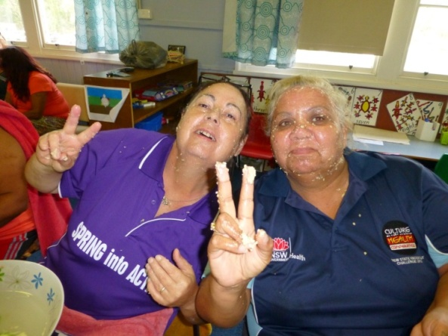
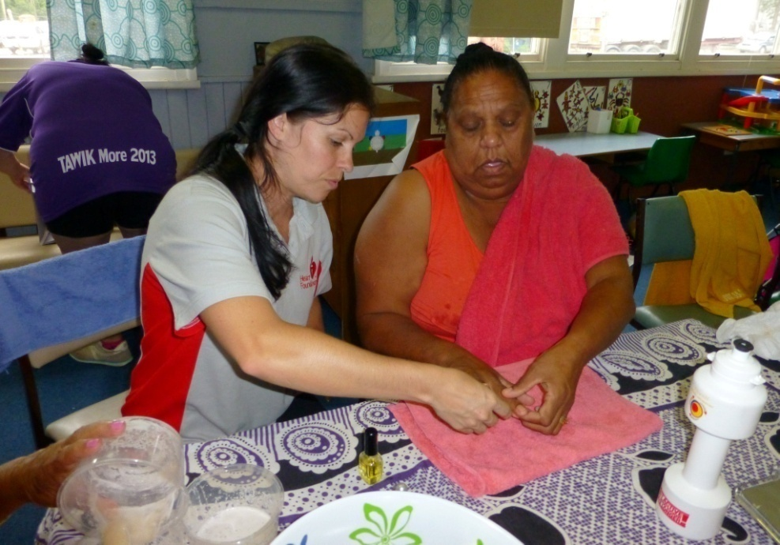
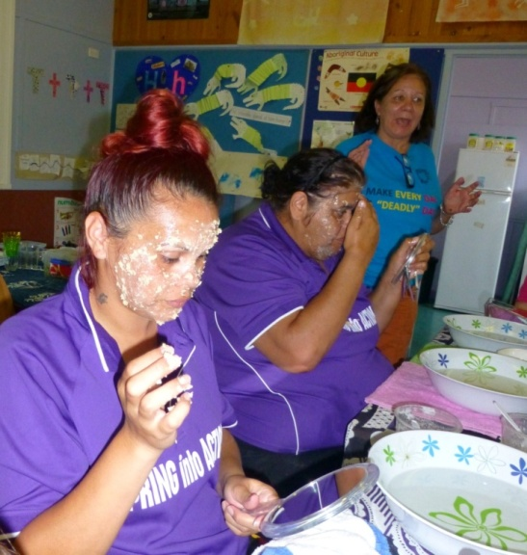
Notes:
One the last day of the program there was a pamper day provided to participants. The ladies enjoyed a hand massage which used hand wash and sugar, both ingredients are readily available. They also tried a facial scrub which used, raw oats, honey and plain yoghurt; which can also be made at home.
All the ladies participated in this activity and had fun with lots of laughing and learning together. This session was provided by Lois Sallustio AHLO utilising her skills as a beauty therapist. This was also an opportunity for the community to meet the hospital liaison officer from PMBH.

Slide 10
Long Term Goals
Improved self esteem and confidence
Some form of physical activity regime
A support link is established outside of the group
Individual and family eating patterns change as a result of the program
Participants access the services
Notes:
Some of the results that were seen during this program consisted of;
1. Notable improvement in self-esteem and confidence
2. Participants self-directed motivation, one participant having already lost 20 kg and wanting to continue the journey to loose more
3. Participants starting their own heart foundation walking group outside of this program, meeting each other and others from the community, walking around the oval and using equipment supplied through the Councils, Healthy Communities Initiative.
These types of supported physical activity and healthy eating programs, like the healing program have strong evidence to support the effectiveness to provide participants with the tools to live a healthier lifestyle for now and in the future.

Slide 11
Future Considerations
The greatest burden by 2020 will be chronic diseases
Young demographic profile and families
Health risk factors
Social determinants of health
Notes:
As well we need to take in the future considerations for Aboriginal People. I am not telling you anything here that you don’t already know, but just to reiterate: As we know,
Chronic disease is responsible for 70% of ill-health gap between Aboriginal and non-Aboriginal people
2. The age profile of Aboriginal communities differs from the non-Aboriginal age demographic with the Aboriginal population having a higher proportion of younger people
3. Higher Health Risk factors such as smoking, poor nutrition, physical inactivity, low rates of immunisation are contributing to poorer health outcomes
4. Social disadvantages, directly related to dispossession and characterised by poverty and powerlessness, are reflected in measures of education, employment, and income
http://www.gpnsw.com.au/__data/assets/aboriginalhealth/201203_workshop/120315_prs_Get-Healthy-NSW-Health-Dr-Brendan-Goodger.pdf) Point 2: ABS Table Builder Points 3 and 4: www.healthinfonet.ecu.edu.au Point 5: NSW Health, AMIHS webpage
If anyone is interested in running a Healing program information can be found on healthinfonet website under programs and projects.
http://www.gpnsw.com.au/__data/assets/aboriginalhealth/201203_workshop/120315_prs_Get-Healthy-NSW-Health-Dr-Brendan-Goodger.pdf) Point 2: ABS Table Builder Points 3 and 4: www.healthinfonet.ecu.edu.au Point 5: NSW Health, AMIHS webpage

