Slide 1
Learning from each other and growing together Growing opportunities for a sustainable Aboriginal Mental Health workforce
Cindi McCormick – Clinical Supervisor
Allison White – Partnerships Coordinator
Northern Sydney Local Health District
Mental Health Drug and Alcohol Service
Notes:
*

Slide 2
Overview
Where have been
What we learnt
How we have changed
Moving forward
Creating a sustainable model for your service
Notes:
*

Slide 3
Where we have been
Kristen Ella
First NSLHD MHDA Aboriginal Mental Health Trainee
Notes:
*

Slide 4
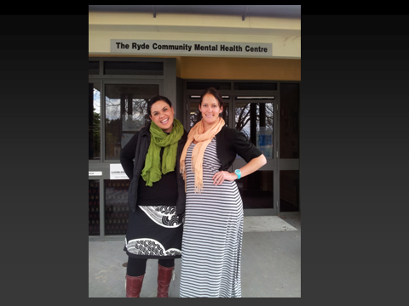
Notes:
*

Slide 5
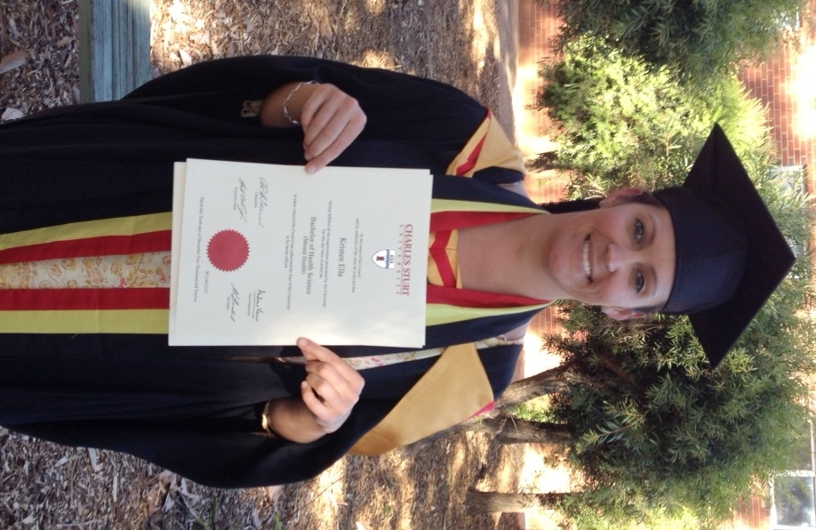
Notes:
*

Slide 6
Initial Support Model
Executive Support
Partnerships Coordinator
Work place Supervisor/Mentor
Trainee
Ryde Community Mental Health Team
North shore Ryde Community Mental health Service
NSLHD MHDA Workforce
Notes:
*

Slide 7
What we learnt
Whole of service response is needed
Transition into the traineeship can be daunting– new role, new team, new profession - large organisation
Service welcome and team preparation vital
Value in team cultural development prior to commencement
Increased support to address University / workplace interface
Notes:
*

Slide 8
Growing opportunities – ideas?
Notes:
* What do you reckon we could have done make this work better?

Slide 9
How we have changed
Notes:
*

Slide 10
Our family grew
Notes:
*

Slide 11
NSLHD MHDA Executive Support
Notes:
*

Slide 12
Nathan
Notes:
*

Slide 13
Allison
Notes:
*

Slide 14
Cindi
Notes:
*

Slide 15
Cindi

Slide 16
Scott
Notes:
*

Slide 17
Kas

Slide 18
Nathan & Kas
Notes:
*

Slide 19
Ryde Community Team
Admin team
Acute Care Team
Case Management team
Early Interventions Service
SMHSOP Team
Medical Team
Drug & Alcohol Service
Assertive Outreach Team
Notes:
*

Slide 20
How we have changed
Service and Team well prepared and welcoming
Well informed about how to support trainee
Offered opportunity to be involved
Value the role of the trainee
Value and embrace trainee cultural expertise
Seeds sown and family prepared
Notes:
*Service and Team well prepared and welcoming – team meetings
Well informed about how to support trainee – questions and discussion brainstorm ideas support
Offered opportunity to be involved – EOI mentor/ supervisor
Value the role of the trainee – positive feedback from team and previous experience
Value and embrace trainee cultural expertise – Positive and keen to participate
Seeds sown and family prepared – ready to go

Slide 21
Moving forward
Notes:
*

Slide 22
Creating a sustainable model for your service
Offer opportunities to teams
People WANT to be involved
Service ownership
Self sustainable
Cultural growth
Trainee well nurtured ready to flourish
Community development approach
Notes:
*Offer opportunities to teams -
People WANT to be involved-
Service ownership-
Self sustainable-
Cultural growth-
Trainee well nurtured ready to flourish-
Community development approach-

Slide 23
No wai te reo i powhiri nei i ahau
For whom is this knowledge that greets me
No Nga Tipuna e
From our ancestors
Na wai te reo i tuku iho e
Who can embrace this gift that’s past on
Na nga tipuna e
From our ancestors
Ma wai te reo e ora ai e
How do we keep this gift alive
Maku ,ma tatou, mate motu e
For me, for you, for us living in this land

Slide 24
Learning from each other, growing together, for nurtured and treasured Aboriginal Mental Health workforce

Slide 25
THANK YOU - WE WELCOME QUESTIONS
CONTACT
Partnerships Coordinator
NSLHD MHDA
Cameron Building
Macquarie Hospital
Wicks Road
Ryde
NSW 2112
ALLISON WHITE
NSLHD MHDA
PARTNERSHIPS COORDINATOR
Alison.White@health.nsw.gov.au
Phone: 98587777
CINDI MCCORMICK
NUM TARBAN HOUSE
MACQUARIE HOSPITAL
Cindi.McCormick@health.nsw.gov.au
Phone: 98875990
Notes:
*

