Slide 1
Pathways to Psychiatry for aboriginal and torres strait islander people
Nigel Beetson

Slide 2
"Every child in Australia should be born to be able to dream and be what they want to be."
Assoc Prof Kelvin Kong

Slide 3
Aim
Background Information
Pathways into medicine
Challenges and solutions
Dispel Myths

Slide 4
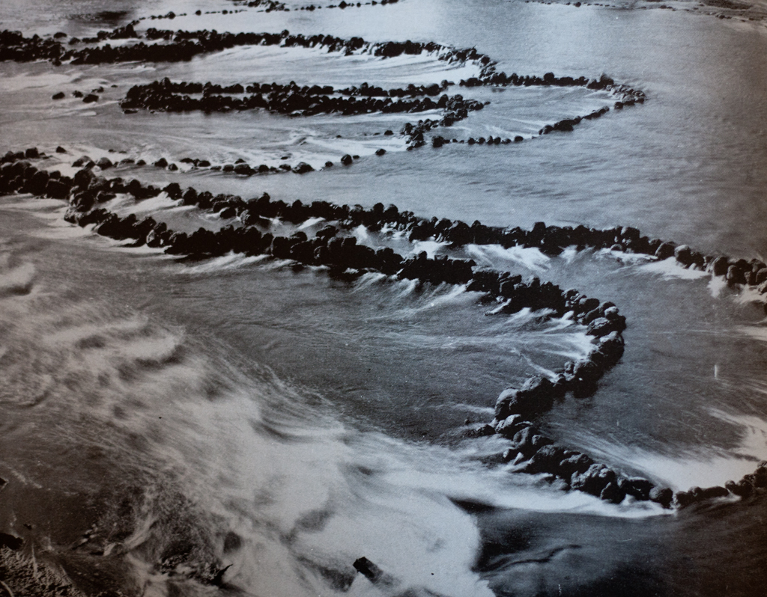

Slide 5
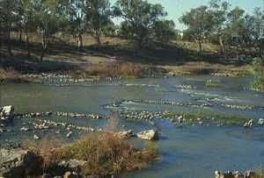
Brewarrina
Brewarrina Fish Traps Barwon River

Slide 6
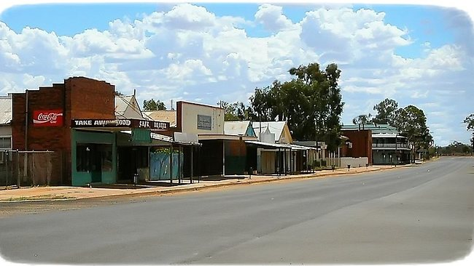

Slide 7
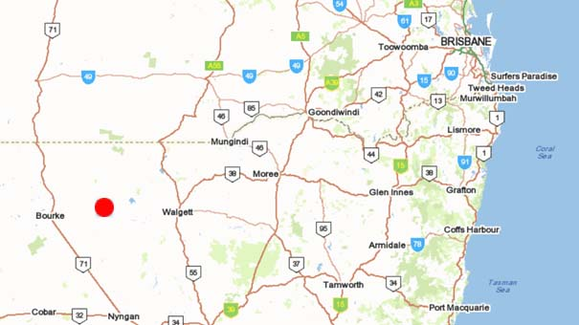

Slide 8
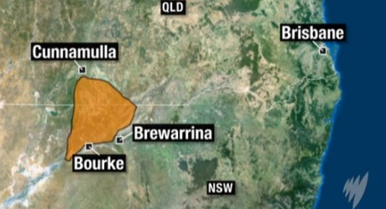
Murawarri

Slide 9
5th Year Medical Student

Slide 10
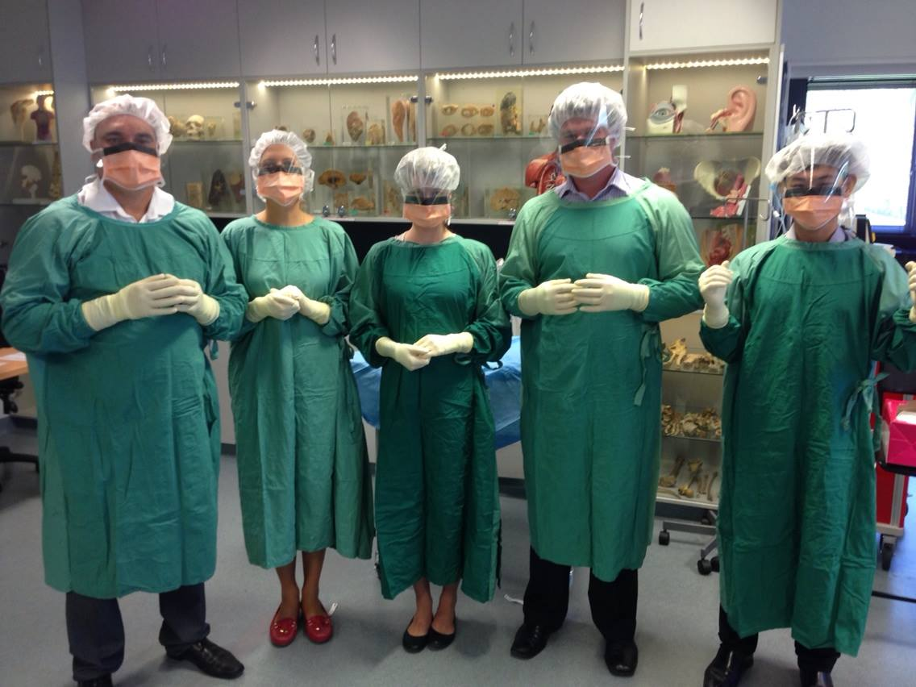

Slide 11
NSW Rural Residential Medical Officer Cadet

Slide 12
AIDA
Aboriginal and Torres Strait Islander people have equitable health and life outcomes.
We do this by:
Providing a unique medical and cultural perspective on Aboriginal and Torres Strait Islander health;
Maintaining links between traditional and contemporary medicine;
Growing and supporting current and future Aboriginal and Torres Strait Islander doctors

Slide 13
Aboriginal and Torres Strait Islander Doctors and Medical Students
There are approximately 180 Doctors
Approximately 260 Medical Students
We require 1000 additional doctors to reach population parity

Slide 14
Why Medicine?

Slide 17
Mental Health Worker

Slide 18
The Secret

Slide 19
The Secret to Medicine

Slide 20
The Secret to Medicine
It is harder to get into medicine than it is to do medicine.
Medicine is achievable

Slide 21
Pathways into medicine Indigenous Entry Scemes
UNSW Pre Medicine Program
UWS Indigenous Entry
Newcastle/New England University Indigenous Entry
Newcastle University Yapug
Sydney Uni
Wollongong
University of Notre Dame

Slide 22
UNSW Pre Medicine Program
4 week residential course
Biology
Anatomy
Biochemistry
Physiology
Pharmacology
Histology

Slide 23
Barawal Yana Muru Marri Indigenous Health Unit UNSW
Attitudes
Lack of confidence and low community expectation is an issue for many Aboriginal and Torres Strait Islander students. Some of you don’t believe you can do it! And,
some of your teachers don’t believe it either.
But, studies have also shown that Aboriginal and Torres Strait Islander students feel better about their ability to achieve as they get older, compared to non-Indigenous
students.

Slide 24
Challenges
Financial
Away from family
Lack of adequate education during school
Poor study skills
Family commitments
Confidence
Racism
Shame

Slide 25
Solutions
ABSTUDY
Scholarships
Indigenous support units (Nura Gili)
Bridging programs
ITAS Tutoring
Study groups
AIDA
Academic support
Support from Medicine faculty
Mentoring

Slide 26
Highlights
Role Models
Success breeds success
Study Groups
Largest Indigenous Cohort in Australia
Support
Self Esteem

Slide 27
Psychiatry
Medical Degree 5-6 years undergraduate program
Intern and residency at hospital 2 years
5 years Psychiatry Training

Slide 28
