Slide 1
Aboriginal Tobacco Resistance Tool Kit
Supporting the Aboriginal workforce to address tobacco in their communities – showcasing the Aboriginal Resistance Tool Kit
SEWB Forum 2014
Jasmine Sarin
Senior Project Officer,
Aboriginal Health and Medical Research Council

Slide 2
What’s the A-TRAC Program?
Goal:
to contribute to reduced smoking rates for Aboriginal people in NSW
Objectives:
To shift community attitudes away from the belief that smoking is normal.
To increase the capacity of NSW Aboriginal Community Controlled Health Services to undertake tobacco resistance and control activities.
To increase people’s self-efficacy in their ability to quit smoking.
To develop new and strengthen existing partnerships with key stakeholders.

Slide 3
What is the tool kit?
A crash course in Aboriginal tobacco control.
Easy to use and practical, irrespective of how much or little experience someone has in tobacco control.
Consists of Modules and templates.

Slide 4
Why was the tool kit developed?
To meet the growing need for practical support around tobacco resistance and control by Aboriginal Community Controlled Health Services (ACCHSs) in NSW.
The Kit was developed in consultation with ACCHSs in NSW.

Slide 5
How to use the kit
Establish a tobacco network at your ACCHS.
Identify the tobacco control areas you would like to work on or continue to develop.
Identify which module(s) are relevant to your service.
Adapt the templates to suit your needs or use them as is.
Create a plan for your service.
Meet regularly to monitor your progress.

Slide 6
The modules
Introduction to the kit
Module 1: Let’s get started
Module 2: Workplace smoking policy
Module 3: Getting to know your community: data collection
Module 4: Social Marketing

Slide 7
What is in each module
Each module contains:
An introduction to each topic.
Templates.
Explanation and examples on how to use. the templates.
Where to get other resources from.

Slide 8
Module 1: Let’s get started!
Smoking in the Aboriginal community
Planning your project
Client information sheets
Fact sheets
Resource list
Templates

Slide 9
TEMPLATE
EXAMPLE

Slide 10
Module 2: Workplace smoking policy
Rationale behind a policy.
Collecting information before developing a policy.
Implementing your policy.
Resource list.
Templates.

Slide 11
TEMPLATE
TEMPLATE

Slide 12
Module 3: Getting to know your community
Planning to collect data.
Collecting the data.
Resource list.
Templates.
Notes:
About this module?
It is important to collect information about your community when considering or reviewing any program or initiative. The information you collect will help you to better understand the attitudes and behaviors of the people you are trying to target. This is true for any program not just a smoking cessation program. The information can be used for reporting or reviewing your program.

Slide 13
TEMPLATE
TEMPLATE

Slide 14
EXAMPLE
TEMPLATE

Slide 15
Module 4: Social Marketing
What is social marketing?
Examples of social marketing campaigns.
Features of a good campaign.
Steps to developing a campaign.
Forming a working group.
SWOT Analysis.
Identifying the required skills.
Undertaking formative research.
Undertaking formative research.
Planning the campaign concept.
Testing the campaign.
Planning to implement the campaign.
Evaluating the campaign.
Additional resources.
Templates.

Slide 16
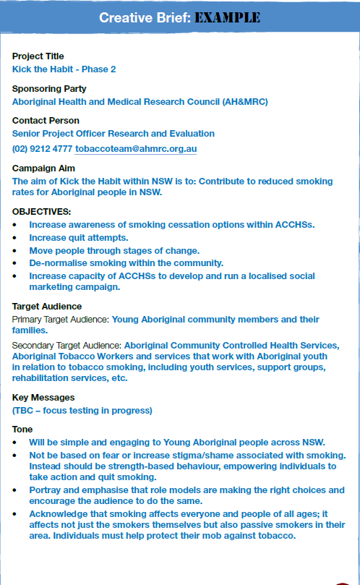
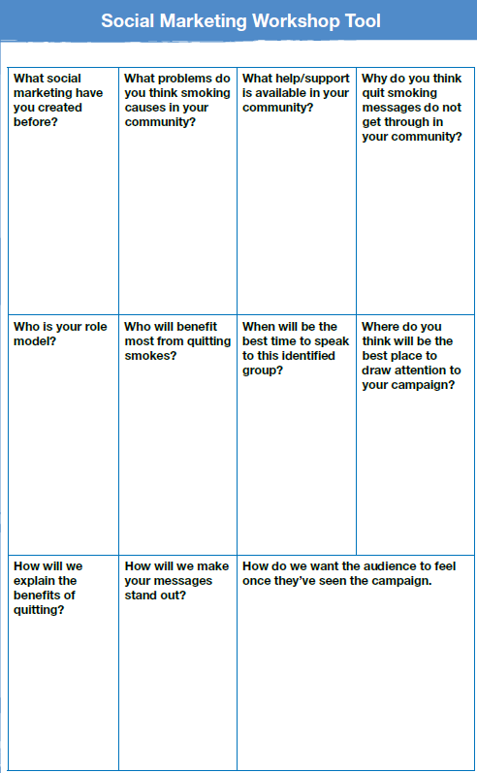
EXAMPLE

Slide 17
How has the Kit been used?

Slide 18
Where to get a copy of the Kit
Each module can be downloaded separately from:
www.ahmrc.org.au/atrtkit.php
Hard copies are limited:
tobaccoteam@ahmrc.org.au

Slide 19
Contact
Jasmine Sarin
Snr Project Officer, A-TRAC program
E: jsarin@ahmrc.org.au
P: (02) 9212 4777

