Slide 1
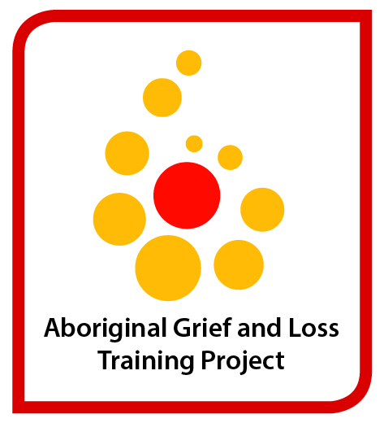
NSW Aboriginal grief and loss training project Advisory Group: Ann Baker, Tom Brideson, Danielle Byers, Anthony Hillin, Len Kanowski, Donna Stanley, Sally Wooding NSWIOP: Danielle Byers, Vanessa Edwige, Anthony Hillin, Megan Wynne-Jones (and new trainer )

Slide 2
Advisory Group
Ann Baker ( prev. Glenn Williams)
State Mental Health Co-ordinator
Aboriginal Health and Medical Research Council of NSW
Tom Brideson
State-wide Coordinator
NSW Aboriginal Mental Health Workforce Program
Donna Stanley
Clinical Leader
Aboriginal Mental Health
Western NSW Local Health Network
Danielle Byers
Director Community Education and Special Projects,
NSW Institute of Psychiatry
Anthony Hillin
Senior Project Officer
NSW Institute of Psychiatry
Len Kanowski
Senior Advisor
Aboriginal Social and Emotional Wellbeing
Centre for Rural and Remote Mental Health, University of Newcastle
Sally Wooding ( prev. Linda Carroll)
Senior Project Officer
Aboriginal Mental Health Programs
Mental Health and Drug and Alcohol Office
NSW Ministry of Health

Slide 3
Aboriginal Grief and Loss Training for Aboriginal Mental Health Workers
NSW Institute of Psychiatry
Tender process. Based on experience with NSW School-Link project
Part of NSW Suicide Prevention Plan
During 2013 – 14 develop and deliver: training workshops resources develop support networks

Slide 4
Today’s presentation
Results from the consultations at the last forum
Update and evaluations from the pilot training program
Summary of the literature review
Development of resources
Today’s focus groups

Slide 5
Last year’s consultation summary
60 participants
Questions informed by state-wide survey
Holistic and culturally appropriate approach
Recognition of participants’ life experience
Comprehensive resource
Community driven
Flexible delivery

Slide 6
Consultation summary continued: Workshop content
cultural and historical losses
traumatic losses - suicide, murder, deaths in custody, sudden death, babies/kids, dv, elders
multiple losses, ongoing
accumulated unresolved losses, intergenerational
terminal illnesses, palliative care at home – hospitals not culturally safe
‘normal’ grief reactions including gender and age differences, childrens’ grief, ‘no one way to grieve’
support and treatment for complex grief
Aboriginal spirituality and grief
Self-care

Slide 7
Consultation summary continued: Policy, management and systems issues
Need training for managers – lack of cultural competence
Managers want us to ‘do our business in a black way but work in a white way’
Lack of support for timeframe of funerals and Sorry Time – need for special leave
Impact of grief on workers – dual role: ‘ work gets in the way of our grieving’

Slide 8
Consultation summary continued: Systems issues
Differences in pay scales between Aboriginal and non-Aboriginal workers
Wait list too long for crisis counselling
Travel to communities without services – costs money and can prevent access
Remote communities issues
Need for community education re grief and loss, planning for end of life, funerals, wills

Slide 9
Consultation summary continued: Biggest and longest lasting impacts?
Community ownership
Broader education – train the trainer
Worker networks/mentoring/protection
Designated grief and loss workers in community
Links to ‘fly-ins’
Regional level co-ordination
Recurrent funding
High numbers trained
Accessible resources
Updating training
Mandatory training
Training of non-Aboriginal staff
Culturally safe environment

Slide 10
Pilot workshops 3 locations: Broken Hill, Taree, and Western Sydney Workshop 1 – one day: information about grief and loss, capacity building of individuals, families and communities to deal with future loss and adversity Workshop 2 - two days: targeted, in-depth workshop, including experiential learning about ways of working therapeutically with grief and loss. target audience and numbers

Slide 11
Workshop 1 summary
Challenges of grief and loss work
Aboriginal and mainstream knowledge
Theories of grief including Rosemary Wanganeen’s 7 phases
Holistic assessment of grief
Complex grief
Worker responsibilities and self-care
Community capacity-building to respond to grief and loss

Slide 12
Workshop 2 summary
In-depth, experiential, two days
Focus on a range of creative ways of working with others’ grief
Focus on own personal experience of loss and what helps
Toolkit of ideas/activities for individual or group work

Slide 13
Evaluation summary 36 participants in total (for both workshops), 30 responses
Percentage of participants
88-100%
86-100%
Quality of training
training was relevant to their current role
would help deliver a better service to their clients
the presentation was of high quality
would recommend it to their colleagues

Slide 14
Evaluation summary continued
for most participants there were small to significant increases in confidence and knowledge in working with grief and loss

Slide 15
Summary of comments
Most helpful aspects
Group discussion/stories of grief and loss (14 responses)
Practical activities/approaches for working with grief and loss (9 responses)
Grief and loss models and assessment (12 responses)
Least helpful aspects
Some of the models (4 responses)
Too much personal reflection (4 responses)
How workshop could be improved
Longer workshops
Simpler models/less wordy
More yarning
Individualising the concepts and linking to practice
Manual of techniques
Video of grief and loss work
Less focus on own grief and loss

Slide 16
Literature review summary
Published and unpublished books, articles, brochures, fact sheets and training material relevant to Australian Aboriginal grief and loss
Library catalogues (Trove, National Library, State Library) and web based searches including AIATSIS, Australian Indigenous Health InfoNet, the Lowitja Institute

Slide 17
Key findings
Lack of theories, models and practice specific to the complex cultural and historic context of grief for Australian Aboriginal people (by Aboriginal or non-Aboriginal authors)
Exception is Wanganeen’s model
Lack of training, resources and support for Aboriginal Mental Health workers in issues of grief and loss

Slide 18
Key recommendations for training, resources and evaluation
Long term approach essential
Underpinned by Aboriginal community empowerment and self-determination
Culturally appropriate, and delivered in a culturally safe environment
Further research: complicated grief, risk and protective factors for grief and loss, grief in children and young people, palliative care.

Slide 19
Development of the grief and loss workshops, resources and support networks
Consultation survey undertaken
Focus groups with Aboriginal Mental Health Workforce at previous forum and this forum
Advisory group guiding the project
Literature review ready for consultation
Pilot project conducted

Slide 20
What’s next?
Today’s consultation
Acting on today’s feedback
State-wide rollout of workshops
Ongoing development of resources
Facilitation of local support networks (what? who? How?)

Slide 21
Today’s consultation groups
Small groups of up to 12 people with a facilitator and scribe
4 questions:
Does the content of the workshops match your needs as identified in the last consultation? Have your needs changed at all?
Do the suggestions for resources (eg counselling in action, cascade training) still match your needs?
Do the suggestions for support (eg peer or special expertise) still match your needs?
Is there anything else we need to consider in developing the project?

