Slide 1
Waminda’s Dead, or deadly Program
Willow Firth & Hayley Longbottom

Slide 2
Holistic View of Life and Health
Cultural, spiritual, social, emotional = INTEGRAL to the health of Indigenous people and therefore Waminda
Colonisation disrupted cultural beliefs – adversely affected the social and emotional wellbeing
Mainstream services did not fit this protocol and lack cultural sensitivities
Notes:
Holistic view and life and Health
Social, and emotional,
Spiritual, cultural
We look at all aspects of a clients health and work through it

Slide 3
Waminda = High retention Rates/ Happy, Supported staff
Now employs 46women – 40 Koori = 87% Aboriginal workforce
97% staff retention rate
Challenging notions of what Koori women can/can’t do
Staff workshop days –
Time management
Financial workshops- being in control
paying bills/working towards buying own home
Self-care/wellbeing
Paying above award wages
Access/opportunity
cultural appropriateness
Work is a positive place! Big part of life
New way of thinking
Can work and support family in flexible happy work environment
Notes:
Waminda creates happy healthy Koori women in a supported flexible workplace.
We spend a lot of time at work so its an important place.
We are looked after at Waminda, its more than a workplace.
Made to believe anything is possible and supported to achieve what we set out to do.
All these following Policies have been put into place to support these ideas: (next slide)

Slide 4
Staff Training and Professional Development Policy
Encourage staff to expand their knowledge and skills
Flexibility of working hours to participate in accredited courses
“Supported employment model”
Easy engagement/easy access
Training from the word go (not to wait 12 months)
First resume/ first interview – understanding
Soft entry into the workforce
Notes:
By providing opportunities to undertake training / study , this will be reflected in continuing improvements to the service.
Within Waminda, going away for training/study is definitely encouraged when its relevant to your role, as this directly benefits the organisation.
The supported employment model is adopted by Waminda as we know its hard for anyone, but particularly Aboriginal women to have a career at all. Its hard to hold down a job in difficult circumstances and with complex needs. Waminda employs a lot of women for their first time and trains them on the job, giving them the confidence to step into the workforce.

Slide 5
Funeral Leave & Funeral Aid
Workers are required to attend funerals in the community out of respect
Funeral leave is above award entitlement
Sorry business
Times of grief and loss – extra support given
Funeral Pamphlet
Financial Assistance ($200)
Bus Hire
Equipment Hire (marquee, chairs, tables etc)
Notes:
FUNERAL LEAVE & FUNERAL AID POLICY
Waminda acknowledges that from time to time staff members will be required to attend funerals in the community as representatives of Waminda and out of respect for the deceased and the family members. Funeral leave is given to Waminda staff as above award entitlement which means this type of leave is not stipulated in our award.
At times of grief and loss families may be left with financial problems and the experience of organizing a funeral can be daunting and upsetting. Waminda aims to support the Aboriginal community at these times where possible.
Listed below are the four types of assistance offered by Waminda. The families have the choice of assistance but can only choose one means of support. The reasoning being that each assistance comes as a cost to the service and Waminda does not receive additional funding for providing this service.
Funeral Pamphlet
Administration can create the funeral pamphlet with family members support and input. Community members must give the admin team sufficient notice where possible to complete this.
Financial assistance
Waminda can give financial assistance of $200 to go towards the cost of the funeral or towards catering. This will be paid directly to the funeral home or catering service and will not be given in cash. All necessary forms should be filled in and approved by management.
Bus Hire
Due to the terms of our Insurance agreements, Waminda can not lease / hire / loan out any of the Waminda owned or leased vehicles. However should a member of staff be available to drive and the bus is not previously booked, transport to and from the funeral may be arranged with sufficient notice.
Equipment Hire
Equipment can be hired free of charge for use at a funeral. Equipment that can be hired is the Marquee, chairs, tables and urn.

Slide 6
Compulsory Clinical Supervision & Grievance Policy
Living and working in the community is hard –
We must debrief/offload
Working environment must be supportive, Operational and friendly
Notes:
Clinical supervision is compulsory for all staff every 6 weeks. Waminda understands living and working in these communities is very difficult and complex. These policies are in place to resolve grievance, challenges etc that staff may face whilst working with Waminda and to ensure that the working environment is operational and friendly

Slide 7
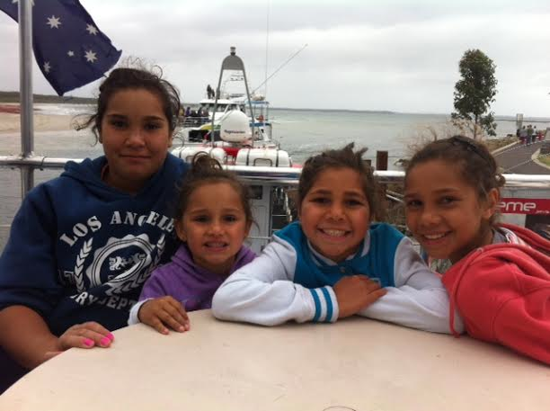
Family Leave Policy
Above award entitlement
Family orientated service
Five family leave days per year (on top of all other leave)
Women are the backbone to Aboriginal Communities
Notes:
Waminda has a strong commitment to families and caring for others. We acknowledge that many of the women have children or grandchildren and often care for others kids. Waminda’s management is committed to maintaining a flexible work environment

Slide 8
Waminda’s Staff Wellbeing Policy
Role models
Practice what we preach

Slide 9
Staff Wellbeing Policy
Waminda’s visionary CEO and Board of Management
Access to exercise shed – including 2 half hour sessions within work hours with qualified fitness instructor
Physical Health Assessments
Nutritional/diet advice
Smoking Cessation Support
Physical Activity/exercise
Notes:
The staff Dead, or Deadly Program we see as equally important as the community program. We see ourselves as role models for the community. How can we run a healthy lifestyle program if you are overweight, smoke and eat unhealthy foods?
STAFF WELLBEING POLICY
At Waminda, we believe that to fully deliver effective, appropriate and holistic services to our clients, we must be present, capable and fully functional. Wellbeing covers a number of factors which influence and impact upon our daily lives such as diet, stress management, time management, exercise, health and safety requirements and cognitive and emotional factors.
The effects of these factors on our ability to meet our clients’ many complex needs can not be underestimated and Waminda aims to ensure that all staff and board members are given the opportunity, knowledge and resource availability possible, to maintain their own wellbeing within the capacity of our service. How can we help our clients to lead healthier more fulfilling lives if we are not doing so ourselves?
Waminda offers all staff and board members the access to the program to encourage all employees to participate in improving and maintaining their health and wellbeing.
EXERCISE
Healthy Eating programs
Physical Health assessments
Smoking cessation.
To encourage staff to participate in the wellbeing sessions offered at Waminda, the board of management have approved that each staff member is entitled to:
Up to 2 half hour sessions a week,
Staff can participate in other sessions, however this will be recorded in your own time

Slide 10
“Health is Wealth, Movement is Medicine”
We have GP/clinic/nurse, but we work within a social model of health
Health delivery – centered around holistic approach
Drawing on principals of orthodox medicine but incorporating into a holistic approach
Lifestyle change
Being overweight with chronic illnesses doesn’t have to be the norm
Notes:
Drawing on principals of orthodox medicine but incorporating into holistic approach
Eg if GP check finds overweight hypertensive client, its not ok just to prescribe medicine – must refer them into the Dead, or Deadly Program to look at causes and change lifestyle.

Slide 11
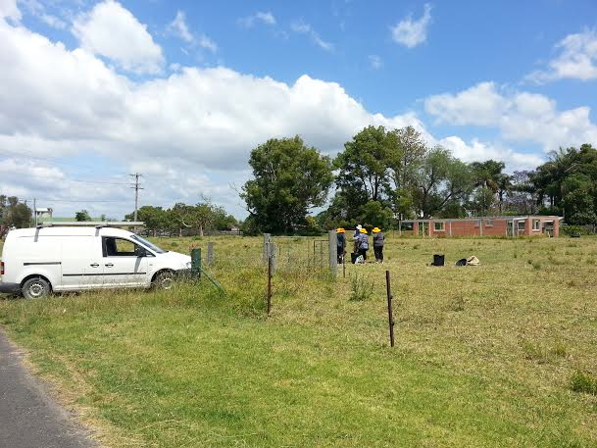
Waminda & SOLA: Sustainable Living Garden Project
Provide people with disabilities with meaningful employment
For Koori women being released from prison as condition of their release
To enter into training/employment with improved health
The women will be engaged and productive members of the community
Build self-esteem/confidence
Reduce isolation
Bridge cultural/social divide

Slide 12
Teaching women basic carpentary skills gives the women self-confidence and independance
Notes:
The Garden program was set up between Waminda and SOLA (Slice of Life Austraia)

Slide 13
Garden Project

Slide 14
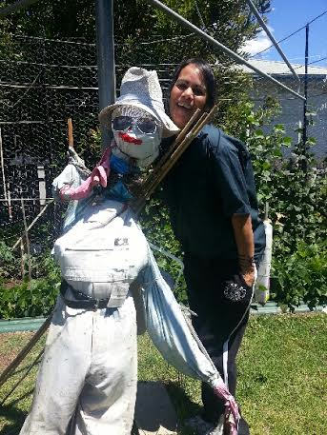
Garden Project

Slide 15
“To build a workforce, you need to build people” Create, happy, healthy women Employment doesn’t happen overnight

Slide 16
“Being able to maintain a successful Aboriginal workforce strategy is all about believing in people. Give someone an opportunity, listen to them, value them, offer the right training at the right time, and they blossom and grow and become the best person they can be” Faye Worner .CEO

Slide 17
My Wellbeing Story
Notes:
Relationship- being trapped. Controlling behaviour – typical for Koori women. He wouldn’t let me look after myself.
Lack confidence/ low self-esteem
Sneak to work to work out – clinical supervision and with senior staff. Waminda supported me through leaving. Enough was enough. Don’t want kids to go trough this.
Gave me the confidence to keep going.
Felt good after exercising. Gave me the confidence to step out on my own.
Flexible work hours to help change of time around kids/home life. HARD.

Slide 18
“DEAD, OR DEADLY ?!” OUR PROGRAM
Questions and challenges chronic disease & learned behaviours in our community
We have a choice – staff and community:
We can be DEAD, OR DEADLY …
Enjoy this little snapshot of our program. It also interviews a few clients who have turned their life around and started working.
Notes:
The short film demonstrates the program we offer staff and community to look after themselves and their community. It also contains a few individual narratives of how clients came through Waminda as clients and ended up strong and confident enough to enter the workforce. Enjoy.

