Slide 1
support – hope – inspire – nurture - empower

Slide 5
Celebrating 30 years

Slide 6
And recognises the Traditional Custodians of Australia and the local Aboriginal communities where SHINE for Kids provides services.

Slide 7
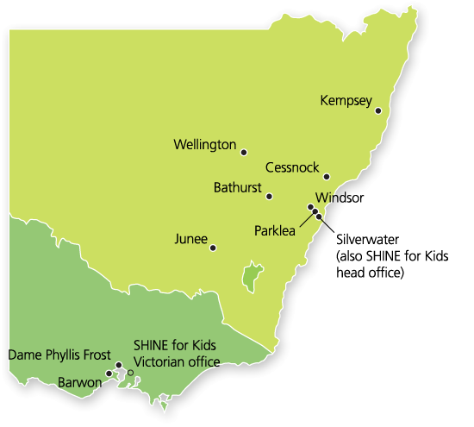
About SHINE for Kids
Notes:
Talk about the range of programs and locations.
BTF is offered at Kempsey

Slide 8
Aboriginal MH&WBW Forum Shine for Kids Lloyd Gibbs
Working through incarceration with an holistic approach to reintegration for the emotional wellbeing for families

Slide 9
The research
5% of Australian children experience parental incarceration
They can be left traumatised, stigmatised, isolated
They fall through the cracks in the system
They become the unseen victims of crime
and 5–6 times more likely to become prisoners themselves

Slide 10
The research
20 % of Aboriginal children experience parental incarceration
They can be left traumatised, stigmatised, isolated
They fall through the cracks in the system
They become the unseen victims of crime
and are even more likely to become prisoners themselves
Aboriginal people make up approximately:
20% adult prison population (male), and
29% adult prison population (female)

Slide 11
Program philosophy
NOT to tell them what to DO but to GIVE them the want to DO
STAND along side them, empower them to succeed
Challenge their belief that imprisonment is ‘normal’
Challenge their belief that their going to prison does not affect their children
Notes:
Final stage – no more groups are being held, only follow up support being provided.

Slide 12
Successes
Aboriginal men are now involved with:
Cleaning up parks & painting playground equipment
Lawn mowing to the elders for free
Opening up a gym & to teach boxing
Cultural bush walks
Completing their HSC/ N&L to get a license
Getting a job for the first time
Notes:
Final stage – no more groups are being held, only follow up support being provided.

Slide 13
Successful reintegration
Through the SHINE for Kids, Belonging to Family Project we will see inmates returning to the community as experienced positive role models with the re-offending cycle broken.
This is powerful for Aboriginal people and will impact on future generations of Aboriginal children who for them the cycle of intergenerational crime has now ceased.
Notes:
Final stage – no more groups are being held, only follow up support being provided.

Slide 14
Thank you!

Slide 15
Forum presentation web links
Shine for Kids
http://www.shineforkids.org.au/
Belonging to Family
http://www.shineforkids.org.au/what_we_do/belonging_to_family.htm
You tube clip
http://www.youtube.com/watch?v=ZQgWBSMXlwg

Slide 16
Any questions??
SHINE for Kids
Head Office
(02) 9714 3000
inquiries@shineforkids.org.au
Lloyd Gibbs & Barbara Cohen Aboriginal Group Workers (Belonging to Family Project)
(02) 65613800
btf@shineforkids.org.au

