Slide 1
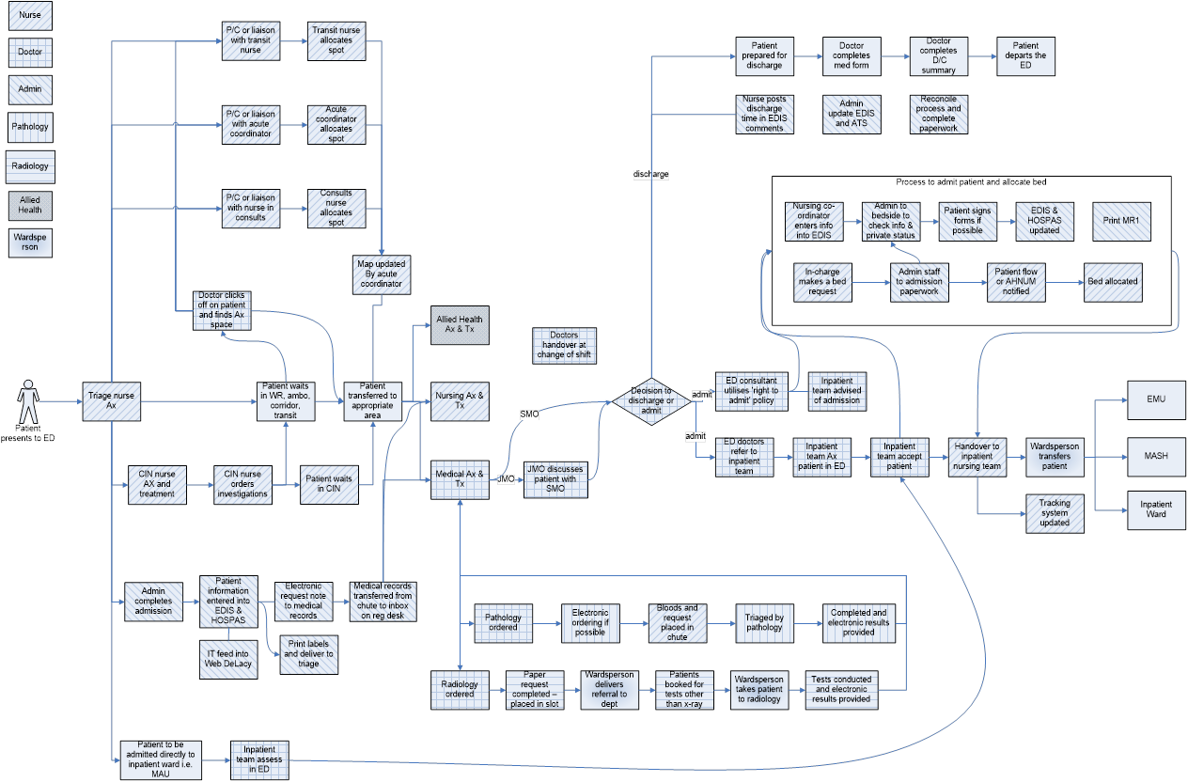
Patient Journey Mapping

Slide 2
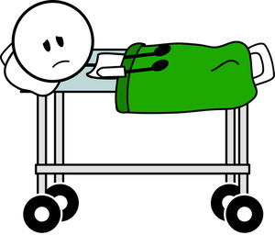
Voice of the Patient Surveys, Interviews and Observation
Why do I have to keep telling my story?
ED
Imaging department
Pathology
Consultant Physicians
Patient Flow
Theatres
Wards
Allied health
Clinics
Community Health
Patient
Journey

Slide 3
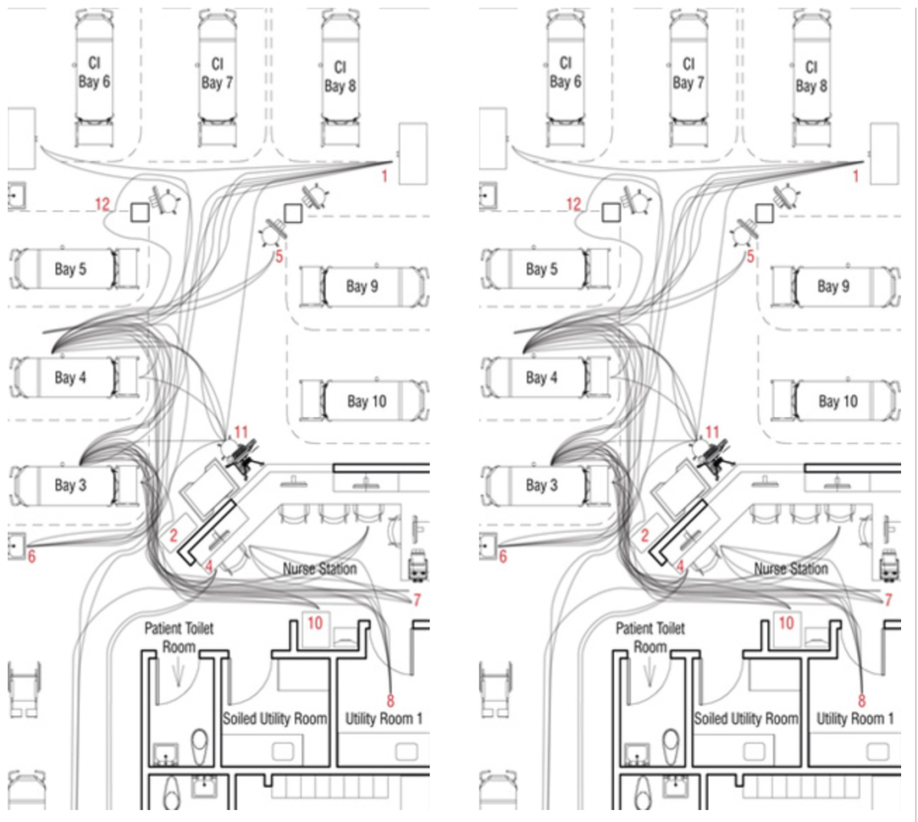
Spaghetti Diagram

