Slide 1
[Insert Hospital Name]
Timeline Study
Prepared by (15pt Arial) [Insert name of presenter 15pt Arial Bold] [Insert title] [Insert Hospital name]
Month 200X (12pt Arial Bold)

Slide 2
Why do we need the Timeline Study? because we know things look like this...
Initial ED Review
Junior RN, senior RN, junior MO, senior MO....then decision
In Patient Review
Calls to Specialty Consultant unanswered
Consultant not in hospital
Multiple referrals
Bed Allocation
Bed status not accurate, electronic systems not fully utilised
Bed staff spend significant time ‘looking’ for beds
Available beds ‘hidden’ on wards
ED Patient Preparation for Ward
Ward ‘didn’t see’ bed request
Ward ‘not ready’ to take patient
Competing RN priorities in ED
Competing MO priorities in ED
Patient Transfer
Orderlies not available
How do all the different parts coordinate themselves?

Slide 3
This is what it should look like: The Ideal Patient Journey
Initial ED Review
Patient seen quickly by senior decision maker
In Patient Review
Specialty Consultants available
ED able to admit to ward (PD2009_055)
Bed Allocation
Bed status live, accurate, available
Bed selected at time of need
Ward advised of patient’s ETA
Capacity identified and available
ED Patient Preparation for Ward
ED prioritises admission/transfer
Required ED resources are coordinated
Patient Transfer
Orderly’s roster are optimised
Orderly’s duties are prioritised
An ED and Hospital wide focus on operations

Slide 4
Methodology
Data collected manually over 2 days on [insert your dates here]
Staff collecting data included [insert range of staff groups who participated]
The journeys of [insert number here] patients were followed from arrival at triage to departure from ED
Data points included times to: Initial ED Review; In Patient Review; Bed Allocation; ED Patient Preparation for Ward and Patient Transfer
A significant amount of narrative was also collected by the staff about observations of the process in action, barriers identified and missed opportunities.

Slide 5
So what did our Patient Journey timeline look like?
Median – 0.00
Target – 0:30 mins from triage
00% decrease required
Median – 0.00
Target – 1:00 mins from referral by ED
00% decrease required
Median – 0.00
Target – 1:00 mins from bed request
00% decrease required
Median – 0.00
Target – 0:30 mins from bed ready
00% decrease required
Median – 0.00
Target – 0.15
00% decrease required

Slide 6
Our patient journey timeline
30 minutes
Triage to seen by ED Medical Officer
1.5 hours
ED / Disposition decision
1 hour
Decision to admit to bed request & allocation / inpatient input
1 hour
Bed allocated – ward ready / communication/ transfer
XX minutes
XX % reduction required
XX hours
XX % reduction required
XX hours
XX % reduction required
XX hours
XX % reduction required
Notes:
Ideal – seen by mo in 30 minutes and discussed with SMO within

Slide 7
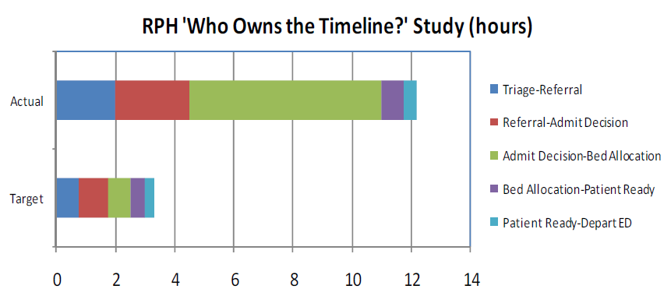
Baseline study
Key studies
“Who owns the timeline?” – first done RPH 2009
Provided clarity on where the delays were

Slide 8
Themes of barriers to flow identified during observations
[Insert local issues identified in the study]

Slide 9
Where do we go to from here? Discussion Points
Root Cause Analysis
Solution Design

