Slide 1


Handbook for Nurses and Midwives: Responding Effectively to People Who Use AOD
Identifying and Managing Family and Social Needs
Prepared by Mary Wahhab
November 2021

Slide 2
This presentation was prepared by Mary Wahhab as part of the Nursing and Midwifery Community of Practice, it supports the implementation of the NSW Health Policy Directive Nursing and Midwifery Management of Drug and Alcohol Use in the Delivery of Health Care PD2020_032.

Slide 3

Outline of presentation
AOD use and child wellbeing & child Protection
Abuse & neglect
Accidental or intentional consumption of methadone or buprenorphine by a child
Homelessness or risk
Substance use in Pregnancy and Parenting
Violence including FDV

Slide 4
AOD Use and Child Wellbeing & Child Protection
Roles NSW health staff:
Promote the health, safety, welfare and wellbeing of children and young people when providing healthcare.
Collaborate with interagency partners to ensure child wellbeing and protection
Responsibilities of Nurses and Midwives:
Assess for child wellbeing risks & concerns
Identify risks and respond effectively & promptly by:
  Raising concerns
  Reporting concerns
  Safety plan to mitigate risk

Slide 5
AOD use and Child protection & Child Wellbeing
Risk Factors for recurring child abuse and neglect Include:
Maternal Mental Health
Domestic Violence
Substance use
Child Wellbeing and Child Protection should be part of the assessment process when working with patients who are parents/carer, or women who may be pregnant.
Risk assessment should be collected from various sources and not only from patient
Substance use alone does not mean parenting will be adversely effected
Often risk is multi-layered and complex

Slide 6
Consideration with Risk Assessment
When assessing risk, consider the following:
  Age of the child or young person
  Emotional and developmental milestones
  Level of vulnerability
Other information to gather:
  Who lives with the child or young person
  Number and ages of all children
  Other adults living/visiting the home
  Identification of risk
Action plan following identification of risk:
Monitor risk and escalate concerns to manager and or senior clinician
Reporting requirements and responsibilities
Collaborate with other health professionals or support services to ensure safety and wellbeing of the child and or young person
Inform family about speaking with other services and referral pathways for effective support
Handbook for Nurses and Midwives: Responding effectively to people who use alcohol and other drugs, 2020

Slide 7

Child Wellbeing Guidelines and Resources
Mandatory Reporter Guide (MRG)
  Assists clinicians in their decision making about the level of risk and in deciding what initial action to take
  Action can be influenced by the concerns and answers to the questions
Child Wellbeing Unit (CWU)
  Telephone consultation service, advice and information on background health, child protection/wellbeing of a child/young person/vulnerable family
  Health CWU 1300 480 420 (Monday-Friday 8.30am-4.30pm) or submit an
  eReport after registering for ChildStory https://reporter.childstory.nsw.gov.au/s/login/
Child Protection Helpline – Risk of significant harm
  Call 13 2111
  Helpline e-reporting
Policies and Procedures
  Child Wellbeing and Child Protection Policies and Procedures for NSW
  Chapter 16A of the Children and Young Persons (Care and Protection) Act 1998

Slide 8

Abuse and Neglect – Types of Abuse
Abuse refers to acts of commission
Types of Abuse:
  Physical
  Psychological
  Sexual abuse
  Emotional abuse
  Domestic and family violence
Neglect refers to acts of omission
Neglect:
Neglect – failure by parent or caregiver to provide a child with basic items
  Supervision; Food; Clothing/hygiene; Shelter/environment; Medical/dental care; Mental health care; Education – not enrolled, habitual absence
Notes:
Physical abuse is a non-accidental injury or pattern of injuries to a child or young person caused by a parent, caregiver or any other person.
Psychological abuse is characterised by a person subjecting or exposing another person to behaviour that may result in psychological trauma, including anxiety, chronic depression, or post-traumatic stress disorder.
• Sexual abuse occurs when someone involves a child or young person in a sexual activity by using their power over them or taking advantage of their trust.
• Emotional abuse of a young person can occur if the behaviour of their parent or caregiver damages the confidence and self-esteem of the child or young person, which often results in serious emotional disturbance or psychological trauma.
• Domestic or family violence is any abusive behaviour used by a person in a relationship to gain and maintain control over their partner or ex-partner. It can include a broad range of behaviours that cause fear and physical and/or psychological harm. If a child or young person is living in a household where there have been
incidents of domestic violence, they may be at risk of serious physical and/or psychological harm

Slide 9
Accidental or intentional consumption of Methadone or buprenorphine by a child
Ingestion of methadone and buprenorphine takeaway doses is dangerous for children and can be life threatening, even a small amount can be fatal
Immediate medical care must be initiated if in community setting
  Call Emergency
  Assess level of consciousness and monitor child until in the care of ambulance
Hospital setting
  Oxygen therapy
  Naloxone
Reporting Requirement
Notify:
    Prescriber/Clinic - dosage/takeaways
    Pharmaceutical Regulatory Unit (PRU)
    Child protection helpline report
    Child protection services/social worker at hospital prior to discharge
NURSES WORKING IN ED
Refer to Incident Management Policy Mandated reporting – Legal and Policy Requirements of the NSW Health

Slide 10
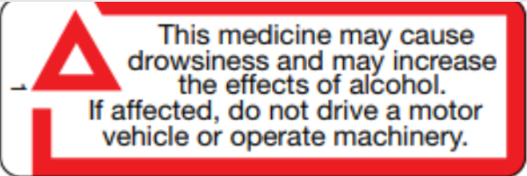
Risks following discharges from a facility
Nurses and Midwives should identify whether patient has recently been discharged from a facility such as:
  Hospital or other health setting
  A rehabilitation or detoxification service
  Correctional centre or other custodial setting
  Other temporary health of social service
Patients sometimes commence Opioid Agonist Treatment (OAT) treatment during an admission in a health setting such as methadone, buprenorphine
Risks following discharges include:
  Resumption of substance use post discharge
  With reduced tolerance, risk of intoxication and or overdose is high
  Dose changes or initiation on OAT treatment may pose a risk on normal activity such as driving skills, operating machinery
Infographics: NUAA Users News
Notes:
Methadone (Biodone Forte® or Methadone Syrup®)
Do not drive: 4 weeks from start
Especially Careful : 3-5 days after dose change
Buprenorphine (Suboxone® or Subutex®)
Do not drive: 2 weeks from start
Be especially careful: 3-5 days after dose change

Slide 11

Homelessness or Risk of Eviction
Substance use is likely to be a marker for the presence of other risk factors, including poverty, homelessness, inadequate accommodation and poor social supports.
Patients identified as being homeless or at risk of eviction should be referred to social worker at the hospital
Strategies to encourage discussions:
  Building rapport
  Approach topic with sensitivity
  Ensure language is appropriate and not blaming

Slide 12

Substance use in Pregnancy & Parenting

Slide 13

Substance Use during Pregnancy
While reporting concerns relating to an unborn child is not mandatory, it is good practice and allows:
  Department of Communities and Justices (DCJ) and other agencies to work collaboratively with the pregnant woman and partner to engage in services for support to the parent/s and unborn child
  DCJ to prepare statutory/protective intervention following the birth of the child
Clinicians are encouraged to engage pregnant women to provide support and access to services such as SUPPS service.
Stigma is a barrier to accessing services. Clinicians are encouraged to:
  Ensure confidentiality
  Engage sensitively
  Build rapport and trust
  Offer appropriate care and referral pathways for support
SUPPS supports pregnant women who use substances from the antenatal period to two years post-delivery
Infographics: SWSLHD SUPPS service

Slide 14
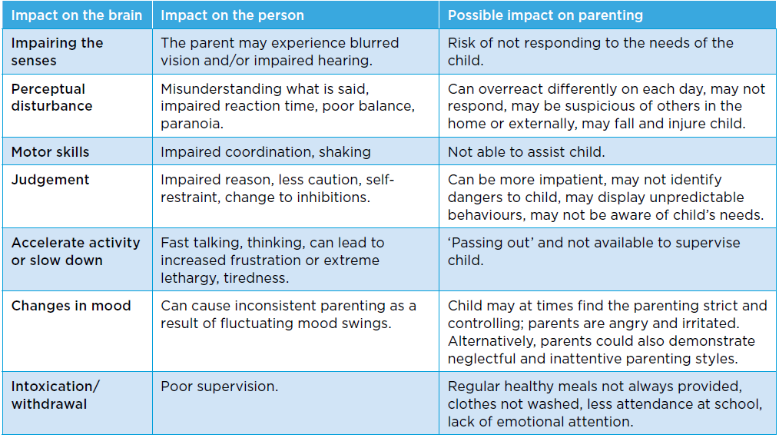
Substance Use and Impact on Parenting
Source: Handbook for Nurses and Midwives: Responding effectively to people who use alcohol and other drugs, 2020

Slide 15

Domestic and Family Violence

Slide 16

Domestic and Family Violence (DFV)
DFV refers to acts of violence that occur between people who have, have had an intimate relationship
Elements of Domestic Violence (DV) are ongoing patterns of behaviours aimed at controlling a partner, through fear and a range of other tactics to exercise power and control another person and their children
DV may include physical, verbal, financial, sexual, emotional, and psychological abuse
DFV occurs in cyclical patterns making it difficult for the victim to leave the relationship
Family violence is a broader term referring to violence between family members as well as between intimate partners.
Key points
Responding to DFV is the responsibility of all NSW Health employees
Risk assessment is considered routine clinical practice where DV is identified
Risk assessment is part of an ongoing continuum of care, therefore should be reassessed
Risk changes quickly - must be continuously assessed, monitored and reviewed as part of patient care

Slide 17


Risk Assessment and Child Protection
DFV Risk Assessment
Clinicians who have received training in Domestic Violence Routine Screening (DVRS) should conduct risk assessment using the structured risk assessment tool when safe and appropriate
Clinicians who have not received training, should refer to another trained clinician in psychosocial interventions/conducting the assessment
When conducting risk assessment consider the:
  Safety of all children
  Safety planning as part of the intervention
  Reporting responsibilities starting with MRG
Risk Assessment tools:
  Domestic Violence Routine Screening Tool (DVRS)
  Domestic Violence Safety Assessment Tool (DVSAT)

Slide 18
References
NSW Ministry of Health. (2020). Handbook for Nurses and Midwives: Responding effectively to people who use alcohol and other drugs
NSW Ministry of Health. (2020). Drug Compendium: Supplement Reference for AOD Treatment
NSW Ministry of Health. (2020). Nursing and midwifery management of alcohol and drug use in the delivery of health care: procedures
NSW Health. (2013). Child Wellbeing and Child protection Policies and Procedures for NSW Health https://www1.health.nsw.gov.au/pds/ActivePDSDocuments/PD2013_007.pdf
NSW Health. (2006). Domestic Violence - Identifying and Responding. https://www1.health.nsw.gov.au/pds/ActivePDSDocuments/PD2006_084.pdf

