Slide 1
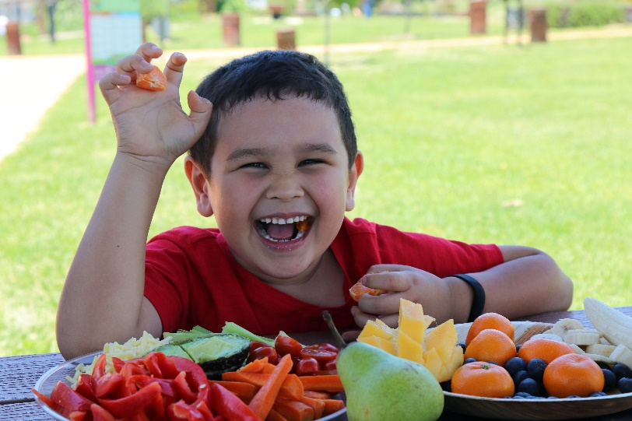
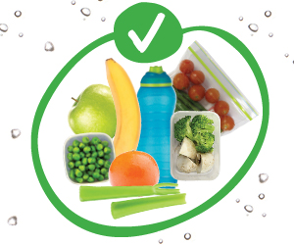
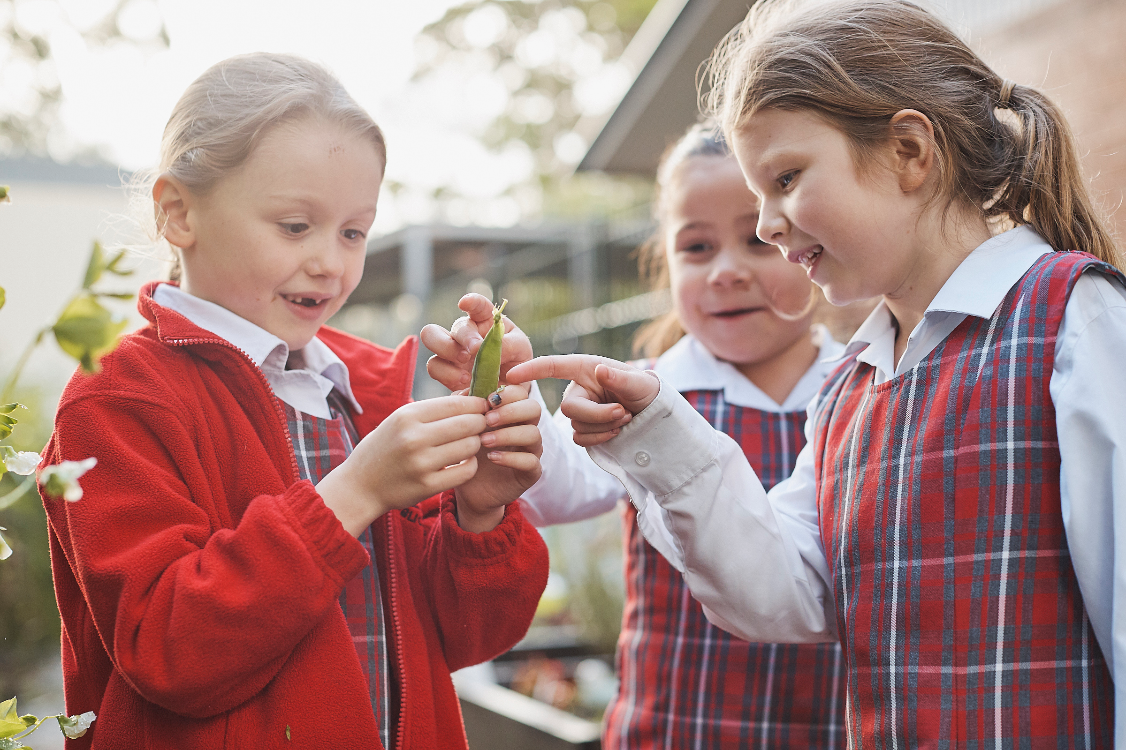
Crunch&Sip®
NSW Health acknowledges the development of the Crunch&Sip® campaign by
the Department of Health, Western Australia.

Slide 2
Overview
What is Crunch&Sip®?
Why should your school participate in Crunch&Sip® ?
How can Crunch&Sip® be implemented at your school?
How can you find out about Crunch&Sip®?
Challenges
Notes:
This presentation aims to inform schools of how they can choose to implement the Crunch&Sip program and the associated benefits of the program.

Slide 3
What is Crunch&Sip®?
Crunch&Sip® encourages children to eat vegetables or fruit and drink water
Students ‘refuel’ on fruit and vegetables and ‘rehydrate’ on water during a supervised, set time
At most schools Crunch&Sip® happens within the classroom
The school decides how and what time best suits their needs
Notes:
The Crunch&Sip® break is a time for students to have a snack of fruit or salad vegetables and a drink of water during class. Many children can get tired and lose concentration during long learning sessions. The short Crunch&Sip® break provides an opportunity to refocus and helps improve concentration as well as physical and mental performance.

Slide 4
Why should your school participate in Crunch&Sip®?
Students who are not hungry and are well hydrated:
Perform better in the classroom
Show increased concentration
Are less likely to be irritable and disruptive
Notes:
Every child deserves the best start in life.
Good eating habits formed during childhood help children grow well and protect them against disease in later life.
Only 1 in 20 (5%) of children in NSW (aged 5-15 years) eat the recommended amount of vegetables daily.
There is also evidence that children who consume low levels of fruit and vegetables are more likely to be overweight or obese.
Source: NSW Health - https://www.health.nsw.gov.au/hsnsw/Publications/chief-health-officers-report-2017.pdf

Slide 5
Why should your school participate in Crunch&Sip®?
It helps gives the children the best start in life
It helps create good eating habits
It helps increase vegetable consumption amongst children
It helps protect against a number of diseases and the likelihood of becoming overweight or obese

Slide 6
Hear what others say about Crunch&Sip®
Notes:
Take a look at this video presentation to hear what other schools think of the Crunch&Sip program.
{PLAY VIDEO}. {REQUIRES INTERNET}.
Link: https://www.youtube.com/watch?v=6YZPlHwnyag

Slide 7
How can Crunch&Sip® be implemented at your school?
STEP 1.
Consult staff and discuss how you want to implement Crunch&Sip®
STEP 2.
Discuss with parents/carers and inform them of their role in supporting Crunch&Sip®
STEP 3.
Discuss Crunch&Sip® with students and involve them in developing classroom rules that set out how the program will work.
STEP 4.
Launch Crunch&Sip® at school.
Aim for 70% of classes participating, at least four days a week.
STEP 5.
Link Crunch&Sip® to other areas of school life (e.g. school vegetable garden).
STEP 6.
Include Crunch&Sip® in your school policy.
Notes:
As a staff, discuss and decide on a model that works best for the school. Timing can be any time that suits the school – whether it be in the morning or afternoon session is up to the school. You may wish to determine a time for the program as an individual class, an entire stage, or the whole school.
Trialing the program is a great way to have 1-2 classes, or an entire stage learn what works well and what does not. From this trial, the teachers involved can provide feedback to the rest of the staff to help guide how the rest of the school implements the program.
Provide information about Crunch&Sip to other important areas of the school – parent body, PDHPE committee and any other relevant curriculum group, as well as the canteen – who may wish to start selling “Crunch&Sip veggie stick packs or fruit packs”

Slide 8
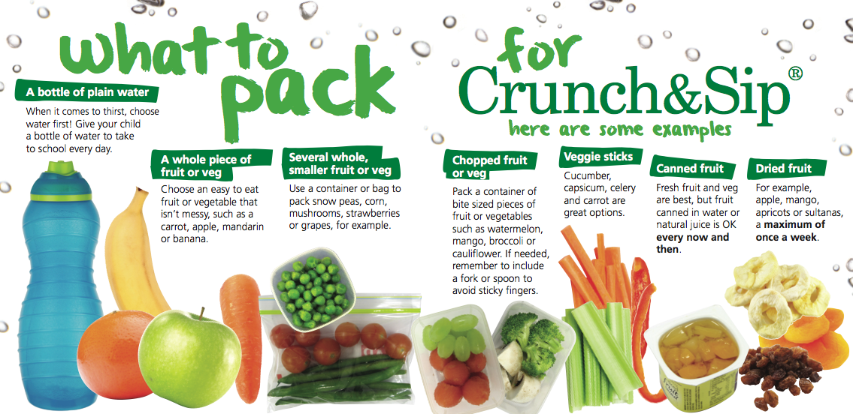
How can Crunch&Sip® be implemented at your school?
Notes:
Encourage more vegetables than fruit and advise changing up the options, so the children don’t get bored BUT can also experience new vegetables and fruit they haven’t tasted before.

Slide 9
How can Crunch&Sip® be implemented at your school?
Only fruit & vegetables are suitable for Crunch&Sip®. These are not suitable:
Fruit juice
Fruit products such as roll ups, leathers or straps
Potato or veggie chips
Olives
Fruit canned in syrup
Popcorn
Notes:
Explain that these foods have often been accidentally brought to Crunch&Sip sessions – popcorn for instance, may be a healthier option than chips… however is not appropriate for Crunch&Sip.

Slide 10
Challenges
Keeping momentum up
Hold an annual ‘launch’ event
Challenge and track class participation
Ensuring all students bring their Crunch&Sip®
Remind parents
Cut up and share all fruit and vegetables
Have Crunch&Sip® packs at school canteen
Plant a school garden and use the produce
Link with local suppliers
Reducing burden on teachers
Involve students in establishing class rule around reducing mess and keeping to a set time

Slide 11
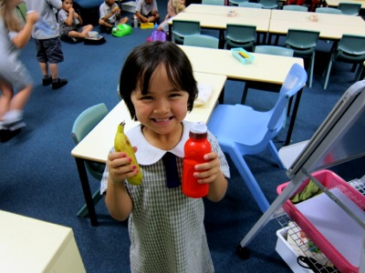
Remember…
I hear, and I forget.
I see, and I remember.
I do, and I understand.
Chinese Proverb
For more info:
www.health.nsw.gov.au/heal/primaryschools/Pages/crunch-and-sip.aspx

