Slide 1
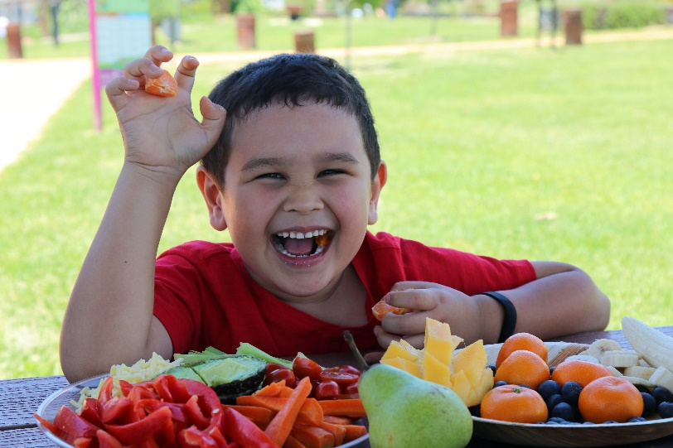
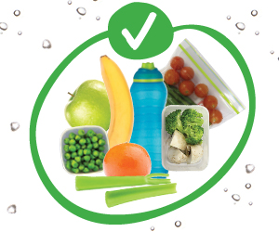
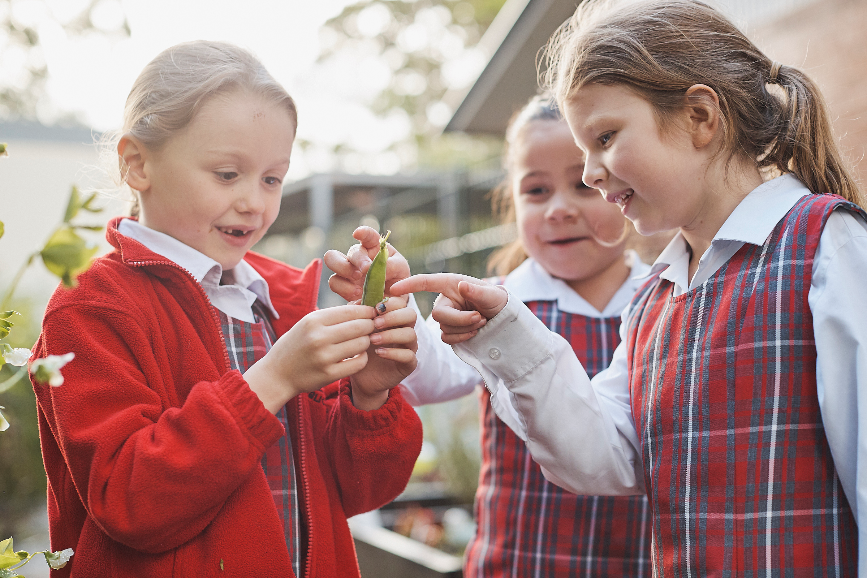
Crunch&Sip®
NSW Health acknowledges the development of the Crunch&Sip® campaign by
the Department of Health, Western Australia.

Slide 2
Overview
What is Crunch&Sip®?
Why our school participates in Crunch&Sip®
What others say about Crunch&Sip®
What is the role of parents?
Notes:
This presentation aims to inform parents about the Crunch&Sip program and the associated benefits of the program.

Slide 3
What is Crunch&Sip®?
Crunch&Sip® encourages children to eat vegetables or fruit and drink water
Students ‘refuel’ on fruit and vegetables and ‘rehydrate’ on water during a supervised, set time
Each class teacher decides how to do Crunch&Sip® and may establish their own class rules
Notes:
The Crunch&Sip® break is a time for students to have a snack of fruit or salad vegetables and a drink of water during class. Many children can get tired and lose concentration during long learning sessions. The short Crunch&Sip® break provides an opportunity to refocus and helps improve concentration as well as physical and mental performance.

Slide 4
Why our school participates in Crunch&Sip®
Students who are not hungry and are well hydrated:
Perform better in the classroom
Show increased concentration
Are less likely to be irritable and disruptive
Notes:
Every child deserves the best start in life.
Good eating habits formed during childhood help children grow well and protect them against disease in later life.
Only 1 in 20 (5%) of children in NSW (aged 5-15 years) eat the recommended amount of vegetables daily.
There is also evidence that children who consume low levels of fruit and vegetables are more likely to be overweight or obese.
Source: NSW Health - https://www.health.nsw.gov.au/hsnsw/Publications/chief-health-officers-report-2017.pdf

Slide 5
Why our school participates in Crunch&Sip®
It helps gives the children the best start in life
It helps create good eating habits
It helps increase vegetable consumption amongst children
It helps protect against a number of diseases and the likelihood of becoming overweight or obese

Slide 6
Hear what others say about Crunch&Sip®
Notes:
Take a look at this video presentation to hear what other schools think of the Crunch&Sip program.
{PLAY VIDEO}. {REQUIRES INTERNET}.
Link: https://www.youtube.com/watch?v=6YZPlHwnyag

Slide 7
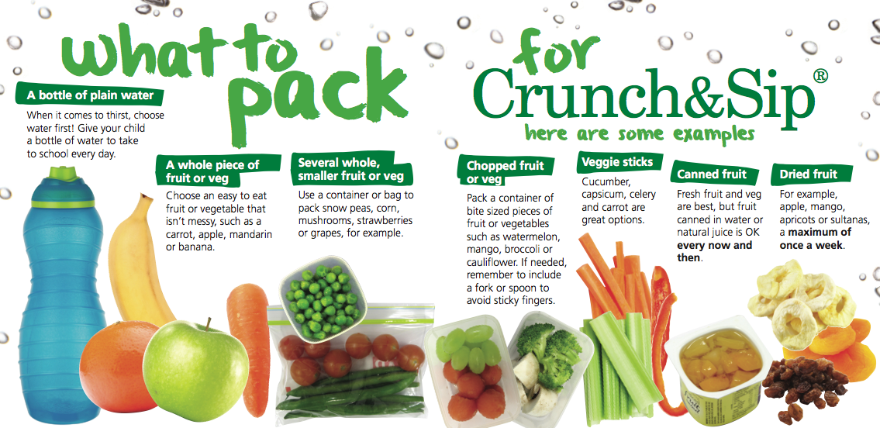
Please pack some fruit or vegetables and water everyday for Crunch&Sip®
Notes:
Encourage more vegetables than fruit and advise changing up the options, so the children don’t get bored BUT can also experience new vegetables and fruit they haven’t tasted before.

Slide 8
Please pack some fruit or vegetables and water everyday for Crunch&Sip®
Only fruit & vegetables are suitable for Crunch&Sip®. These are not suitable:
Fruit juice
Fruit products such as roll ups, leathers or straps
Potato or veggie chips
Olives
Fruit canned in syrup
Popcorn
Notes:
Explain that these foods have often been accidentally brought to Crunch&Sip sessions – popcorn for instance, may be a healthier option than chips… however is not appropriate for Crunch&Sip.

Slide 9
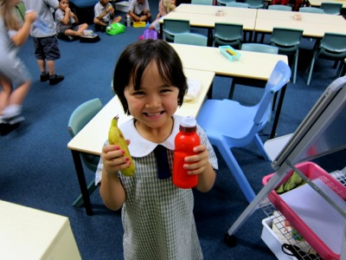
Remember…
I hear, and I forget.
I see, and I remember.
I do, and I understand.
Chinese Proverb
For more info:
www.health.nsw.gov.au/heal/primaryschools/Pages/crunch-and-sip.aspx

