Slide 1
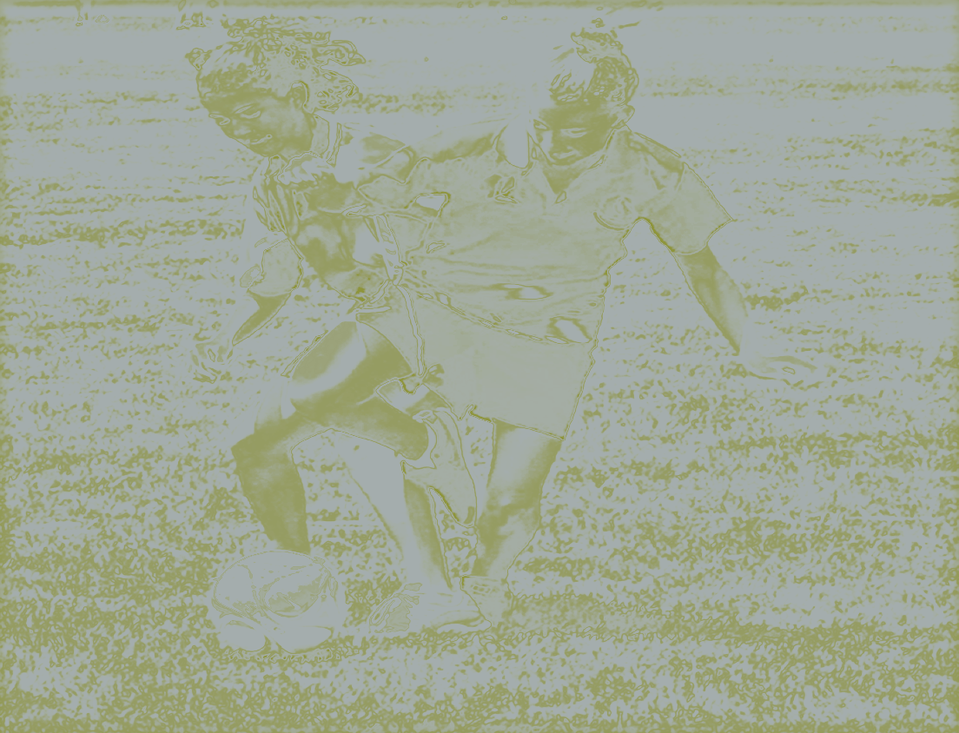
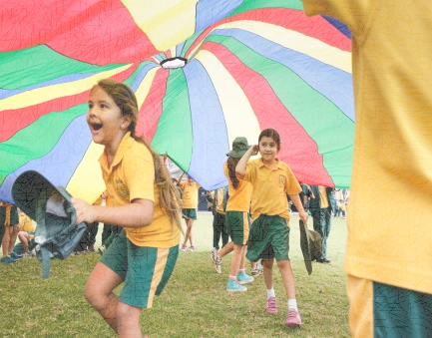
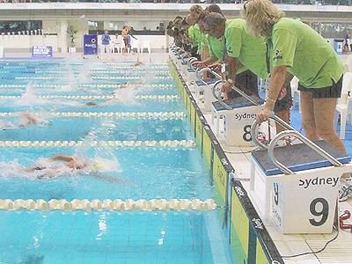
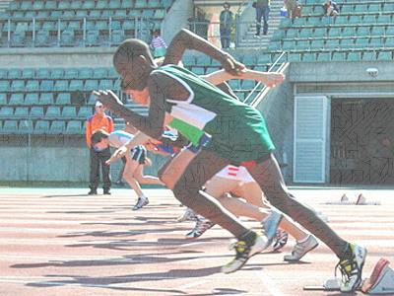
Physical activity in nsw public schools
Ross Morrison, Leader, NSW School Sport Unit

Slide 2
Setting the scene
Planned physical activity
Physical Education as part of PDHPE
Weekly timetabled Sport
Other structured physical activity programs
Notes:
The PDHPE Key Learning Area is mandatory for students from Kindergarten to Year 10.
All students in Years K-10 must participate in weekly school sport as part of the school day. This is where we are very unique to all the other Australian states and territotires and countries.
About 2211 schools with over 774000 students (2014 data)

Slide 3
Actions to increase physical activity
Sport and Physical Activity Policy changes
Physical Literacy continuum
Physically Active Schools website
Monitoring
Teacher Professional Learning

Slide 4
Teacher support
Teacher professional learning
Live Life Well @ School
School Sport Unit TPL - 3000 teachers participating across 200 workshops
40 registered courses through BOSTES
Building teacher capacity
Integrated learning
Thinking while moving - teaching maths through physical activity
State-wide workshops and K-6 conferences
Lesson plans and demonstration videos
Website and resources
School Physical Activity Review Tool
Physical Literacy Continuum
School case studies
Demonstration videos
Tools and resources

Slide 5
Student programs
Largest and longest running Gifted and Talented program: 275,000 students annually
Students can represent school, zone, region, state and Australia
Pacific School Games Adelaide 2015
Representative School Sport Pathway
Sport and Physical Activity Programs
NSW Premier’s Sporting Challenge
Over 338,000 students from 1,388 schools and 7,400 staff participating in the ten week physical activity challenge in 2015
100,000 primary school students from 1,430 schools
Acknowledged as the most significant contributor to water safety at 2015 Water Safety Awards
School Swimming and Water Safety Program
Sport for students with additional needs
Participation programs for 8,500 students with additional needs at a variety of multi-sports days/come and try days and sport specific competitions

