Slide 1


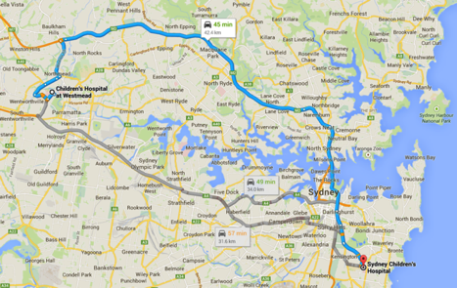


Slide 2
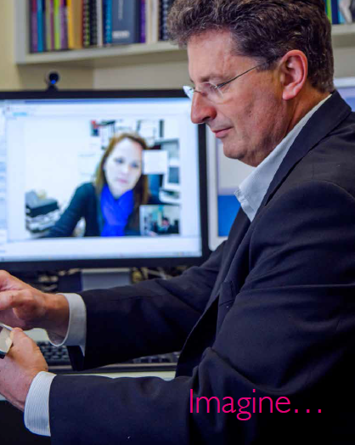
What do Patients and Families want?
Communication/Information/Feedback
Safety
Possibilities
On line education
Translation
Self check in
Self assessment
Referral and appointment tracking
e-clinic
e-Results
Q and A on line
Contribution to the record
Way-finding
Transition

Slide 3


A lifetime
health record
In the hands of patients and
families
Notes:
To create patient access and control in the Australian context
Records for life
Changing the future for the next generation
Shared care model
Based on life- not health events
Retrospective diagnosis and treatment
Data hoarding versus data sharing

Slide 4

Strategy Refresh

Slide 5
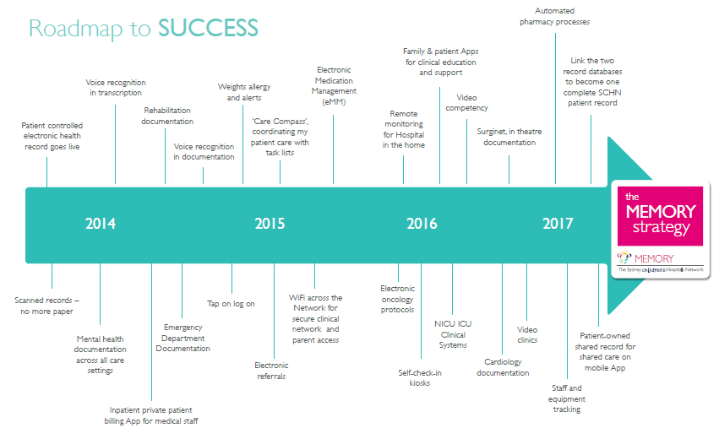
MEMORY

Slide 6


E ref
Triage/Pre assessment
Education commences
referrer informed of plan and dates
SMS reminders
Allied/nursing check in
E-clinic with GP
Specialty clinic face to face
Specialty care
eRFA
Pre planning
billing
admit
Self check in
Pt portal update for DC
IP notes
IP education
DC communication
Registered with pt portal
billing
education
Team update
My team
Self check in kiosk
Follow up

Slide 7
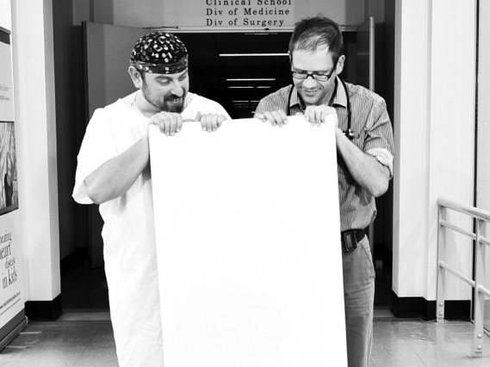

Partner focussed
+
Flexibility

Slide 8

ROI for The Patient Portal
Shared Care
Education
Work-flow
Real-time
Patient surveys/PROMS/PREMS/PRMs
Events between
Safer care
Patient Satisfaction
Staff Satisfaction
Better Communication
Clinical Outcomes
Lower Readmissions
Revenue
Better use of resources

Slide 9
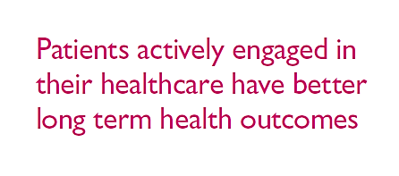
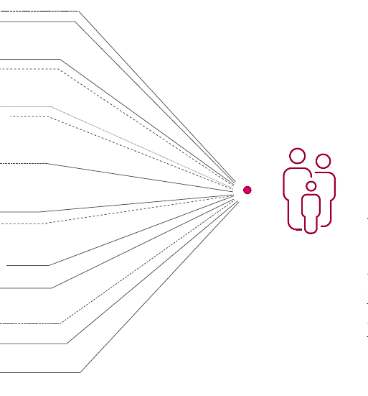
Wants
Parents/patients contribute
Past records option
Summaries/results/meds
Medical professional details
Schedule /Wait times on hand
Environmental control
A library
Maps
Feedback
Concerns
Security
Age limits
Transition

Slide 10
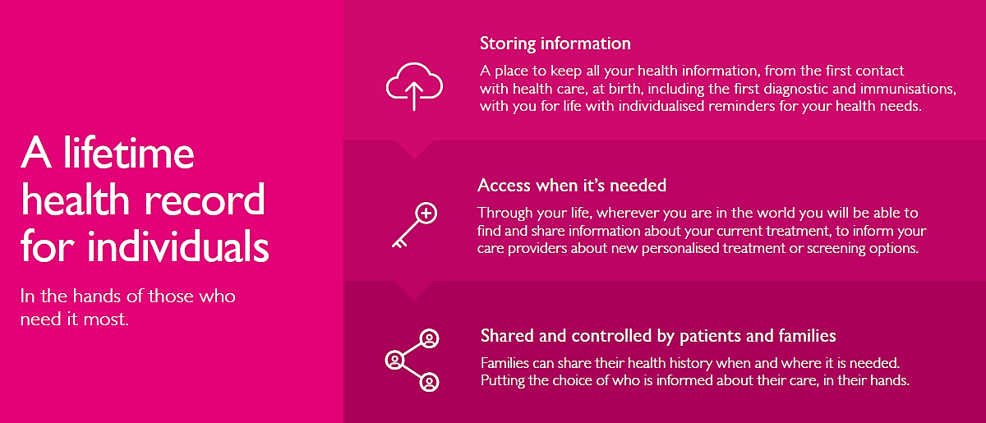

Storage
Access
Control

Slide 11
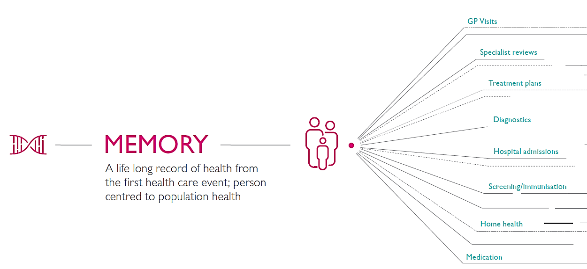

Slide 12
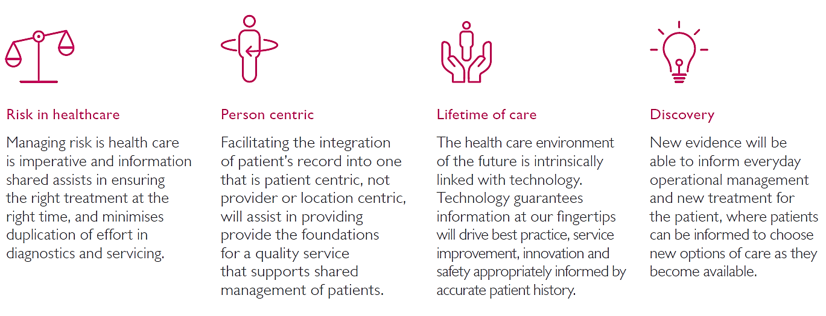
Safety First
Lifetime Care

Slide 13

What will records in the hands of patients change?

Slide 14
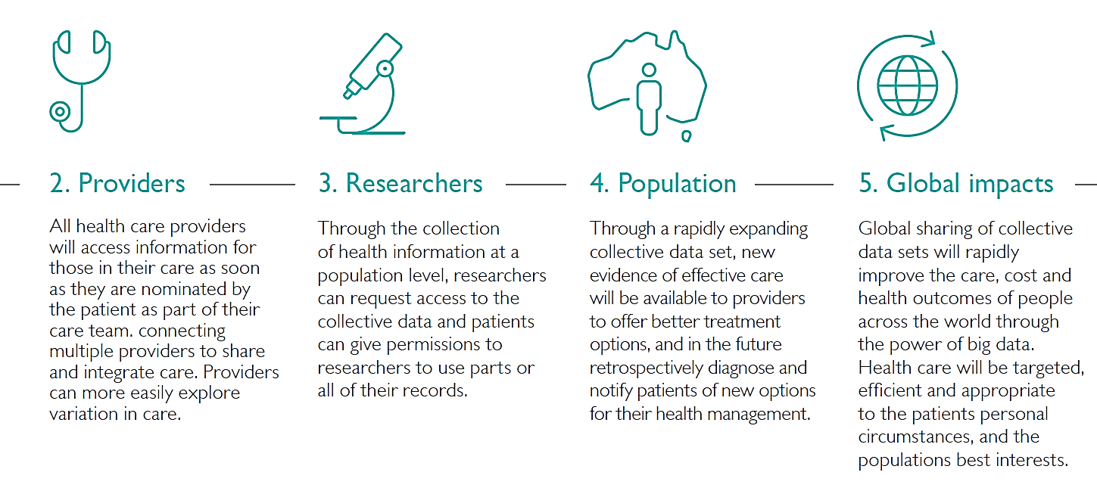
Healthcare Transformation

Slide 15
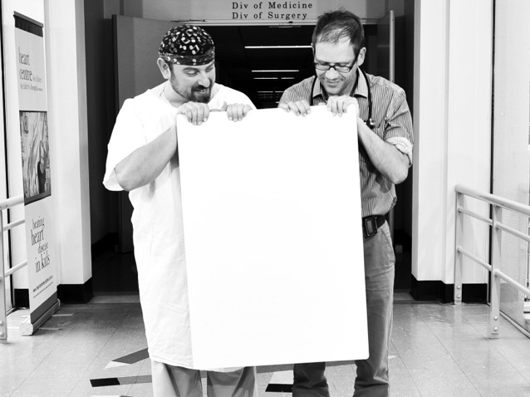
Data
Analytics
Research
Transformation

Slide 16

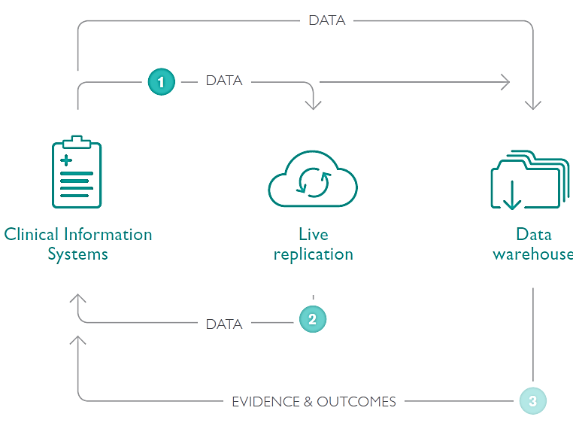
Care
Analytics
Research

Slide 17
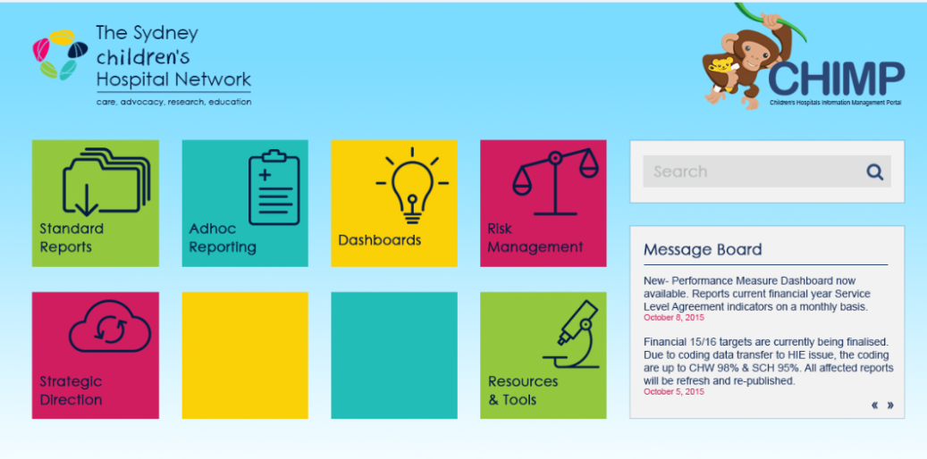

Slide 18
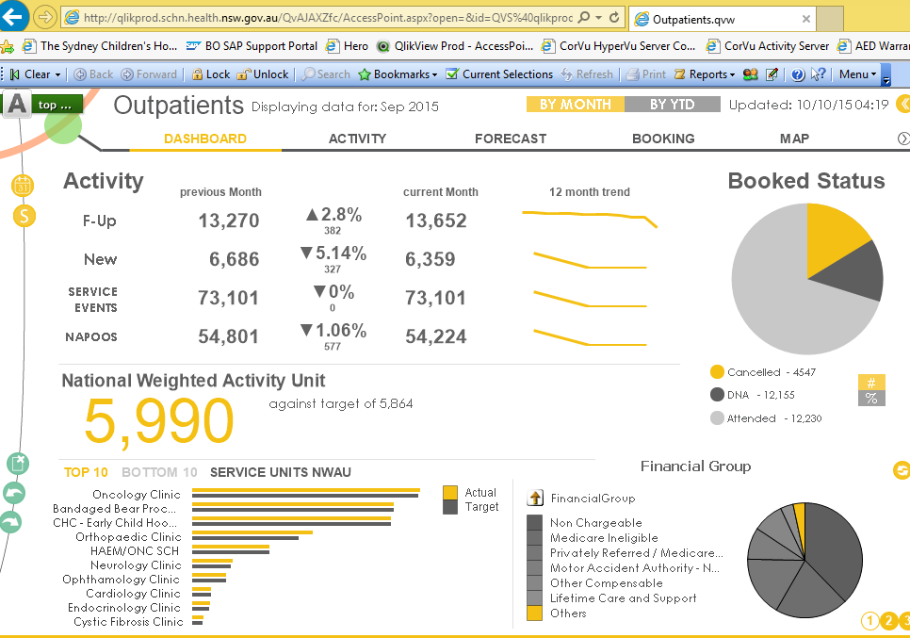

Slide 19
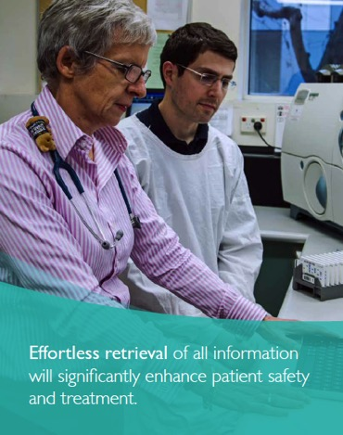
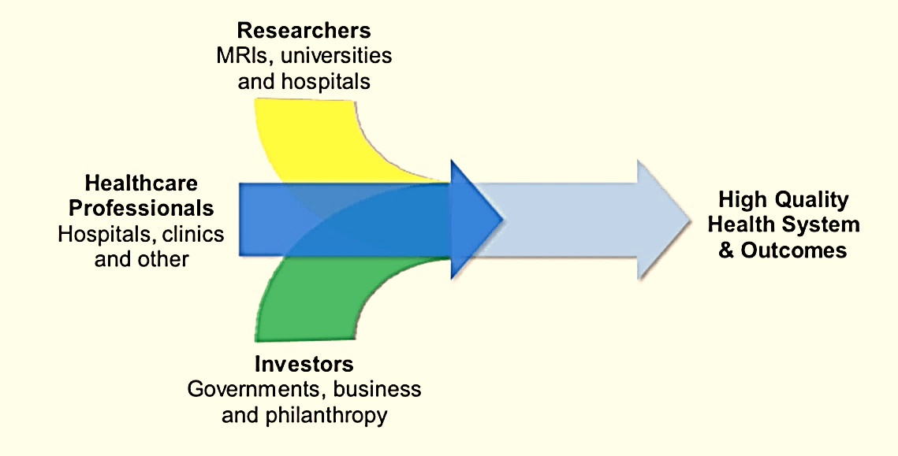
Research
‘Secondary use’
Longitudinal - Tracking illness and Health
Precision /Personalised treatment
Prediction, prevention and retrospective diagnosis
  Access/ownership
  Useability/Flexibility
  Cost
  Cooperation

Slide 20
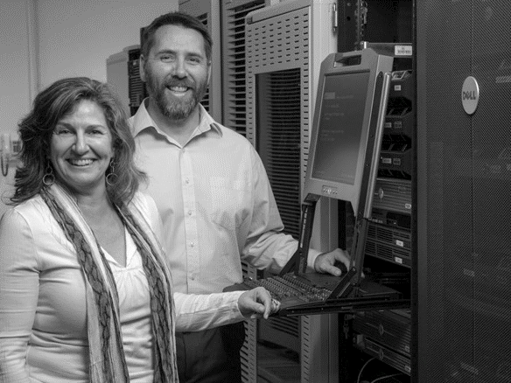
Possible ?

Slide 21
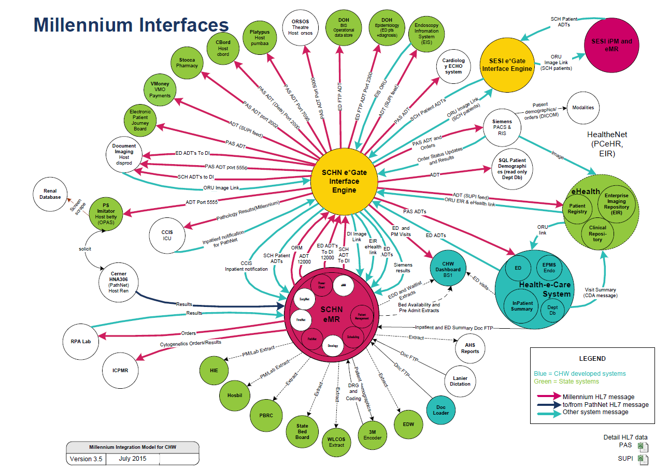

Slide 22
Existing Databases/ infra-structure
Integration
PCEHR
EIR
HealthenetBlue Book
Physician
Direct messaging
User interface
With patient permissions
Surgeon
Medical Imaging
Other provider
data repositories
Medical Imaging
Nurses
Pharmacy

Slide 23
Patient controlled
Outputs/inputs
Patient
guidance
Imaging
Patient controlled interactive
Pathology
Static information, system
outputs
Demo-graphic
History
Treatment Plans
Allergies
Wearables
Wellness
diary
Medication
Combination of interactive, updated data

Slide 24
Variable Lifetime Views

Slide 25
Snapshots
Male
5 years old
Laparoscopic Appendectomy

Slide 26
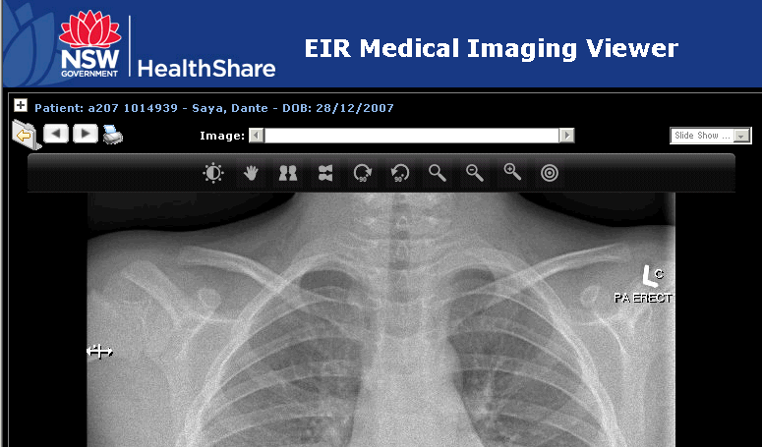
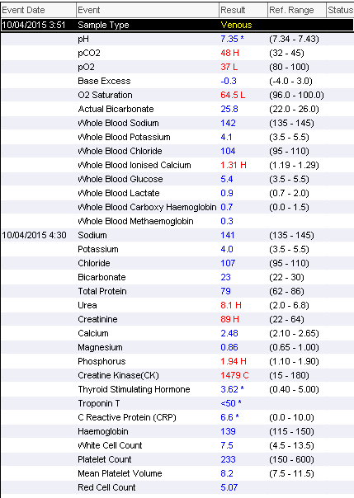
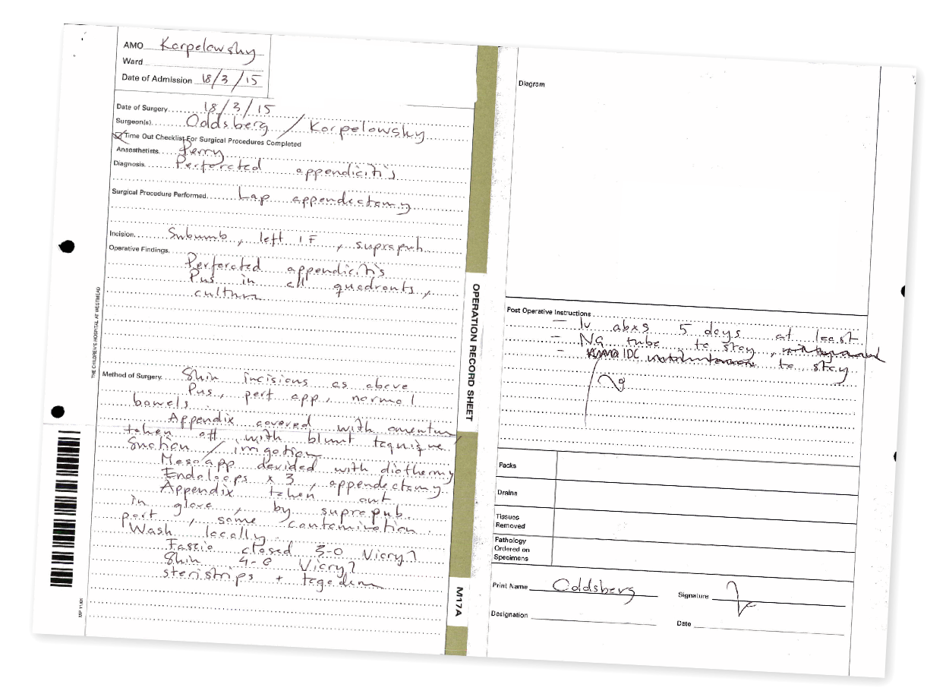
Snapshots
Male
5 years old
Laparoscopic Appendectomy
Documentation:
Operation Report »

Slide 27
Snapshots

Slide 28
Lifespan View
Surgery
overview, event or series
Immunisation
Consultation
Event: C
Date: 25/06/2010
Click for more details
Medication
admission
Surgery
physio
physio
Chiropractic
Event A
Date: 03/03/2010
Click for more details
Event : F
Date: 03/03/2011
Click for more details
Event : H
Date: 03/03/2011
Click for more details
Event : I
Date: 25/02/2013
Click for more details
dental
Health tracking
sports
Incident: D
Date: 03/03/2010
Click for more details
Incident: G
Date: 03/03/2010
Click for more details
Incident: H
Date: 03/03/2010
Click for more details
meditation
Carer support
Birth
01/01/2005
6 months
01/07/2010
1 year
01/01/2011
18 months
01/07/2011
2 years
01/01/2012
3 years
01/01/2013
4 years
01/01/2014
Present
4 years 5 months
Event : B
Date: 10/05/2010
Click for more details
Event : E
Date: 10/01/2011
Click for more details
Event : J
Date: 05/06/2013
Click for more details

Slide 29
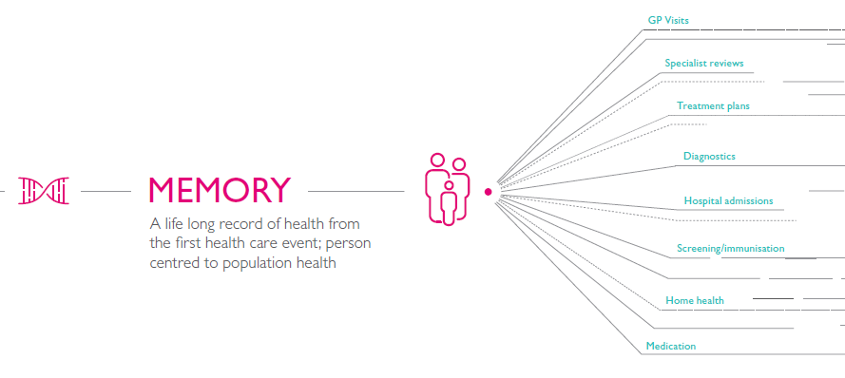
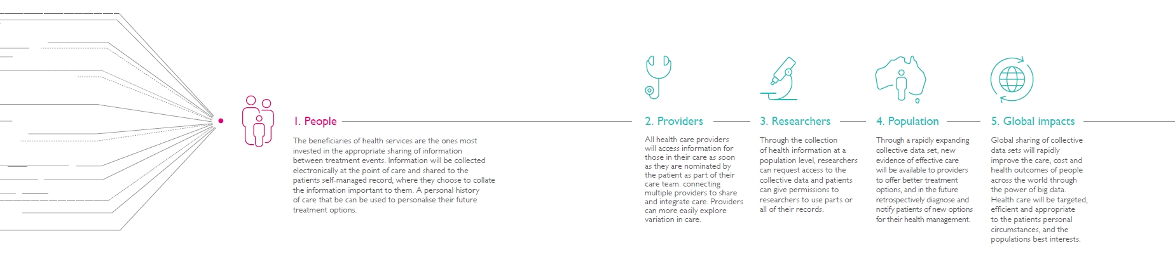
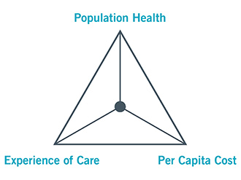

Slide 30



