Slide 1

Essential Youth Healthcare Skills
Youth Health Training Initiative
Training date [Insert]
Location [Insert]
Trainer [Insert]
Copyright 2018 - NSW Ministry of Health
2nd Edition

Slide 2

Introductions and Training Overview (20 min)

Slide 3
Suggested ground rules
One person speaking at a time
Confidentiality of any disclosures
Respond respectfully – no put downs, minimising
Speak on behalf of yourself only
It is ok to ‘pass’ – taking risks enhances learning!
Respect any differences
Mobiles / laptops / devices off – strictly no recording or photos to allow confidential discussions
Return on time after breaks

Slide 4
Training day – overview
Understanding young people’s development and health needs
Creating accessible, youth-friendly services
Responding to diversity
Confidentiality and medico-legal dilemmas
Engaging the young person to conduct a HEEADSSS assessment
Conducting a HEEADSSS psychosocial risk assessment
Developing a plan to manage risks
Navigating local service referral networks/Your action planning

Slide 5

NSW Youth Health Framework 2017-2024
Three goals – the health system and services:
Respond to the needs of young people, including targeted responses for vulnerable young people
Are accessible and young people are engaged and respected
Support young people to optimise
their health and wellbeing.
4

Slide 6
NSW Health Initiatives
Youth Health and Wellbeing Team – role
Youth Health and Wellbeing Initiatives
  Sector wide training
  Resource development
  Sector support
5

Slide 7
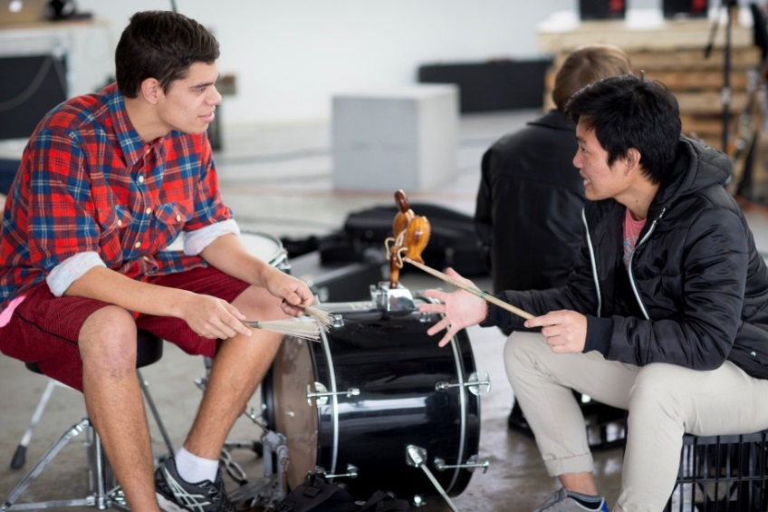
Module 1: Understanding young people’s development and health needs (60 min)

Slide 8
Four guiding principles:
Developmental perspective – stages, changes, tasks
Biopsychosocial model – health problems and needs
The risk and protective framework
Youth friendly communication and engagement skills
Ref: YHRK – Sections 1 & 3.3
7

Slide 9

How do you define adolescence?
8

Slide 10
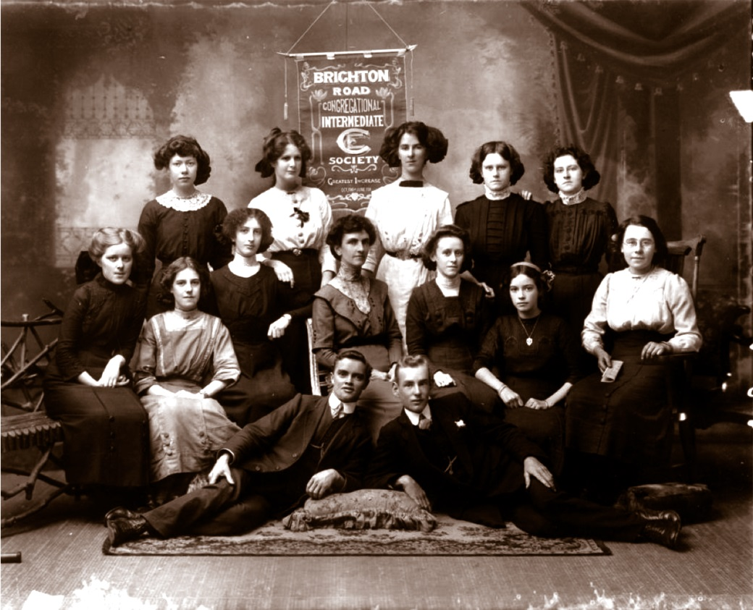
The adolescent perspective - why does it matter?
Activity – the time machine
Group of young people from the Brighton Road Congregational Intermediate Society, Brisbane, 1911 (State Library Queensland)

Slide 11
The developmental perspective
Three stages:
Early (11-14yr) – rapid pubertal growth / change
Middle (14-17yr) – changes nearly complete, peer / social / sexual interests
Late (17-20yr) – adult roles & appearance
10

Slide 12

Developmental changes and concerns
– group discussion
What are the major changes that occur in adolescence?
Physical
Cognitive
Psychosocial

Slide 13
Major developmental tasks
Autonomy – independence
Self-identity
Sexual identity formation
Body image
Negotiating peer and intimate relationships
Developing goals
Acquiring skills
Developing own moral/value system

Slide 14
Brain development and risk-taking
The brain is still developing during adolescence – trauma can impact
A ‘normal mismatch’ between:
  Urges and drives (e.g. novelty-seeking, risk-taking)
  Impulse suppression - weighing up consequences of behaviour
Risk-taking is a normal and important part of developing into an adult – not necessarily negative

Slide 15
The ‘engine’ is switched on but the ‘brakes’ are still developing
Picture source: Joyce Djaelani Gordon & Peter Chown. Practical Guide to Youth Friendly Health Services in Indonesia, September 2009. YAKITA & Nossal Institute for Global Health.

Slide 16
The developmental perspective – why it matters?
Helps to:
Understand the young person’s concerns and risks
Understand how they make choices, decisions, and capacity to give informed consent
Guide our communication strategies – tailored to developmental level
Tailor appropriate interventions and health promotion strategies – for the development stage

Slide 17
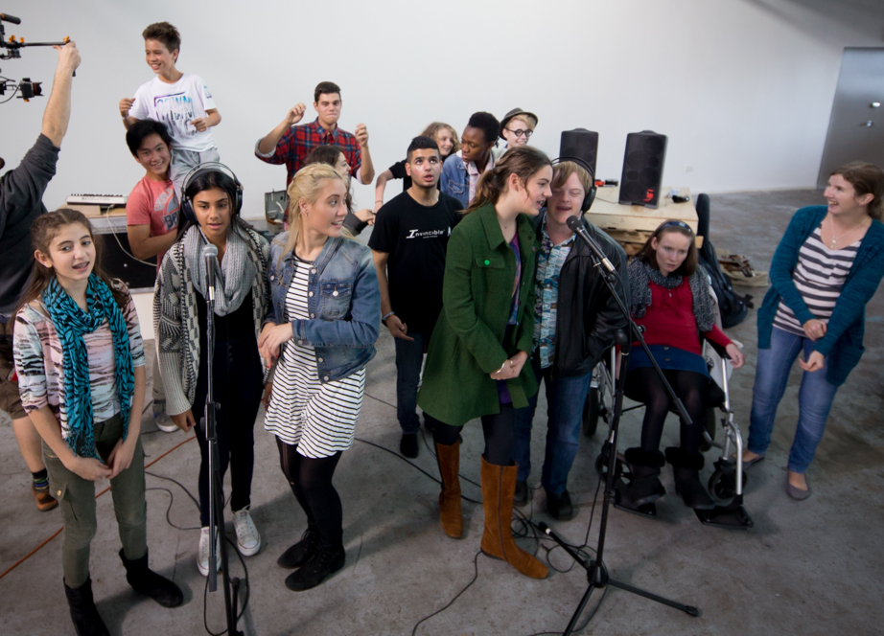
Young people’s health status – group discussion
What do you think are the main health concerns or problems for young people?

Slide 18
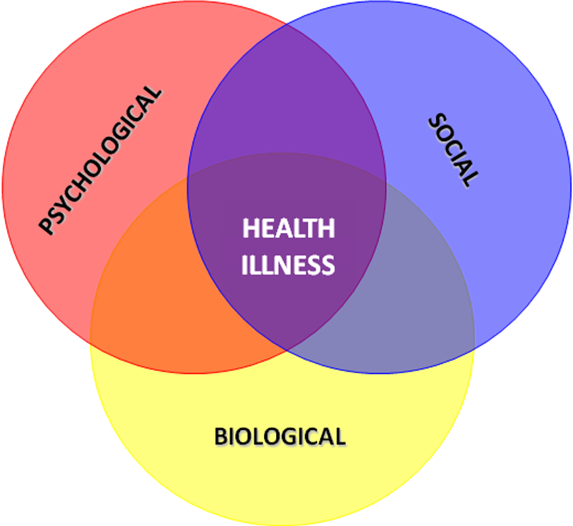
Biopsychosocial model of adolescent health – definition
The dynamic interaction between physical processes, and social and psychological factors and behaviours impacting on health
17

Slide 19
Biopsychosocial model of adolescent health
Most health problems are psychosocial – a consequence of risk- taking and exposure to social and environmental risk factors
The leading causes of death and illness in the age group 12–24 years
  Accidents and injuries (2/3 of all deaths)
  Mental health problems
  Substance abuse (drug and alcohol use)‏
  Sexual health problems
Young males death rate twice that of young females (43 and 22 per 100,000 respectively)
Aboriginal young people’s death rate is 2.5 times higher than other Australian young people (80 and 32 per 100,000 respectively)

Slide 20
Current youth health trends
Increasing rates of:
Abuse and neglect for 12-17 year olds
Chronic conditions among 12-24 year olds (63.9%)
Hospitalisation due to self harm among 12-24 year olds
Reducing rates of:
Death from injury and poisoning for 12-24 year olds
Physical activity in 15-24 year olds
Harmful levels of alcohol consumption in 12-24 year olds
Smoking in 12-24 year olds
Pregnancy in 15-19 year olds
Source: The AIHW youth health portal http://www.aihw.gov.au/nyif
http://youth.nsw.gov.au/youth-snapshot/

Slide 21
Features of adolescent health problems
A mismatch between help-seeking and major diseases
Lack of awareness of where to seek help
Critical time for the onset of many health problems
Co-morbidity – e.g. mental health, substance misuse, sexual health problems
Psychosocial – risk-taking
Socio-economic disadvantage

Slide 22
Protective and risk framework
Protective factors:
Act as a buffer to consequences of any risk factors
Interrupt the risk chain
Prevent the initial occurrence of a risk
Risk factors:
Risk taking is a normal part of adolescent development
Enable testing limits, learning skills, independence
Can increase adverse psychosocial and health issues

Slide 23
Example protective factors – strengthen
Connectedness – school, peers, community
A caring family environment
Supportive relationship with at least one caring adult
Achievements and sense of belonging at school
Social skills, positive self-esteem
Sense of purpose and meaning

Slide 24
Example risk factors – minimise
Socio-economic disadvantage
Poor parenting, family conflict and breakdown
School failure, bullying
Lack of meaningful relationships with adults and peers
Individual characteristics – e.g. low self-esteem, poor social skills
Exposure to trauma, violence and crime
Racism
Discrimination

Slide 25
Risk and protective factors – case scenario
What are some of the possible risk and protective factors in the young person’s life?
What is your assessment of the risk status (Low/Medium/High)?
What would you focus on to minimise the risks and enhance the protective factors?

Slide 26
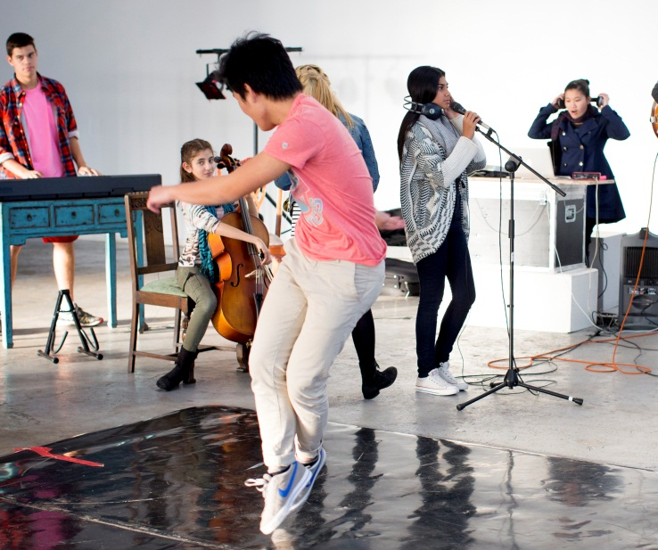
Implications for your service/practice
– group discussion
Do you assess and focus on both risk and protective factors?
How can you take a holistic approach to address interconnected factors impacting on health and wellbeing?

Slide 27
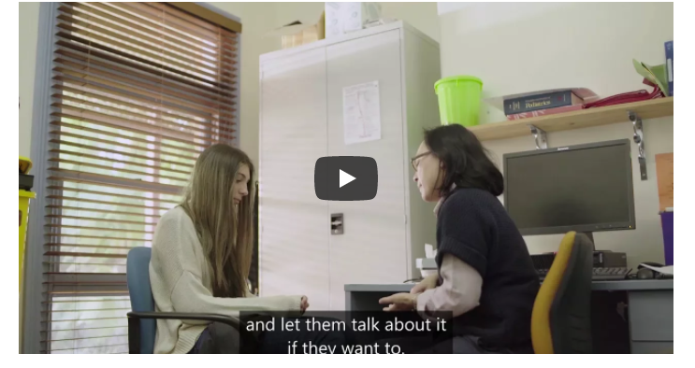
Watch Video 2 – What a young person may bring to the conversation (8.21 min)
26

Slide 28
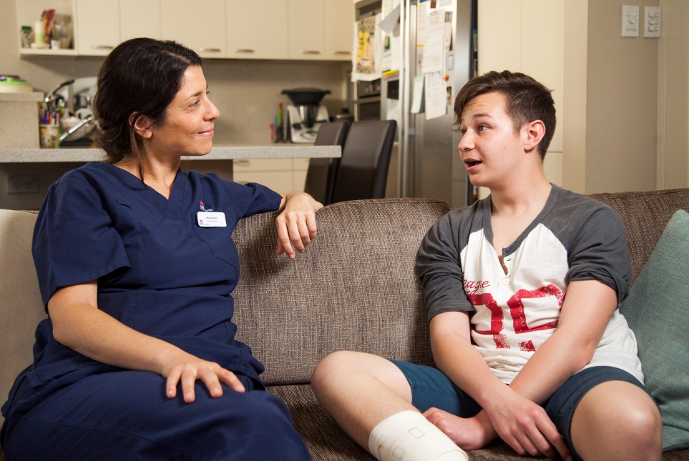
Module 2: Creating accessible, youth friendly services (30 min)
Ref: YHRK – Section 3.4 + 3.6
27

Slide 29
Access barriers and challenges: your service
– group discussion
What are the main barriers for young people accessing your service?
What are the main barriers YOU experience in working with young people (e.g. experience, knowledge, skill)?

Slide 30
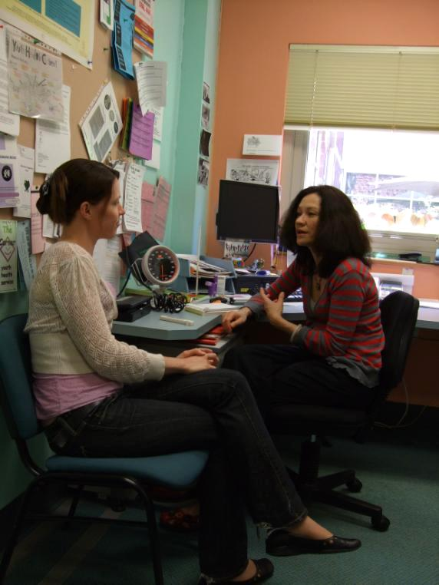
Characteristics of youth friendly services
What are the key characteristics of a youth friendly service?
How youth friendly is your service?
What steps have you taken to make your service more youth friendly?

Slide 31
Staff attitudes and communication style
Accessibility – convenience
Confidentiality and privacy
Youth Friendly Service
Youth-friendly environment – reception, waiting area etc
Practice administration and youth-friendly procedures – appointments, billing, cost etc

Slide 32

Checklist – is your service youth friendly?
Complete the checklist 1st section only: (1) Accessibility - how accessible is your service?

Slide 33

MORNING TEA

Slide 34
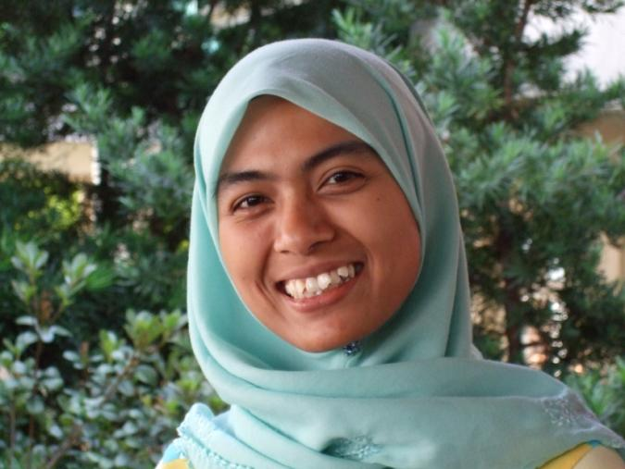
Module 3. Responding to diversity (20 min)
Ref: YHRK Section 3.6 + 3.4

Slide 35
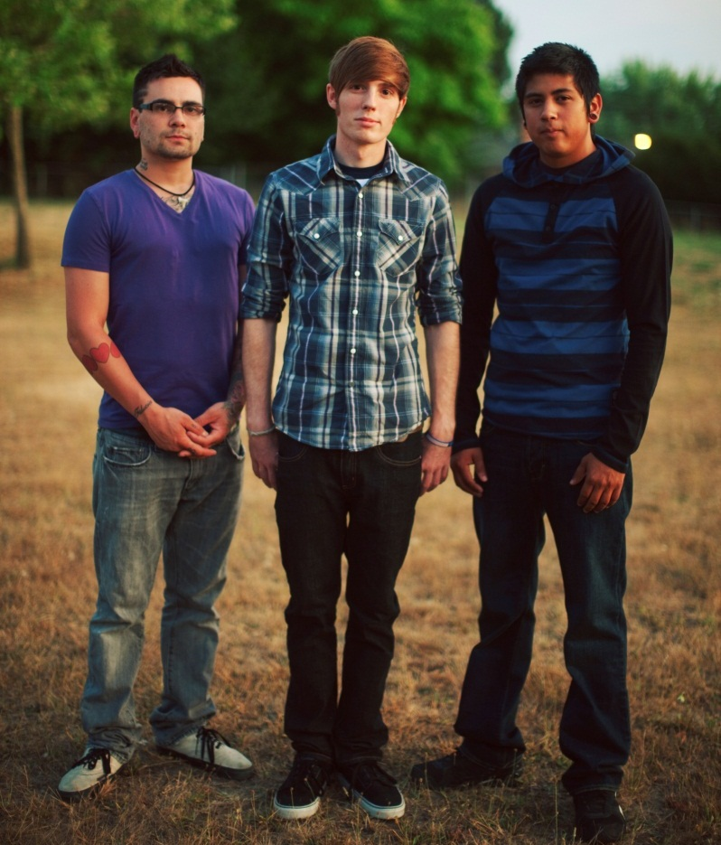
Diversity – strengths, risks, disadvantage, opportunities
African refugees
Transgender young people
Aboriginal young people

Slide 36
‘Diversity sensitive’ youth health consultations – large group discussion
What are some of the diversity issues to consider when working with young people?
What are possible protective factors to strengthen and the risks to minimise?
How would you approach working in a ‘diversity sensitive’ way with young people?
How might your own background impact on the consultation?

Slide 37
Working with young people from diverse backgrounds
Enhance protective factors e.g. collectivism
Assist them to negotiate both cultures, build self esteem and supportive relationships
Minimise the risk factors e.g. isolation, shame, discrimination and migration stressors
Ask how they define their own identity in different contexts – don’t assume
Offer support/services - let young people and families decide how they want to proceed
36

Slide 38
Culturally sensitive approach – ask
How does the young person view themselves within the context of their culture/family?
In which ways do they follow/not follow the norms of their culture/family?
What has changed since they became an adolescent? Are they treated differently by parents, siblings, relatives?

Slide 39
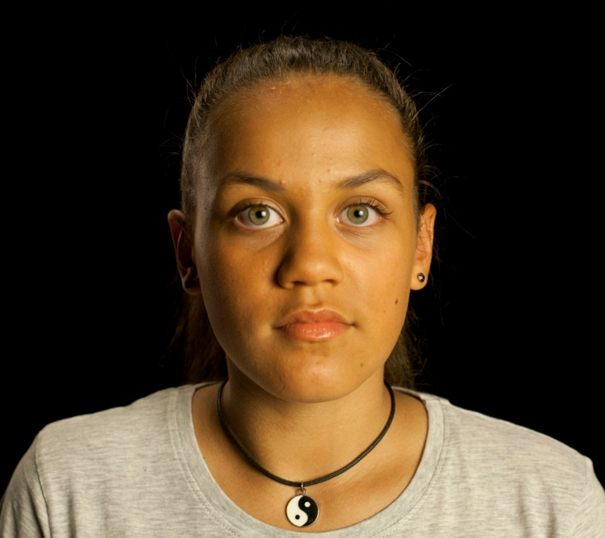
Module 4. Confidentiality and medico-legal dilemmas (60 min)
General information only - not advice!
Seek medico-legal advice for specific cases
Follow NSW Health policies and guidelines
Ref: YHRK Sections 3.1 + 3.5

Slide 40
Values continuum
Do you ….
Agree Disagree
39

Slide 41
Minors (under 18) medico-legal issues
The law is not clear cut – takes into consideration legal status and adolescence as time of development
Allows privacy, confidentiality and capacity of a minor to make their own decisions/consent to medical treatment if judged as competent
Balanced with the need to protect young people from harm, and the central role of parents/carers
Privacy and medical records – access by parents/carers
Duty – Child Protection and Mandatory Reporting

Slide 42

Confidentiality and consent
NSW Health Privacy policy
Youth Friendly We Keep It Zipped resources
Limits to confidentiality – e.g.Chapter16A of Children and Young Persons (Care and Protection) Act
41

Slide 43
Principles guiding confidentiality
Confidentiality is key concern of young people
Reluctant to discuss risky behaviours / sensitive issues without assurance of confidentiality
Need to advise – when you have a duty to share or report
Duty of care – exemptions to confidentiality where:
  Young person consents to disclosure
  Practitioner is compelled by law to disclose
  Exemption is created by legislation

Slide 44
Making a competency assessment - minor
Legally competent to consent to medical treatment if they have - ‘sufficient understanding and intelligence to understand fully what is proposed’ – Gillick Competence
Assessment is based on - age, maturity, level of independence, seriousness of the treatment, understanding of the treatment and risks, ability to grasp consequences of the decision

Slide 45
NSW Children and Young Persons (Care and Protection) Act
Provides
Definitions of child (under 16yr), young person (16-17yr) and Risk of Significant Harm
Reporting requirements including for homeless children and young people
Chapter 16A creates a legal mechanism for information sharing for child protection purposes between prescribed bodies
Requires taking reasonable steps to coordinate the provision of services to ensure the safety, welfare, or the wellbeing of children

Slide 46
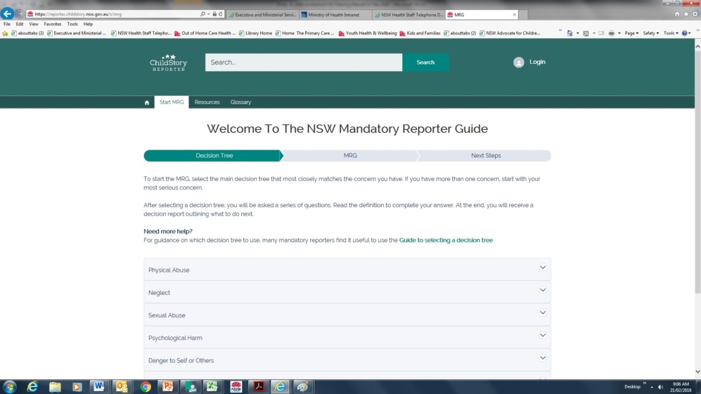
Responding to abuse and neglect
Use the Mandatory Reporter Guide (MRG) – decision tree
Follow Child Wellbeing and Child Protection Policies and Procedures for NSW Health Workers (PD2013_007)
45

Slide 47
Child wellbeing and protection - contacts
NSW Health Child Wellbeing Units and Child Wellbeing Coordinators 1300 480 420 (8.30am to 5.00pm, Monday to Friday). After hours leave a message or eReport wellbeing concerns to the CWU via the online MRG).
Child Wellbeing Coordinators – list of LHD contacts is on NSW health website.
Report imminent suspected Risk of Significant Harm (ROSH) to the Child Protection Helpline 132 111 (24/7)
eReport non-imminent ROSH via the online MRG.
46

Slide 48
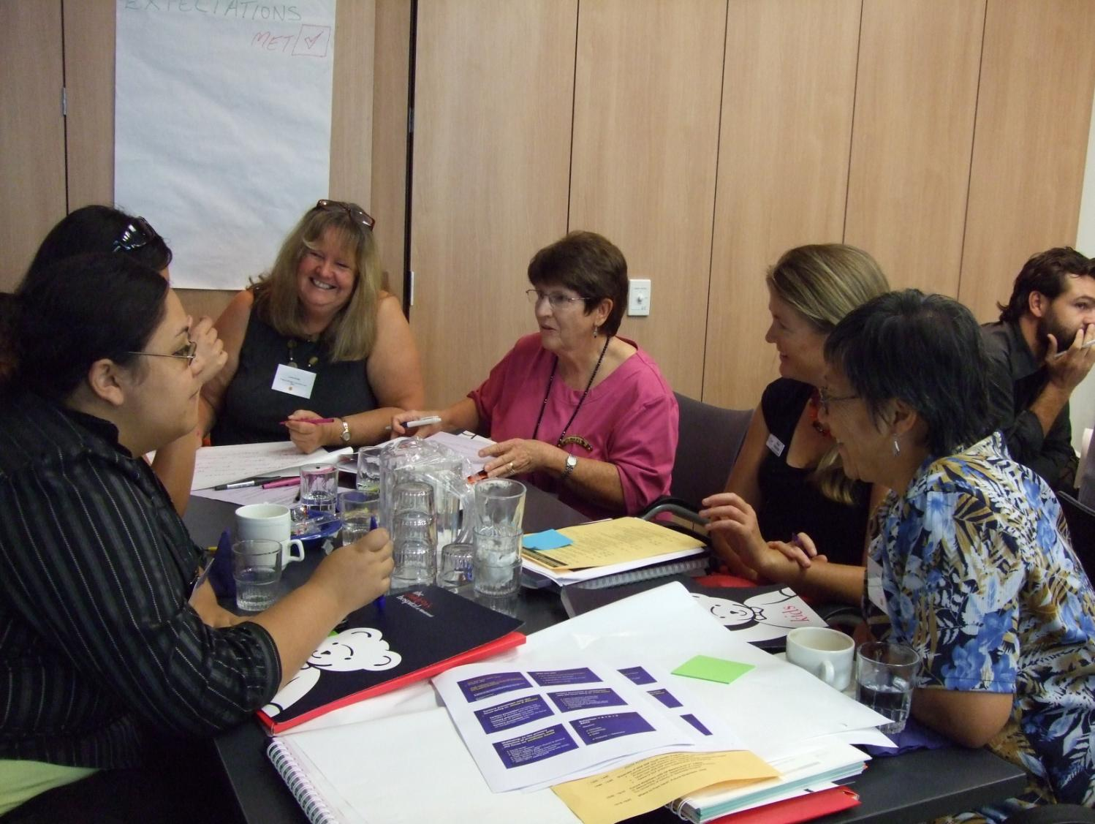
Large group activity – medico-legal dilemmas
After each scenario, answer quickly: Yes/no/ don’t know/depends
Discuss responses and related issues
47

Slide 49

Scenario 1 – 16-year-old boy
In NSW, it is reasonable to assume he can consent to treatment on his own
Consent to treatment for those under 18 years is mostly guided by competency assessments of maturity and generally young people aged about 14 and above can give their own consent
Competency means a full understanding of treatment/s being proposed

Slide 50
Scenario 2 – 15-year-old boy
You cannot tell his mother directly about anything discussed without the boy’s permission
Talk to the boy before his mother comes in about your concerns and say that you would also like to discuss these with his mother present (as well as alone)
Say that although he can attend for confidential consultations by himself, by putting his health at serious risk there could be reasonable grounds for breaking confidentiality
Central to managing this issue is engaging him in a trusting relationship and giving him the opportunity to talk about his risk taking behaviour and context

Slide 51

Scenario 3 – 14 year old girl
Under Chapter 16A you can share information with ‘prescribed bodies’ that relate to the safety, welfare or wellbeing of the young person, whether or not the young person is known to Community Services and whether or not consent has been given

Slide 52

Scenario 4 – 14 year old girl
Consensual peer sex is not of itself an indicator of sexual abuse
The NSW Health Policy (PD2013_007) states:
Health workers need to consider whether sexual activity is with a peer and whether it is consensual, as well as any other indicators that may suggest the young person is at risk of significant harm (ROSH)… ‘peers’ are defined as individuals who are aged within two chronological years of each other (from Section 7)

Slide 53
Your service: Confidentiality and information sharing – group discussion
What are the most common confidentiality concerns of young people entering your service?
What is your service policy and routine approach for managing confidentiality and information sharing?
How do you explain to a young person the limits to confidentiality and information sharing?
How does information sharing between services improve outcomes for young people?
What are the challenges in this area?

Slide 54
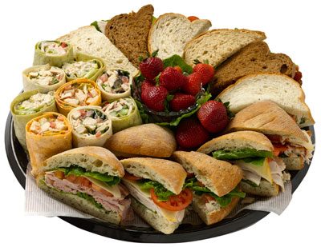
LUNCH

Slide 55

Module 5: Engaging the young person to conduct a HEEADSSS assessment (60 min)
  Ref: YHRK Sections 3.2 + Appendices 3 + 4

Slide 56
HEEADSSS psychosocial risk assessment
A framework for assessment of risk and protective factors in key areas of the young person’s life:
H – home
E – education and employment
E – eating and exercise
A – activities, hobbies and peer relationships
D – drug use, cigarettes and alcohol
S – sexual activity and sexuality
S – suicide, depression, self harm
S – safety
55

Slide 57
NSW Health – HEEADSSS Guidelines
All young people 12-24 yrs – in health system
Not a diagnostic tool
Face-to-face - a conversational approach
Option for completion of : Youth Health and Wellbeing Assessment Chart
Protective & risk factors
Clinical judgement regarding appropriateness (e.g. health condition)
56

Slide 58
A guide to using HEEADSSS
Before starting - reassure about confidentiality
Tool to guide the interaction – engagement is important
Not a prescriptive / checklist process
Be flexible in how you apply it
Let the interview flow naturally in an interactive style
Come back to any areas not covered
Listen carefully
Explore in more detail - areas of ambiguity / risks / sensitive areas (e.g. drugs, sex)

Slide 59
The needs and fears of the young person when seeing a health professional?
What are their needs and fears when seeing a health professional?
How do / don’t they like to be treated?
Do they want us to use their slang / talk like them?
What approach will built trust and rapport?
Who are they likely to bring along for support? Why?

Slide 60
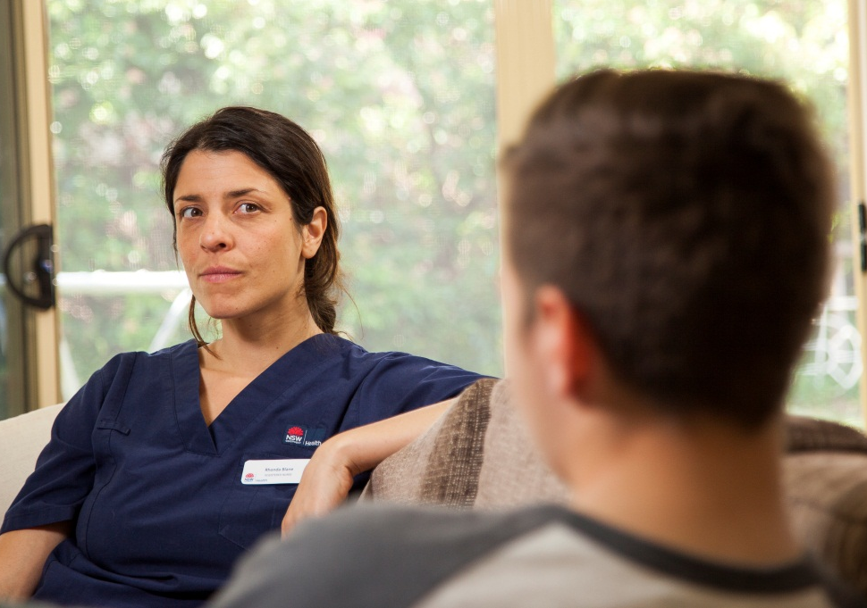
Engaging the young person – group discussion
What are the do’s and don’ts of effectively engaging and communicating with young people?
59

Slide 61
Golden rules
Stop talking – give your time and attention
Put them at ease – no jargon, be sincere
Be interactive – give feedback, ask questions
Reflective listening – tone, ideas, words, non-verbals
Don’t assume or judge – ask open-ended questions
Build trust – empathise
Be self-aware – aware your language / attitude etc
Allow them to educate / inform you
60

Slide 62
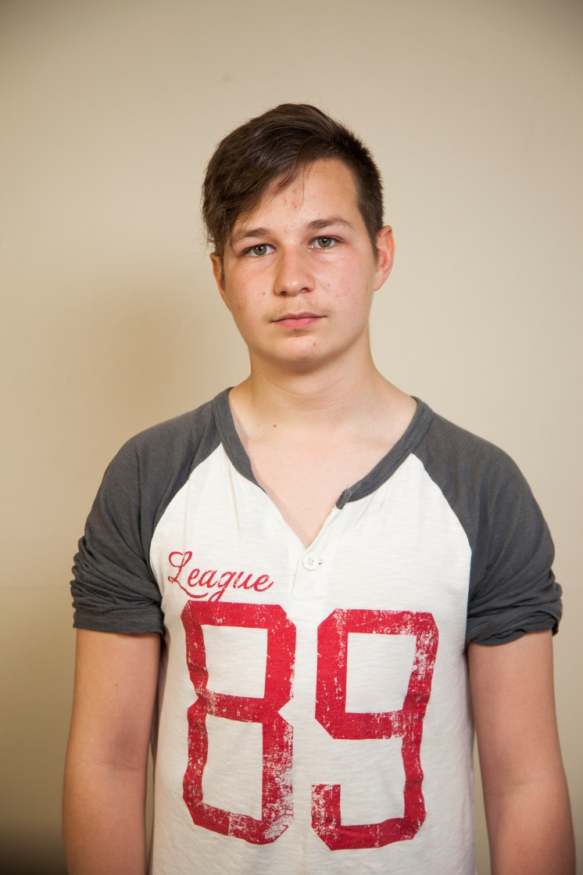
Engaging a ‘challenging’ young person – case discussion
Michael is a 16 year old boy who has been brought in by a support worker. He looks angry and agitated, and stares at the floor while the support worker explains why he has brought Michael in to discuss his issues.

Slide 63
Engaging the ‘challenging’ adolescent
Empathise with their situation – validate their feelings
Take an open stance – be interested in them, take time
  Don’t blame them / label them – e.g. ‘non-compliant’
Use reflective listening to build rapport: “My guess is that you’re not too happy about being here today …”
Be collaborative – ask them to help you understand - e.g. “I’m not sure if this is correct …..have I got this right?”.
Don’t take challenging behaviours personally
Avoid being authoritarian – no power struggles

Slide 64
Engagement challenges for YOU when working with ‘challenging’ young people – group discussion
  What are the challenges YOU experience when engaging challenging young people in a first session?
  How could you more effectively engage with the young person?
  What are specific issues you tend to react to or find a barrier?

Slide 65
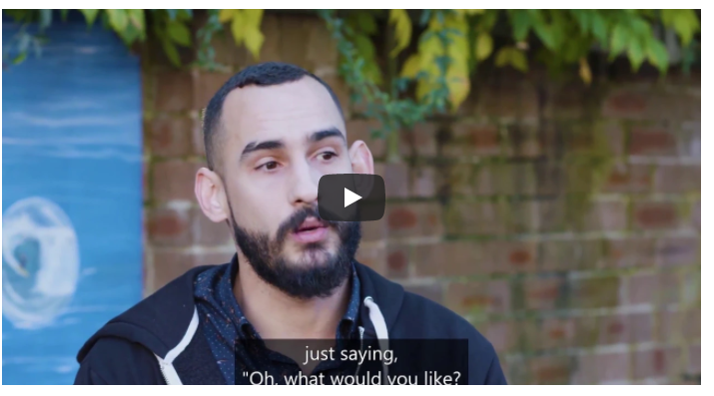
Video 3 (10.54 min) – Useful tips for HEEADSSS conversations
What is effective / ineffective?
What words would you use to engage and discuss confidentiality in the first session?
How do you ask the parent / carer if you can see the young person alone?

Slide 66
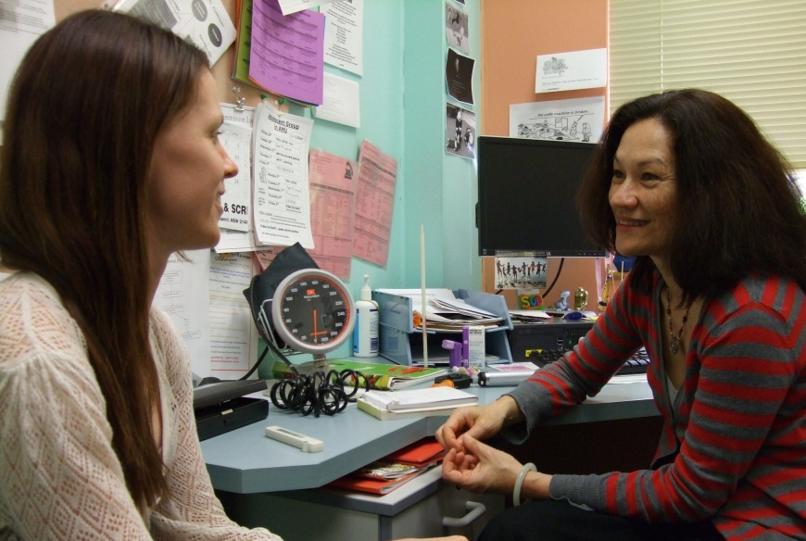
Module 6: Conducting a HEEADSSS assessment (60 min)
  Ref: YHRK Sections 3.1

Slide 67
First consultation – explaining confidentiality
Don’t assume they understand what ‘confidentiality’ means
Explain clearly what confidentiality is and what it means to the young person
Keep it simple – discuss early on
Explain the limits of confidentiality – including exceptions
Remind them again if they are about to disclose
Prepare your ‘form of words’
Explain Australian privacy law to CALD families

Slide 68

Engaging and explaining confidentiality in the first consultation – skills practice
Case scenario – Jenny is a 15-year-old girl seeing the health professional alone for the first time. She is anxious about confidentiality, and doesn’t want her parents to know she is seeing you.

Slide 69
HEEADSSS - types of questions to elicit information
Open-ended questions – e.g. What difficulties are you having at the moment?
Focused questions – e.g. Can you tell me about what happened when you visited the doctor?
Closed questions – e.g. Have you been having trouble sleeping?

Slide 70
HEEADSSS - questioning approach
Start with open-ended questions – then move to more focused and closed questions
The type of question is influenced by the young person – e.g. more focused and closed questions if very talkative / rambling
The developmental stage influences the type of questions – early adolescents often respond to more focused questions – e.g. ‘Tell me how you are feeling when you are at school’ rather than ‘What’s school like?’

Slide 71
HEEADSSS - asking sensitive questions
Progress from less sensitive to more sensitive questions
Remember – HOME can be a highly sensitive area
Offer a non-threatening explanation for the question you ask: ‘I’m going to ask a number of questions to help me better understand your health…or your situation’
Request permission to ask sensitive questions:
‘I’d like to ask you a few personal questions. You don’t have to answer these if you don’t feel comfortable. This will help me to get a picture of your life and health issues. Remember that anything we discuss will be kept confidential. Is it OK if I ask you some more questions?’

Slide 72
HEEADSSS - the ‘third person approach’
Use a ‘third person approach’ to normalise and lessen the impact of sensitive questions:
Example:
    ‘Many young people your age are beginning to have experiences with drugs or alcohol (or sex). Have you or any of your friends ever done this? (or, had a sexual relationship)?’
Or:
  ‘Sometimes when people feel very down they can think about hurting themselves. Have you ever had any thoughts like this?’

Slide 73
HEEADSSS - wrapping up
Provide feedback about your assessment
Compliment on strengths and areas where they’re doing well
Highlight areas of concern for follow-up
Invite questions – engage in planning
Discuss who to involve in referral or follow-up
Discuss what to tell and not to discuss with their parents:
‘Rebecca, before you mother comes back in I’d like to be clear about what to tell her and what not to talk about. What would you like mum to know about what is going on for you?’

Slide 74
HEEADSSS - wrapping up
If engaged in risky behaviours, provide information about the risks and discuss ways to protect themselves:
Example:
‘Rebecca there are a few things you’ve mentioned that I’m concerned about – especially your drug use. I know you’ve said that it’s a big part of what you do when you’re with your friends. But I’m wondering how much you know about some of the risks. If you like, I can give you some information about this and we can discuss ways to reduce the risks.’

Slide 75
Look deep
Picture source: Joyce Djaelani Gordon & Peter Chown. Practical Guide to Youth Friendly Health Services in Indonesia, September 2009. YAKITA & Nossal Institute for Global Health.
Many adolescent problems are interrelated and interventions in one area can lead to positive outcomes in other areas. Presenting problems may not be the main problems

Slide 76
HEEADSSS role play – skills practice scenario
15 year old girl - Alison:
H – home - divorced parents, lives with mother working in low income job, older brother left home, no other family, mother’s boyfriend stays over
E – education and employment - still at school, art is her favorite subject, wants to leave and get a job to make money
E - eating and exercise - wants to lose weight, lots of takeaway, doesn’t like exercise
A – activities, hobbies and peer relationships - gets on with peers, likes art, has a best friend
D – drug use, cigarettes and alcohol - binge drinks with friends on weekends, smokes cigarettes, occasional drug use
S – sexual activity and sexuality - same-sex sexual activity with best friend when drinking
S – suicide, depression, self harm - gets a bit down, frustrated about no money, not suicidal
S – safety - doesn’t like mother’s boyfriend when he
drinks, he gets ‘overly friendly’

Slide 77
BREAK

Slide 78
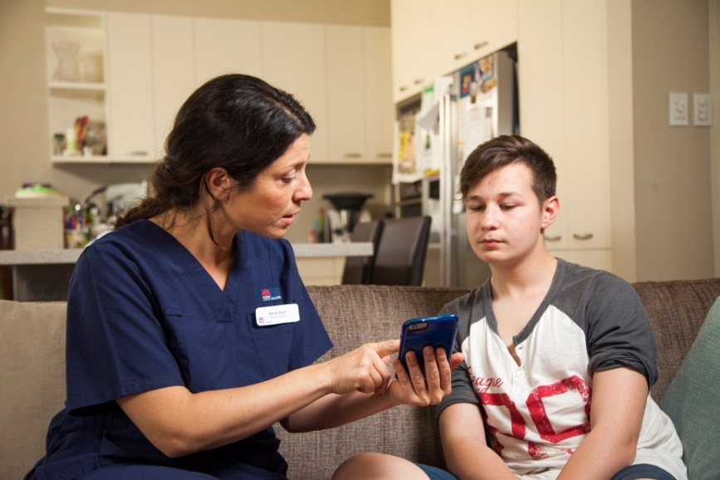
Module 7: Developing a plan to manage risks (30 min)
Ref: YHRK Section 3.3 p.86-92 + Appendix 3

Slide 79
Risk level – guides intervention
Low risk – safe experimentation – ‘healthy experimenter’
Moderate risk –behaviours with harmful consequences – ‘vulnerable’
High risk – major disruption or risk to health, safety or life – ‘troubled’ or ‘out of control’
Picture source: Joyce Djaelani Gordon & Peter Chown. Practical Guide to Youth Friendly Health Services in Indonesia, September 2009. YAKITA & Nossal Institute for Global Health.

Slide 80
When do risk factors require intervention?
Interferes with normal adolescent development
Poses serious risks to health and safety
Established part of the young person’s lifestyle
Disconnection from family, school and relationships
Risk factors outweigh protective factors

Slide 81
Develop a plan to address risks
Set goals and develop a plan – with the young person
Provide assessment feedback
Agree on the next steps/who to involve
Follow-up – advocate/refer/information/support
Clarify your role
Refer to YHRK Appendix 3 Youth Health Check template

Slide 82
Help the young person change
Raise awareness of risks and consequences
‘Personalise’ the risk – help them see how it applies to them
Promote a belief that change will reduce risk
Support a belief that they can make the change
Teach skills to make the change e.g. practising saying ‘no’
Identify and reinforce support for making changes
81

Slide 83
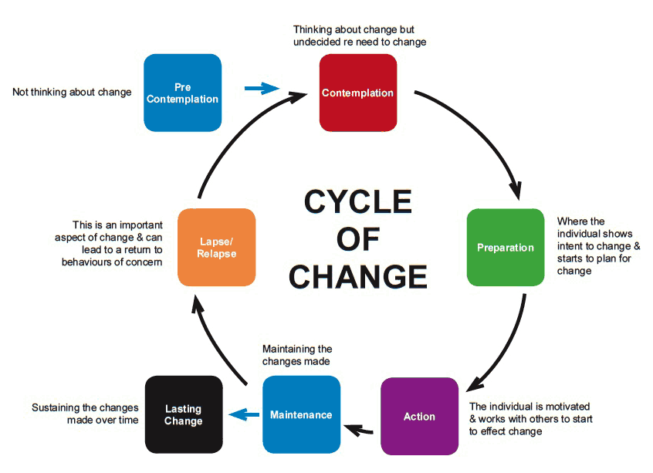
Stages of Change Model
Developed by Prochaska & DiClemente
82

Slide 84

Change is difficult – resistance is normal
Why should I change?
– costs/benefits
Do I want to change? - importance
Is now a good time to change? - priority
Can I change? - confidence
How do I change? - skills
Do I have support for change? -

Slide 85
Motivational Interviewing
You can’t make someone change
Ambivalence or resistance to change is normal
Arguing/pushing/persuading – increases resistance
Start with their concerns - not yours
Assess their stage - ‘readiness to change’
Change goals – meaningful to the young person
Intervention - should match stage of change
Worker - assists them to move through the stages
Increasing resistance – change your approach

Slide 86
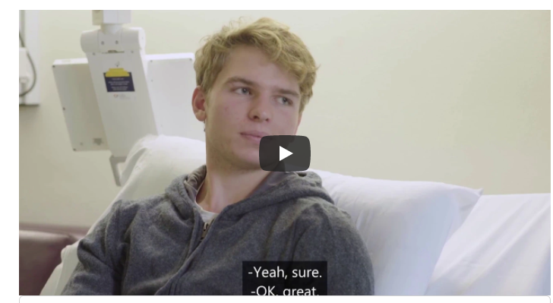
VIDEO 4 (8.23 min) - Developing a responsive management plan
Small groups – discuss how you can respond to risks and develop a risk management plan WITH the young person

Slide 87
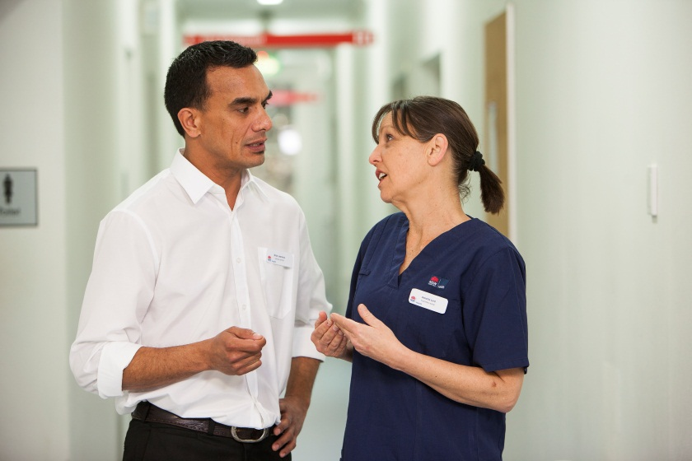
Module 8: Navigate local service referral networks (30 min)
Ref: YHRK Section 2.3

Slide 88
Healthcare service networks/partnerships
Develop a network of professionals and specialist services for complex issues
Specialist health services – alcohol and drug, DV, sexual assault, HIV, mental health, disability, family etc
Youth specific services – youth health centres, youth refuges, hospital adolescent units, school counsellors etc
Community services – e.g. Centrelink
Cultural / community specific services – e.g. refugees, LGBTI, interpreters, deaf community, ATSI services etc

Slide 89

List local services for young people
What local services are relevant to young people?
What are service gaps?
What is your role in linking the
young person to services?
What are the barriers for young
people accessing services?
How can you assist to remove access barriers?

Slide 90
Action Stations (20 min)
Look and Feel: What can I do to make my service more appealing to young people?
Personal Style: What can I do to better engage with young people?
Opening Doors: What policy changes could I implement to make my service more accessible to young people?
Knowledge/Skill Gap: What else do I need to develop to more effectively engage with young people on health?

Slide 91


Thankyou
Evaluations
Certificates

