Slide 2
The aboriginal drug & alcohol network
ADAn
WHO IS ADAN?
NSW Aboriginal alcohol & other drug (AOD) workers from:
ACCHS’s (AMS’s)
LHD’s (Area Health)
NGO’s (Aboriginal & Mainstream)
Project of the Aboriginal Health & Medical Research Council (AH&MRC) funded by the NSW Ministry of Health.

Slide 3
Why was adan established
ADAN was formed due to a recommendation put forward at the 2003 ‘Grog Summit’
To unite a largely disjointed cohort of unique workers with specific needs
ADAN has been running for 10 consecutive years. The 10 year anniversary was held last year in Sydney.

Slide 4
ADAN activities
ADAN Symposium - annual event
Primarily targets NSW Aboriginal AOD workforce
ADAN Leadership Group - quarterly meetings
State workforce representatives from wider ADAN members
ADAN Managers Forum – biannual
Targets CEO’s, Directors, senior managers & line managers of Aboriginal drug & alcohol workers

Slide 5
Resources
Current projects
Developing workforce role templates (ACCHS & LHD)
Adapting an Orientation package
Evaluation of ADAN Model
ADAN e-list
Continuous communication & Information sharing.
Link to current information, resources and research
Training & Regional Forums (ad hock)
IRIS Training (Indigenous Risk Impact Screen) and brief intervention

Slide 6
The adan symposium
An annual event which rotates around the state.
Locations are voted on by ADAN members at the previous Symposium & decided upon by the Leadership Group.
2013 ADAN Symposium – 10yr Anniversary
Held in Sydney
100+ delegates in attendance
2 ½ day agenda based on abstracts, member feedback and Leadership Group decisions: features keynotes, workforce programs, service and program profiling and modelling and consultations and feedback from workforce.

Slide 7
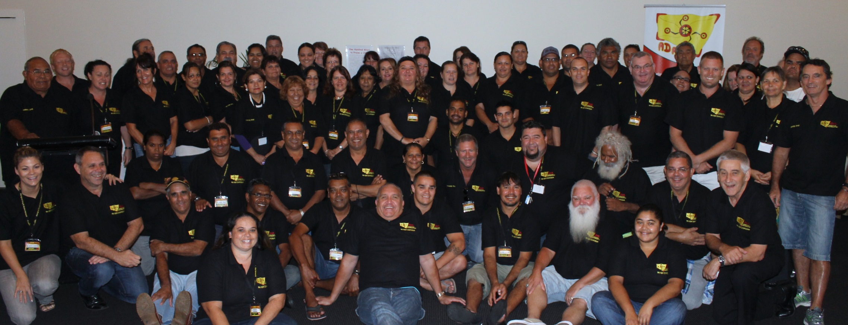
2012 ADAN Photo – Coffs Harbour

Slide 8
The adan leadership group
Meet quarterly
Two elected members from the 11 AH&MRC regions.
Workforce focused
Key Aboriginal drug & alcohol consultative and advocacy body for the state.

Slide 9
purpose
To guide ADAN Activities
Oversee the development of a range of projects,
Ensure ADAN members are consulted and represented on issues affecting them,
Integrate ADAN key priority areas into ADAN activities

Slide 10
Represent ADAN members at a state level
Consult with wider ADAN members on current issues and strengths
Advocate on workforce and community issues and strengths

Slide 11
Provide advice to key stakeholders
Provide a forum for key stakeholders to access
Review & provide feedback on state and national policy and programs (such as MHDAO, IRHP, NIDAC)
Share information from on the ground workers

Slide 12
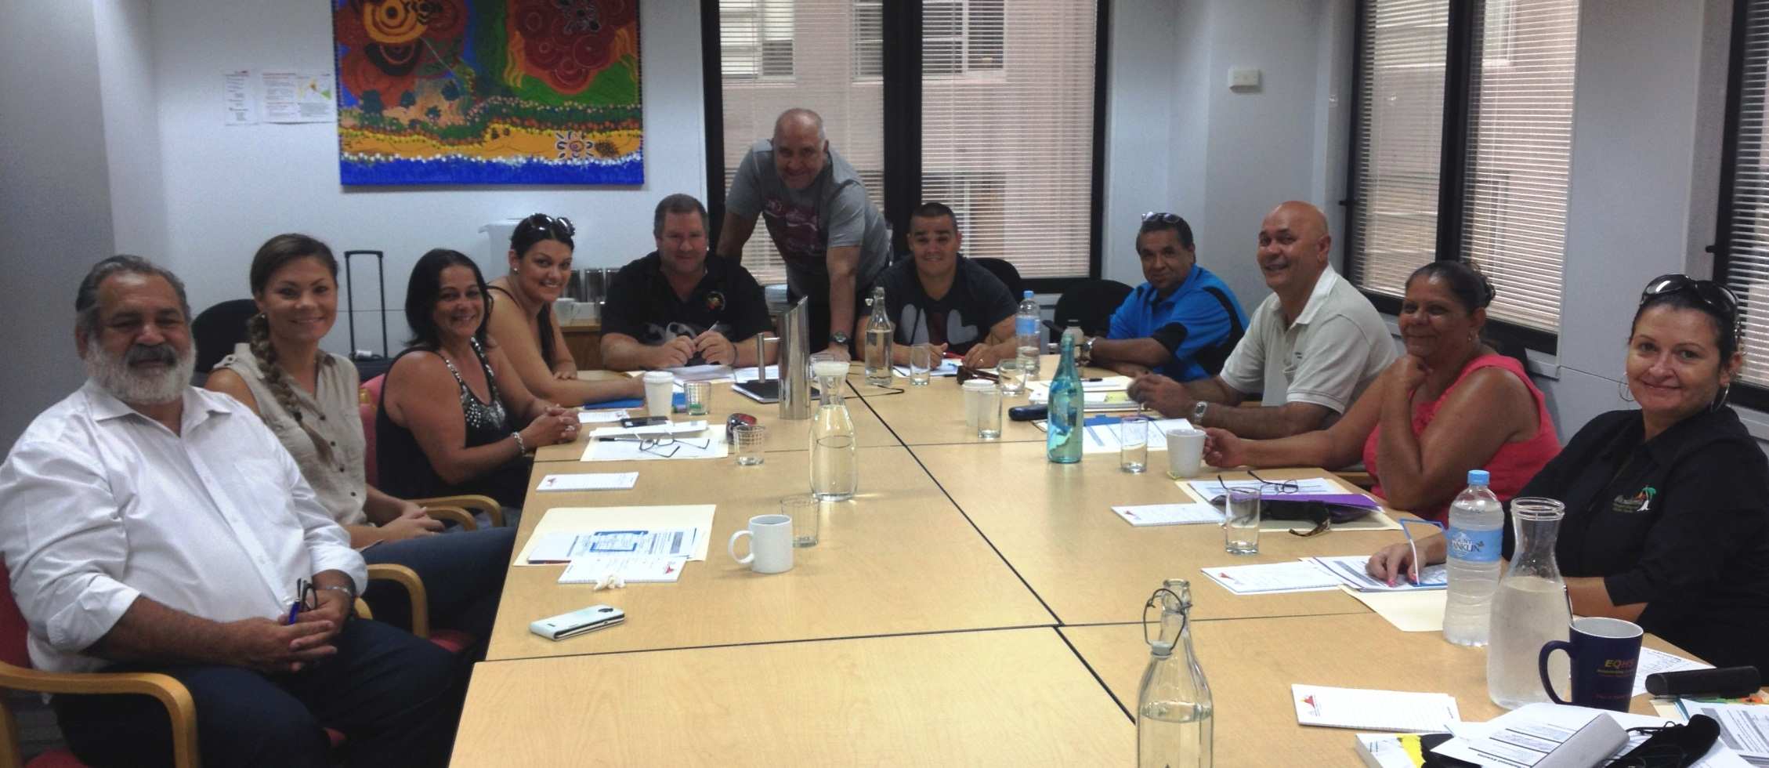
Leadership Group 2014

Slide 13
AH&MRC Regional map

Slide 14
Indigenous Risk Impact Screen
2x workshops held in 2013
6x TBA for 2014
“IRIS is a two factor screen that assesses alcohol and other drug use and associated mental health issues. The screening instrument allows for the assessment of risk factors for alcohol and other drug use and associated mental health issues in a culturally appropriate and timely manner.”

Slide 15
ADAN Managers Forum
2012 Managers Forum – bi-annual event
Approximately 45 attendees in 2010.
Focus on strategic development and direction for managers within the Aboriginal D&A Sector.
Target Group– CEO’s, Senior Managers & line Managers of Aboriginal drug and alcohol workers.

Slide 16
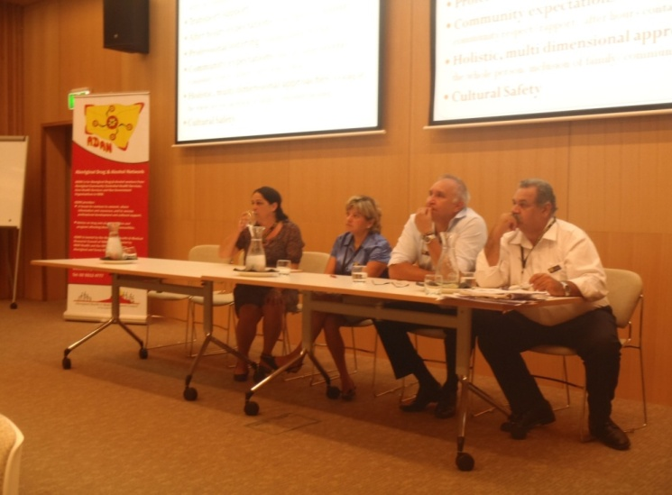
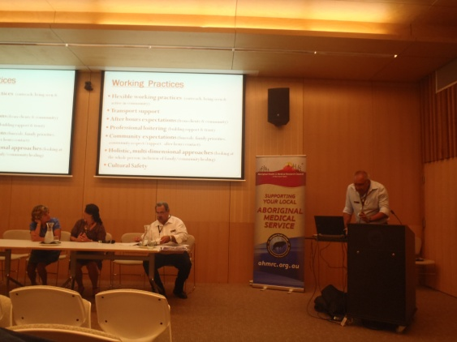
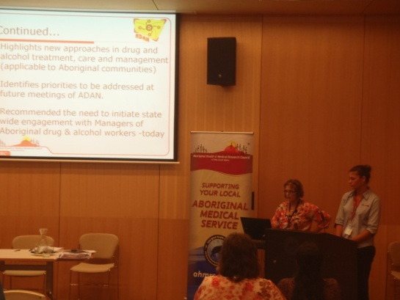

Slide 17
NSW aboriginal residential healing & drug & alcohol network
NARHDAN
Membership
All current Aboriginal residential rehabilitation services in NSW
Meets quarterly
Established to provide a united voice for these culturally specific services who can be marginalised, undervalued and underfunded.

Slide 18
Current business
A forum for advice, advocacy and consultation
Development of a Best Practice Framework & Model of Care
Specific for NSW
Culturally specific and relevant
Based on Aboriginal specific best practice principals
Linked to state and national policy and research
Enabler for other jurisdictions

Slide 19
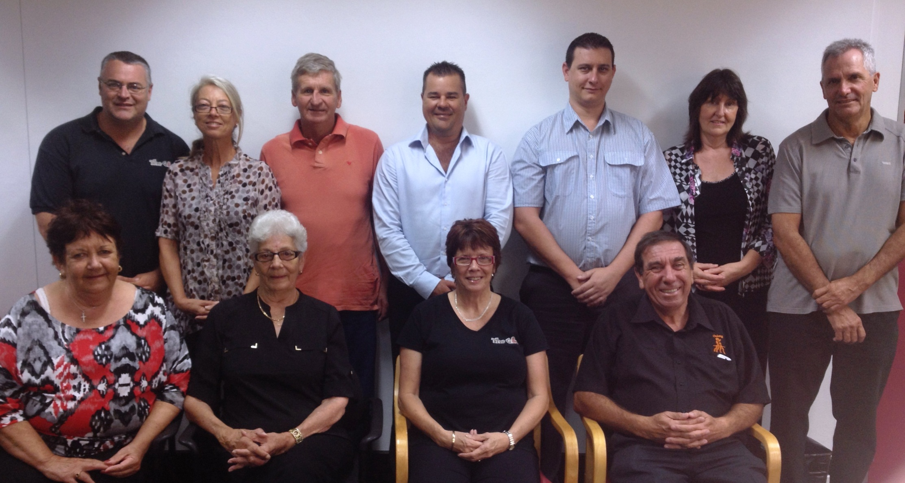

Slide 20
National indigenous drug & alcohol committee (NIDAC)
NIDAC: The Leading Voice in Indigenous Drug and Alcohol Policy Advice NIDAC provides advice to government, based on its collective expertise and knowledge from those working in the field, health professionals and other relevant experts.

Slide 21
activities
National Conference – held biannually
Melbourne 2014 June 4-6
Members Meetings
Rotated nationally each quarter
Consultations
Online
Face-to-face – Rotated nationally each quarter
Linking into existing forums, workshops & meetings such as ADAN & NARHDAN

Slide 22
NIDAC 2012 Conference
Approximately 30 ADAN members, including 8 ADAN Leadership Group members attended
2 ADAN specific Presentations
2 ADAN members received awards
Award for Excellence, Female Worker: Ms Gabrielle Sledge
Honour Roll: Mr Steve Ella

Slide 23
Sector resources
The Handbook for Aboriginal Drug & Alcohol Work.
Authors and editors included Kylie Lee, Brad Freeburn, Steve Ella, Warren Miller, Jimmy Perry, Kate Conigrave and contributing authors.
Handbook available online & can be purchased. http://sydney.edu.au/medicine/addiction/indigenous/

Slide 25
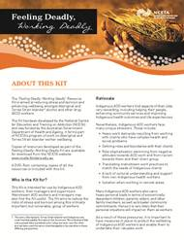
NCETA
Various resources
Stress and burnout
Self care and retention
Worker wellbeing
http://nceta.flinders.edu.au/workforce/indigenous-aod-workforce/feeling-deadly-working-deadly-indigenous-worker-wellbeing/

Slide 26
NIDAC publications & reports
Injecting drug use & associated harm amongst Aboriginal Australians.
Addressing FASD in Australia.
Addressing harmful alcohol use amongst Indigenous Australians.
Indigenous specific AOD interventions – snapshot of expenditure.
For further information & publications you can access the NIDAC website - http://www.nidac.org.au/

Slide 27
Questions?
Thank you!
☺

