Slide 1
Neami National, Dubbo Sub-Acute Service & Aboriginal Linkages Program
Lee Willis
Aboriginal Social & Emotional Wellbeing Worker
Alex Carr, Emma Nolan, Jesseka Flakelar
Aboriginal Trainees
Neami National Dubbo

Slide 2
Neami National
Our vision
Full citizenship for all people living with a mental illness in Australian society
Our mission
Improving mental health and wellbeing in local communities

Slide 3

About Neami
Neami National is a community-based provider of recovery oriented services
Neami supports people with a severe and enduring mental illness to live independently in the community
The organisation is characterised by proactive leadership, effective governance and a clear vision.

Slide 4
About Neami
Neami was established in Victoria in 1987
Expanding to become a national organisation offering a broad range of services
Approximately 3,000 individuals are supported by Neami each year across our 35 service sites in 5 states
Our services work at a local level to build the relationships in the community that will support consumers to become active and involved within their own communities.

Slide 5

Neami service sites
NSW
Ashfield
Bankstown
Broken Hill
Campbelltown
Carrington
Darlinghurst
Dubbo
Hurstville
Maitland
Pagewood
Smithfield
Way2Home Assertive Outreach
Wollongong
SA
Elizabeth
Murray Bridge
Pooraka
Port Adelaide
Prospect
Seacliff
WA
Armadale
Joondalup
Perth
QLD
Darra
Strathpine
VIC
Blackburn
Breaking the Cycle
Briar Hill
Doncaster
Fairfield
Glen Waverley
Heidelberg
Kew
Preston Northern PARCS
Regent
Splash Art Studio
Thomastown

Slide 6
Our approach
Our approach is geared towards providing:
An optimistic view of consumers’ self-determined recovery journey
Hope, optimism and choice as critical values that drive Neami
Staff behaviours that reflect these values.
Neami believes that strong partnerships with carers, consumers, clinicians, employment and education providers and other community organisations is the key to effective service provision.

Slide 7
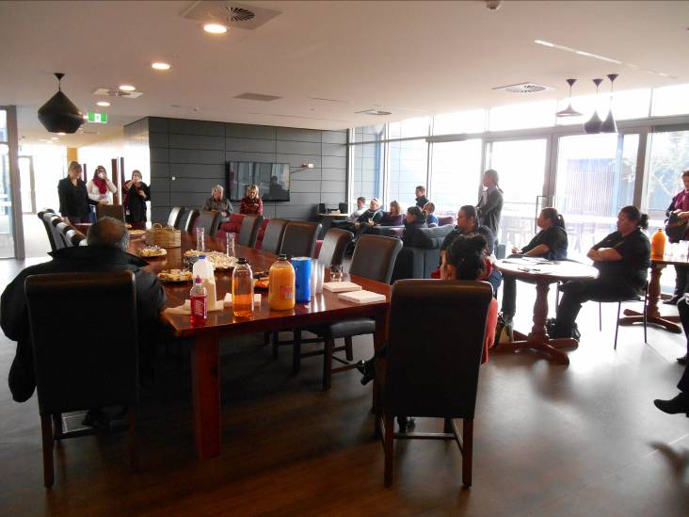
The Collaborative Recovery Model
Central to our approach is facilitating consumer choice within the context of an individual recovery plan.
In 2009, Neami implemented the Collaborative Recovery Model (CRM)
The CRM is a comprehensive, strengths and evidence based approach that was developed by the University of Wollongong.

Slide 8
The Collaborative Recovery Model
CRM has two guiding principles:
1) Recovery is an individual process
  Recovery is described as a deeply personal, unique process of changing one’s attitudes, values, feelings, goals, skills and/or roles.
  It is a way of living a satisfying, hopeful and contributing life.
2) Collaboration and autonomy support
  Research consistently shows there is a correlation between the strength of the working relationship and mental health outcomes.

Slide 9
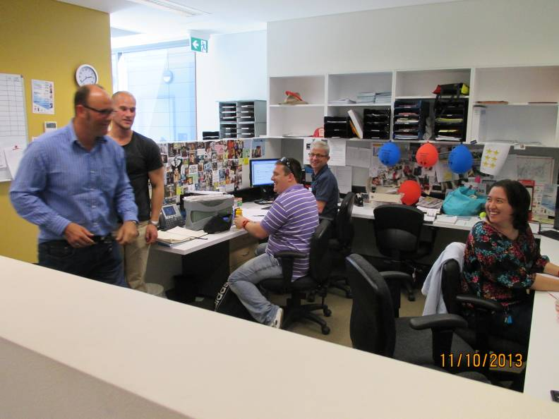
The Collaborative Recovery Model
The introduction of the CRM within Neami ensures the agency’s 400 plus staff have:
Consistent approach to recovery
Consistent understanding of recovery
This is complemented by the
employment of peer support
workers who deliver Flourish

Slide 10
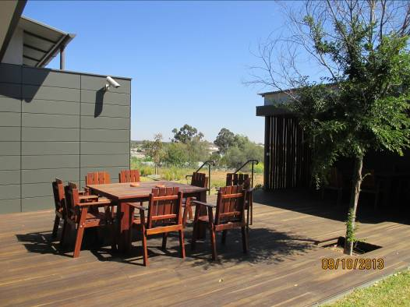
Flourish
A self-development group program based on the CRM
Values and strengths based program
8 modules delivered over 6 weeks
One on one coaching in between group sessions
Developing skills of goal setting, positive thinking and mindfulness techniques
Uses the tools of Camera, Compass and Map

Slide 11
Optimal Health Program
Relapse prevention package
Facilitated by support workers
8 sessions delivered over 4 weeks, with twice weekly one on one coaching
Based on a version of the stress-vulnerability model called the ‘I Can Do’ Model
This model looks at the interaction of stressors, coping strategies, vulnerabilities and strengths to build resilience
Uses tools such as SMARTER goal setting, health planning and journaling

Slide 12
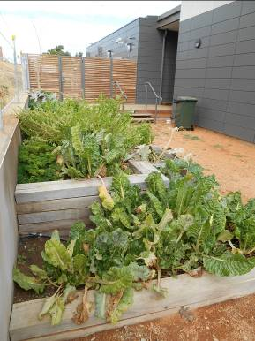
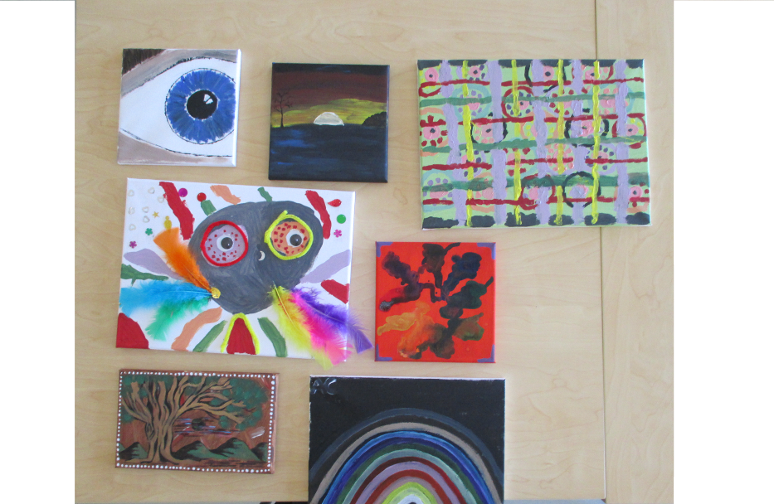
Neami National Services
Home and community based outreach
Community and group programs
Homelessness and housing services
Prevention and rehabilitation services
Service coordination
Partners in Recovery
Arts based practice

Slide 13
Dubbo Sub-Acute Service
Falls under prevention and rehabilitation services
Established in 2013 to provide recovery focused sub-acute care to people from Dubbo and surrounding regions
10 bed facility, 6 week residential program
Consumers practice life skills;
  cooking, shopping, cleaning, transport, medication etc.
Access to clinical services;
  registered nurses, social worker, psychologist. Also have regular reviews with a psychiatrist.
Strong emphasis on partnerships and ongoing support after exit

Slide 14
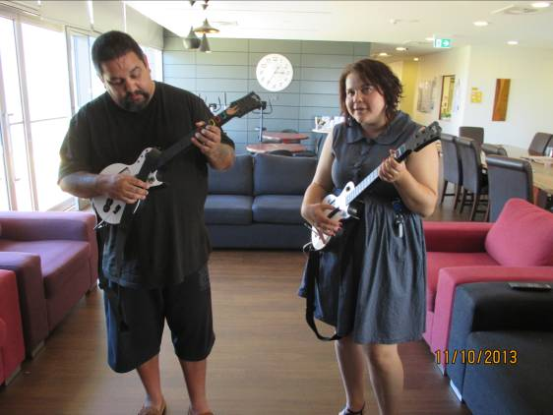
Dubbo Sub—Acute Service
Also offer a non-residential program.
This is open to past residential consumers as well as consumers who only wish to use day programs.
These day programs include:
  Cooking
  Arts and crafts.
  Education groups.
  Primary Health Clinic.
  Goal setting.
  Spirituality.
  Flourish and Optimal Health Programs

Slide 15
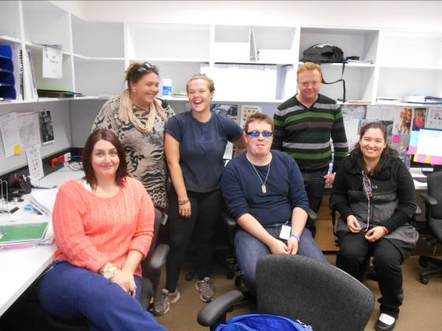
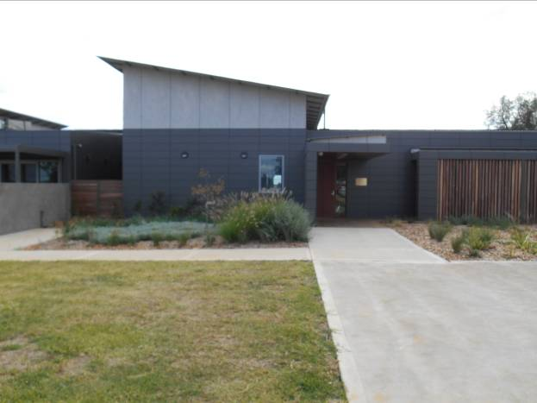
Service development and innovations
The employment of health promotion officers in each state.
The development of an organisation-wide approach to meeting the needs of clients with a dual diagnosis.
The continuation and expansion of our research program.
The introduction of a formal sustainability plan
  Establishing a program to assist clients to do the same.
The creation of the Aboriginal Linkages Program.

Slide 16
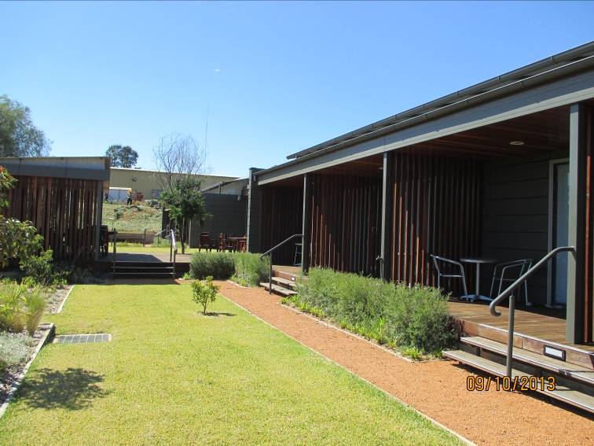
Aboriginal Linkages Program
Provides outreach support to Aboriginal communities in Central Western NSW
Created in response to the fact that Aboriginal people are typically over-represented in acute inpatient settings and under-represented in community based mental health services

Slide 17
Aboriginal Linkages Program
Employs an Aboriginal staff, headed by a Social and Emotional Wellbeing Worker to;
  Ensure that the many diverse Aboriginal communities in Dubbo and surrounding regions are able to access the Centre;
  Promote knowledge of the Centre as a safe space for Aboriginal people;
  Develop strong partnerships with communities, service providers and individuals to encourage and facilitate Aboriginal peoples’ access to the service;
  Assist people to ‘step up’ into the Centre, diverting them from an acute inpatient admission; and work directly with consumers and their families to facilitate successful transitions home;
  Build capacity within communities to foster better mental health and social and emotional wellbeing.

Slide 18
Our vision
Full citizenship for all people living with a mental illness in Australian society
Our mission
Improving mental health and wellbeing in local communities
neaminational.org.au
Lee Willis, Alex Carr, Emma Nolan, Jesseka Flakelar
Neami National Dubbo
6826 8246

