Slide 1
Research…Pfft! A dirty word? Or an avenue to privilege and action Aboriginal voices
SUPERVISORY TEAM
PhD Candidate
Chontel Gibson
Charles Sturt University
Principal Supervisor
Associate Professor Michael Curtin Charles Sturt University
Co-Supervisor
Professor Pat Dudgeon
University of Western Australia
REFERENCE GROUP
Community Elder representative
James Williams
Local Aboriginal Elder Group
Daroo Elders
Clinical Leader (Mental Health & Drug and Alcohol)
Donna Stanley
Statewide Co-ordinator (Aboriginal Mental Health Workforce)
Tom Brideson

Slide 2
Contextualising research in Indigenous communities
Research has a negative history with Aboriginal and Torres Strait Islander communities in Australia.
Developments in Indigenous research methodologies have changed Western science.

Slide 3
Culturally Appropriate Research
In Australia, good practice research standards are illustrated in the:
Values and Ethics: Guidelines for Ethical Conduct in Aboriginal and Torres Strait Islander Health Research
AH&MRC Guidelines for Research into Aboriginal Health - Key Principles
Indigenous Standpoint Theory and Community-Based Participatory Research bring these to life.

Slide 4
Indigenous Standpoint Theory
Some key principles:
Promotes human rights and social justice
Values the voices of Indigenous peoples
Addresses issues that are important for community
Acknowledges the political, social and historical contexts
Works in the cultural interface
Understands the role and position of the researcher in the research

Slide 5
Community-Based Participatory Research
Key underpinnings:
Promotes human rights
Works in partnership with community
Recognises diverse experiences
Allows for a dynamic and flexible process

Slide 6
Sharing and valuing older Aboriginal peoples’ voices in social and emotional wellbeing

Slide 7
1. Talking up the research
6. Sharing the research design, process and outcomes
2. Networking, vouching and connecting with older Aboriginal people
5. Actioning and privileging older Aboriginal peoples voices
3. Spaces for sharing voices
4. Privileging voices in interpretations, analysis and representations

Slide 8
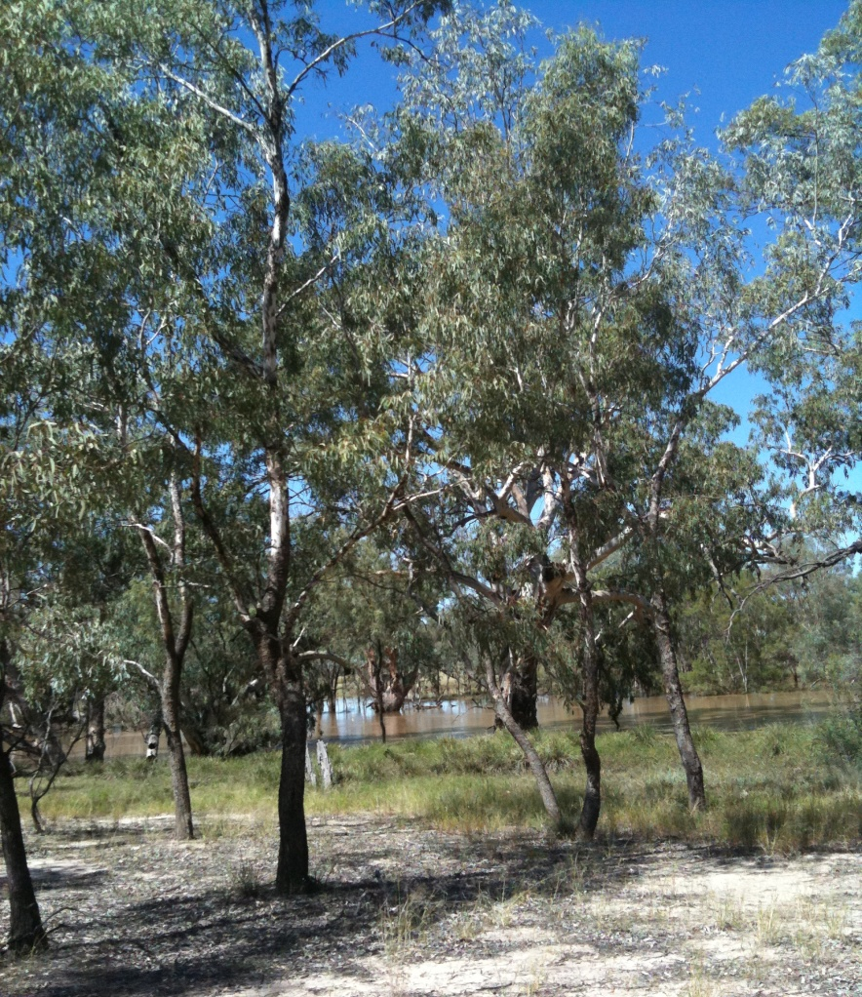
Conclusion
Indigenous Standpoint Theory and Community-Based Participatory Research provides two culturally appropriate methodologies to share and value the voices of Aboriginal people in research.

