Slide 1
Helping Build a Strong Connected Community
City of Sydney and South Sydney
Based in Waterloo/ Redfern

Slide 2
Our Mission: To support young people, children families, and communities to value each other and create opportunities to realise their hopes and dreams.
Weave is a non-profit community organisation that has been working with disadvantaged and vulnerable young people, women, children and families in the City of Sydney and South Sydney areas for 30 years.

Slide 3
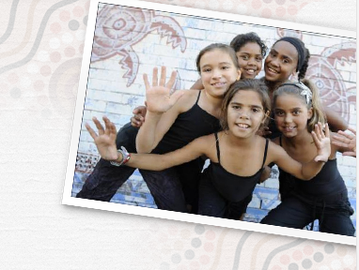
Weave provides innovative, diverse programs that educate and empower people experiencing issues relating to mental health, homelessness, substance use, trauma and poverty to make positive change in their lives.
Weave prides itself on engaging Indigenous young people and the local community in creative arts based programs and youth driven initiatives.

Slide 4
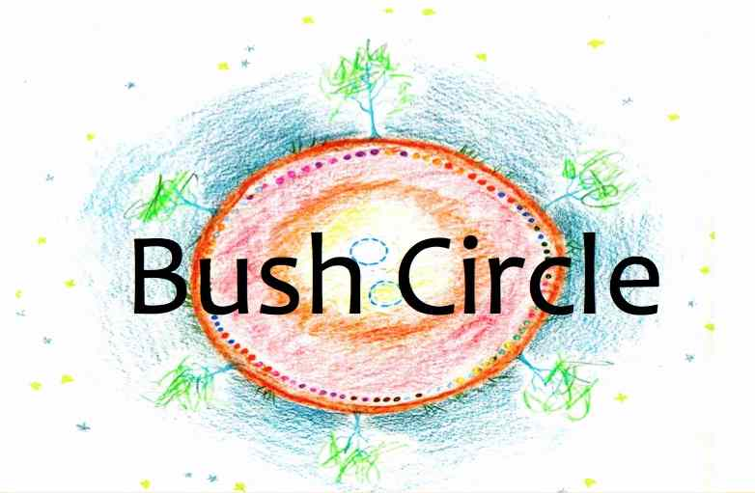
A project of the Speak Out Dual Diagnosis Program
February 2014

Slide 5
Who for: 16 to 28 year olds experiencing co-existing mental health and alcohol and other drug issues.
Mission Statement: Bush Circle’s mission is to strengthen young people’s resources (internal and external) through experiential group work, and relationship with nature, culture and each other.

Slide 6
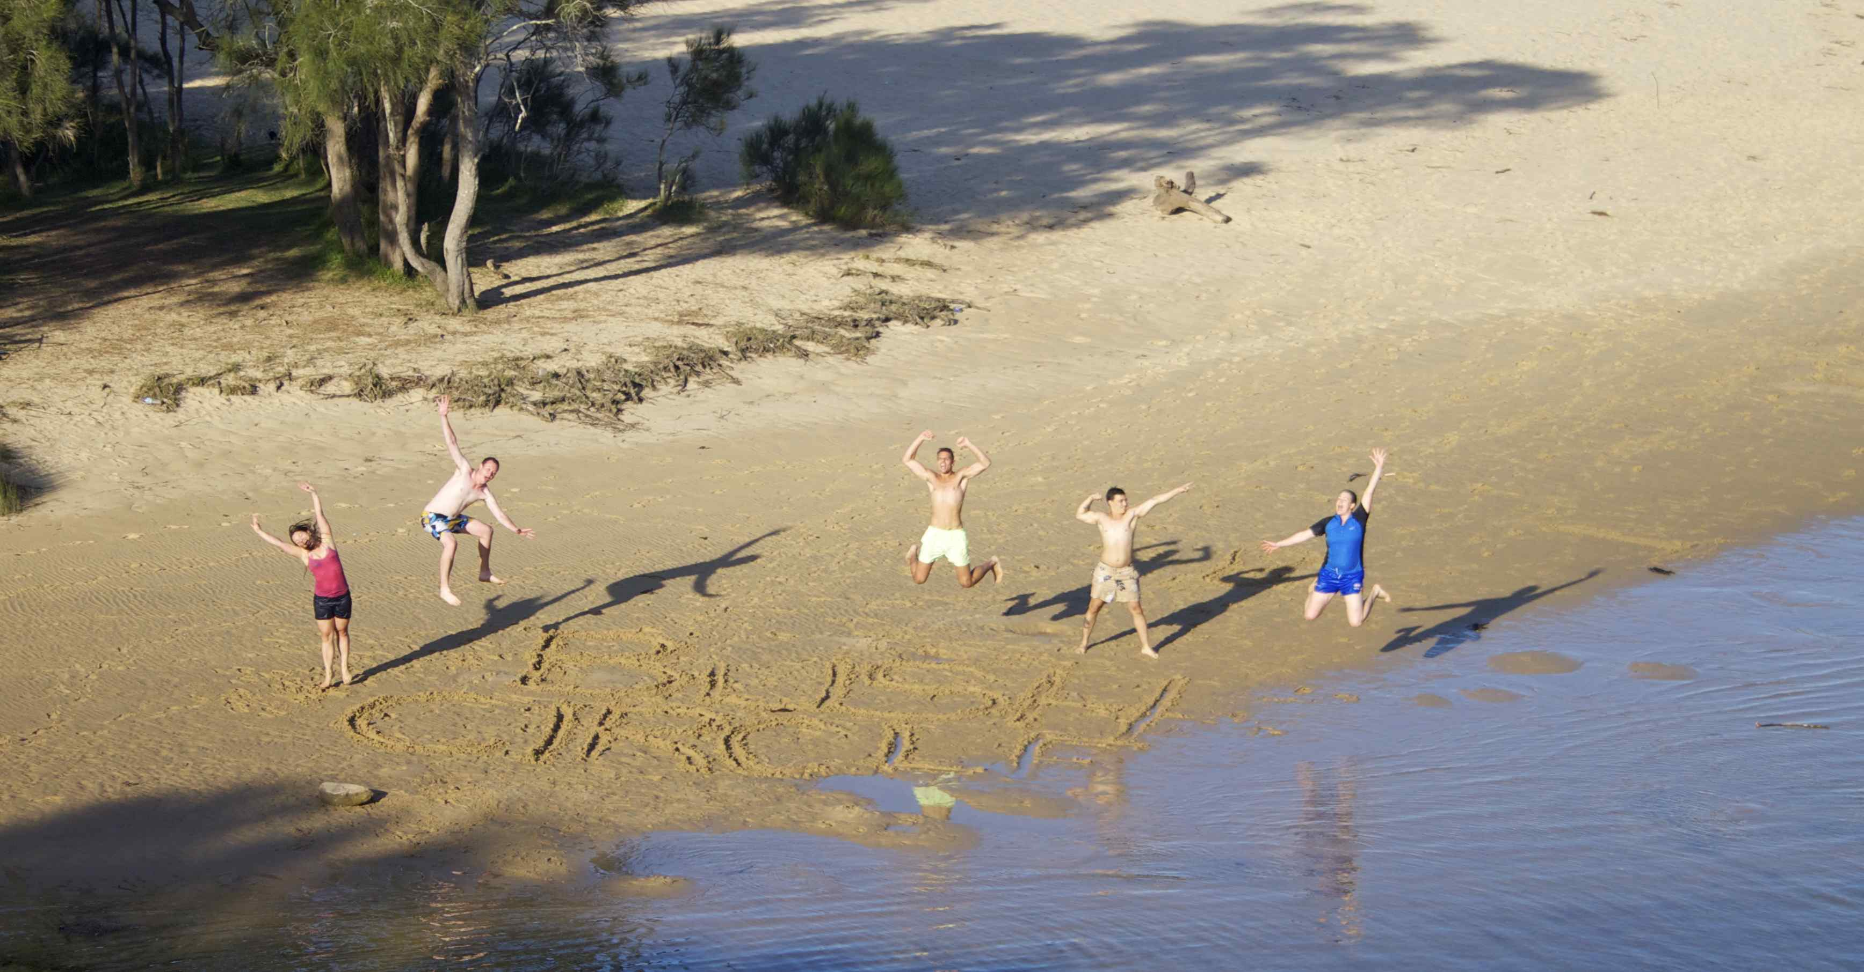
The Bush Circle Model:
Relationship with Something Bigger
Relationships and Community
Real-time Practice
Relationship with Yourself

Slide 7
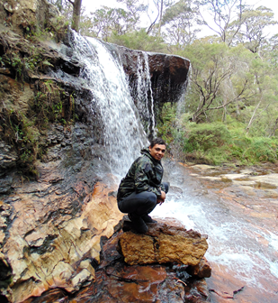
Relationship with Yourself:
Relationship with Yourself
Inner Warrior/ Internal Sanctum
Self-Esteem and Purpose
The Only Constant Your Whole Life
Acceptance and Motivation

Slide 8
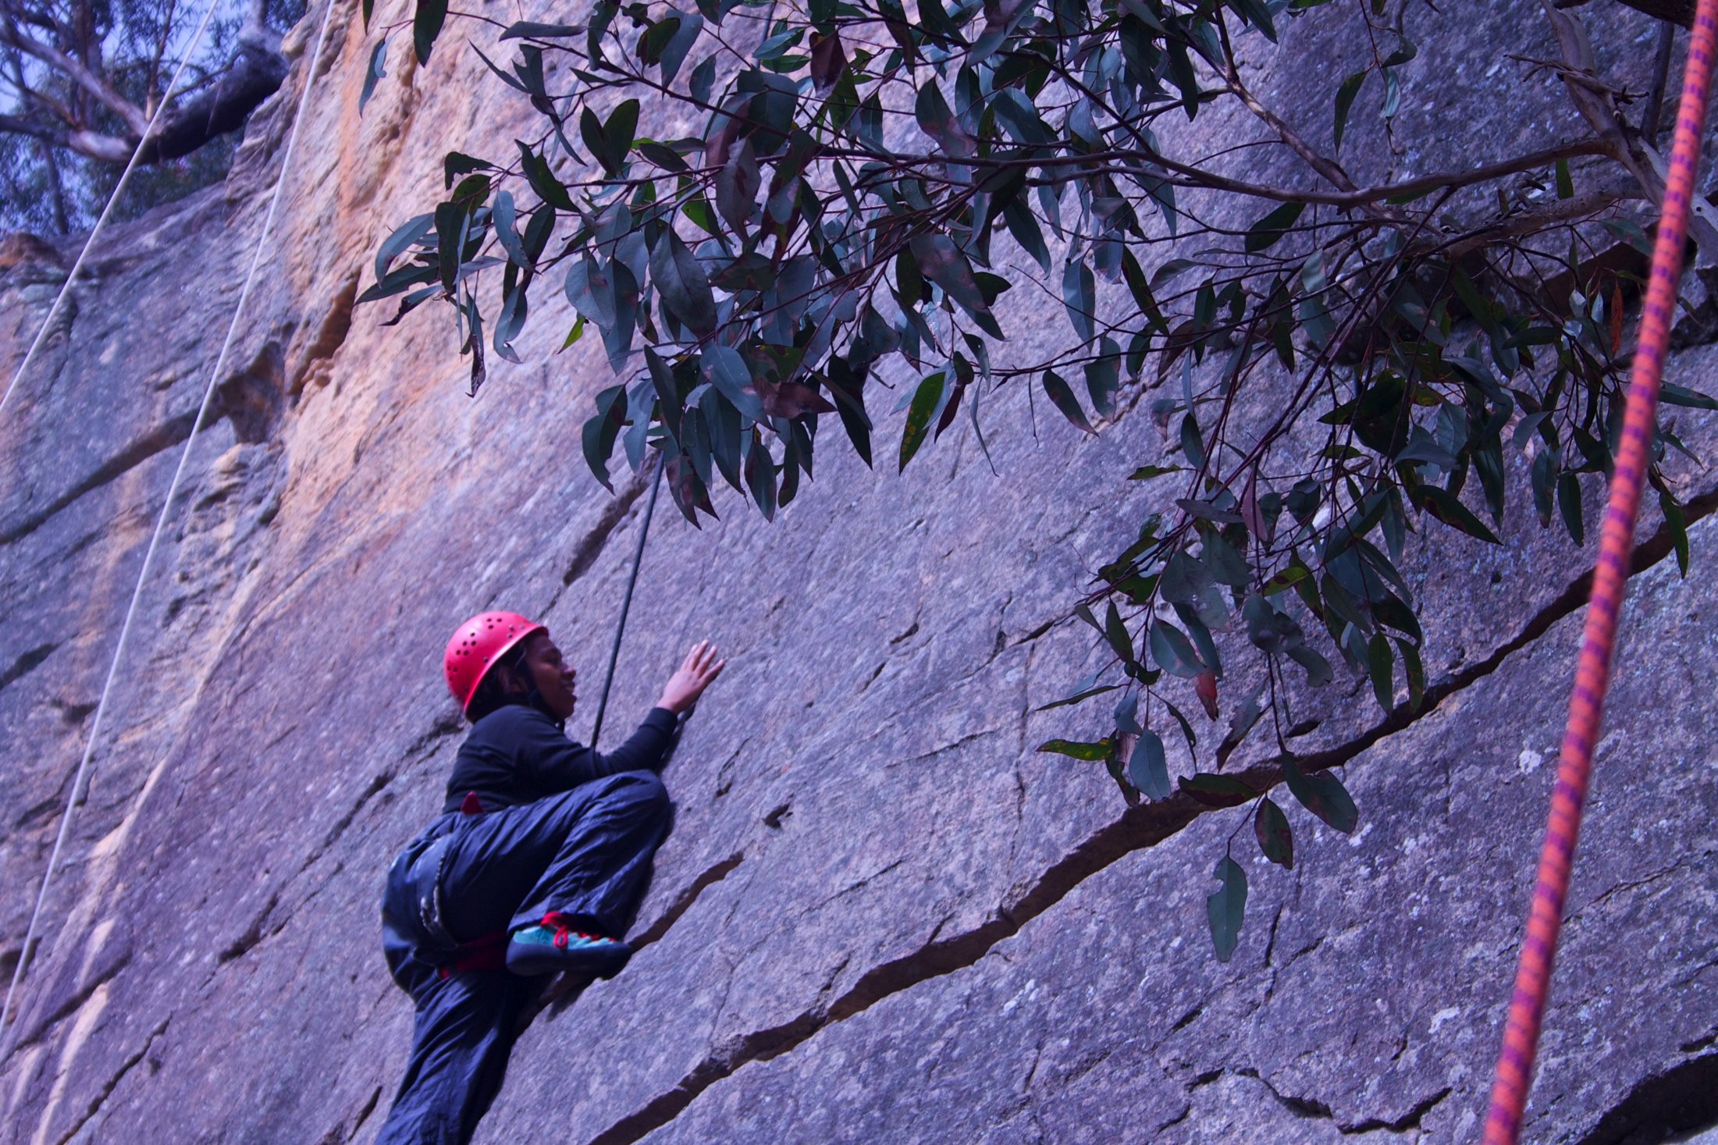
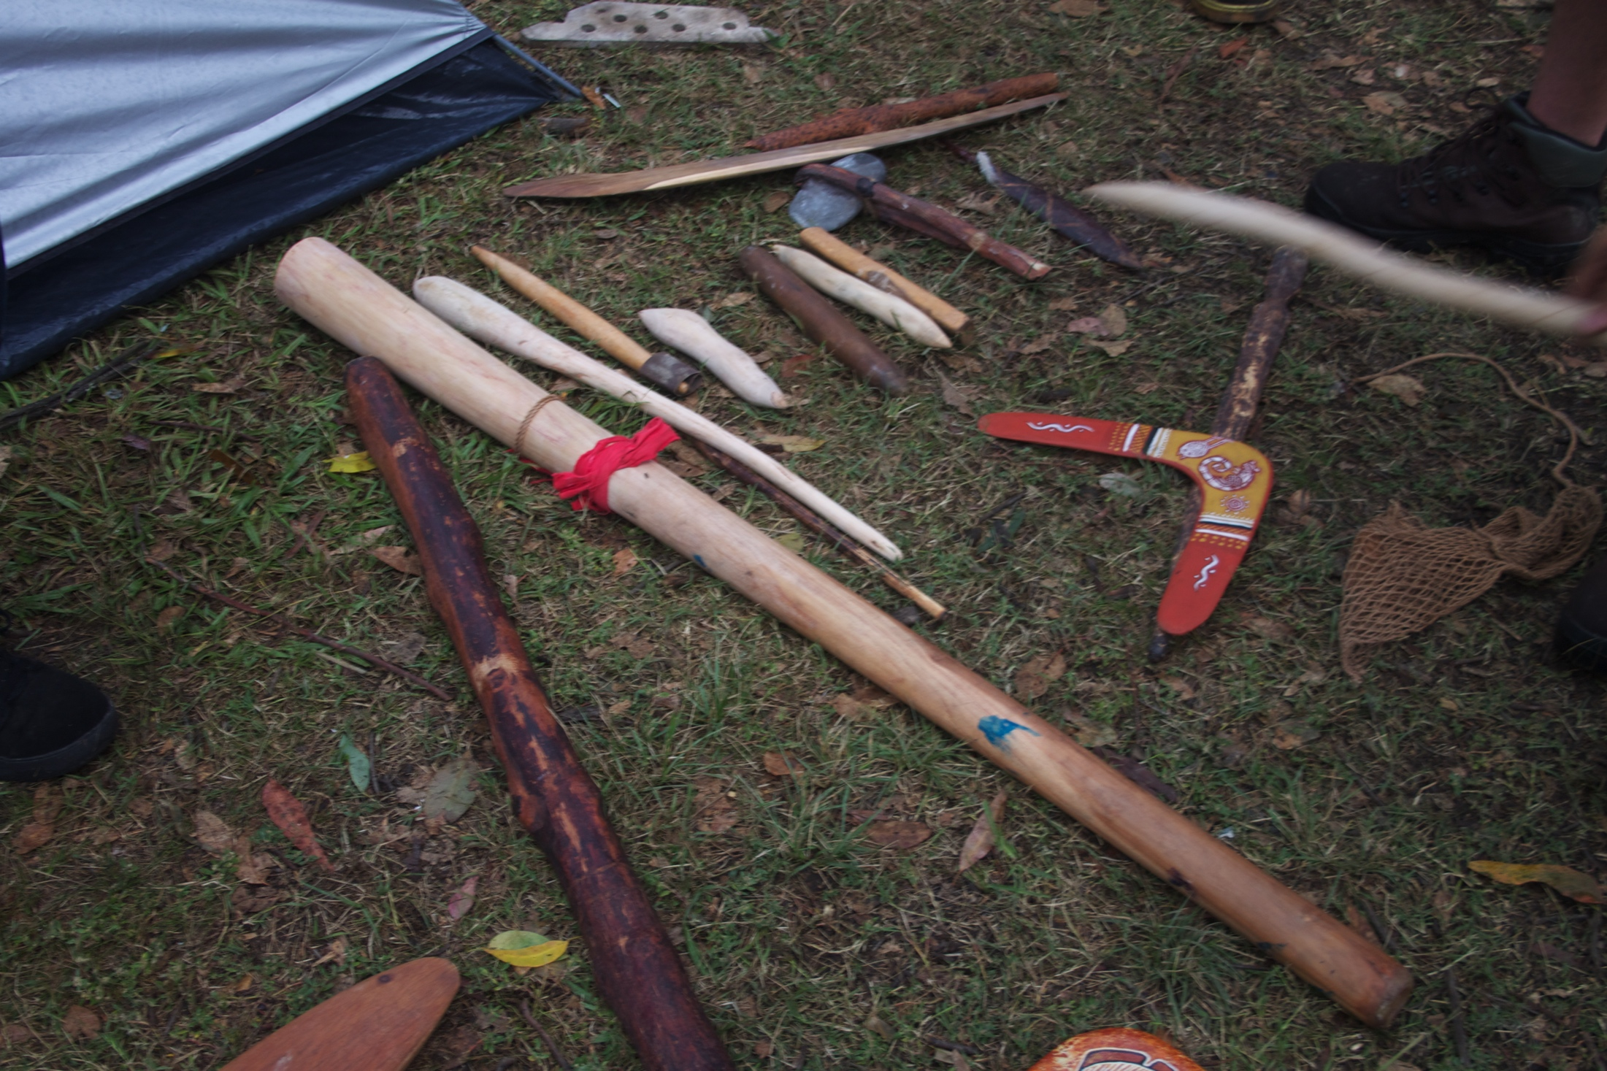
Real Time Practice:
Real Time Practice
Relationship to self
Real time practice with stress, emotional regulation and precursors to AOD use
Real and meaningful consequences
Life skills and stress management skills
Increasing Realistic Resources – Internal and External
Sense of Control (trauma and addiction)
Experienced, it becomes personal - Able to teach it to others.

Slide 9
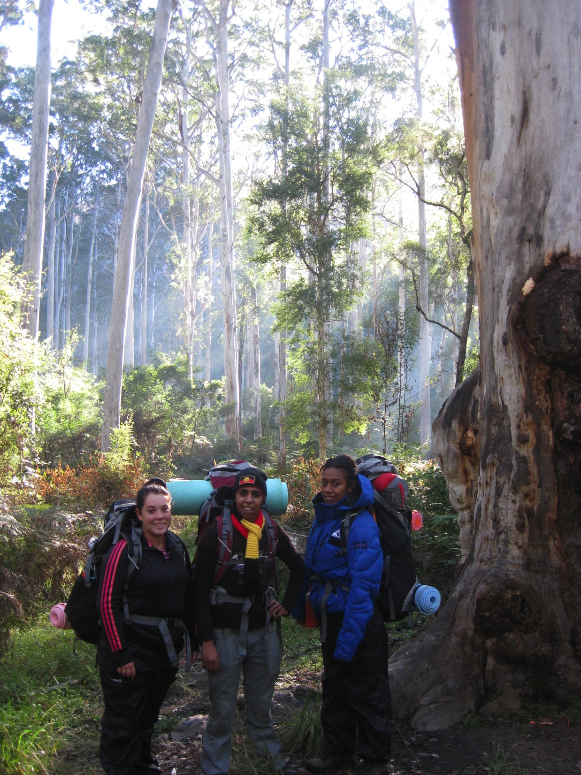
Relationships and Community:
Relationships and Community
Real Time Practice
Relationship to self
A Family/ Community System
Relational, Here and Now
Attunement and Autonomy
Choice
Joint Vision and Contribution

Slide 10
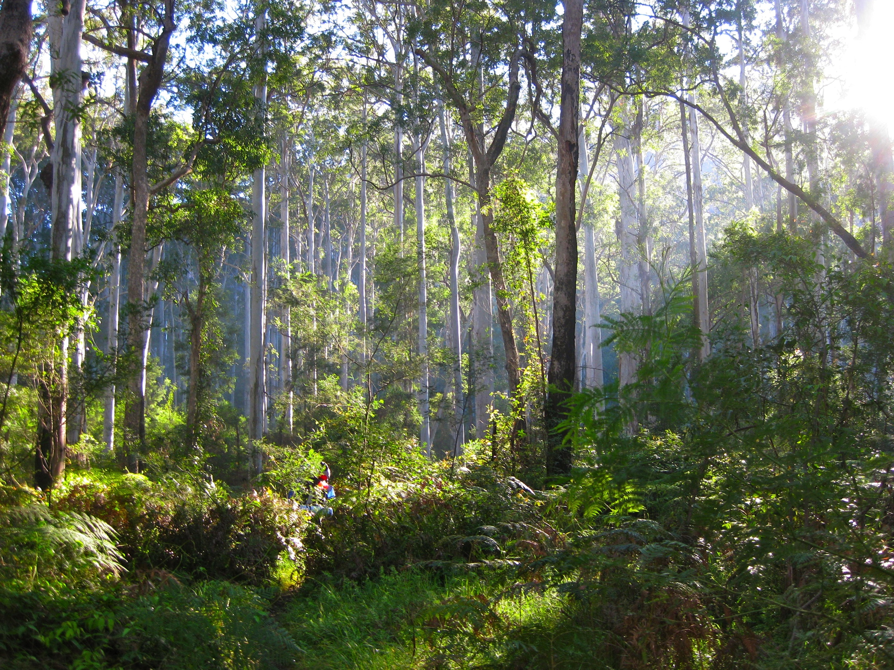
Relationship with Something Bigger:
Relationship with Something Bigger
Relationships and Community
Real-time Practice
Relationship with Yourself
Culture
Spirituality
Nature/ Land
Metaphor and Meaning
The Role of Elders
Rite of Passage – Markers, Being Seen, Acknowledged

Slide 11
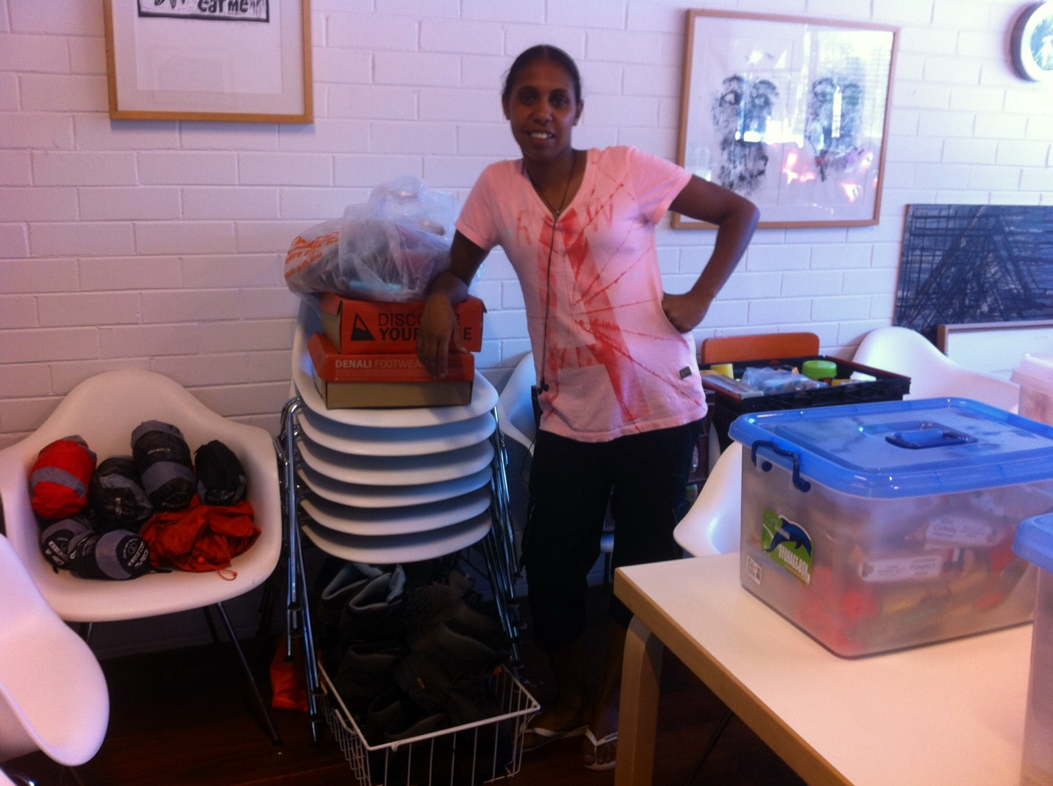
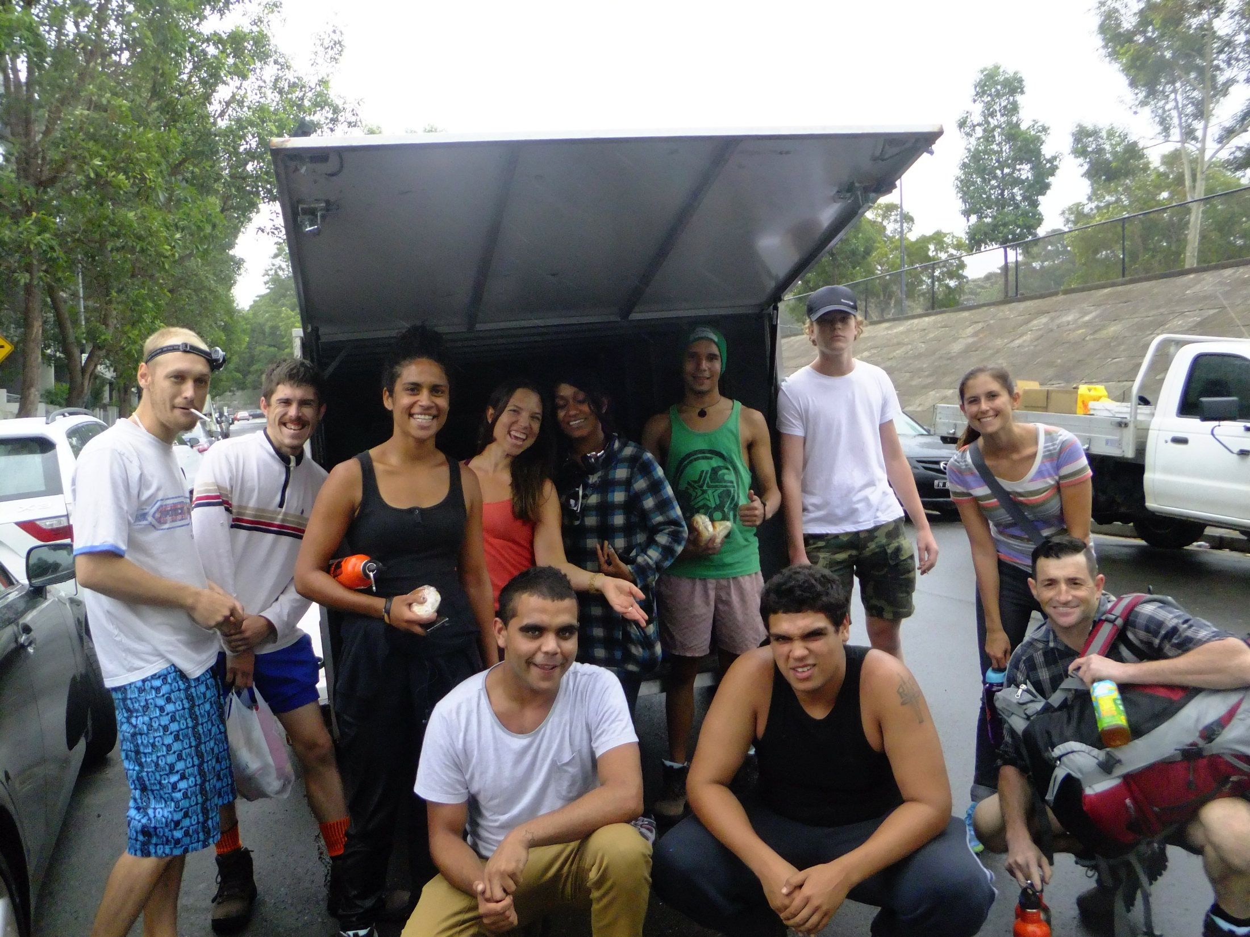
Community Partnerships:
NSW National Parks and Wildlife, Blue Mountains
Anaconda - the adventure specialists
Gundungurrah Aboriginal Heritage Association
Jamieson Parks Paddle
Blue Mountains Adventure Company
The Settlement Youth Neighbourhood Centre

Slide 12
www.weave.org.au

