Slide 1
PD2014_030
Using Resuscitation Plans in End of Life Decisions
Presented by [Insert name of presenter]
[Insert title]
[Insert LHD/SHN name]
Month 2014

Slide 2
Outline
Resuscitation Plans in the context of Advance Care Planning and End of Life
Background to Policy Directive (PD) development
Scope
Statewide Resuscitation Plans – adult and paediatric
Key issues for use
Where to get more information

Slide 3
TRIGGERS
Uncertain recovery
If the treating clinician asks, ‘Would I be surprised if this patient were to die in 6-12 months?’ and the answer is ‘No’.
If a patient clinically deteriorates requiring activation of a Rapid Response System, or is anticipated to do so
If the patient’s condition is considered high risk - for example recurrent admission to hospital with severe chronic illness; a diagnosis of metastatic cancer; steady deterioration of a chronic respiratory, cardiac, liver or neurological illness; or other progressive advanced life limiting illnesses.

Slide 4
2. Background to Policy Directive (PD) development
Development of standardised resuscitation plans is required by the NSW Health Advance Planning for Quality Care at End of Life: Action Plan 2013-2014.
In 2012, a working group was formed to review GL2008_018 Decisions relating to No Cardio-Pulmonary Resuscitation (CPR) Orders. Three rounds of consultation were conducted on draft documents.
PD2014_030 replaces GL2008_018.

Slide 5
3. Scope
All Public Health Organisations must adopt the NSW Health Resuscitation Plans (adult and paediatric).
Resuscitation Plans are intended for use in all NSW Public Health Organisations, including acute facilities, sub-acute facilities, ambulatory and community settings, and NSW Ambulance for patients 29 days and older.
NSW Health Resuscitation Plans are not valid for community patients under the medical care of a doctor that is not a NSW Health staff member. General Practitioners with admitting rights are considered NSW Health staff.

Slide 6
4. Statewide Resuscitation Plans – adult and paediatric
Resuscitation Plan – Adult (SMR020.056)
Resuscitation Plan – Paediatric (SMR020.055)
Forms are mandatory for use & replace equivalent forms used (i.e. no CPR, Direction of care orders)

Slide 7
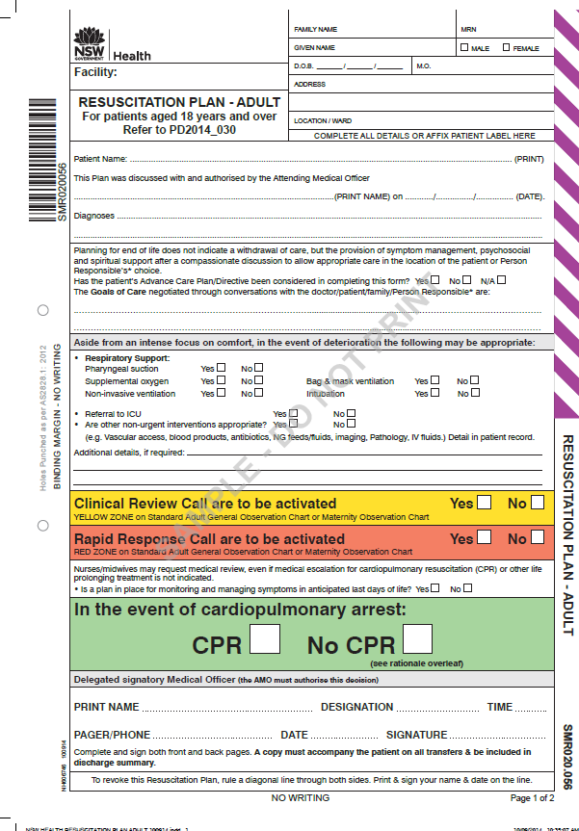
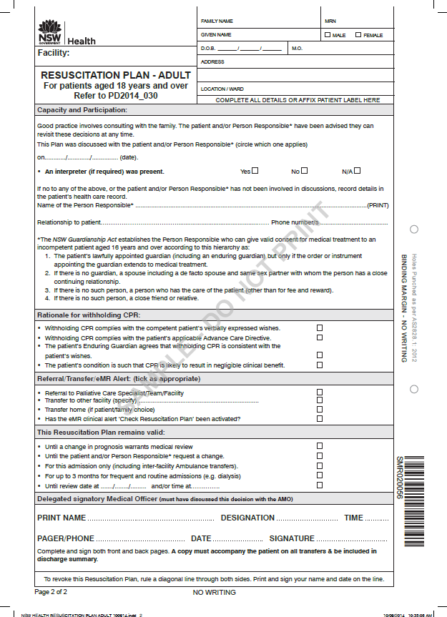
Resuscitation Plan – Adult (SMR020.056)

Slide 8

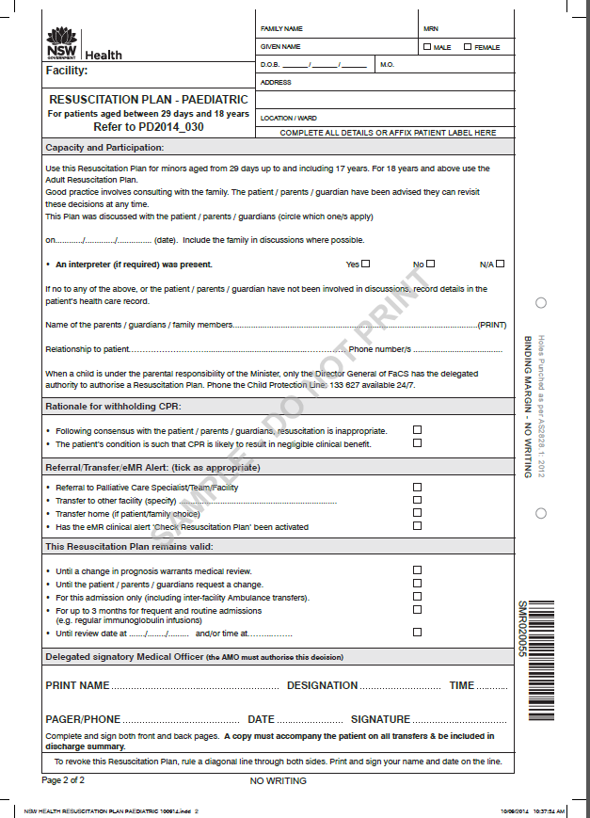
Resuscitation Plan – Paediatric (SMR020.055)

Slide 9
5. Key issues for use (1)
Evidence of prior planning
  A previous Advance Care Directive (ACD) or Advance Care Plan (ACP) must inform decisions recorded in the Resuscitation Plan
  If the ACD/ACP is ambiguous or unclear the conversation should be revisited with the patient and/or Person Responsible
Capacity and participation
  Attending Medical Officers prescribing medical orders, including ‘Resuscitation Plans’, hold responsibility for reaching those decisions, in consultation with patients.
  Where the patient does not have decision-making capacity, the Attending Medical Officer should recommend a course of action in the context of goals of care in discussion with the Person Responsible, Enduring Guardian or family.

Slide 10
5. Key issues for use (2)
Clinical interventions and monitoring
  Vital sign monitoring should be (re)considered if the patient is in their last days and this should be consistent with monitoring frequency prescribed on the Standard Adult General Observation chart, or equivalent standard observation chart
  Nurses may call for medical review of unrelieved symptoms associated with dying, even where activating an urgent Clinical Review call has been considered unnecessary.
Referral/transfer
  NSW Health Resuscitation Plans are valid for use by NSW Ambulance staff in all situations involving patient contact.
  A hard copy of the Resuscitation Plan should accompany the patient on inter-facility transfer.
  Resuscitation Plans are valid in community settings except for community patients under the medical care of a doctor that is not a NSW Health staff member. General Practitioners with admitting rights are considered NSW Health staff.

Slide 11
5. Key issues for use (3)
Authorising and signing the Resuscitation Plan
  The Attending Medical Officer (AMO) has medico-legal responsibility for a patient, even if other medical officers are involved.
  Discussion with the patient/Person Responsible about resuscitation should generally be undertaken by the most experienced clinician.
  Delegation to a JMO should only occur with adequate training, supervision and support. If a JMO is required to discuss and document a Resuscitation Plan (e.g. out of hours) this must be discussed with the AMO at the earliest opportunity.
  Consistent with PD2005_406, other health care professionals (including nurses) cannot be delegated the task of informing patients or obtaining consent for resuscitation planning. When requested by a patient, they are permitted to provide information and should document this in the medical record.
  Neither the patient, nor their Person Responsible, is required to sign the Resuscitation Plan.

Slide 12
5. Key issues for use (4)
Reviewing the Resuscitation Plan
  Generally, a Resuscitation Plan needs to be clarified from one acute admission to the next where a change in prognosis is likely.
  A Resuscitation Plan may be valid for up to 3 months for frequent and routine ‘admissions’ e.g. renal dialysis.
Revoking or amending the Resuscitation Plan
  For significant amendments (for example, a change to the CPR order), the Resuscitation Plan must be revoked and a new Plan completed. The procedure for revoking the Resuscitation Plan is to rule a diagonal line through both sides, then print and sign your name and date on the line.
  For less significant amendments (for example, a change to the intervention section), the Resuscitation Plan can be amended and initialled. This should be documented in the medical record.

Slide 13
5. Key issues for use (5)
Storage of Resuscitation Plans
  It is recommended that the current hard copy should be kept at the front of the patient’s health record. It is preferable that multiple copies are not made.
  Details of the Resuscitation Plan should be included in handover between shifts.
  Resuscitation Plans must be integrated into electronic health record systems in appropriate forms
  Resuscitation Plans should be incorporated into hospital discharge summaries, where possible.

Slide 14
6. Where to get more information
PD2014_030 is available at http://www0.health.nsw.gov.au/policies/pd/2014/PD2014_030.html
[Insert details of LHD Executive Sponsor]

