Slide 1
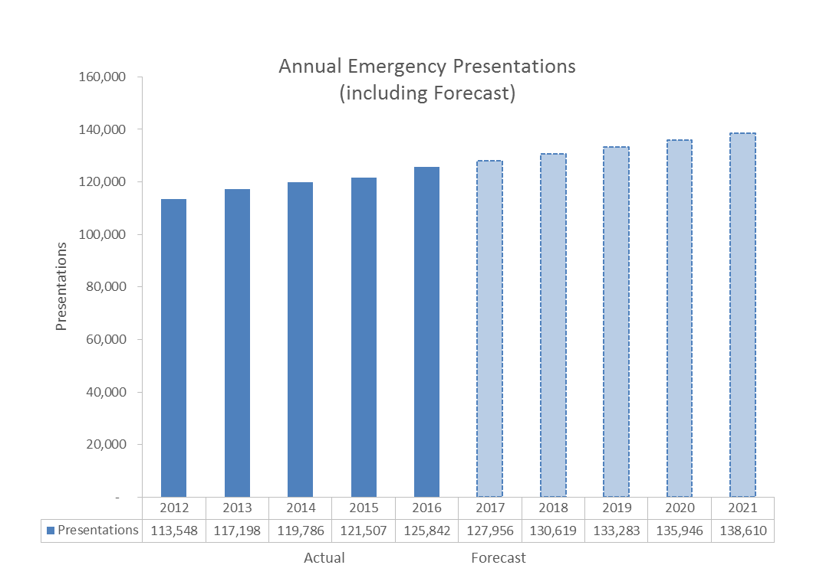
Example Output – ED Presentations
Quantitative data diagnostic
Consider sub-types (by Category, clinical need, or presenting complaint)
Look at past and predicted activity
Drill-down into monthly and daily variation
Consider mode of arrival and trends over time
Info available at: HSP app, FirstNet report or Facility dashboard/ reports generated by data managers, monthly performance reports, PFP predictive tool extract

Slide 2
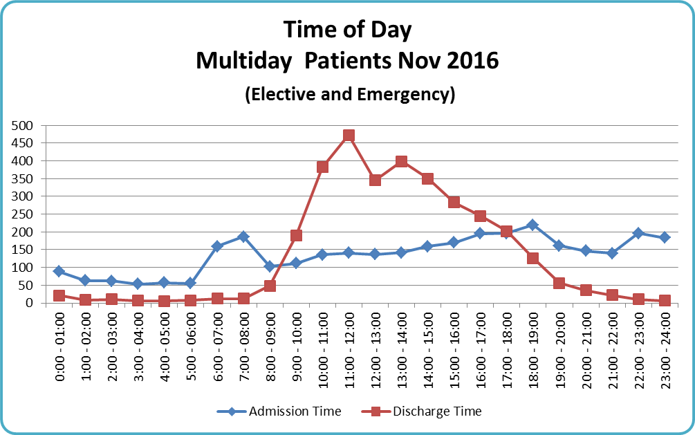
Example Output – Admissions vs Discharges
Consider inclusions and exclusions (eg. ED short stay)
Drill down into different weekdays
Drill down into different specialties
Consider system activities at key peaks and troughs in activity (e.g. ward rounds / lunch breaks / JMO rotations)
Info available in: Facility report, PAS reports (eMR/ PAS)

Slide 3
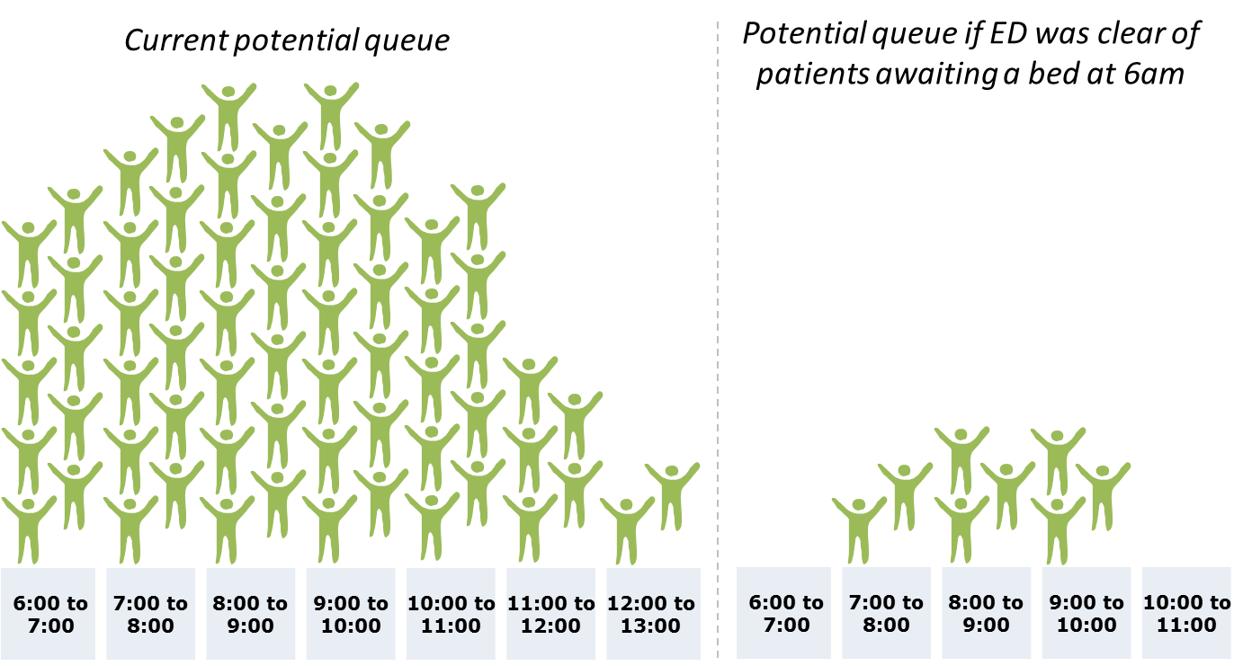
Example Output – What if modelling
Model ‘what if’ scenarios:
What if ED were empty at 7am
What if we discharged before 10am
What if we reduced admissions by 5%
Info available in: The what if modelling available on PFP predictive tool

Slide 4
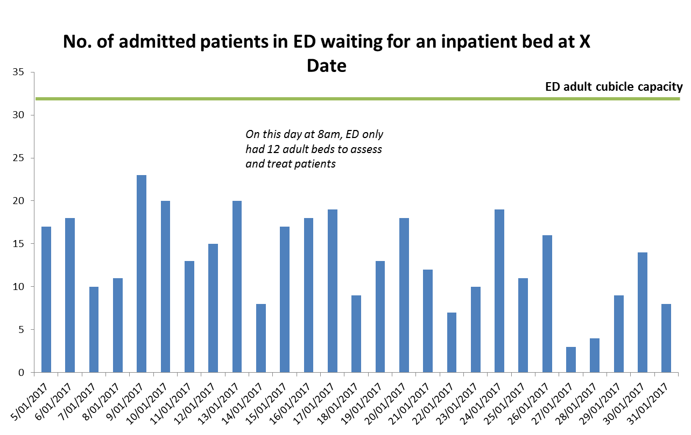
Example Output – Occupancy
Look at occupancy for different ‘physical spaces’, e.g:
ED
Assessment Units
Wards
Transit Lounge
Look at snapshots for different days, different months and different times
Drill-down into specific cohorts
Info available in: the HSP app and Hospital and Ward occupancy data can be found on the PFP

Slide 5
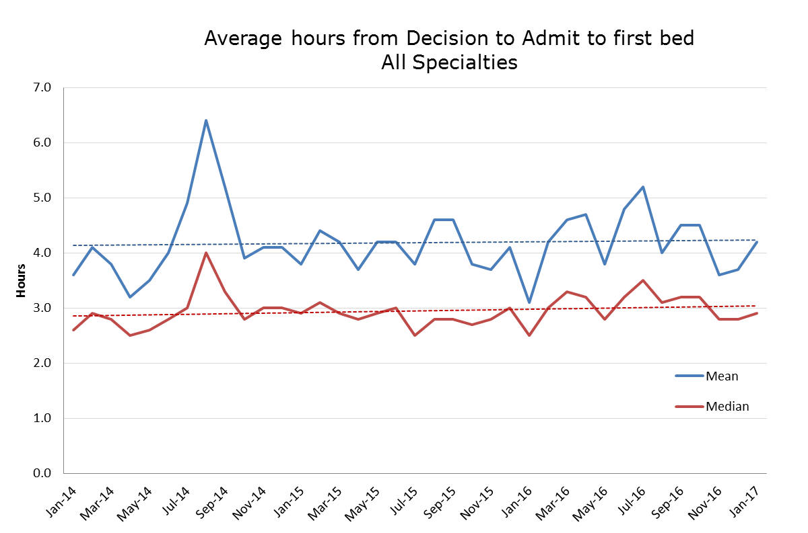
Example Output – Length of Stay
Look at Length of Stay for different parts of the patient journey:
ED – waiting decision
ED – waiting admission
Assessment Areas
Wards
Other physical locations
Discharge areas
Explore variation by specialty; clinician; Hospital LOS; (wards or specialty) day of week; time of day; triage category
Look at specific cohorts (e.g. elderly / long-stay patients)
Retrospective information available in: Health Round Table, ABM portal, Monthly Performance reports, local facility reports
Operational data available in: PFP has LOS filters and reports for current inpatients

